Slide 1



Smarter Expense Management for Charities:
Supporting Staff and Volunteers

Slide 2


Meet Jahana
Here's a little bit about me...
I work closely with existing customers day to day
to ensure ExpenseIn not only meets their expectations but also helps streamline business processes.
My focus is to make sure our customers feel supported, confident and they're able to get real value from ExpenseIn.
Customer Success
Team Manager

Slide 3


Agenda
Why Expense Processes Matter More Than We Think
Where Does Your Expense Process Sit?
The Invisible Cost of Poor Expense Processes
Where Do Expense Processes Break Down?
A Smarter Expense Workflow for Charities
What Better Processes Can Achieve
Practical Steps to Improve Your Process
Enabling Smarter Expense Management with Digital Tools
Key Takeaways

Slide 4



Why Expense Processes Matter More Than We Think
Charity finance teams need expense management processes that are simple and easy for staff and volunteers to use.
Expenses are part of everyday charity operations
As charities grow, processes often evolve informally over time
Volunteers and staff regularly incur small costs
Finance teams need visibility and control
"An expense process that typically would have taken months has now been significantly reduced."
Brandon Trust
Notes:
Point One - Expenses are a routine part of charity operations — from travel and meals to postage, phone costs and supplies. NCVO guidance also highlights volunteer costs such as dependent care and support worker expenses.
Point Two - For many charities, these costs are spread across staff, volunteers and trustees, so expense activity can quickly become harder to track. GOV.UK and NCVO both note that charities may reimburse genuine out-of-pocket costs such as travel, meals and childcare.
Point Three - As charities grow, expense processes often develop informally and spreadsheets, email approvals and paper receipts can work for a while, but we see they then become harder to manage consistently. NCVO guidance stressing the need for expense policies, claim forms and proper records, especially for scaling organisations.
Point Four - Finance teams still need visibility and control, even when claims are small, because records need to show what was purchased, why, and who approved it. This is especially important when it comes to scale.

Slide 5
Where Does Your Expense Process Sit?
Fully optimised
Simple, consistent submission experience for staff and volunteers
Automated workflows and approvals
Real time visibility and reporting
Strong audit trail and compliance
Streamlined
Clear policies and submission guidelines
Defined approval workflows
Faster, more predictable reimbursements
Improved visibility for finance teams
Partially structured
Some policies in place
Mix of manual and digital processes
Approval workflows exist but are inconsistent
Delays still common
Manual & reactive
Spreadsheet or paper-based claims
Email approvals
Limited visibility
Slow, inconsistent reimbursements
Notes:
Most organisations sit somewhere between stages one and three. The goal isn’t perfection, it’s identifying where small improvements can reduce friction and improve experience.

Slide 6
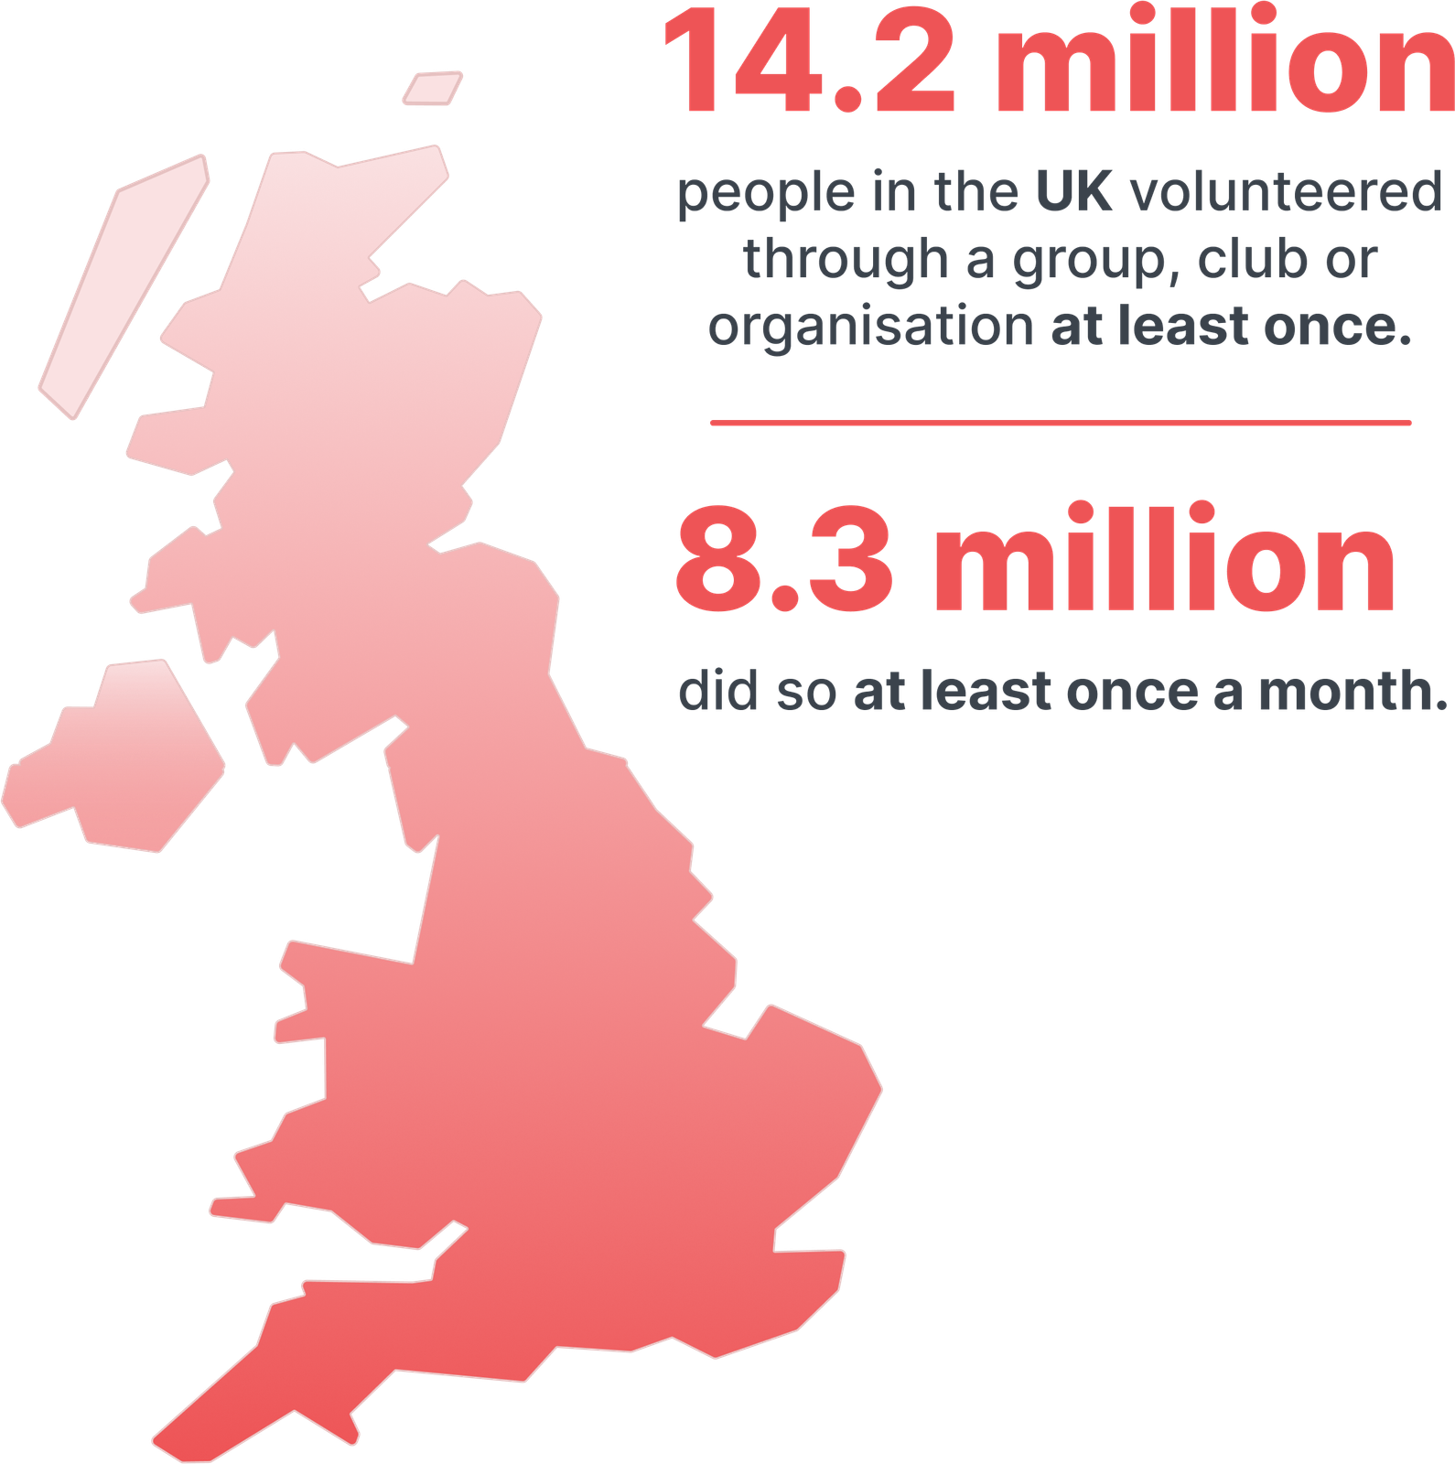
The Invisible Cost of Poor Expense Processes
Volunteers Left Out of Pocket
Volunteers may have to cover expenses themselves
Some people simply cannot afford to volunteer regularly
Unintentionally create barriers to participation
NCVO, UK Civil Society Almanac 2024
Notes:
Around 14.2 million people in the UK volunteer through a group, club or organisation each year — showing just how important it is for charities to have clear, manageable processes for volunteer-related expenses.

Slide 7
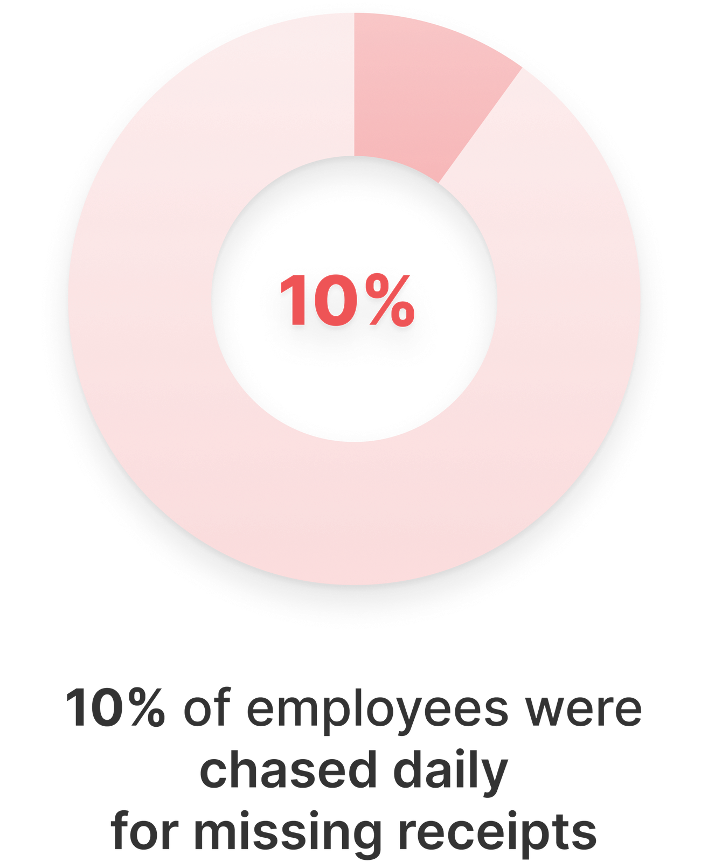
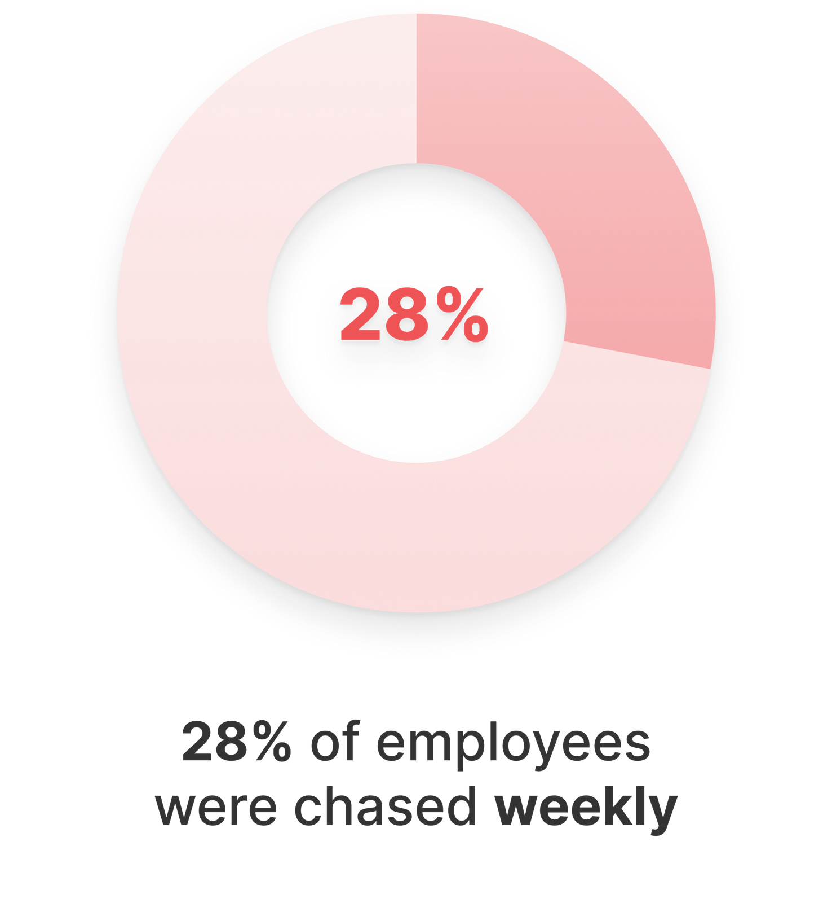
The Invisible Cost of Poor Expense Processes
Staff Frustrated with Administration
Searching for lost receipts
Multiple approval steps
Submitting the same information repeatedly
209 hours
a year are lost to duplicative work​
2025 ExpenseIn survey of 500 UK employees
Asana, Anatomy of Work Index

Slide 8
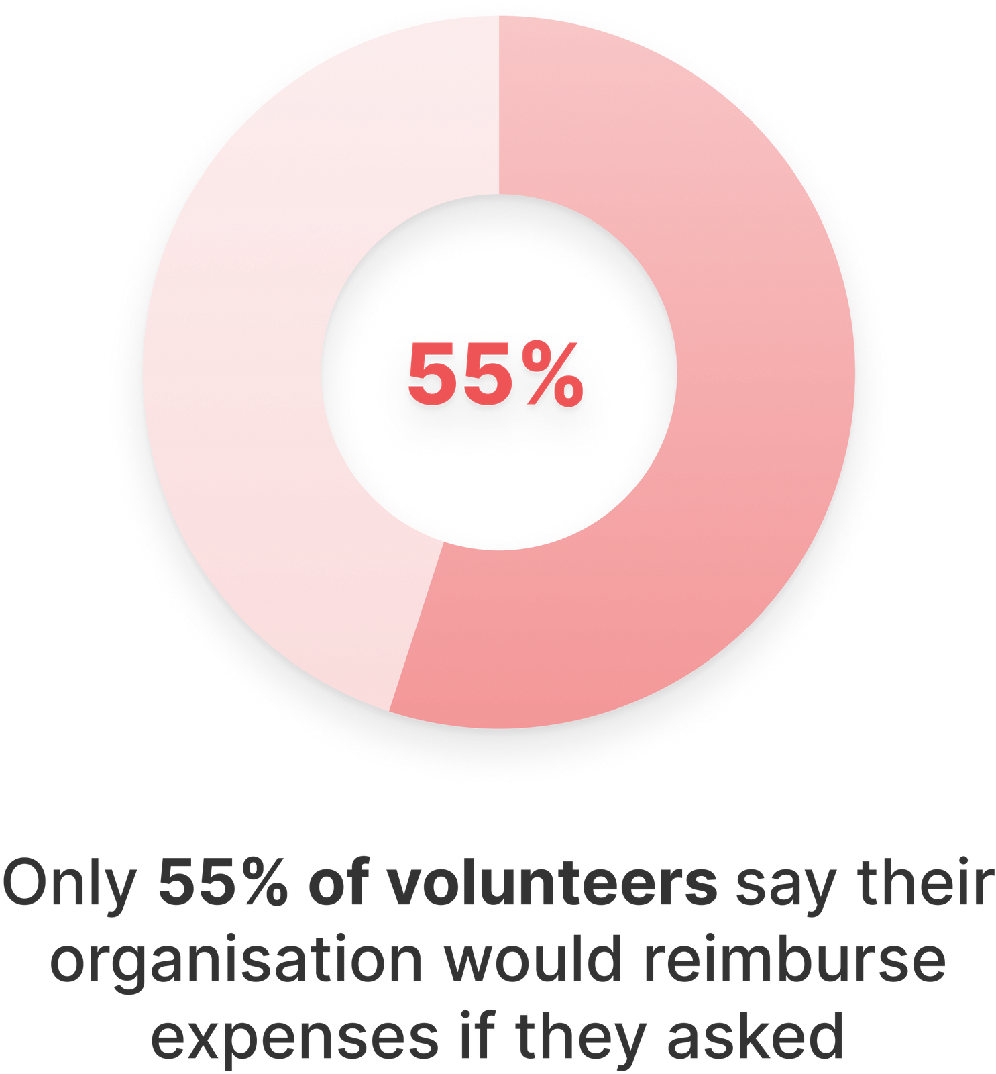
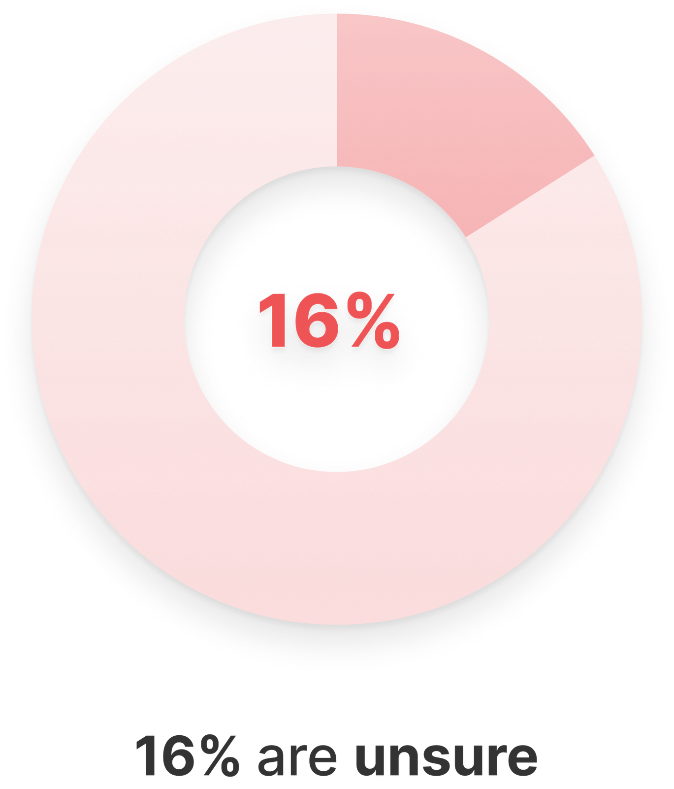
The Invisible Cost of Poor Expense Processes
Slow Reimbursements
Reimbursements can take weeks
Volunteers and staff lack visibility on claim status
Finance teams often deal with follow-up emails and queries
28%
Of employees described their expense management as time-consuming and manual.
NCVO, Time Well Spent 2023
2025 ExpenseIn survey of 500 UK employees

Slide 9
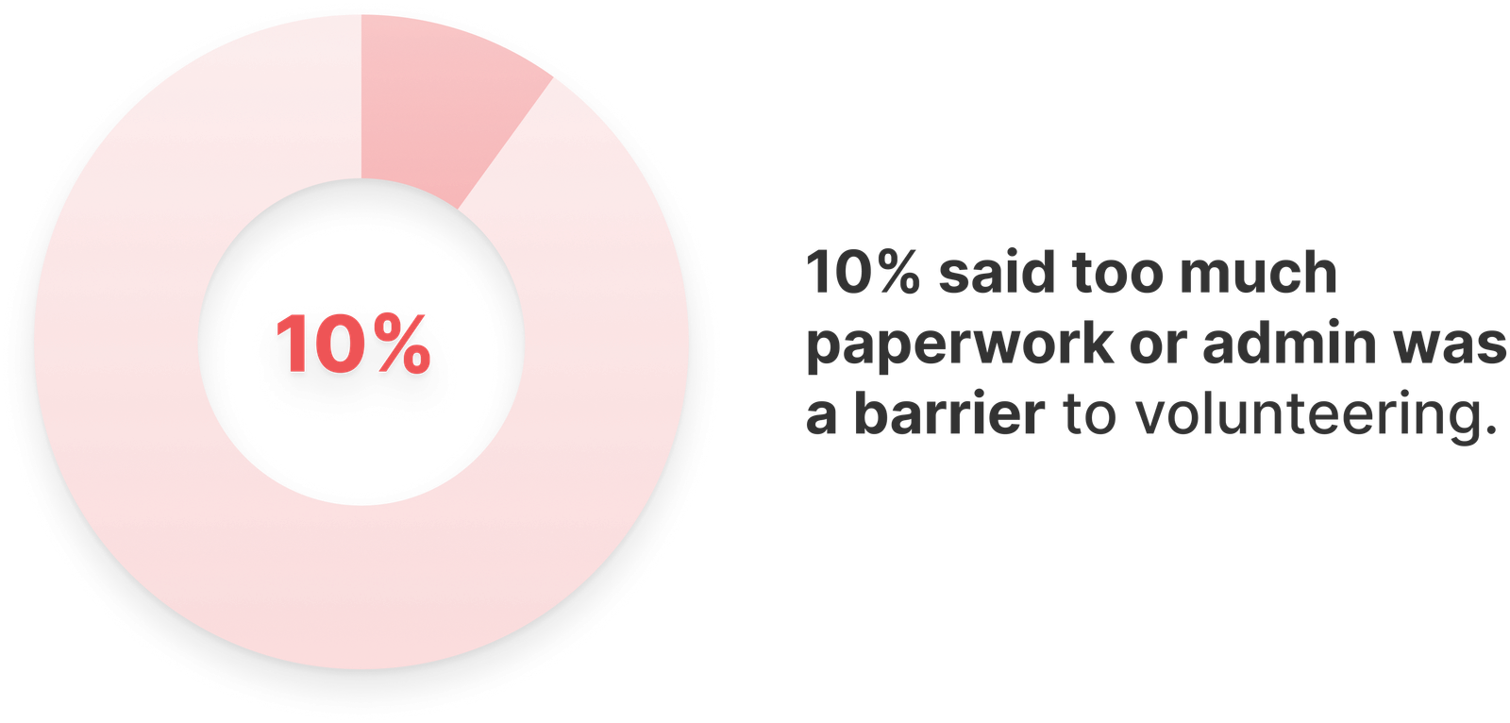
The Invisible Cost of Poor Expense Processes
Confusing or Unclear Expense Policies
Uncertainty about what can be claimed
Claims being rejected or resubmitted
Extra back-and-forth between teams
NCVO, Time Well Spent 2023

Slide 10

Where Do Expense Processes Break Down?
Expense challenges are not caused by people, but bad processes.
Manual spreadsheets or paper claims
Lost receipts & late claims
Multiple approval layers
Lack of visibility into claim progress
Expense policies that are unclear or outdated
Lack of real time visibility and oversight
Onboarding can take too much time for volunteers
Notes:
Onboarding for volunteers can take long when setting them up for expenses. Paperwork and processes. Not being able to set spend limits. Going over budget can be complicated. How much spending is tied to project, events because they cant see int in real time and lack of spending limits.

Slide 11

Principles of Smarter Expense Management
Clarity: Clear and accessible policies
Consistency: Simple submission processes and defined approval workflows
Efficiency: Faster reimbursements
Visibility: Real time insights, tracking and transparent reporting
Notes:
Importance of setting the expectations

Slide 12
A Smarter Expense Workflow for Charities
1
2
3
4
Clear Guidelines
Documentation & Record Keeping
Simple Submission
Structured Approval
Define what can and cannot be claimed
Share policy with volunteers and staff upfront
Verification: Receipts serve as proof of the expenses.
Audits: Having a set of receipts helps demonstrate compliance.
Encourage capturing receipts immediately.
Submit expenses quickly (ideally within a set timeframe)
Defined approver
Set expectations on timelines
Notes:
Point 1 - Provide examples(travel, meals, supplies)
Point 2 - Ensure that all expenses areaccounted for. Having a set ofreceipts helps demonstrate compliance with financialpolicies and regulations.
Point 3 - Travel, meals,equipment, or othercosts incurred.
Point 4 - Avoid too manyapproval layers

Slide 13
A Smarter Expense Workflow for Charities
5
6
7
8
Finance to Review
Prompt Reimbursements
Reporting & Visibility
Continuous Improvement
Validate Claims
Ensure Compliance
Clear Audit Trail
Categorise for Better Insight
Process payments regularly (weekly/bi-weekly)
Communicate timelines clearly
Regular Payment Cycles
Reduce Financial Barriers
Track spend by category
Monitor trends
Provide visibility to finance and leadership
Review policies regularly
Gather feedback from volunteers and staff
Identify bottlenecks

Slide 14

What Better Processes Can Achieve
Improve consistency
Clear policies and standardised submissions reduce errors and out-of-policy claims.
Strengthen oversight
Defined approval steps provide visibility and control over spending.
Ensure accurate records
Proper documentation and validation create a reliable audit trail.
Reduce process gaps
Streamlined workflows minimise delays, bottlenecks, and manual errors.
Increase accountability
Clear roles and approvals ensure responsibility at every stage.

Slide 15

Practical Steps to Improve Your Process
Where to start?
1
Review your current expense policy
Map your existing approval workflow
Identify bottlenecks and manual tasks
Introduce clearer submission guidelines
Explore digital tools that reduce admin
2
3
4
5

Slide 16
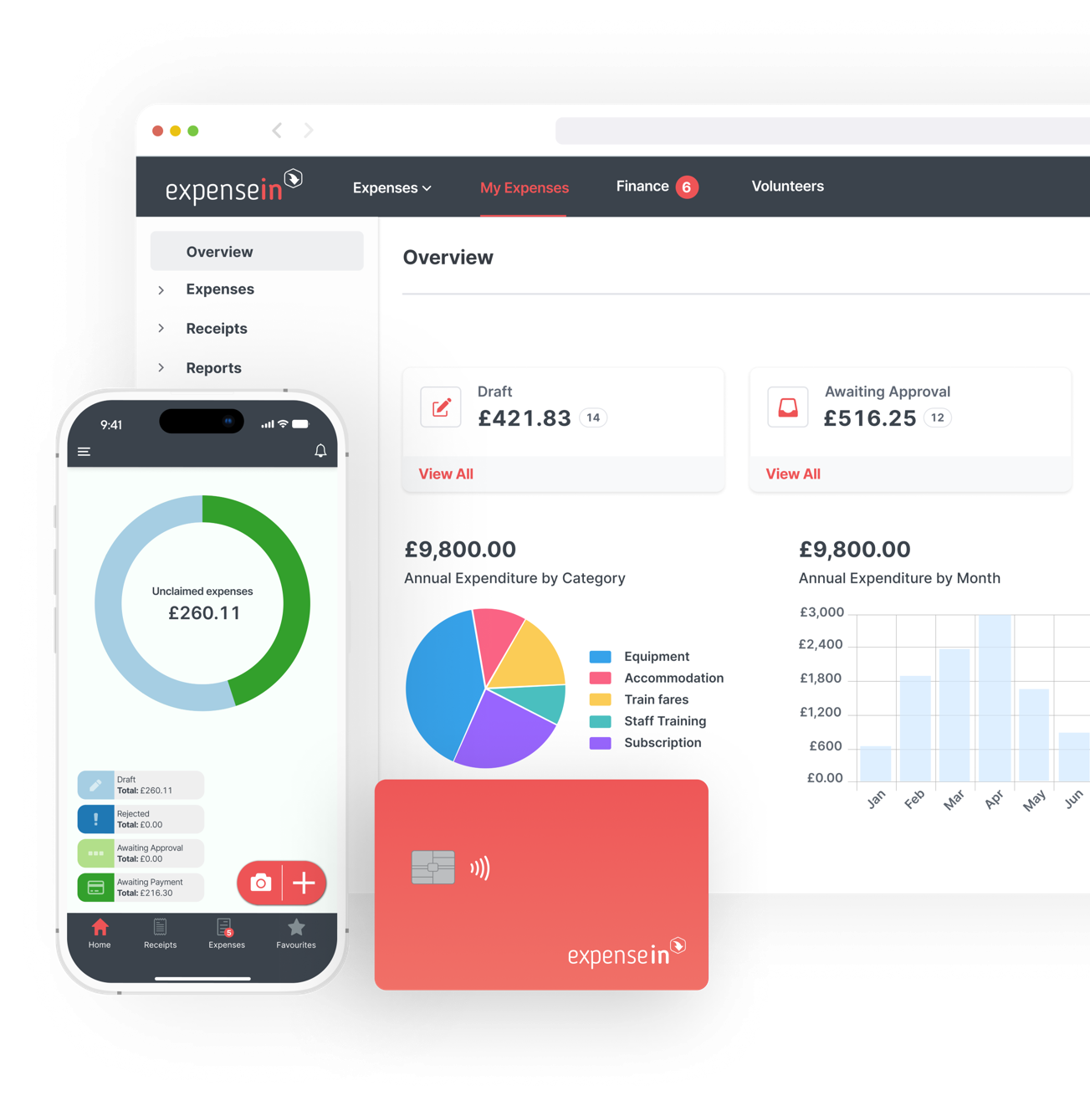

Enabling Smarter Expense Management with Digital Tools
Digital tools can support the workflow, helping charities to:
Simplify submissions
Capture receipts and submit claims quickly and consistently
Speed up approvals
Automate workflows and reduce bottlenecks.
Improve visibility Provide real time insight into claims and spending
Reduce admin time Minimise manual processing for finance teams
Strengthen security and compliance Ensure policies are applied consistently with clear audit trails.
Cards issued by Stripe

Slide 17

Key Takeaways
Expense processes impact more than finance.
Inefficient workflows create hidden organisational costs.
Clear, structured processes reduce friction and risk.
Small improvements can have a big impact.
Remove the friction so, you can focus on delivering your mission.
Want to learn more about ExpenseIn? Book a call with the team:
jahana.khan@expensein.com
Notes:
Mention that we have the guide and the blog which will help them build upon this to help strengthen their expense management process.
Mention charities discount.

Slide 18
Questions?

