Slide 1

The Digitally Informed Trustee
4 February 2026

Slide 2
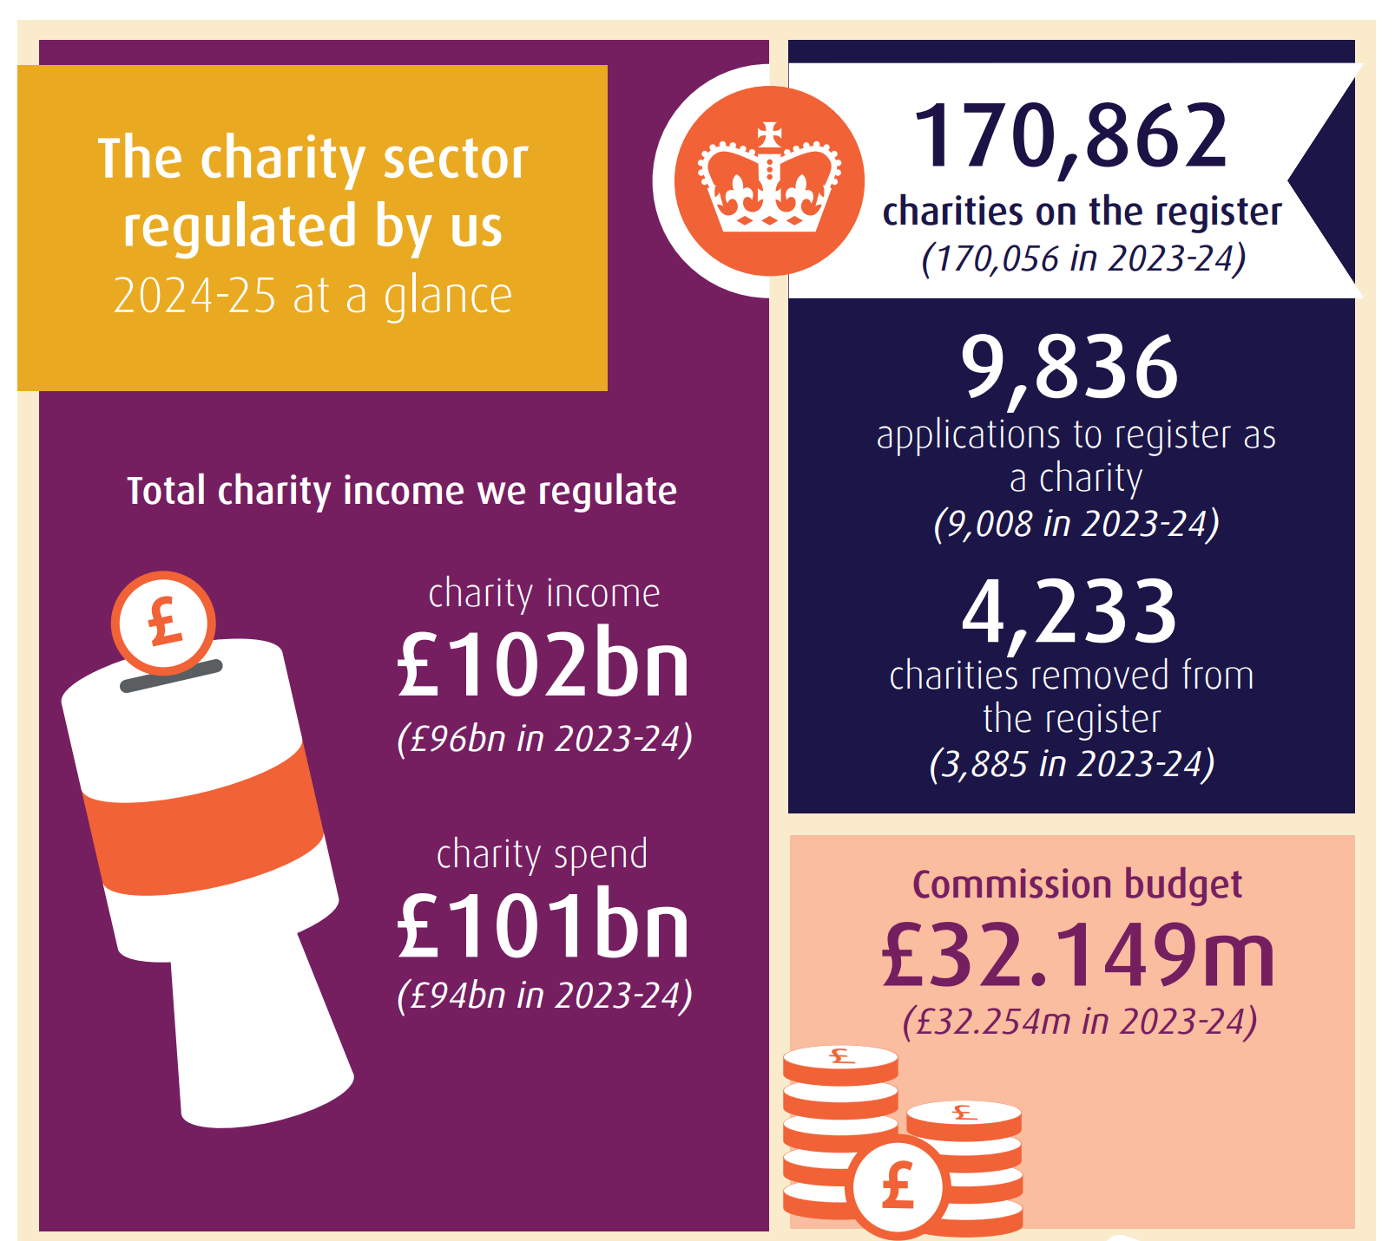
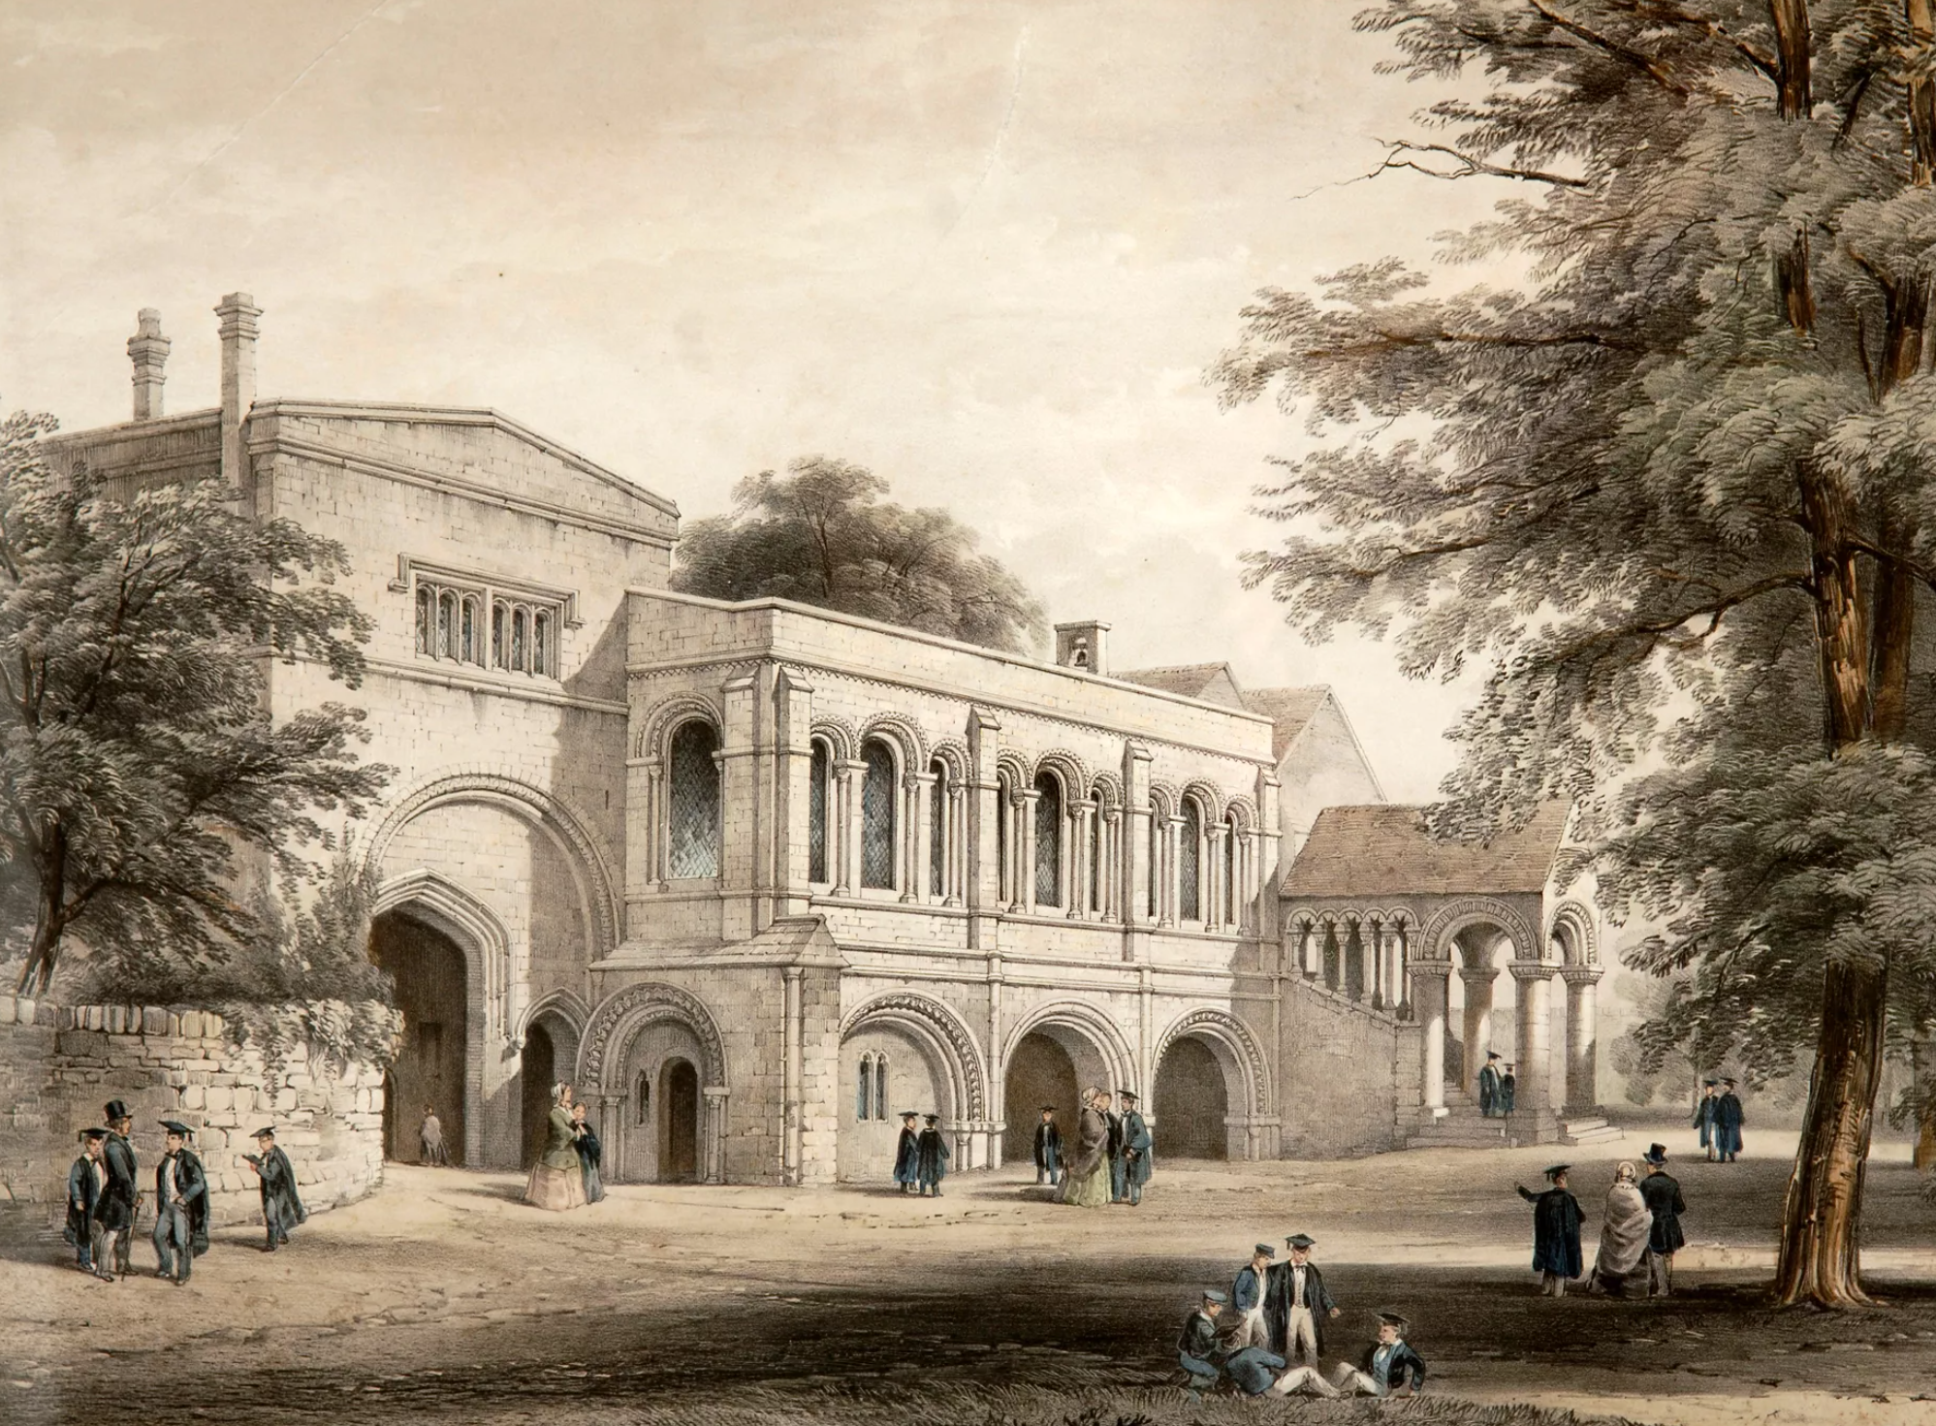
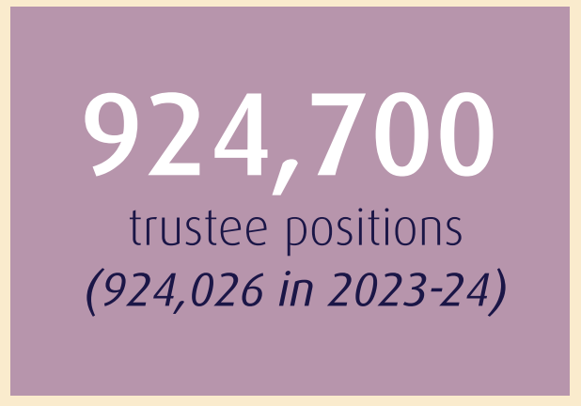
Oldest charity on our register
The King’s School, Canterbury
Founded in 597

Slide 3

Who are we?
What we do:
Register eligible organisations
Provide advice and guidance
Take enforcement action, where necessary
Publish information on charities

Slide 4
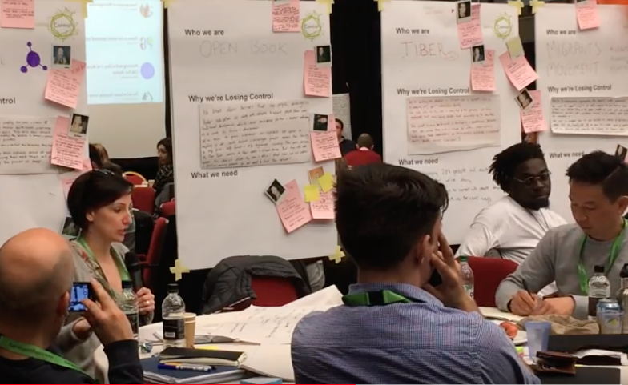
Asking the right questions, considering the right factors
When making decisions for your charity, you must:
act within your powers
act in good faith and only in the interests of
the charity
make sure you are sufficiently informed
take account of all relevant factors
ignore any irrelevant factors
manage conflicts of interest
make decisions that are within the range of decisions that a reasonable trustee body could make

Slide 5
How your charity will use social media | Does our policy currently (or need to) cover this?
What your objectives are in using social media
What platforms you will use
Whether you will create private community groups or host discussion forums. If you will, how you will moderate these groups or forums
What your policy is on moderating third party content, and what comments you will respond to and how, and what comments you will like or reshare
Your oversight and controls around who uses social media on your charity’s behalf | Does our policy currently (or need to) cover this?
How you manage access to your charity’s social media accounts and social media security
Who can post day-to-day content, and about what. For example, routine announcements of the charity’s work
When additional approval is needed, and who is involved. For example, high profile announcements or dealing with a social media crisis
Who is responsible for reviewing and moderating content and how often
Who can delete content, and in what circumstances
Required conduct for those managing the account | Does our policy currently (or need to) cover this?
Your rules including compliance with relevant laws and any codes of conduct
Your rules around managing interactions with children and young people and/or with vulnerable people
How you will ensure your staff and volunteers have the skills and knowledge to use social media appropriately
How you will check the policy is being followed and act if it is breached
Relationship to other policies | Does our policy currently (or need to) cover this?
How this policy interacts with your policies and processes on safeguarding, risk, whistleblowing and HR
The charity’s guidelines on personal social media use by trustees, employees or volunteers
Responding to incidents | Does our policy currently (or need to) cover this?
Who can amend or delete content, and in what circumstances
When you and/or your senior staff need to be involved
When issues need to be reported to the full trustee board
If, when and how you will respond to complaints or criticism on social media
What to do if you receive abusive messages including how you will support trustees, staff and volunteers if they are the subject of online abuse
What you will do in the event of a social media crisis, for example, having a communications plan and stopping any scheduled posts or sharing content from third parties
Checking if you need to report a serious incident to the Commission or make reports to the police or other regulators
How your charity will use social media
What your objectives are in using social media
What platforms you will use
Whether you will create private community groups or host discussion forums. If you will, how you will moderate these groups or forums
What your policy is on moderating third party content, and what comments you will respond to and how, and what comments you will like or reshare
Your oversight and controls around who uses social media on your charity’s behalf
How you manage access to your charity’s social media accounts and social media security
Who can post day-to-day content, and about what. For example, routine announcements of the charity’s work
When additional approval is needed, and who is involved. For example, high profile announcements or dealing with a social media crisis
Who is responsible for reviewing and moderating content and how often
Who can delete content, and in what circumstances
Required conduct for those managing the account
Your rules including compliance with relevant laws and any codes of conduct
Your rules around managing interactions with children and young people and/or with vulnerable people
How you will ensure your staff and volunteers have the skills and knowledge to use social media appropriately
How you will check the policy is being followed and act if it is breached
Relationship to other policies
How this policy interacts with your policies and processes on safeguarding, risk, whistleblowing and HR
The charity’s guidelines on personal social media use by trustees, employees or volunteers
Responding to incidents
Who can amend or delete content, and in what circumstances
When you and/or your senior staff need to be involved
When issues need to be reported to the full trustee board
If, when and how you will respond to complaints or criticism on social media
What to do if you receive abusive messages including how you will support trustees, staff and volunteers if they are the subject of online abuse
What you will do in the event of a social media crisis, for example, having a communications plan and stopping any scheduled posts or sharing content from third parties
Checking if you need to report a serious incident to the Commission or make reports to the police or other regulators
Checklist for developing a social media policy

Slide 6
Trust in charities still ranks very high compared to other organisations, with only trust in doctors continuing to rank higher
Mean
7.1
6.5
6.1
5.8
5.2
5.2
5.1
4.7
4.2
3.5
3.5
Summary: A2. On a scale of 0-10 where 10 means you trust them completely and 0 means you don’t trust them at all, please tell me how much trust and confidence you have in each? Base: All respondents (4092)
Significant difference against previous wave at 95% confidence interval

