Slide 1



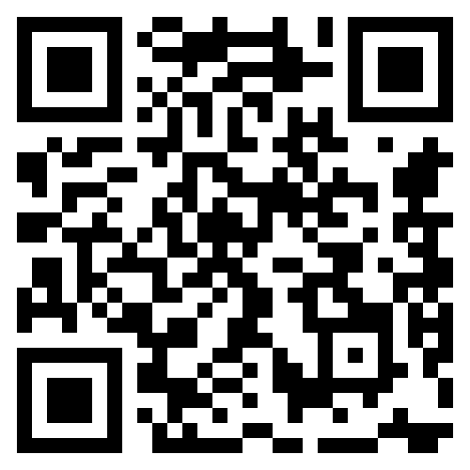
Jason Cartwright
Founder
jason@givefood.org.uk
www.givefood.org.uk
Notes:
Hello everyone, I’m Jason and I’m the founder of Give Food.
It’s lovely to be invited by Charity Digital to talk to you all.
I’ve never discussed any of this work publicly before, and it’s lovely to be allowed out from behind the keyboard.

Slide 2

Use data to highlight local and structural food insecurity
Provide tools to help alleviate it
Notes:
This is our mission
We’re a small independent charity that uses data to highlight local and structural food insecurity then provides tools to help alleviate it.
We’re very small, under £20k turnover and four volunteer trustees.
I hope to show you how even as a tiny, tech-focused charity organisation we’ve been able to have an outsized impact reaching millions of people, with AI recently having a profound effect on our charity.

Slide 3

👋
Notes:
I’m a programmer, professionally making digital products for 28 years.
Previously worked for logistics businesses, startups, the BBC and Google
Ran a company called Potato, a Sunday Times Tech Track fastest growing UK company which became part of WPP

Slide 4

Notes:
Background of food banks
According to the HoC library foodbank usage has exploded in our country in the last 15 years, from 61,000 emergency food parcels handed out in 2010 to over 3.1 million in 12mo over 2023/24.
Why do people use food banks? Inadequate benefits, in-work poverty, poor health, disability, a unexpected change in circumstance
Food bank, whilst called Food Banks, often offer far more than just food - with services onsite and signposted
It’s very upsetting that behind all our interesting and fun talk of data and everything there are real people with real difficulties that AI probably can’t solve. It’s also worth acknowledging that as a charity we don’t believe we should exist.

Slide 5
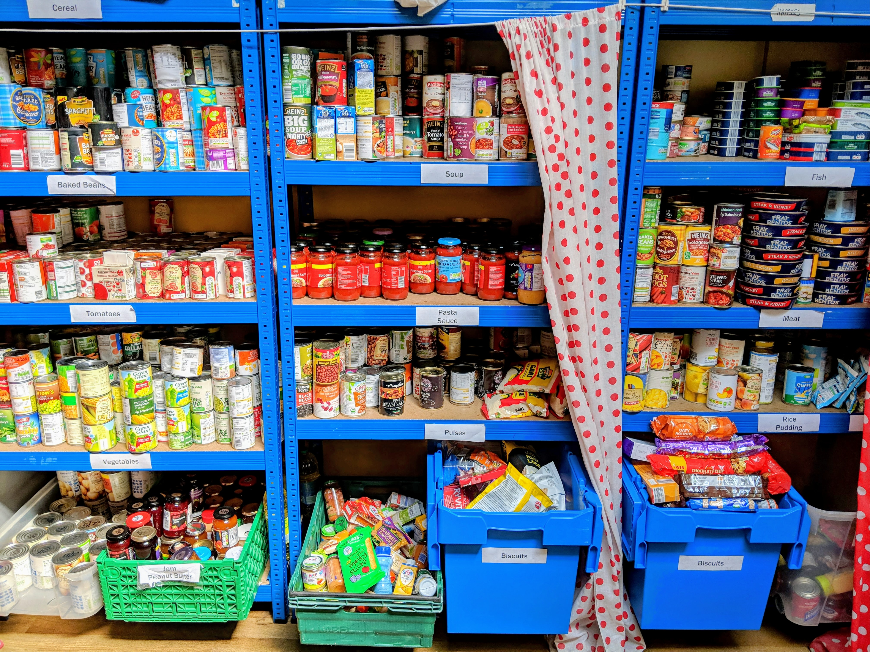
Notes:
Origin story
In 2018 I started making grocery shopping deliveries to a food bank where I grew up in Devon. It turns out you don’t need to make a Tesco delivery to your own house - it can go anywhere. Foodbanks published what they needed on their website or Facebook page. Was surprised how effective they were. So I started building up a list of food banks then using basic software to scrape what they needed from their websites.
The list, which started in a spreadsheet, became the only national database of food banks and additionally had realtime information on what they needed.
We became a charity in 2020, 20-odd days before the UK went into lockdown. All of a sudden everyone wanted to know where the foodbanks were

Slide 6
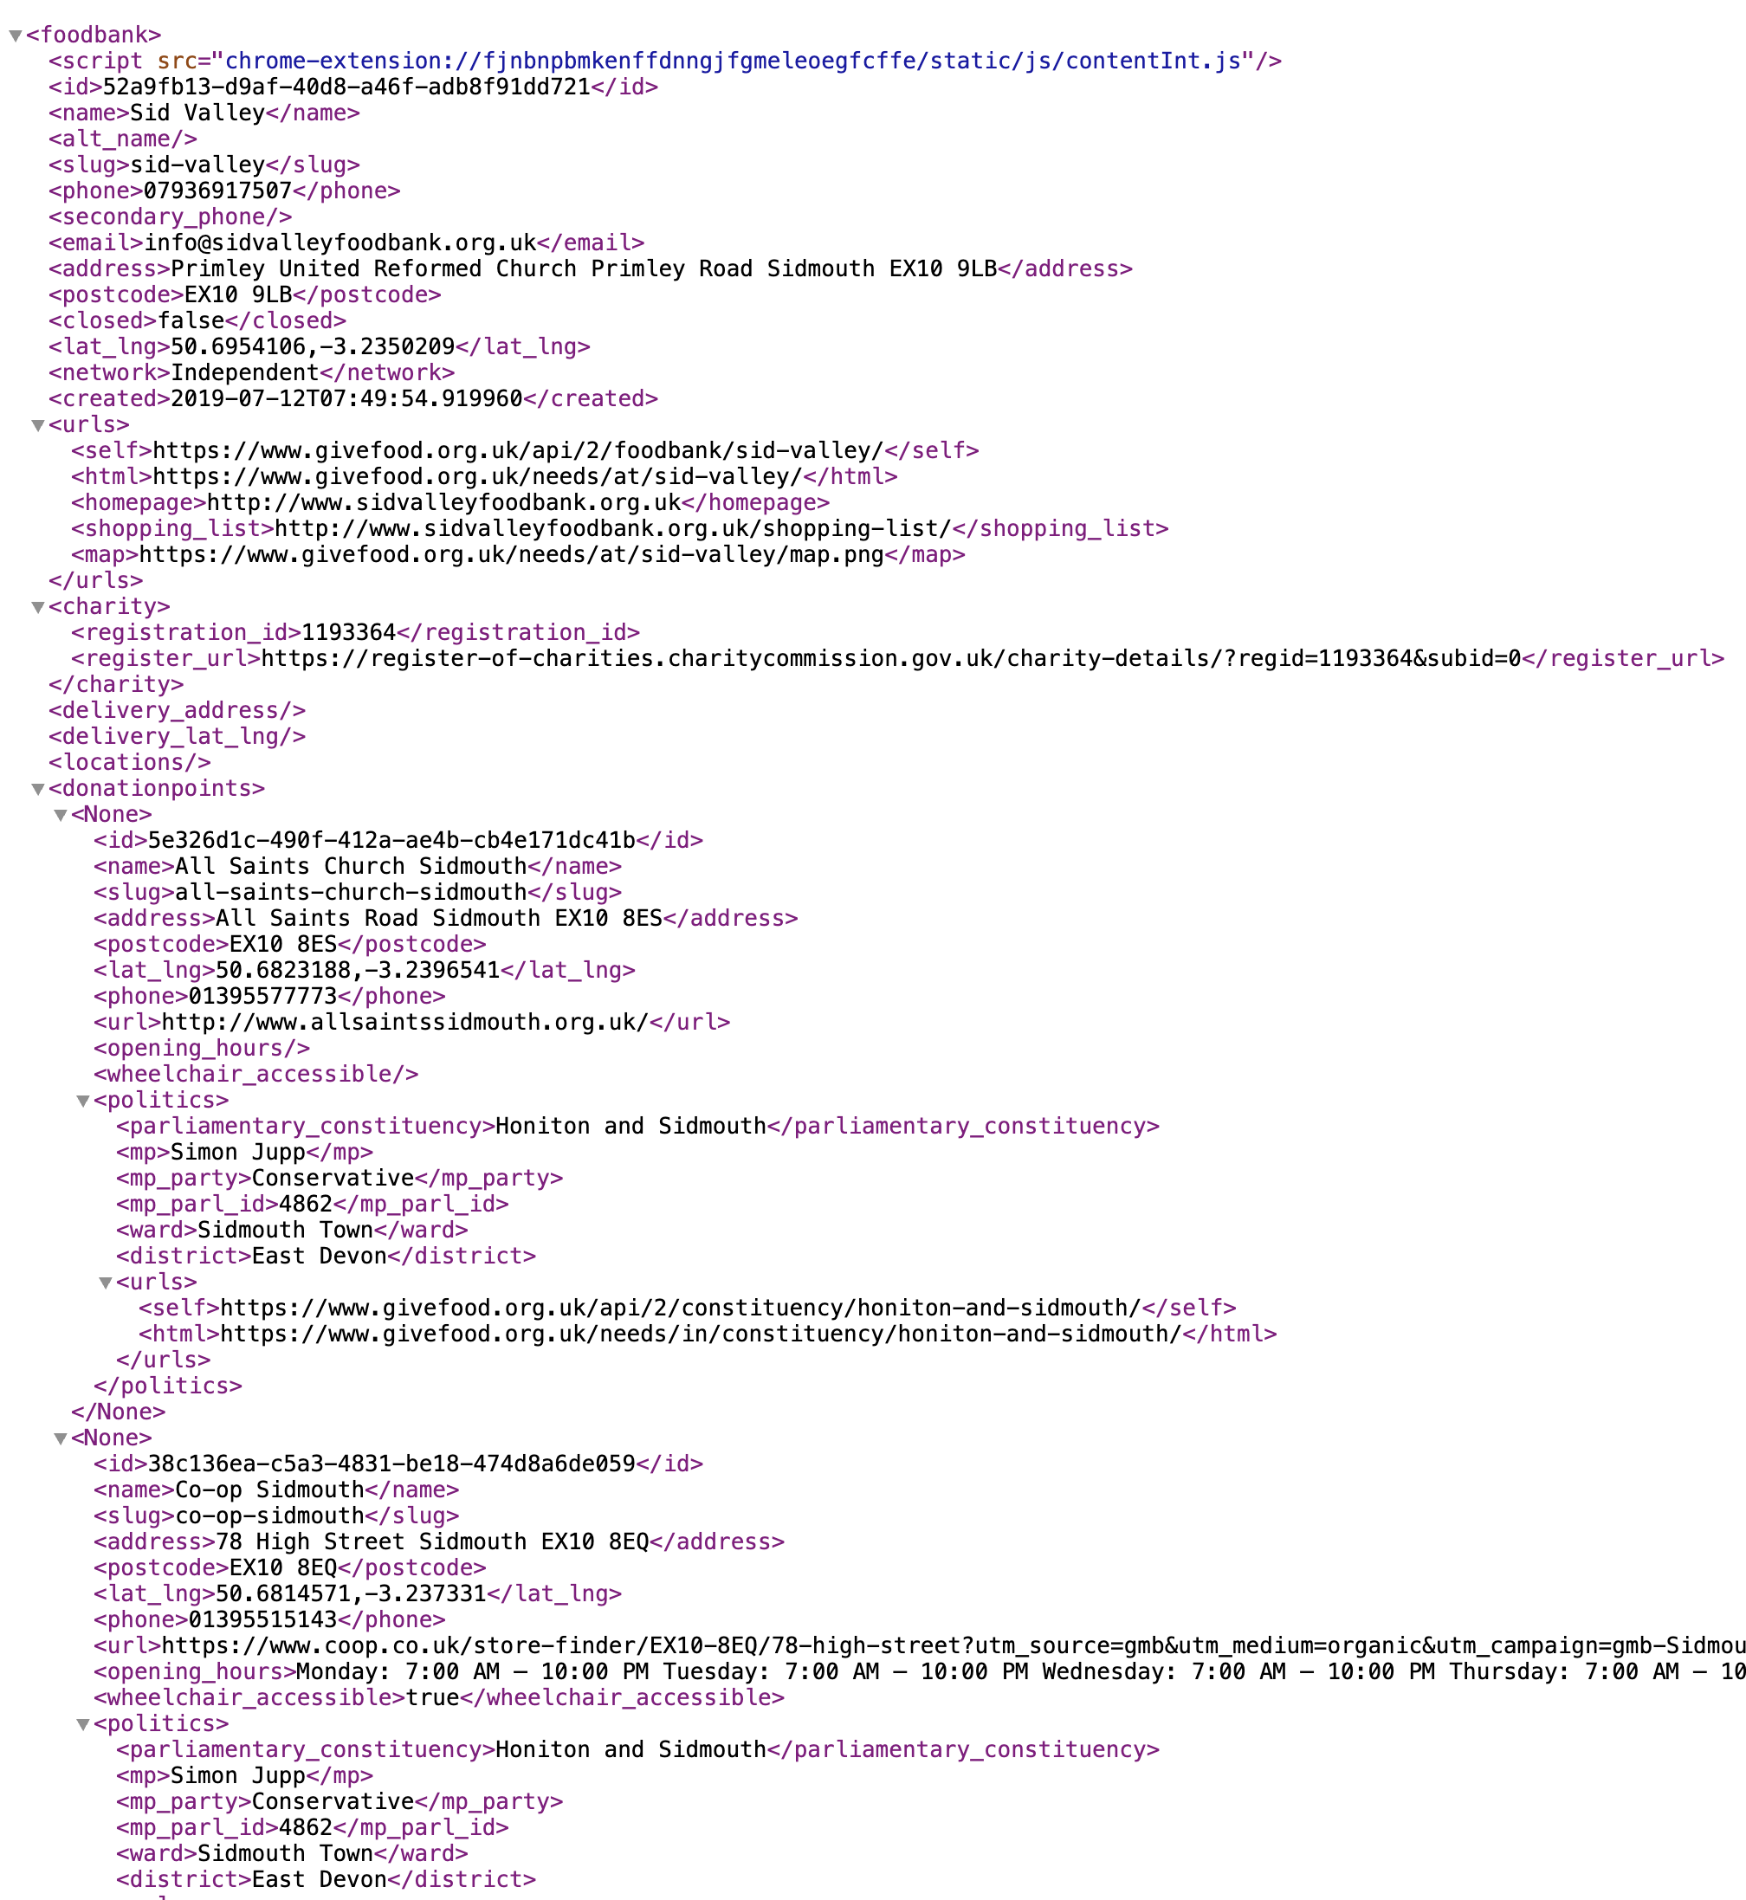
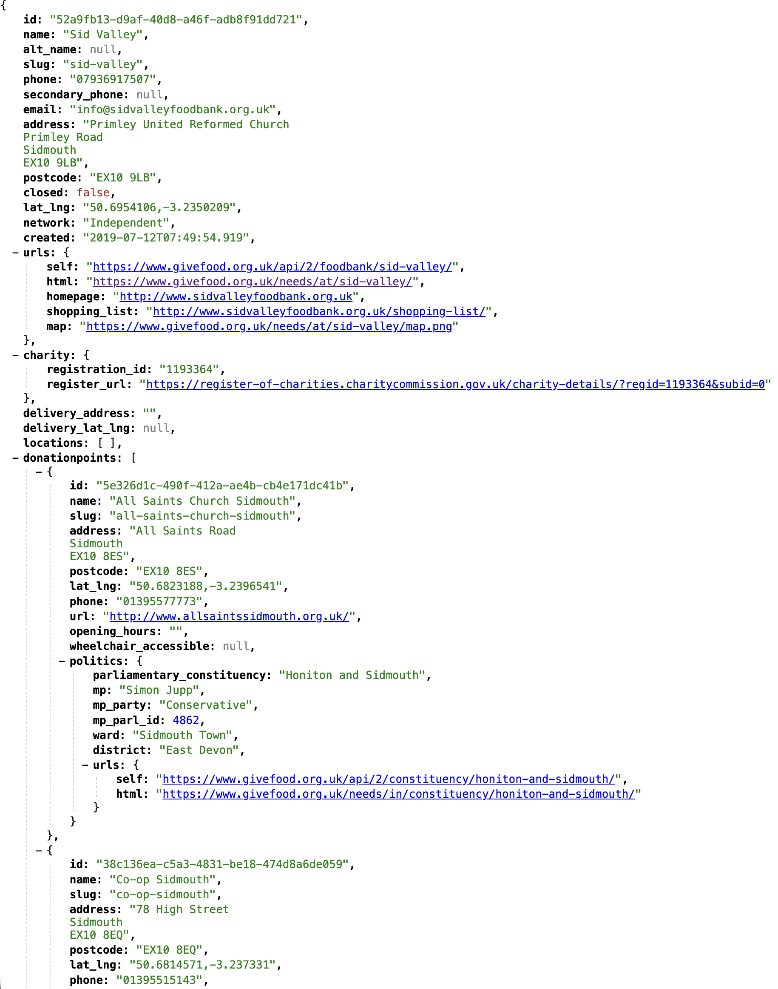
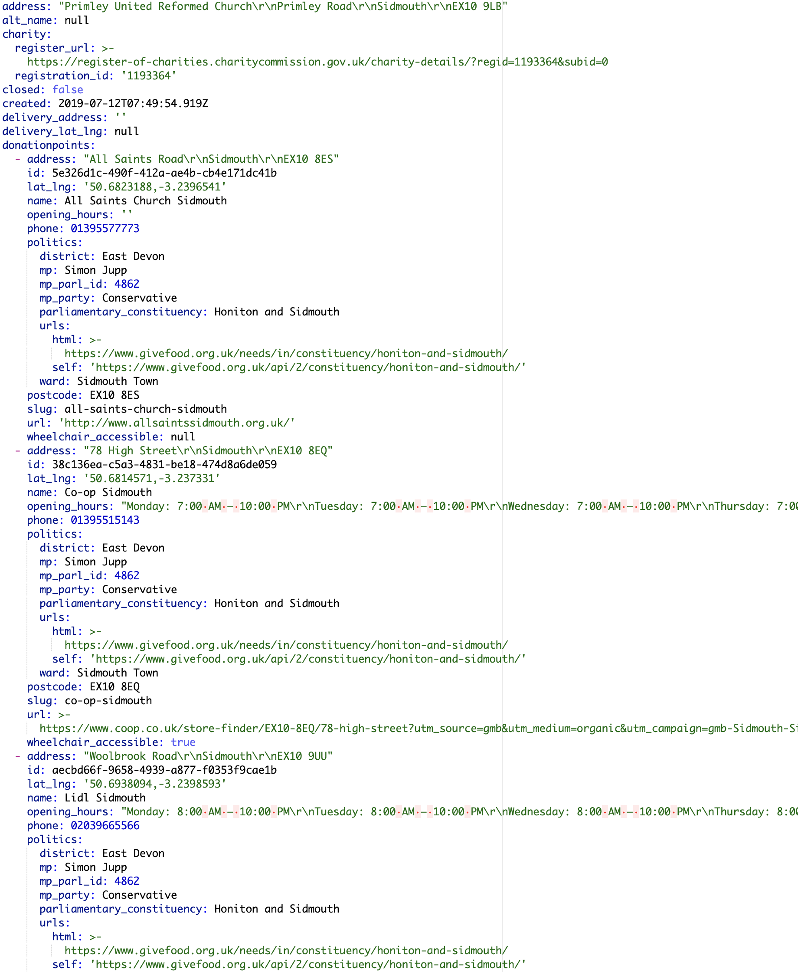
Notes:
Where we are now. We run the only national database of food banks. A rich dataset of information about the food banks, their underlying charity, geography they work in, locations, donation points, and perhaps most interestingly realtime information on what they need donating.
Over a million lines of code
~1.2m datapoints about food banks
We talk to partners that distribute our data via our API and dumps of data
We also offer tool to the public to use our data - via apps (with location notifications), WhatsApp, email, browser notifications. Tool to write to your MP

Slide 7

Notes:
By being open and permission-less our data is used by everyone from students, university research depts, governments, food manufacturers and the media. Someone even built an Alexa skill, so you can ask your smart speaker what your local food bank needs.
So in summary we’re a tiny charity, outsized reach, lots of data, lots of code. AI currently deals with both of these things really well.

Slide 8
Non-dairy Milk Alternatives Except Almond Milk, UHT Non Dairy Milk, UHT Milk (Blue Full Fat) And Semi Skimmed, Ukt Milk ( Whole Or Semi), Long-life Milk (1l), Long Life / UHT Milk, UHT Milk (1litre), UHT Milk: Full Fat Or Semi-skim, UHT Milk (2 Litres), Cartons Of Milk, Semi Skimmed UHT Milk (Green), Full Fat (Blue) UHT Milk, UHT Milk (Blue/green/red), UHT Milk (Semi-Skimmed Or Whole) 1 Litre Pack, UHT Milk Full Fat, UHT Milk (Green/blue), Long Life Milk Whole And Semi Skimmed Types, UHT Milk (Long-life), Milk UHT/dried, Semi Skimmed & Full Fat UHT Milk, Milk (UHT Long/life 1 Litre), U.H.T. (Long Life) Milk, UHT Non-Dairy Milk (Except Oat), Milk (UHT) / Powdered Milk, Long-life/uht Milk & Juice (Including Kids Juice Cartons), UHT Milk (No Skimmed Milk Please), UHT Milk (Non- Refrigerated), UHT Non-Dairy Milk (E.G. Soya Almond), UHT Milk (Not Blue), UHT Milk - All Varieties, Vegan Milk, UHT Non-Dairy Milk (Except Oat Please), Long Life Milk - Whole Milk, UHT Milk 1litre, UHT Milk (full fat), UHT Milk Semi Skimmed And Full Fat, UHT Milk - Both Full Fat And Semi Skimmed, Long Life Milk, Milk (UHT/long-life), Free From Milk (Soy/oat/almond Etc.), Longlife Milk And Fruit Juice, UHT Full Cream Milk, Semi-skimmed Long-life Milk, UHT Semi-Skimmed Dairy Milk, UHT Milk ( Whole & Semi), Powdered Milk (Not Baby Milk), Cartons of milk, Millk (Long-life), Long Life Milk (Full Fat & Semi Skimmed), Long-life UHT Milk, UHT Milk (1 litre), Milk (UHT Or Powdered), Semi Skimmed Milk, Long Life Milk (UHT Or Powered), UHT Milk (Full Fat And Semi Skimmed Only) - Urgent, UHT Milk - Whole Or Semi-skimmed, Milk - (UHT / Long Life Only), UHT Milk (Both Whole Milk And Skimmed), UHT Milk / Powdered Milk., UHT Or Fresh Milk (No Stock), 1l UHT (Long Life) Milk, UHT Milk 1l (Semi Skimmed), Milk (UHT Cartons), UHT Milk & Soya Milk, UHT Milk (Full/semi-skimmed), UHT Milk (Semi-skimmed And Whole), Milk - 1ltr long life green - we are very short of this, UHT Milk 1lt, Long-Life Dairy Milk, Fresh Milk, UHT (Long Life) Milk & Fruit Juice, Milk (UHT or dried), UHT Milk (Including Dairy Free Options), UHT Semi-skimmed Or Whole Milk, UHT Milk - Semi Skimmed If Possible, Milk - UHT, UHT Milk (2l), UHT Milk (1 Litre), UHT Milk (Semi And Full) - No Stock, UHT/longlife Milk, UHT Milk (Green One Litre), UHT Milk - Particularly Full-fat, Long Life Milk Semi Skimmed & Whole Milk, Milk (Uht), Milk (UHT and powered), Carton Of UHT Milk, Two-pint Long-life Cartons Milk, UHT Milk (1 Litres), Milk (long life), UHT Whole & Semi Skimmed Milk (Blue & Green Cartons), Milk (Long-Life), UHT Milk Semi-skimmed, 1 Litre Cartons Of UHT Milk, UHT Milk (Blue Full Fat) & Semi Skimmed, Cartons Of Long Life Full Fat Milk, Plant Based Milk, Full Fat UHT Milk, UHT Semi Skimmed Milk (Green Carton), UHT Milk 1l (Semi Skimmed Or Wholemilk), Long-Life Milk (UHT) Full Fat And Semi-Skimmed, UHT Semi-skimmed Or Whole Milk (Not Skimmed Please), UHT Milk (Blue Full Fat), UHT Milk (Whole Or Semi-skimmed), UHT Long Life Milk, UHT Milk - Urgently Needed, UHT Milk - Whole And Semi Skimmed (Not Skimmed Please), Small Cartons Of Long Life Milk, Milk – 1L UHT semi-skimmed, UHT Milk 1L, UHT Milk ( Not Skimmed Please), UHT Milk (Semi Skimmed And Whole Fat Milk), UHT Milk - Semi-Skimmed & Full Cream, Long-Life Full Fat Milk, UHT Milk/powdered Milk, UHT Milk: Whole And Semi-skimmed, Milk (Not Skimmed Milk), UHT Milk - Skimmed Semi-skimmed And Full Fat Only Please, UHT Milk (Whole & Semi-Skimmed), Long Life Milk (Including Soy/Almond), Semi-skimmed Milk, Plant Milks Especially Oat., UHT Milk (Blue Or Green), Long Life Milk (Ideally Full Fat Or Semi Skimmed), UHT Milk (Whole Semi), Non-dairy Long-life Milk - Soya Almond Rice Etc, UHT Semi-skimmed Milk (Green Carton), Long Life Semi Skimmed Milk, UHT Milk (Long- Life), I Ltr UHT Milk Cartons, UHT Whole Milk, UHT Milk - Full Cream, 1 Litre Cartons Of Long-life Cow's Milk, UHT Milk (1 Litre) Full-cream And Semi-skimmed, UHT Whole & Semi Skimmed Milk, UHT Milk (Full Fat Or Semi-skimmed Not Skimmed Or Soya/oat Etc), UHT Long-Life Milk, Long-life Or UHT Milk, Long-life Milk - Especially Semi-skimmed, UHT Milk (Semi-skimmed Or Whole) 1 Litre Pack, UHT (Long Life) Milk And Fruit Juice, UHT Milk Particularly Semi Skimmed And Full Fat, UHT Milk (Long - Life), Dairy Free UHT Milk, UHT Milk (full-fat), UHT Milk And Juice, Milk 1L Cartons, UHT Milk (Green And Blue), UHT Semi Skimmed Milk - Green Carton, UHT Milk (Whole And Semi Skimmed), UHT Milk And Milk Powder, Long-life Cartons Of Milk, Litres UHT Milk, Carton Of Milk, Soya Milk And Oatmilk, UHT Milk - Whole & Semi, UHT Milk (1 litre) full-cream and semi-skimmed, UHT Milk (Semi-skimmed Or Whole), Long Life Milk (Whole Or Semi Skimmed), Long Life Milk, Long Life Milk (Semi Skimmed And Full Fat), Dried Milk Or Marvel, UHT Milk (Semi And Full) - Low Stock, UHT Milk - Semi-skimmed, UHT Or Fresh Milk (Fresh Milk - Please Drop Off At Foodbank Only), Longlife Almond Milk, Milk Powder (Not Baby Formula), UHT Milk Red, Milk – UHT, Long Life Semi & Whole Milk Cartons Both 500ml & 1lt Packs, Semi-skimmed Or Whole UHT Milk (Not Skimmed), Long-Life Millk (UHT) Full Fat And Semi-Skimmed, UHT Milk (Semi-Skimmed Or Whole), UHT 1l Milk, UHT Milk 500ml Cartons, Milk (UHT/Carton), Long Life Milk - Small Cartons If Possible, Milk UHT 1L, Milk (UHT / Long-life), UHT Semi Skimmed Milk, UHT Milk - No Stock, UHT Semi-Skimmed Milk, UHT (Long-life) Milk, Milk (UHT And Powered), UHT Milk - Urgent, Longlife Milk (Full Fat And Semi-Skimmed), UHT Milk (Full Fat Semi-Skimmed And Dairy Alternatives), Milk: Powdered, UHT Milk (1l & 500ml), Milk – Long Life Dairy, UHT Milk (Urgent), UHT Cartons Of Semi-Skimmed Milk, UHT Milk Urgent, Long Life Semi-Skimmed Milk (Green), Skimmed Milk (UHT), Milk (UHT) - Non Dairy Dairy And Dried, UHT Milk (Semi Skimmed Or Full Fat - Not Skimmed), Longlife Milk - Not Skimmed Please, Long-Life Milk (Esp Full Fat Blue Cartons), Long Life Milk (UHT), UHT/long Life Milk, UHT Milk (Blue), UHT Milk - Full Fat And Semi Skimmed Please, UHT Milk - Full Fat Or Semi Skimmed, Oat Milk, UHT Milk 1L, Milk UHT - Long Life, Milk - Long-Life, UHT Milk., UHT Milk Blue Or Green Cartons, Evaporated Milk (Tins), UHT Milk 1 Litre, Long Life Milk (Green & Blue), UHT/Long Life Milk, Long Life Non-Dairy Milk, Longlife Cows Milk, UHT Milk (Full Or Semi Skimmed), UHT Milk - Not Skimmed, UHT Milk (Semi-skimmed 1 Litre), UHT Milk Packets Of Sugar, Long life/UHT Milk, Semi-Skimmed Long-Life Milk, Milk (Long Life/UHT) 1L Cartons, Long-life Milks - All Types, UHT Semi-skimmed Milk, Milk (UHT Or Powered), UHT Milk (Whole & Semi-Skilled), UHT Milk - 1 Litre Carton, Cartons Of UHT Blue Full Fat Milk, 1 Ltr UHT Milk (Green), 1Ltr UHT Milk, Oat/Almond Milk, UHT Milk (Whole), UHT Milk- Full Cream And Semi-Skimmed, UHT Milk 1l (Semi Skimmed And Whole), UHT Semi Skimmed Milk (1l), UHT Milk (Semi-skimmed & Whole), UHT Milk Both Whole And Semi-skimmed, UHT Milk 1 L, Semi-Skimmed Or Whole Milk 1 Litre, Long-Life Semi Or Full Milk, Whole Milk (UHT) (1 Litre), UHT (Whole) Milk (1 Litre), Milk UHT Long Life (Not Plant Milk), Long Life Milk - Semi Skimmed, Long-Life (UHT) Milk, Milk (Whole Only), UHT Semi-skimmed (Green) Milk - Low Stock, UHT Milk Including Soya, Milk (UHT Long Life 1 Litre), Longlife Whole & Semi-Skimmed Milk, UHT Milk / Powdered Milk, UHT Milk (Green), Milk (Powdered And UHT), Milk (UHT 1 Litre Green), UHT Milk (Full-Fat), Milk - UHT Or Powdered, Long Life Milk Semi-skimmed, Long-Life Milk, Milk - UHT/long-life Semi Or Whole, Long-Life Milk - Full Fat (Blue), UHT Milk Full Fat Blue Top, Single Pints Of Long Life Milk., UHT Milk (Long Life Milk), UHT Milk Full Cream Or Semi-Skimmed, Milk UHT Or Powdered, UHT Milk - Full Fat And Semi Skimmed Only Please, UHT Milk (1 Litre) or Skimmed Milk powder, UHT Semi Skimmed Milk (Green), UHT Carton Milk, Milk - UHT/long-life - Semi Or Whole, UHT Milk (Semi And Full Fat Only Please), 1ltr UHT Milk, UHT Full Fat (Blue) Milk, 2 Pint Long Life Milk, UHT Milk (2 Litres), Whole And Semi Skimmed UHT Milk, Longlife Semi Skimmed Milk, UHT / Longlife Milk, UHT Milk - Full Fat - Blue, UHT Semi Skimmed And Whole Milk, UHT Milk (Full Fat And Semi Skimmed Only), Whole Milk (UHT), Long-Life Full Fat Milk (Blue Cartons), Long Life Milk & Dried Milk, Long Life Semi-Skimmed Milk, UHT Milk (Semi-skimmed Or Full Fat), Whole (Blue) UHT Milk - No Stock, UHT Milk - Whole Or Semi-skimmed No Skimmed Please, Milk - Long-life, UHT Full-cream Milk, Milk (UHT or Powdered), UHT Milk 1l (Semi-skimmed), Long-life Milk/fruit Juice, UHT / LongLife Milk, Milk – Semi-skimmed Long Life, Milk (1 Litre UHT), Longlife Whole And Semi-skimmed Milk., Long-life Full Fat Milk (Blue), Long Life Whole Milk, Long Life Milk (Including Alternative Milks), Milk - UHT/long-life, Non-Dairy Milk, Milk (UHT) Semi Skimmed/full Fat, UHT Whole (Blue) & Semi Skimmed (Green) Milk, UHT Milk 500ml /1 Litre Cartons, UHT Milk (Green/Red), Long-Life Full Fat Milk (Blue), Milk Semi Skimmed 1l, UHT Milk -(Semi Skimmed Milk Whole Milk Soya Milk Oat Milk Almond Milk), UHT Milk - Semi Skimmed Or Full Fat, UHT Milk - Whole Milk Only, Semi Skimmed & Full Fat UHT Milk (Green & Blue), 1l UHT Milk, UHT Milk Especially Semi-skimmed & Full-cream, Non-Dairy Milk Alternatives, UHT Milk - Semi Skimmed, Long-life Milk (1 Litre Cartons), UHT Milk (Blue And Green Only), UHT Long Life Semi Skimmed Milk, UHT Milk (1l Whole Or Semi-skimmed), Milk (UHT Not Chilled), Semi Skimmed Milk (Long Life), UHT Milk Semi Skimmed And Full Fat Only Please, Milk - Long Life, UHT Milk (Urgent!), Long-Life Milk Of Any Kind, Longlife Milk (Full Fat And Semi-skimmed), Uhht Milk, UHT Milk And Plant Based Milk, UHT Blue, Full Cream UHT Milk, UHT Milk - Semi-skimmed & Full Cream, Milk UHT (semi-skimmed), Milk Powder Long Life Milk, Long Life Milk – Cartons, Milk Powder, Individual Packs Of UHT Milk, Long Life Milk Small Cartons If Possible, UHT Milk (Whole Or Semi Only Please), Longlife Semi Or Whole Milk, UHT Semi-skimmed Or Full Fat Milk, Non-dairy Milk (UHT) And Dried Milk, UHT Milk (1L), UHT Milk And Non Dairy Alternatives, Long Life Milk (Cartons Of Semi Skimmed And Full Fat), UHT Milk (Non - Refrigerated), UHT Or Fresh Milk, Long Life Milk (Including Soy/almond), Oat Or Almond Milk, Full Fat Milk, UHT Milk - Whole And Semi-skimmed, 1l Cartons Of UHT Milk, UHT Milk (Green & Blue), UHT Milk Full Fat "Blue Top", UHT Milk (Full Cream/semi Skimmed), UHT Milk (Semi Skimmed/full Cream), Milk (Long Life UHT), UHT Milk - Full Cream And Semi-Skimmed, Milk (Urgent), UHT Milk Green, UHT Non-Dairy Milk (All Types), Milk – UHT Or Powdered, UHT Milk - blue, UHT Milk - Semi Skimmed Or Full Fat Not Skimmed, UHT Milk (1 Litre And 500ml Packs), UHT Milk Alternatives E.g Soya Oat Milk, UHT Milk (Semi-skim & Whole), Drinks - Long Life Milk Long Life Juices Squash Tea And Coffee, Cartons Of Longlife / UHT Milk, UHT Milk (1l), Milk (UHT / powdered), Long Life Soya Milk, UHT Milk (Semi-skimmed And Whole), UHT Milk Inc Non-dairy, Milk – Uht or Powdered, UHT Milk (Whole And Semi-skimmed), UHT Milk (Whole & Semi Skimmed), Milk (1 Ltr Full Fat Or Semi-skimmed UHT), Long Life Milk and Fruit Juice, Longlife Oat/almond Milk, UHT Milk (Blue And Green Cartons), Small Bottles Of Baby Milk (Follow On Type) 200ml, Long Life Milk (Semi Or Full), UHT Non-dairy Milk: Soya Oat Almond, Semi Skimmed Long Life Milk, Milk - Long Life Dairy Milk, Tins Of Coconut Milk, Milk (Green & Blue) 2 Pints, Long Life Milk 1l Cartons, Milk (Blue-long Life), UHT Milk (Full-fat), UHT Milk ( Whole Or Semi), Cartons Of UHT Milk, UHT Milk & Juice, Longlife Oat Milk, Milk UHT 1L, UHT Semi-skimmed Milk: Green Carton, Long Life Dairy Free Milk (Soya Oat Etc.), UHT Milk Full Cream Or Semi-skimmed, Long Life/UHT Milk, Full-Cream UHT Milk, UHT Milk (Blue And Green), UHT Milk - Full Cream And Skimmed, Longlife Milk - Not Fully Skimmed Please, UHT Milk - Low Stock, Semi -Skimmed Milk UHT, UHT Semi Or Whole Milk, Longlife Oat/Soya Milk, Semi Skimmed Milk – UHT, UHT Milk (Red), UHT Long Life Milk Including Dairy Alternatives, Milk (Long Life/uht) 1l Cartons, UHT Dairy Milk (We Don't Need Oat Milk Etc), UHT Milk (Particularly Blue/full Fat), Full-Fat Long-Life Milk, UHT Milk Or Milk Alternative, Long Life Milk/fruit Juice, UHT Semi-skimmed (Green) Milk - No Stock, UHT Milk (Green And Blue Only), UHT Milk 500ml / 1 Litre, UHT Milk 1Litre, Long Life Milk - Semi Skimmed Milk, Long Life UHT Milk, Full Fat Or Semi-skinned UHT Milk, UHT Milk - Full Fat Or Semi-skimmed, UHT Milk - All Types, Alternative Long-Life Milk, Milk (UHT Or Powdered) 1 Litre, UHT Milk/juice, Milk 1l Cartons Long-life, UHT Blue Full Fat Milk, UHT Milk (Blue/green), Cartons Of UHT Milk (Long Life), Longlife Cartons Of Milk, Milk Substitute (Ie Soya Oat Etc.), 1 Litre UHT Milk (Not Skimmed), Long Life Milk -UHT, UHT Milk And Fruit Juices, Long Like Milk, Semi- Skimmed Or Whole Long Life Milk, Milk – Long Life Or Powdered, UHT Milk (1L Whole Or Semi-Skimmed), Milk (UHT Long Life), Baby Milk No. 1, UHT Milk (Diary Or Non Diary Options), UHT Milkshakes, Semi Skimmed And Whole Milk, UHT/longlife Semi Skimmed Milk, Full-fat UHT Milk (Usually In Blue Cartons), Long Life Milk (1ltr), UHT Milk- Urgent, UHT Milk (Both Whole Milk & Skimmed), Powdered Milk, Full Fat UHT Milk (Blue), Long Life Milk Whole Type, Milk Long Life, Half Litre Cartons Of UHT Milk, UHT Milk (Semi-skimmed), Cartons Of UHT Milk (Semi Or Full), UHT MILK, Semi-skimmed UHT Milk, Long Life Milk (Including Non-dairy), Long Life Semi-skimmed Milk, UHT Milk (1 Litre Semi-skimmed), UHT Long-life Cartons Of Milk, Soya Milk Almond Milk Etc, UHT Dairy Milk, UHT Milk Cartons, Longlife Semi-skimmed Milk, UHT Milk (2 Litres), Long Life Milk (Semi-skimmed And Whole), UHT Milk (Blue/red), Milk (Long-life), Litres Of UHT Milk Full-cream And Semi-skimmed, Milk: Long-Life Cartons, 1l Cartons UHT Milk, Long-Life Milk - Full Fat, Longlife/UHT Milk, Milk UHT (Long Life), UHT Milk (Semi And Full) - Very Low Stock, Long Life/UHT Milk And Juice Including Kids Juice Cartons, Non-Dairy Long Life Milk - Soya Almond Etc., Dried Milk, Semi Skimmed Milk (UHT), UHT Milk - Green Semi Skimmed, Long-Life Full Fat Milk - Blue, UHT Milk 1 Litre Cartons, UHT Milk (not blue), Milk (UHT) Semi-skimmed, UHT Milk (Full Fat), 1L UHT Milk, UHT Milk/ Powdered Milk, Semi-Skimmed Milk, Small UHT Milk, UHT Milk Semi Skimmed Or Whole Milk, Milk UHT 1 Litre, UHT Milk (Semi Skimmed), Cartons Of Long-Life Milk, Fresh: Milk Cheese Margarine Baking Potatoes Juice/cordial Eggs Any Fruit And Veg, UHT Milk (Full Fat/semi Skimmed), Milk (Longlife), UHT Milk 1l, Milk (1ltr UHT), 1ltr Cartons Of Semi-skimmed Milk, Long-Life Milk (UHT) Full Fat & Semi-Skimmed, UHT Milk (Either Full Fat Or Semi-Skimmed), UHT Milk Inc. Non-dairy, Milk - UHT or powdered, Powdered Milk / UHT Milk, Milk Full Fat(blue) And Semi (Green), UHT Milk - Full Cream & Semi-skimmed, Long-Life Milks, Dried Powered Milk, UHT Milk Especially Whole Milk, Longlife Semi-Skimmed Milk, Long-life Milk, Long Life Dairy Milk, UHT Milk 1lt Cartons, Cartons Of UHT Milk (Blue And Green), UHT Milk (Semi Skimmed Or Full Fat Only), Milk (UHT/powdered), UHT Milk (Full Fat And Semi-skimmed), Alternative Milk, Long Life Fruit Juice/ UHT Milk (All Types), UHT Milk - all types, UHT Milk (Semi-skimmed And Full Fat Only), UHT/long Life Life Milk, Soya Milk And Oatmilk For Special Dietary Needs, Skimmed Milk, UHT Milk (Skimmed/semi-skimmed/whole), Milk, UHT Milk (Semi Skimmed & Whole), Long Life/UHT Whole Milk, Long-life Milk Full Fat (Blue), UHT Whole And Semi Skimmed Milk, UHT Milk - Full Cream & Semi-Skimmed, Long-life/UHT Milk & Juice (Including Kids Juice Cartons), Bread And Milk, Semi-Skimmed Milk (UHT) (1 Litre), UHT Milk (long life), Milk (UHT), Soya Milk, UHT/Powdered Milk, UHT Milk (Semi/whole), UHT Semi Skimmed And Whole Milk (Long Life), UHT Milk (1 Litre Or 2-pint Cartons), UHT Milk (Green/Blue/Red), UHT Milk (Full Cream Or Semi-skimmed), UHT Semi-skimmed Milk (Green), Semi-skimmed Milk (UHT) (1 Litre), Long Life Milk Whole And Semi-Skimmed, UHT Milk (Full Fat Or Semi-skimmed), UHT Or Long-Life Milk, UHT Milk Including Non Dairy Options, UHT Semi Skimmed Milk (1 Litre), Milk - Dairy Alternatives (Soya Oat Almond Etc), Long-Life UHT Milk, UHT Milk Semi Skimmed, UHT Or Fresh Milk (No Stock) (Fresh Milk - Please Drop Off At Foodbank Only), UHT Milk (Full/semi Skimmed), UHT Milk - 1 Litre, Milk (Long Life), Whole (Blue) UHT Milk, Fresh: Milk Cheese Margarine Baking Potatoes Juice/cordial Eggs Potatoes Carrots Onions Cauliflowers Apples Bananas Oranges Pears., UHT Milk - Full Cream & Skimmed, UHT Milk (Blue Or Green Cap), 1 Ltr UHT Milk, UHT Milk - Whole & Semi Skimmed Not Skimmed, UHT Milk (Urgently Needed), UHT Milk (Both Green & Blue), UHT Milk - Red/green/blue, Long Life Whole UHT Milk, Long Life Milk Semi-skimmed, UHT Milk (Whole Or Semi Skimmed), 1ltr UHT milk, UHT / Long-Life Milk, UHT Milk (Green Or Blue), Milk - Longlife, UHT Milk Semi Skimmed And Whole Milk, UHT Whole/full Fat And Semi Skimmed Milk 1l, UHT Milk (Full Fat Semi Skimmed And Non-dairy), Milk Long Life 1l Cartons, Long Life Milk Full Type (Blue), Milk Longlife, Non-dairy UHT Milk, Longlife Milk, Long Life Or UHT Milk, UHT Semi Skimmed & Whole Milk: Green & Blue Cartons, UHT Semi Skimmed Or Whole Milk, UHT Milk Especially Semi-skimmed, UHT Skimmed Milk, UHT Milk (Semi And Full), UHT Milk (Blue & Green), Plant Milk, UHT (Longlife) Milk, UHT Milk Especially Full Cream And Semi-skimmed, Semi Skimmed UHT Milk, Whole Milk: Blue Carton, UHT Longlife Milk (Semi Skimmed Or Whole), Drinks - Long Life Dairy Milk Long Life Juices Squash Tea And Coffee, Long Life Milk (Whole/semi-skimmed), UHT Milk (Full/Semi Skimmed), Dried Milk Powder, UHT Milk/long Life Milk, UHT Semi Skimmed Milk: Green Carton, UHT Cartons Of Semi-skimmed Milk, Cartons of UHT milk, UHT Whole Milk Blue Carton, Long-life (UHT) Milk, 1l Cartons Uht Milk, Semi-Skimmed Or Whole Long-Life Milk, Long-life Semi-skimmed Milk - Green, Whole/full Fat Milk 1l (UHT), Milk UHT (Whole Or Semi-skimmed), Milk (UHT / Long-Life), UHT Milk (Full-fat Or Semi-skimmed), Milk (Semi And Full Fat), Longlife Skimmed/whole Milk, UHT Milk - Whole And Semi Skimmed, UHT Milk (Whole & Semi), UHT Milk - Full Cream (Blue), UHT Milk (both whole milk and skimmed), UHT Milk ( Whole), UHT Milk - Full Fat And Semi Only, UHT Milk (Full Fat Or Semi Skimmed), 1 Litre Cartons Semi-skimmed Milk, UHT / Long Life Milk, UHT Milk (Full Fat Or Semi-skimmed Not Soya), Milk - 1ltr long life green, UHT Milk- Full Fat Or Semi Skimmed, UHT Milk - Semi Skimmed If Possible!, UHT Milk - Full Fat And Semi Skimmed, UHT Milk Litres, Long life/UHT Milk and Juice, UHT Milk (No Stock), Uht Milk (1 Litre), UHT Milk Blue Or Green, UHT Milk (Diary & Non Diary Options), UHT Milk (1ltr), 1 Pint Long Life Milk, UHT Non-Dairy Milk (Except Oat Milk Please), Milk UHT (Full fat or Semi-skimmed), Milk UHT/powdered, UHT Semi Skimmed Milk 1l, UHT Milk ( Whole Or Semi Only Please), Diary Free Milk, Long Life UHT Milk Not Chilled, Non-dairy Milk (Soya Etc), Evaporated Milk, Long Life UHT Milk ( Inc Diary Alternatives), UHT Milk Or Long-life, Long Life UHT Milk (Full Fat Or Semi Skimmed), Milk UHT (Full Fat Or Semi-skimmed), UHT Non-dairy Milk (Not Oat Please), Milk (UHT or powdered), UHT Milk 1ltr, Long Life UHT Milk And Fruit Juice, UHT Milk ( Not Skimmed), UHT Milk (Long Life), UHT Milk (Ff And Ss Only Please), UHT Milk - Semi-Skimmed, Semi Skimmed UHT Milk (1l), UHT Milk Full Fat Or Semi Skimmed, UHT Milk: Whole & Semi-skimmed, UHT Milk (Full Fat And Semi Skimmed), UHT Milk (1Litre), UHT Milk (Very ), Long Life Milk/Milk Powder, Long-life Semi-skimmed Milk (Green), UHT Milk & Non Dairy (Oat Soya), Semi-Skimmed UHT Milk, Milk (Long Life ), UHT (Long Life) Milk and Fruit Juice, Long-life Semi Skimmed Milk - Green, Long Life Milk (Whole Or Semi-Skimmed), Milk UHT Long Life, UHT Milk, UHT Or Long Life Milk, UHT Milk (Low Stock), Milk Butter Eggs, UHT (Long Life) Milk, Evaporated Milk (Tinned), Milk (UHT/powder Preferably Semi-skimmed), Long Life/uht Whole Milk, Semi-skimmed Long Life Milk, UHT/long-life Milk, UHT Semi & Full Fat (Green & Blue) Milk - No Stock, Milk (Long Life) 1l Cartons, Long Life Milk (Whole Milk Please), Long-Life Semi-Skimmed Milk, Milk Long Life Cartons 1 Litre, Whole Longlife Milk, Non-dairy Milk, UHT Milk (Blue Full Fat Only), UHT Milk (Not Skimmed), UHT Milk Full Fat Or Semi, Uht Milk, 1 Litre UHT Milk, 1 Litre UHT Milk/juice, Milk UHT / Long Life, Long Life Milk/Juice, Uth Milk, Long-Life Milk (Semi-Skimmed / Full-Fat Preferred), UHT Milk - Especially Semi-skimmed, Long Life Milk - Small Cartons, UHT Milk Tea Or Coffee, UHT Milk: Full Fat Or Semi-Skim, UHT Milk (1 Litre) Or Skimmed Milk Powder, UHT Non-Dairy Milk (All Types Except Oat), Long-life Non-dairy Milk, Cartons Of Long Life Milk Custard, Longlife/uht Milk And Dairy Alternatives, Milk UHT, UHT Milk Semi Skimmed And Full Fat, UHT Milk (full-fat or semi-skim), 1L UHT Long Life Milk, UHT Milk - Whole Or Semi-skimmed Not Skimmed, UHT Milk (Full Fat Semi-skimmed And Dairy Alternatives), UHT Semi-Skimmed Or Full Fat Milk, Milk UHT Longlife [Not Skimmed]
Notes:
Started off using AI with categorisation in 2023. We don’t modify any of the data of what food banks need from the food banks, trusting that they can describe what they need best. However, this has the effect that we can’t analyse trends as different (or even the same food bank) calls the same item different things.
Of about 200,000 items 24,390 different items requested by foodbanks
720 ways to say “Milk”
We now have over 310,000 items.

Slide 9
Notes:
Human would cost about $700. We extrapolated how long it would take to categorise all the items, at a living wage
AI cost $6.37 (OpenAI GPT-4)
AI cost last year $0.07 (Google Gemini 2.5 Flash)
AI cost now $0.008 (Mistral Nemo)

Slide 10
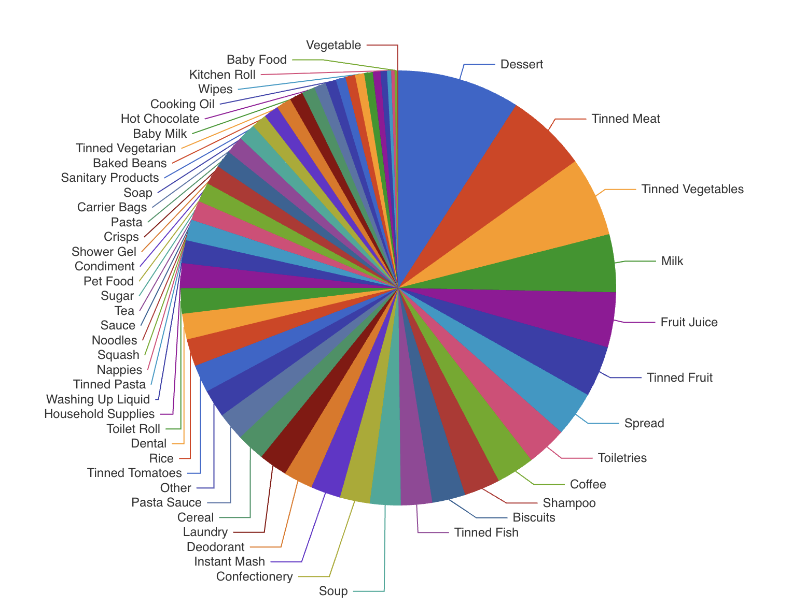
Notes:
So then having all this data structured allows us to produce unique visualisations of what is needed across food banks nationally and, as we’ll get to in a minute new features for users.
Now we use AI for two things - data analysis…. and code.

Slide 11
Notes:
Speaking of building stuff.
This graph shows the number of code changes by Give Food per month for the past year. Code changes aren’t a perfect measure of productivity, some can be big some can be small - but they’ll do as a measurement here.
You can see when we started using AI agents to help code - 17th October.
Rapid prototyping
Better product deeper
No backlog
Momentum

Slide 12

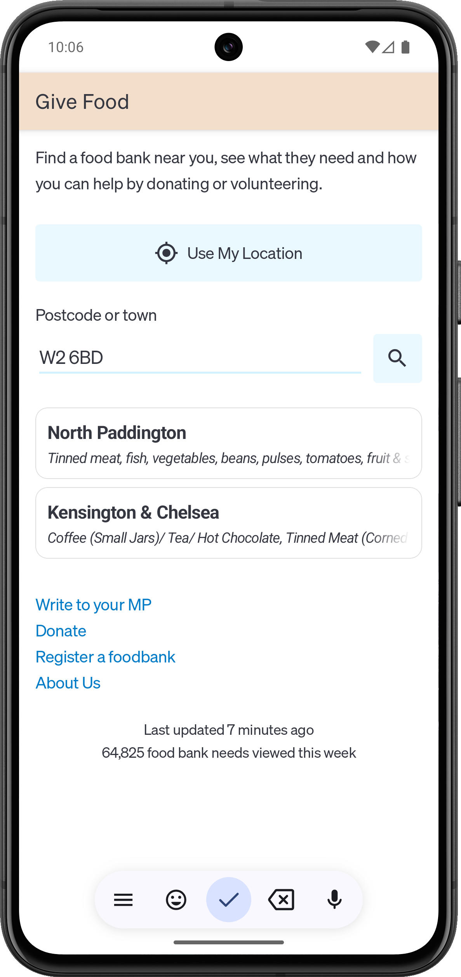
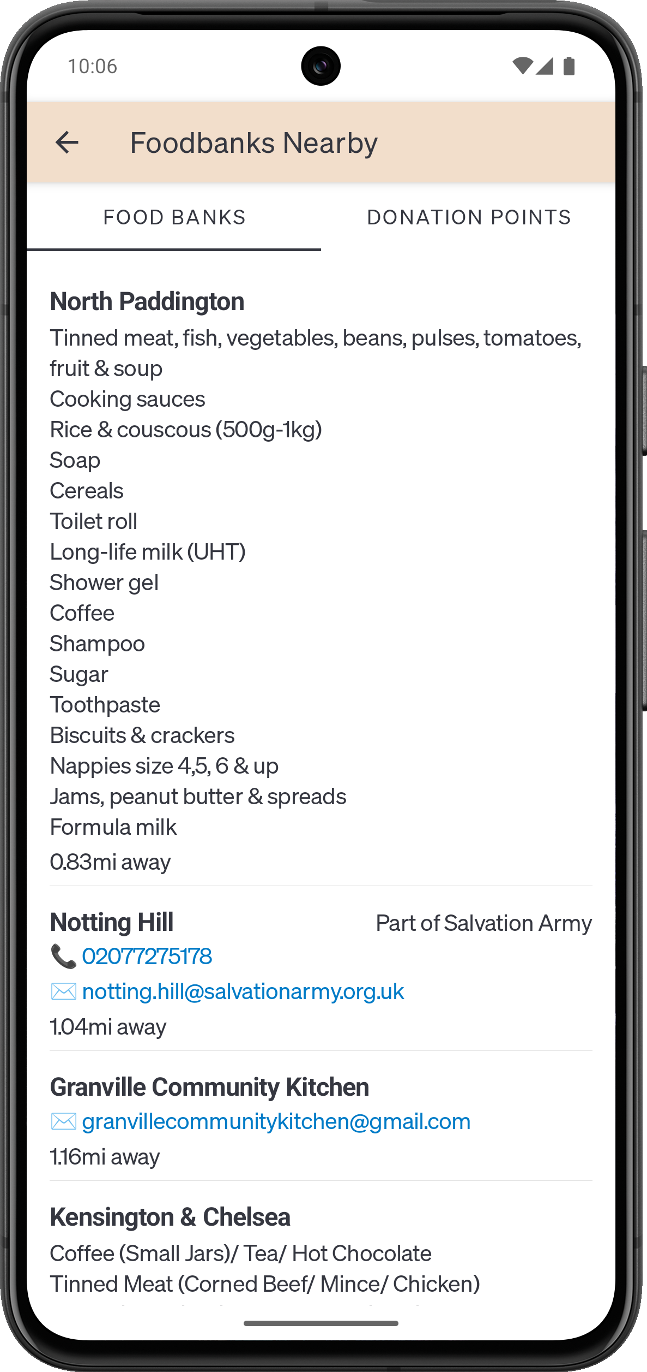
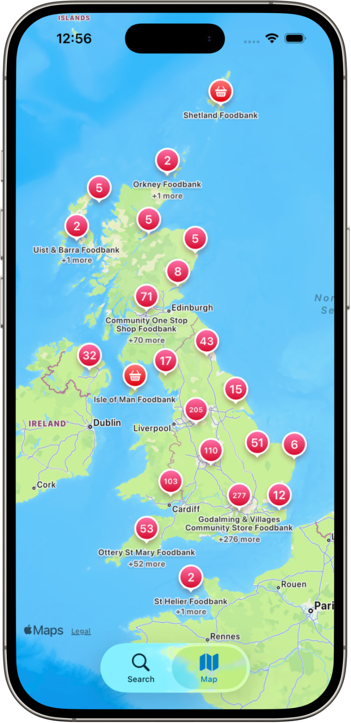
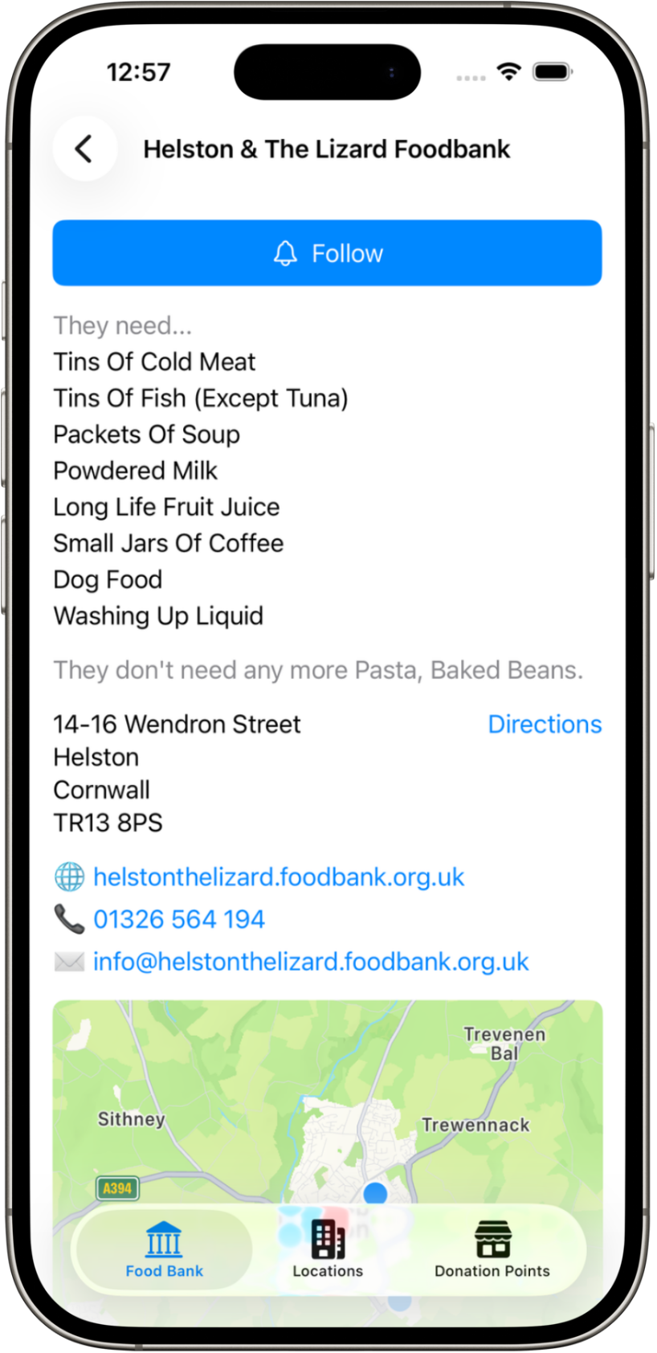
Notes:
One of the first things we used AI agents writing coding for was to build native Android and iOS apps. Whilst I’m a coder, I’ve actually never built an mobile phone app end-to-end by myself before, and I’m certainly no expert in the languages used. These apps were about 90% was built in an afternoon for under $20.
Apple’s app review process to put the app in their app store took longer than the build. Although iOS is a great platform for AI agents to write code for because it’s so tight and controlled.

Slide 13
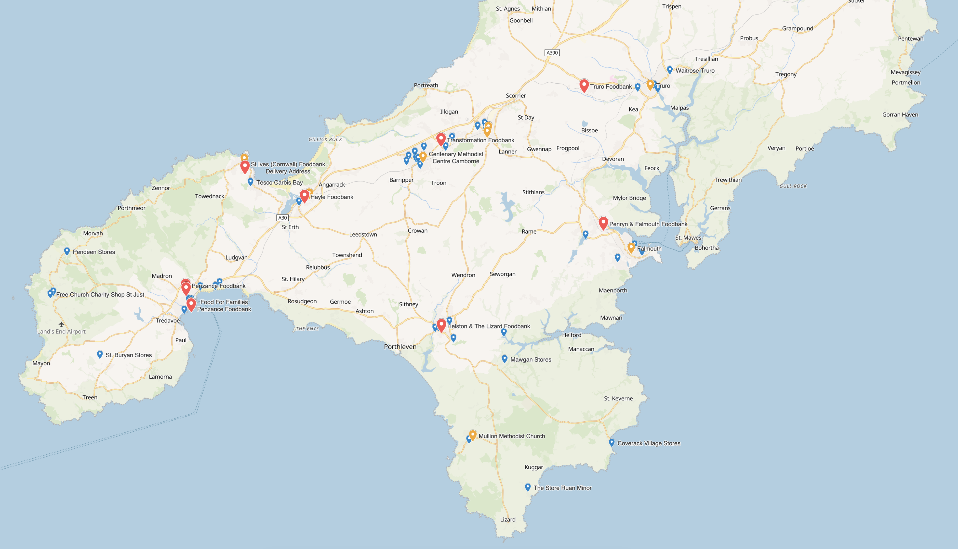
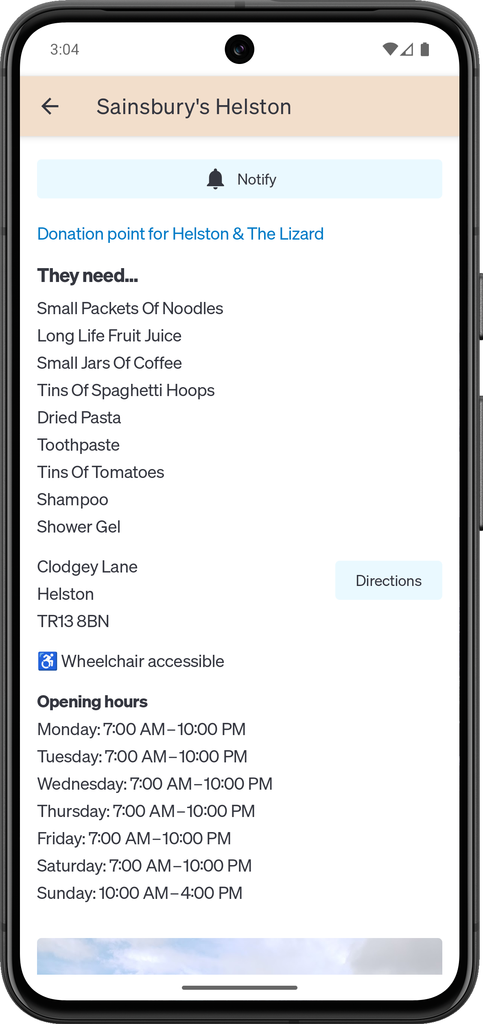
Notes:
One of the interesting features of the mobile apps is the ability to get notified when you are near a donation point. The underlying iOS and Android operating system can notify our app, and in turn notify the user, when the phone is in a predefined place and if it’s loitering. This is really powerful when used correctly.
Here we can tell the user when they are at a donation point (usually a supermarket) what the food bank that accepts donations there does and doesn’t need.
But we couldn’t figure out if you should follow a food bank, and get notified whenever you’re near a donation point for that. Or follow an area. Or follow a specific donation point.
There were pros and cons of all the approaches - but now writing code is almost free, we built four different versions and tested them.

Slide 14
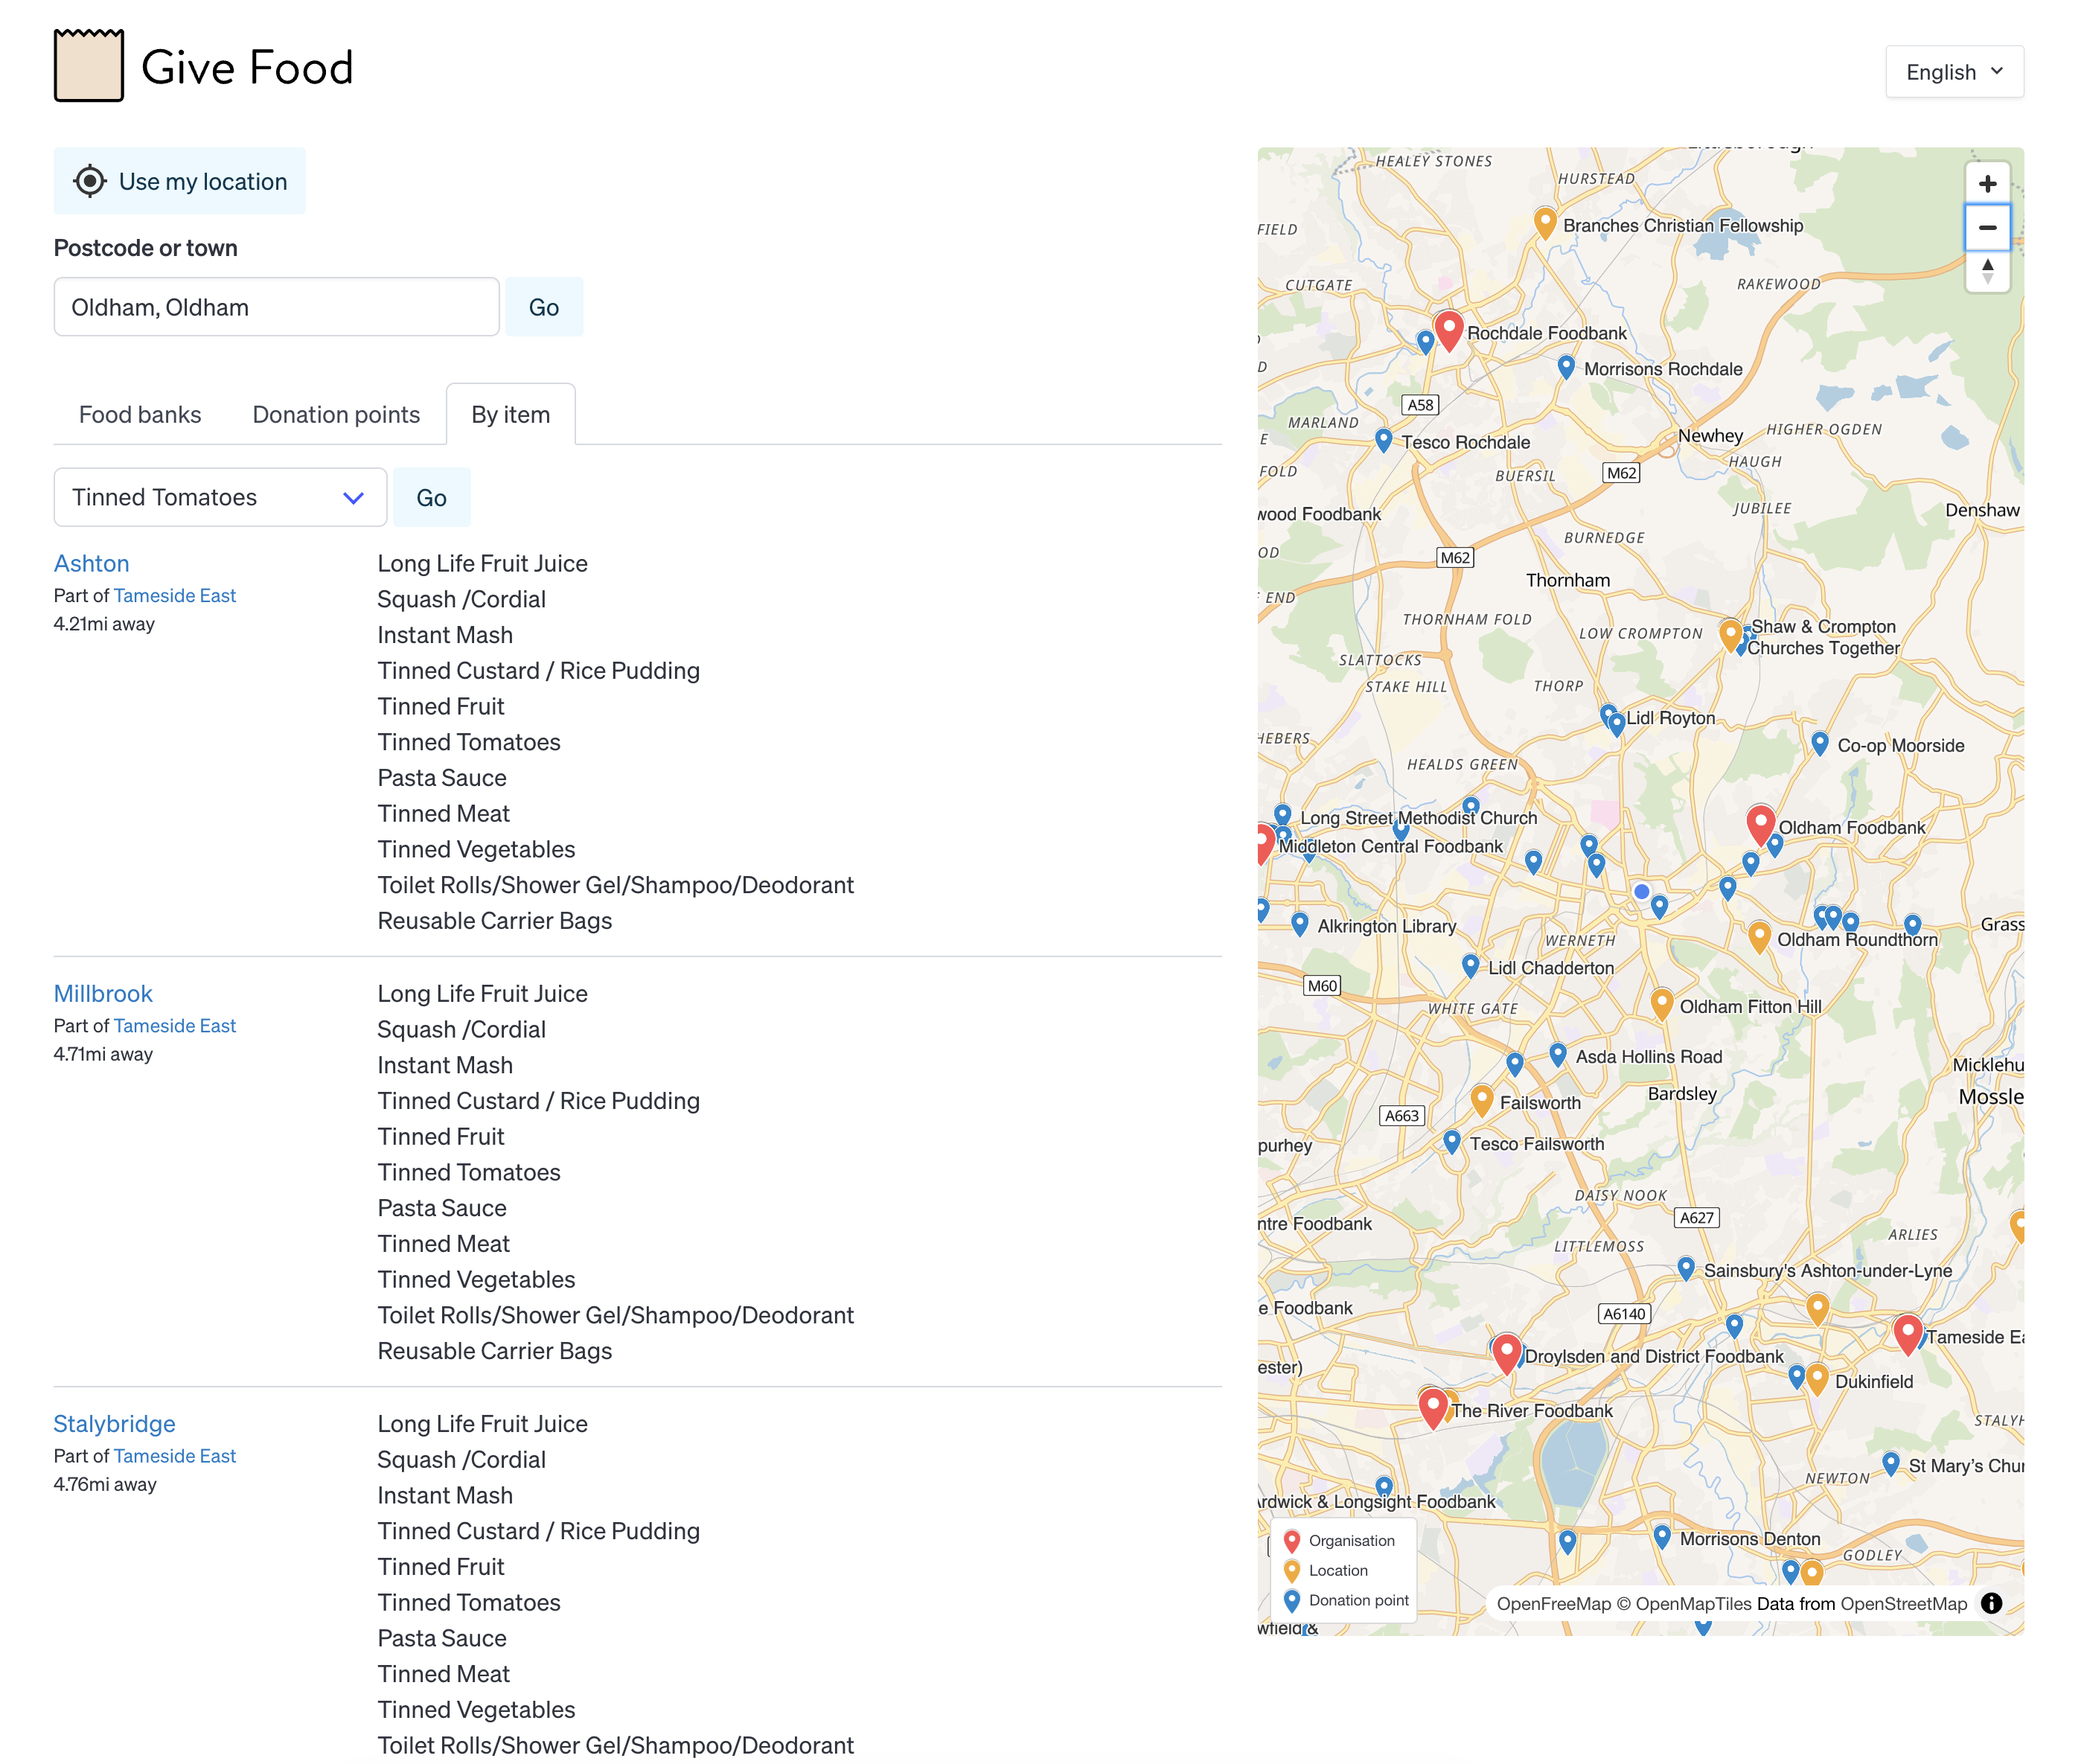
Notes:
This is by far the most requested feature for our website and data. Wouldn’t it be cool if! You are in a location and you want to donate a particular item. For instance you manufacture tinned tomatoes and you’re in Oldham.
People have been asking us to build this for over half a decade, the ticket to do it had been sat there for for five and half years. There was always something more important to build, we never quite figured out the interface, we were never sure it would be quick enough to query the data.
So, we set AI on it. 19mins 43sec. Cost 36c

Slide 15

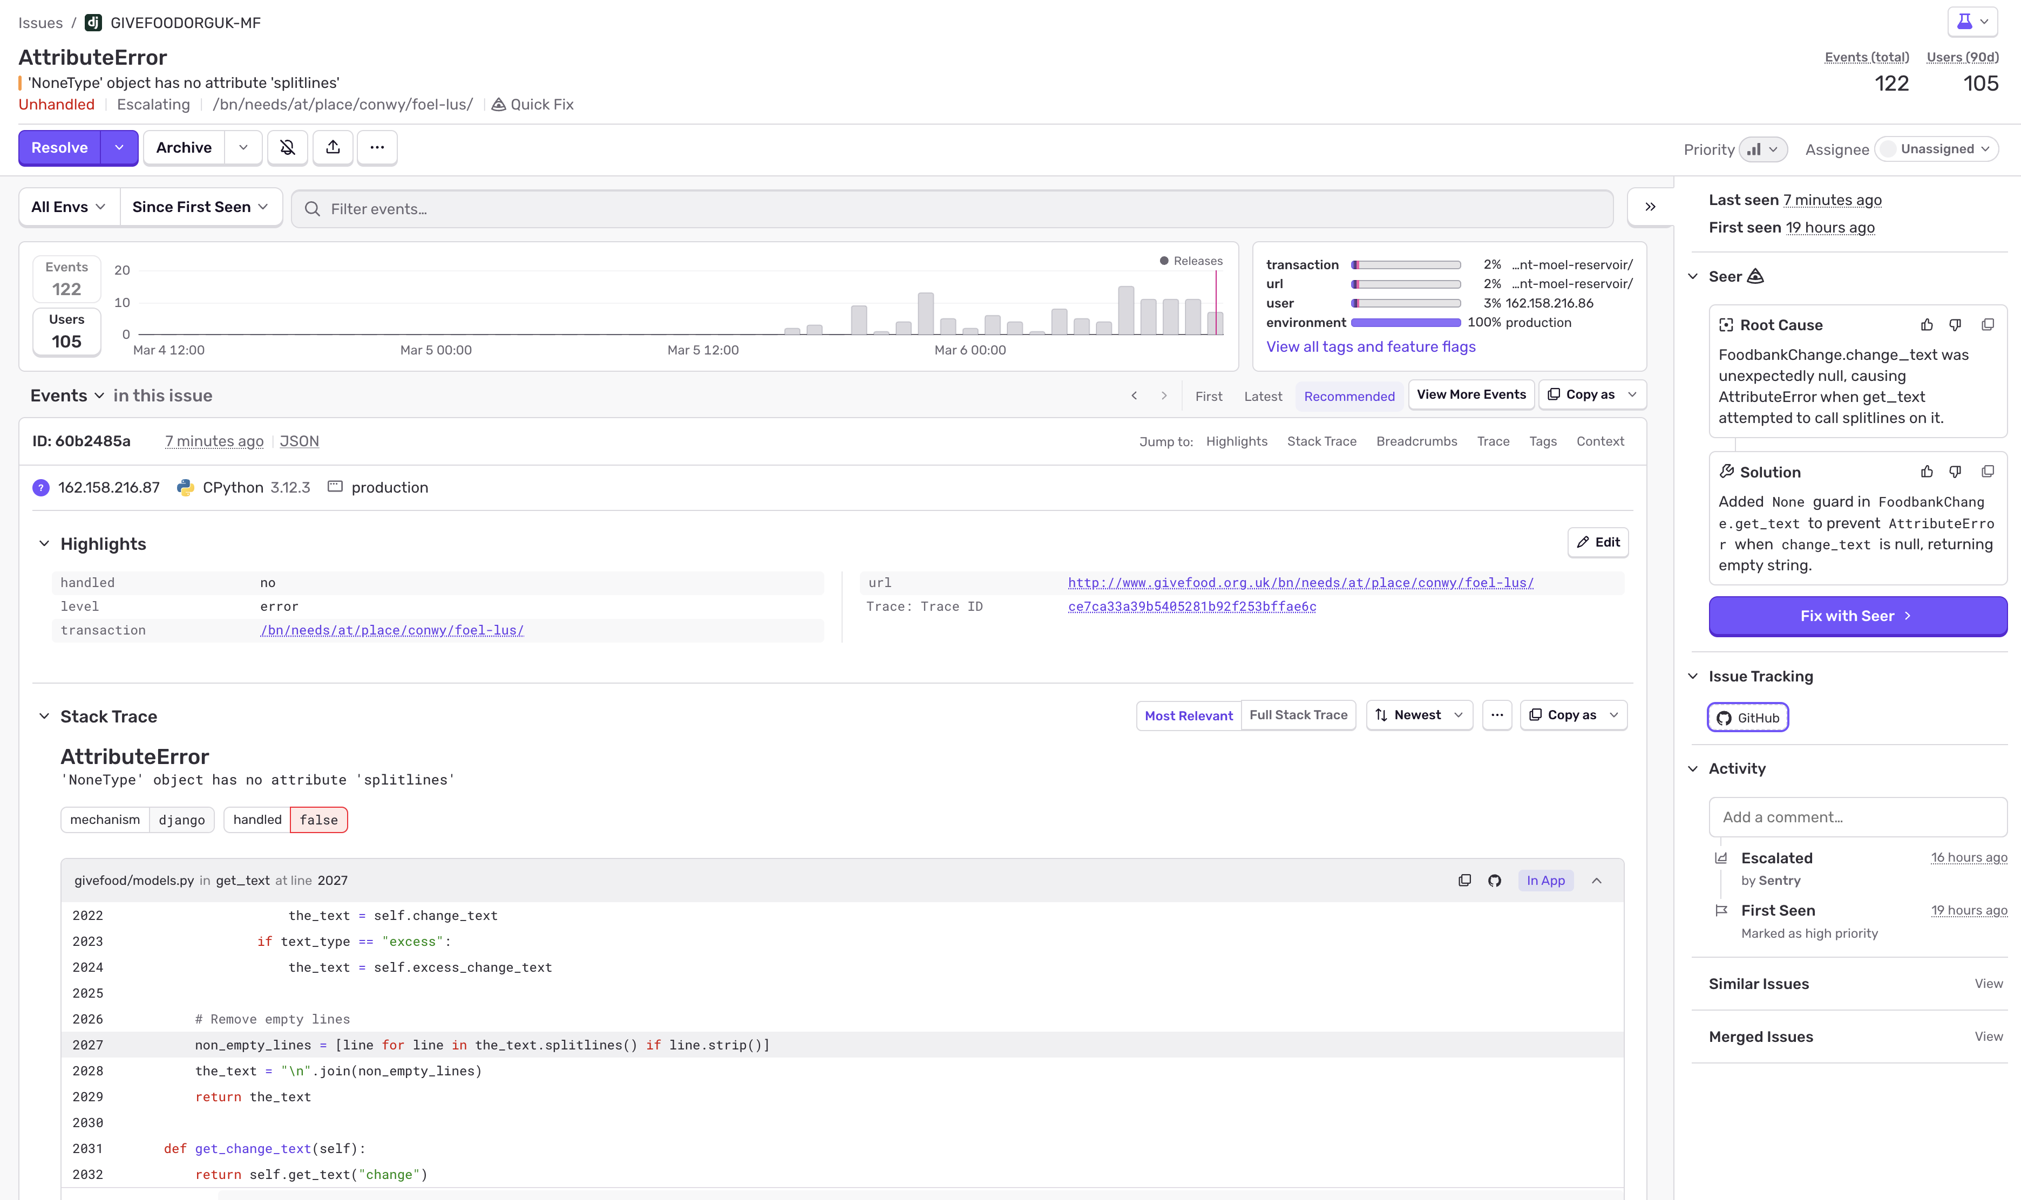
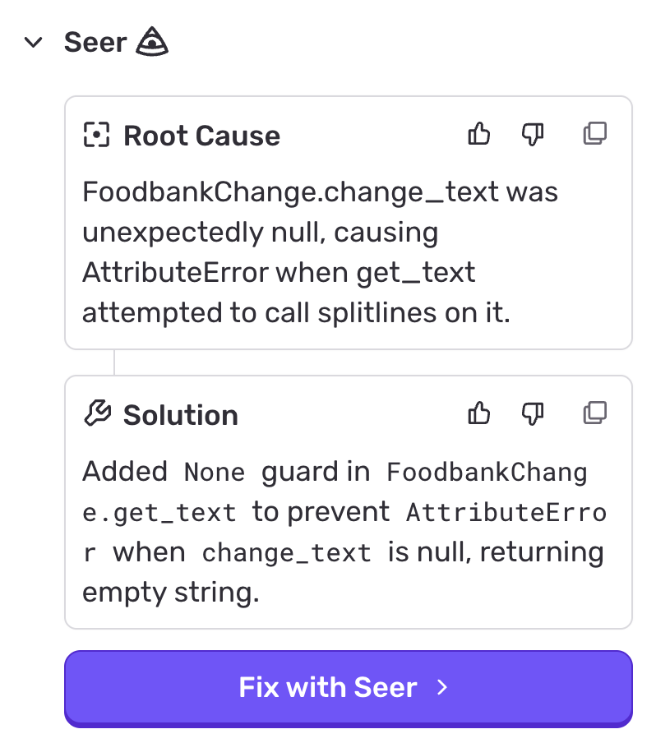
Notes:
Here is an example of AI on our website operation. You don’t need to know the technical details of what’s happened here to cause this error message - it’s a nasty annoying little unexpected error deep in the website. Basically, I screwed up. Unfortunately 105 different users got a 500 Internal Server Error page.
This is Sentry which sits inside our code reporting errors. It’s very cool, and free for non-profits. But the interesting thing that’s happening here is it’s solving the problem - it’s produced, using AI, a human-readable root cause of the problem and more importantly a solution - again human readable.

Slide 16

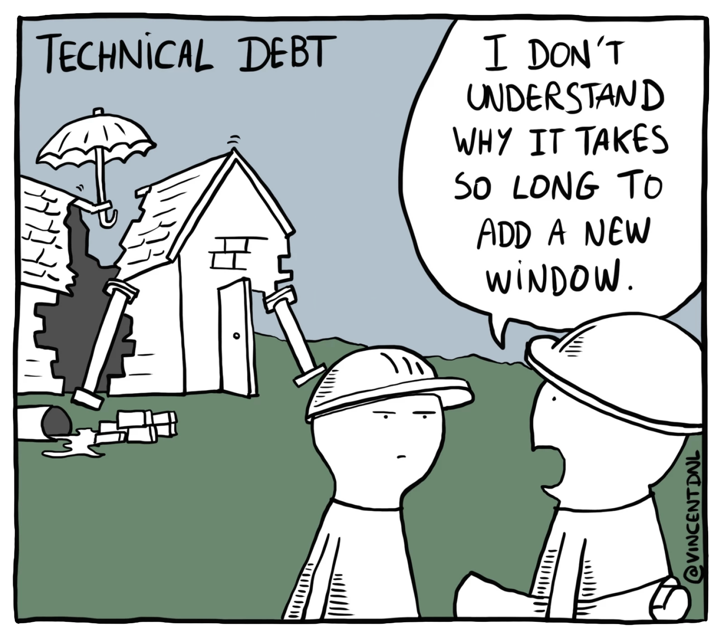
https://vincentdnl.com/drawings/
Notes:
Probably the biggest effect AI has had is overcoming inertia. Like any substantial codebase we used to have a backlog of tickets that nobody got around to, a load of work that was like a millstone tied to our leg holding us back. Use of old libraries, rushed features, unimplemented ideas
That was code. Now lets talk about AI on our daily data.

Slide 17
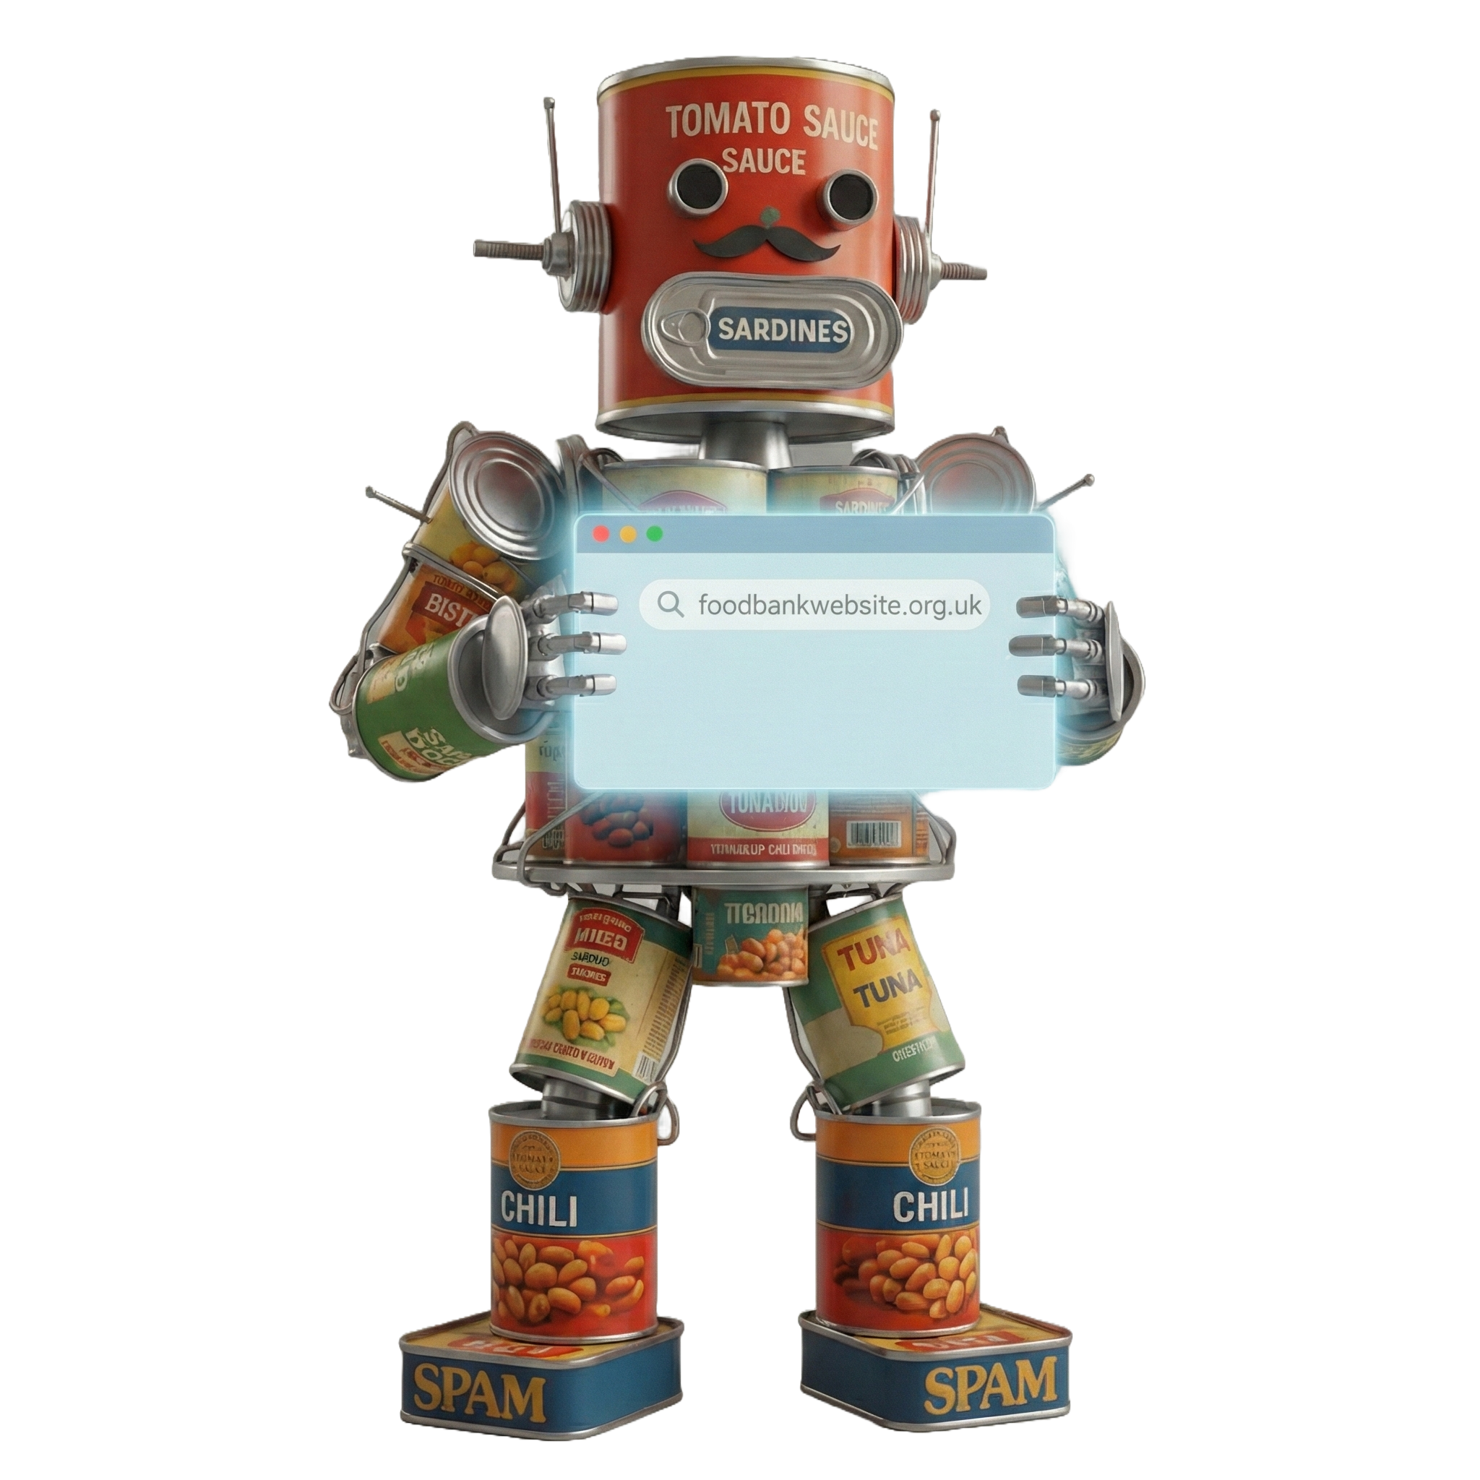
R2-DStew
Rejected names…
Optimius Pantry
The Tea-minator
Anthony MotherBourdain
Jonny-Fibre
C3-Pea0
Gordon RAMsey
Beander
Robo-crop
WALL·Eat
Mozilla/5.0 (compatible; GiveFoodBot/1.0; +https://www.givefood.org.uk/bot/)
Notes:
This is our bot, we call him R2-DStew, but that’s his full name in the white at the bottom. The cool kids call this software an agent now, and our bot is a very simple AI agent that performs tasks on our behalf.
R2 here reads about 4-5 million words a day on our behalf.

Slide 18
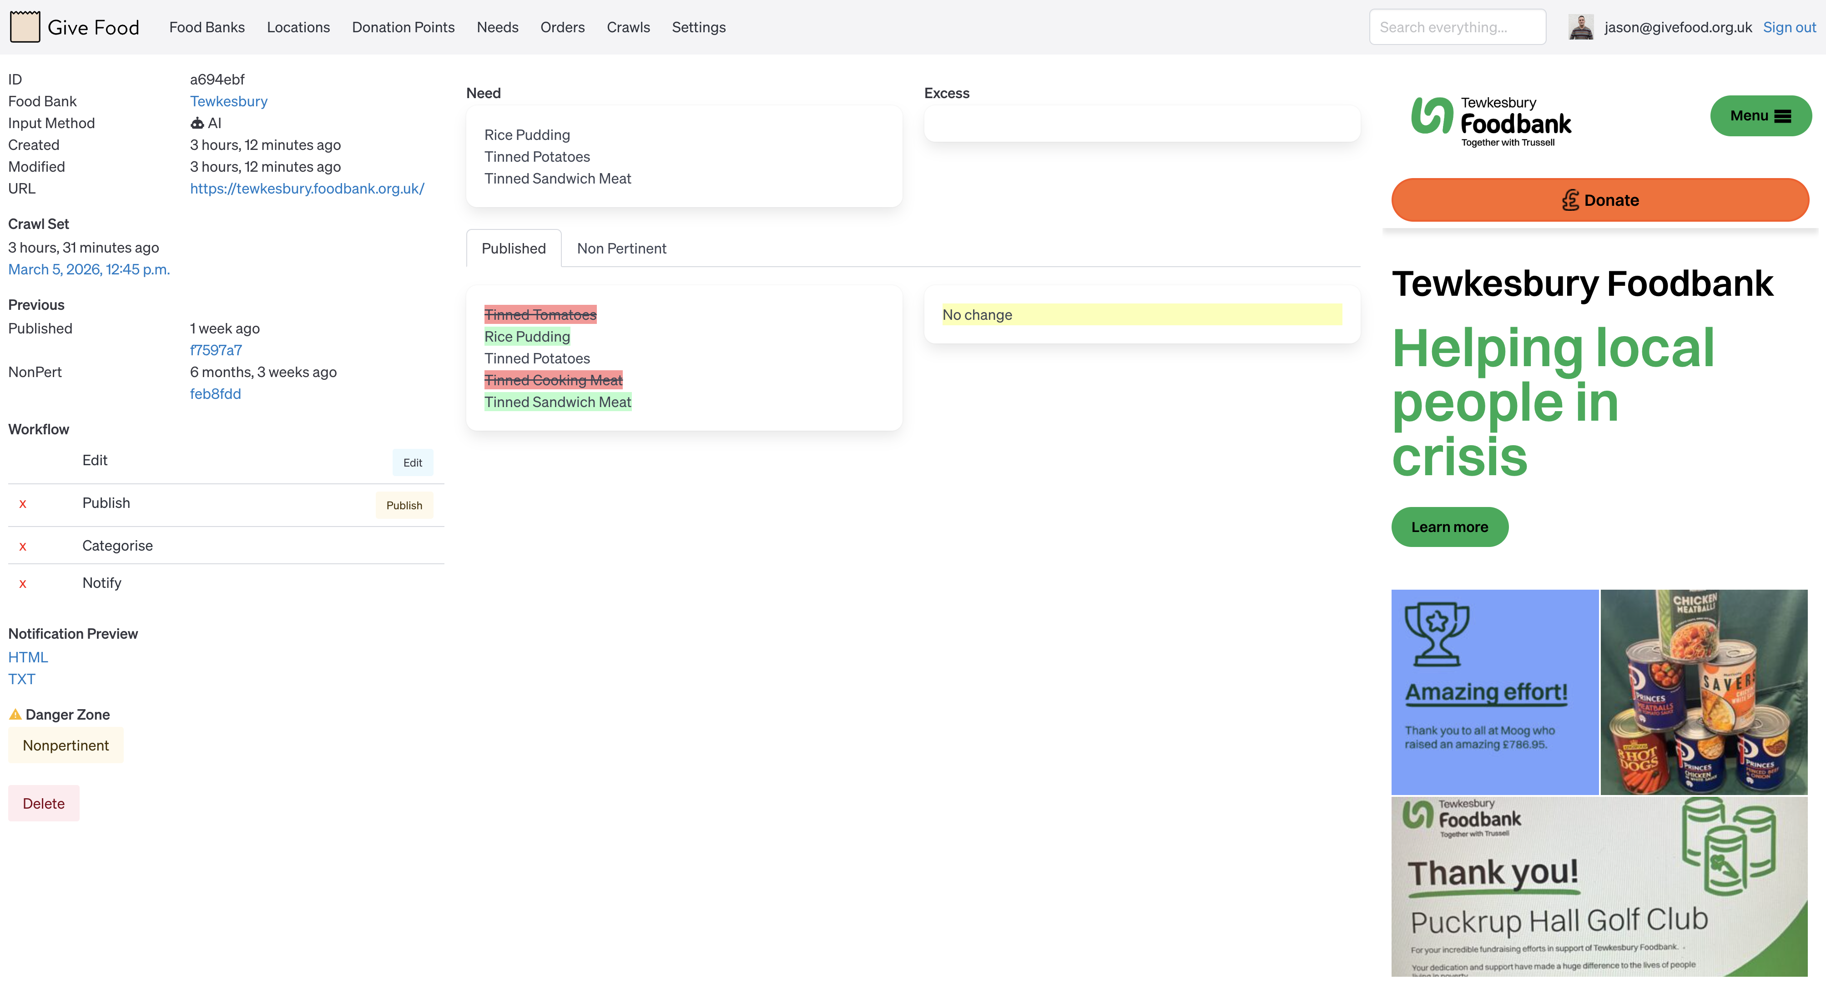
Notes:
This is our man R2 finding a food bank requesting new items and asking a human to validate it. All day every day he goes through every foodbank’s website understanding the text and working out what they would like to have donated. Before AI we used a mixture of dumb web scraping and humans which was error prone.

Slide 19
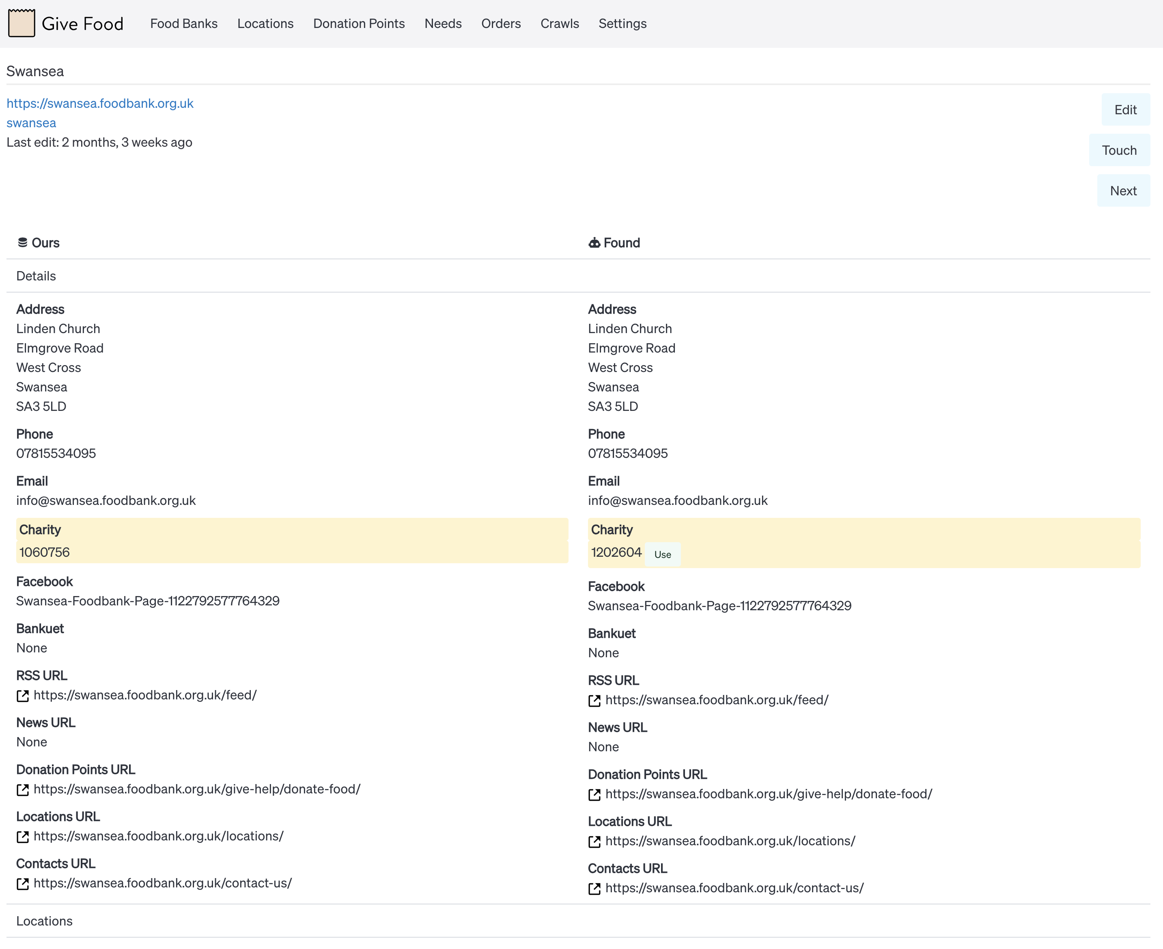
Notes:
Here is another example of R2 at work. Here he crawls the food bank’s website, Facebook page and whatever other sources of information we have, pulling out more web links to find information, plus details, locations, donation points, charity information etc
You can see in this example, Swansea food bank that he’s found that the charity number we have is out of date.

Slide 20

$$$
Notes:
Cost!
We’ve had to try and manage the costs of using AI - it’s really very easy for this to get out of hand. Whilst models have been getting massively more capable and cheaper for the same workloads we keep finding new things for them to do.
For coding we use Github Copilot (from some company called Microsoft!) for a set £400/year. This is more than enough for building and maintaining our work.

Slide 21



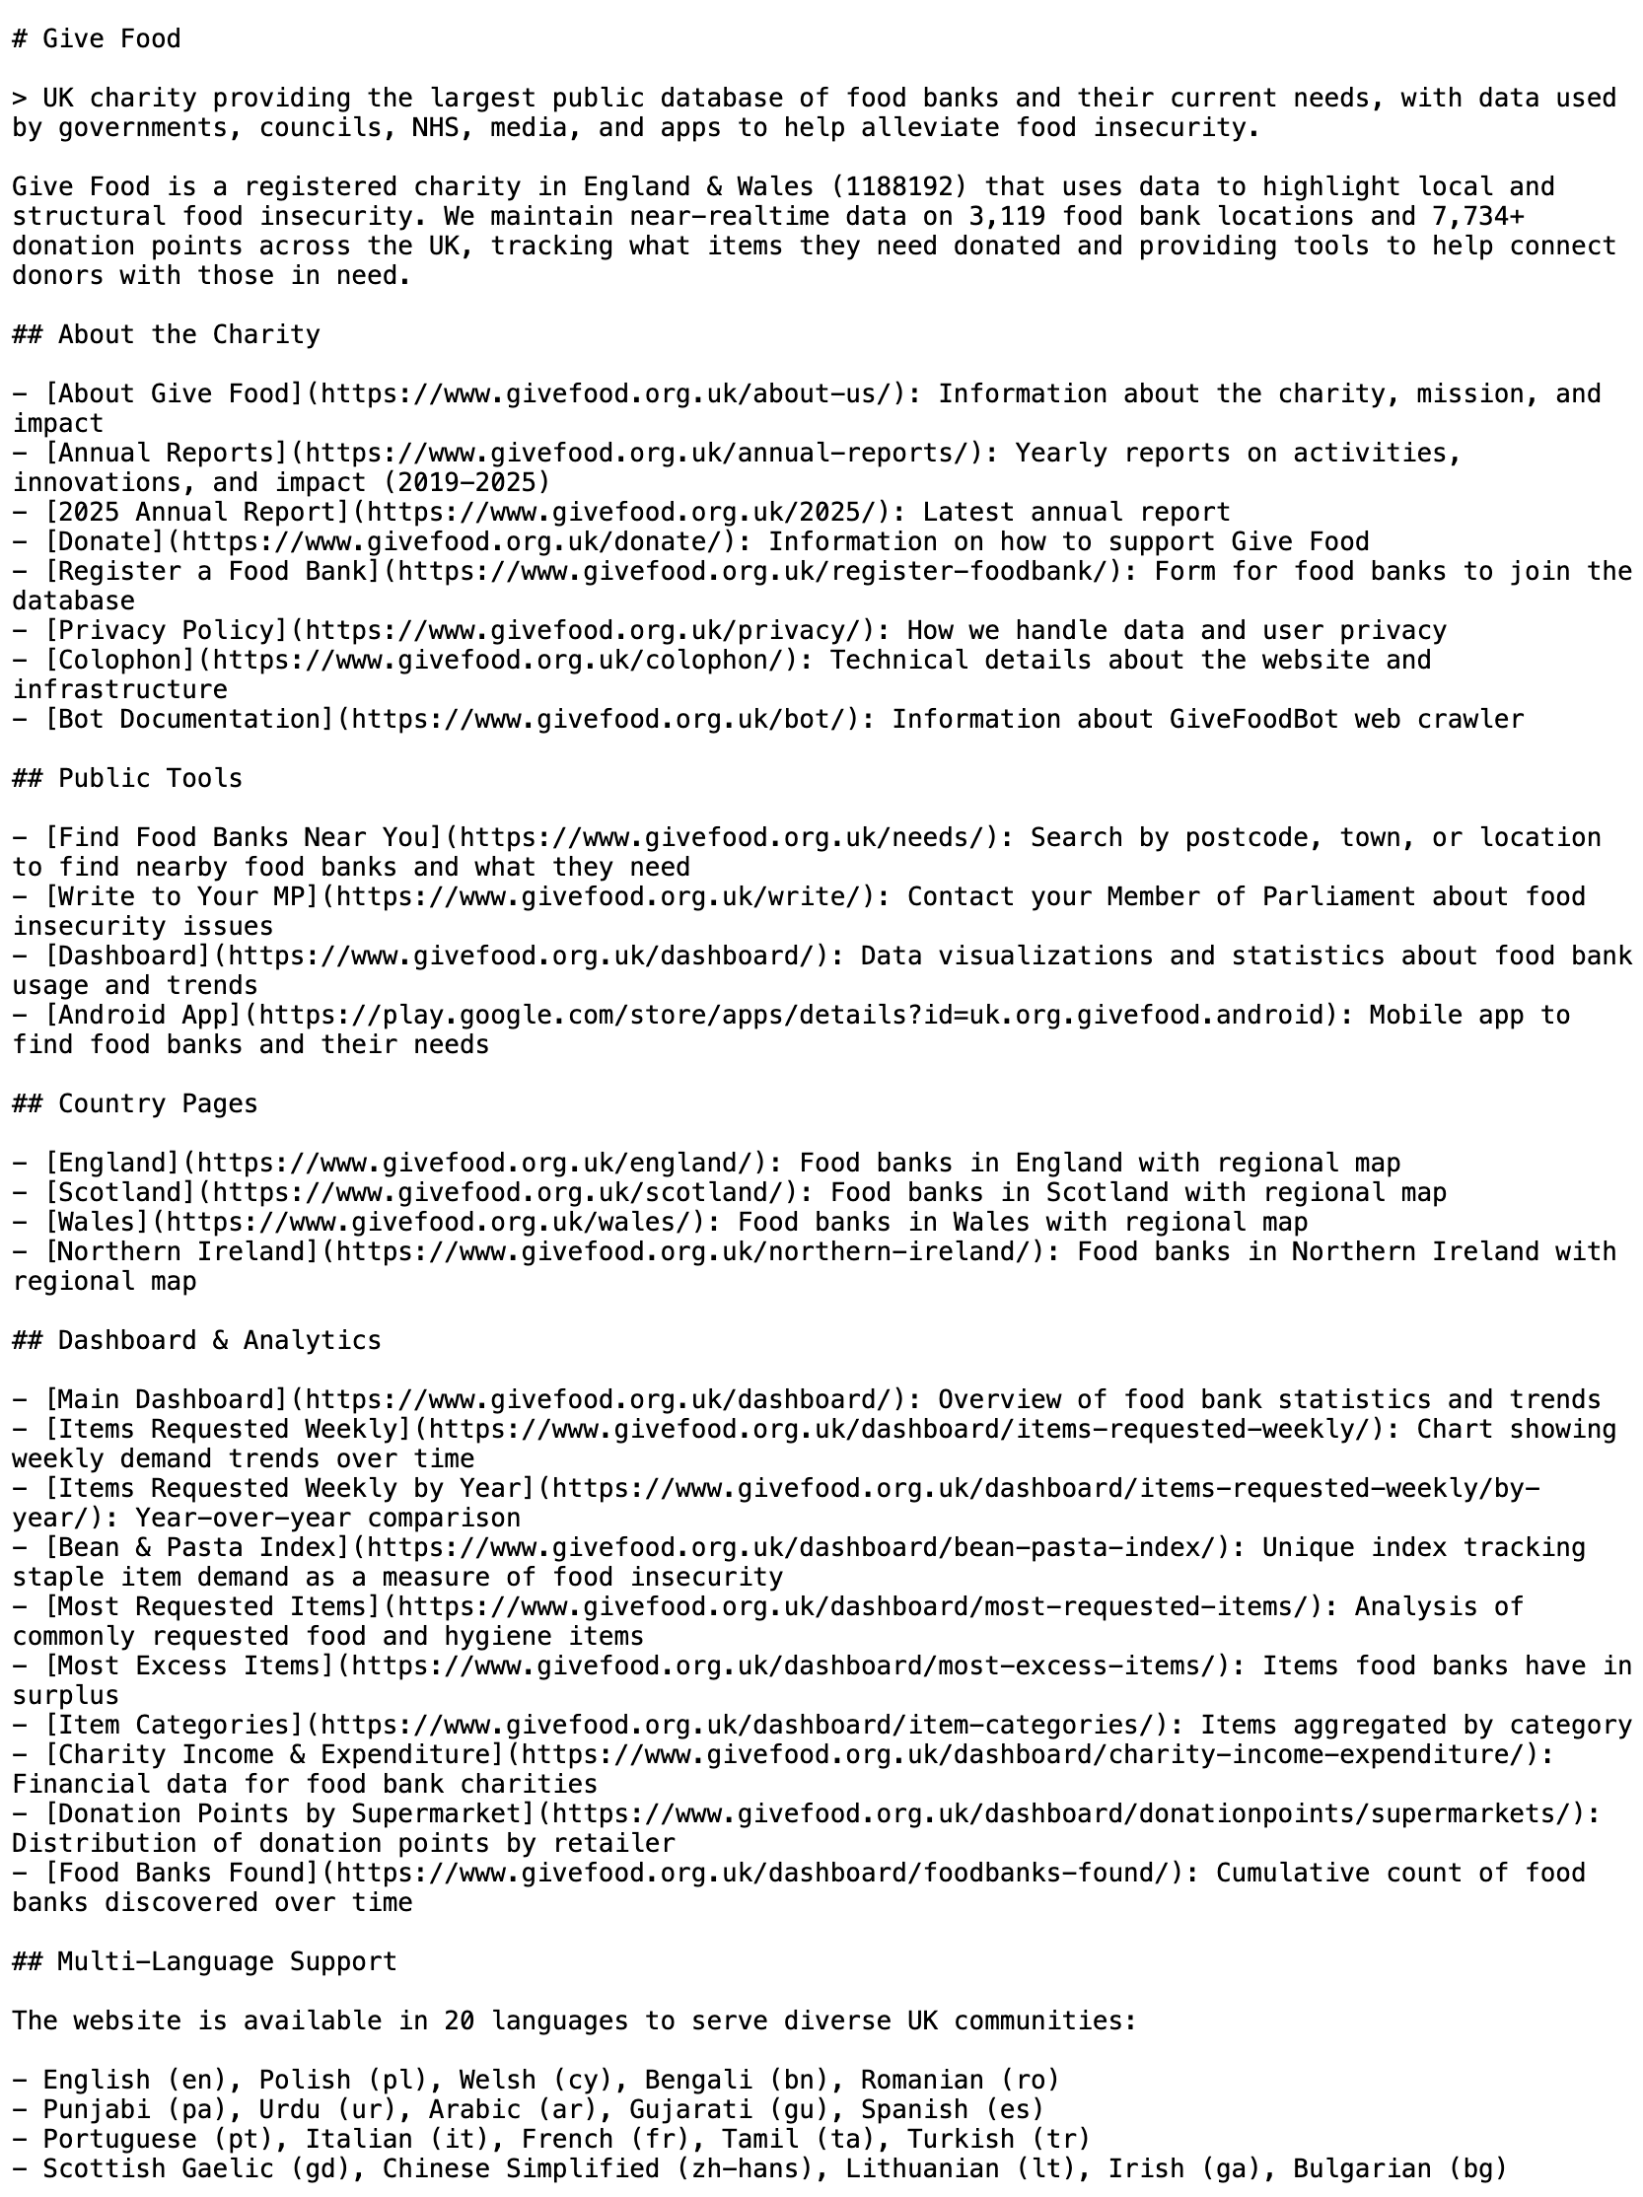
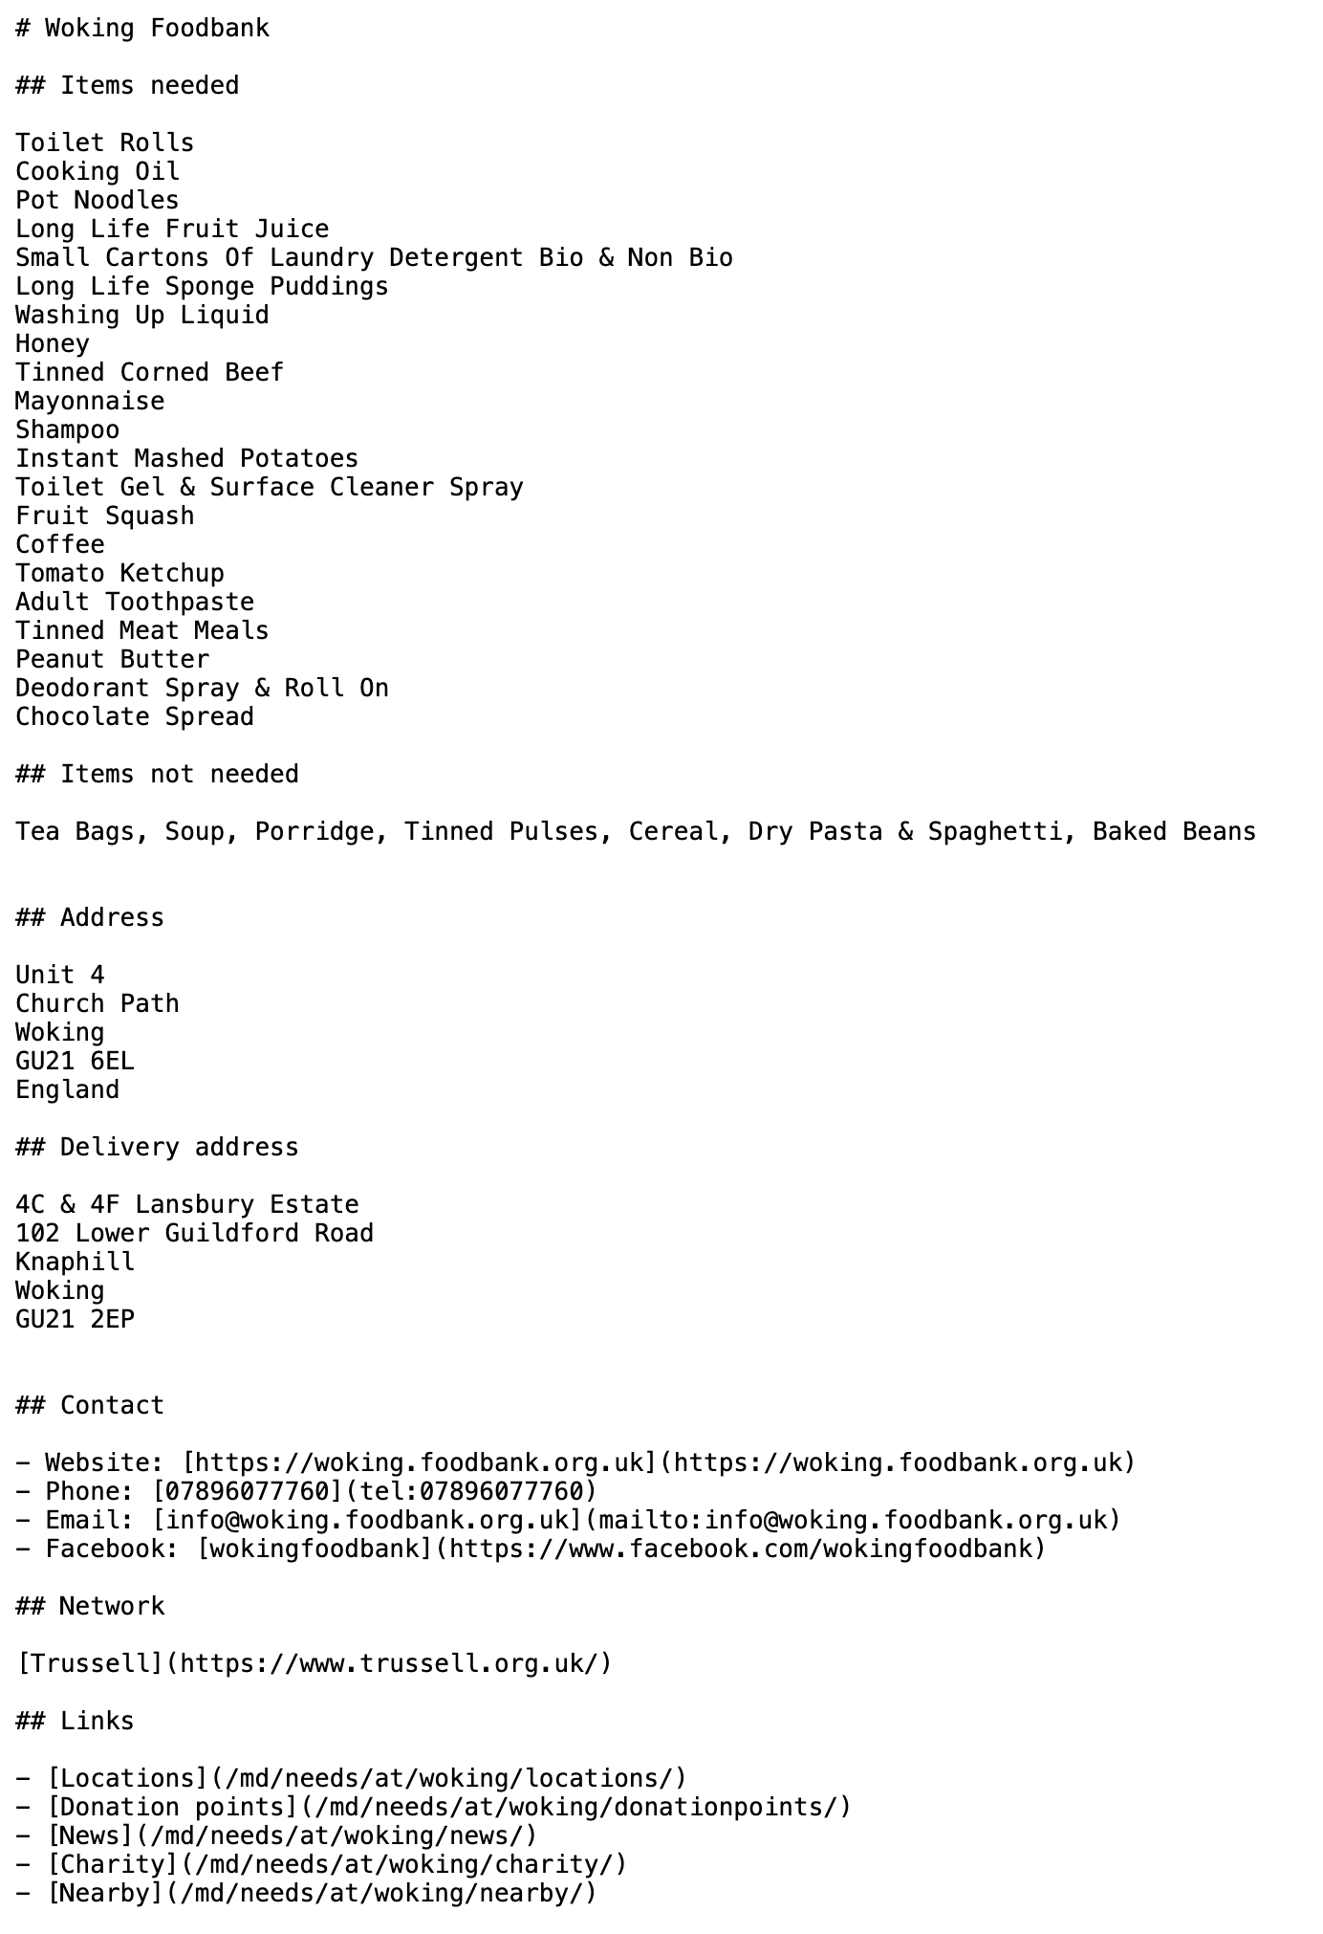
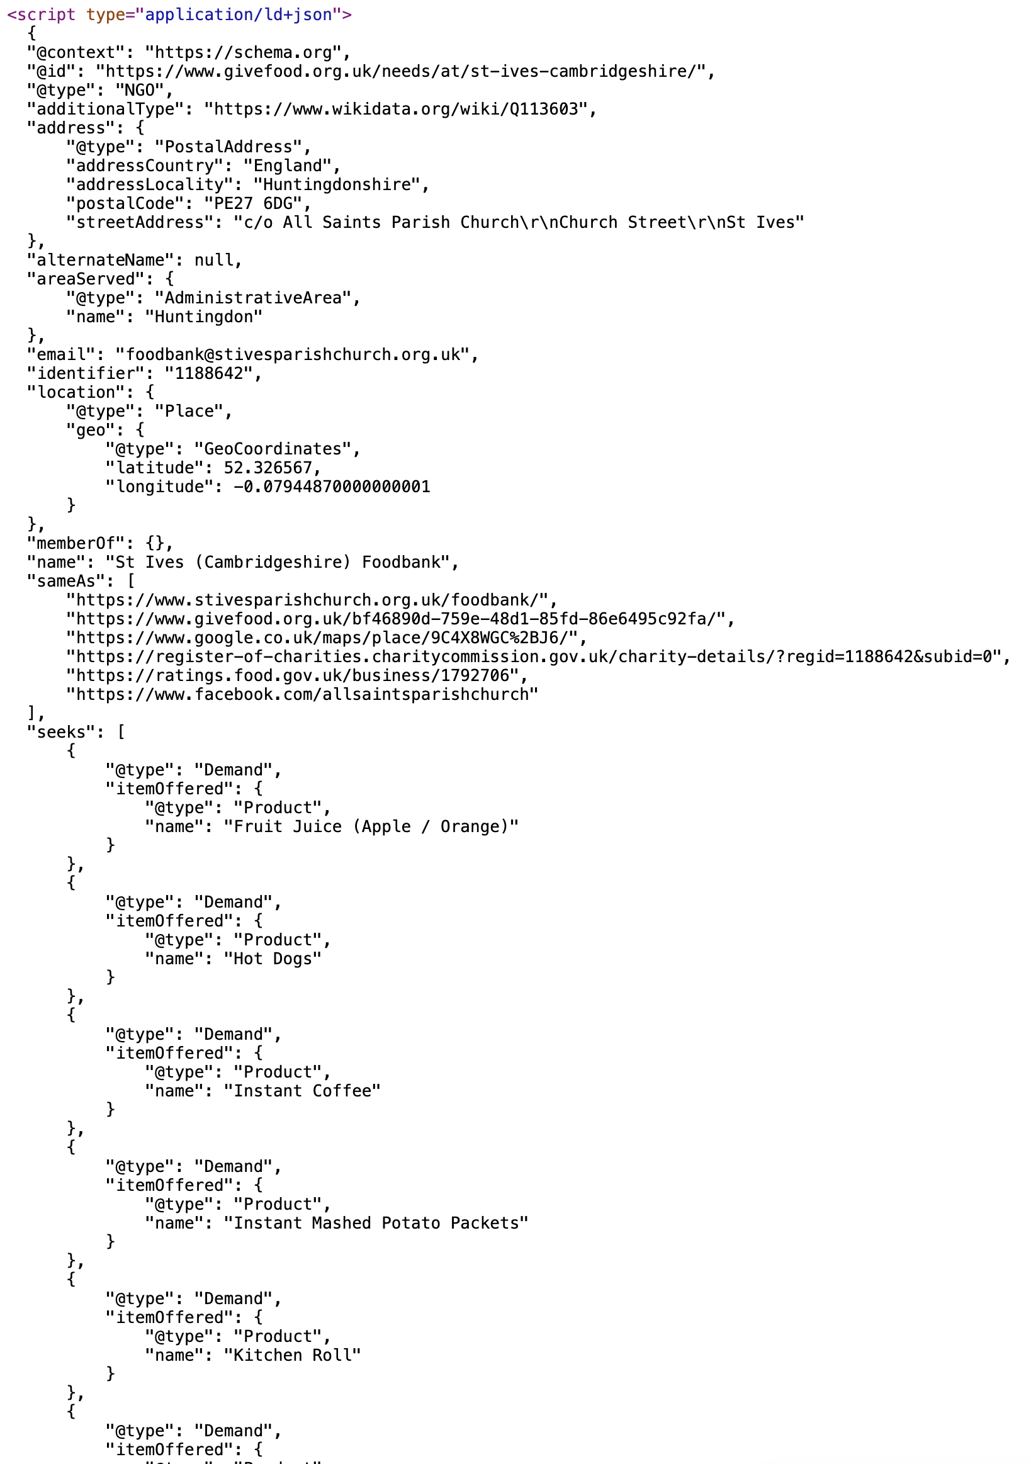
Notes:
All the of the talk previously has been about our internal use of AI, but we’ve also focussed on feeding AI our data. Increasing people are turning to AI to get answers to their questions, and people who can help and get helped by food banks are no different.
The aim here to give AI crawlers detailed structure of our data without any of the bits that us humans need.
We do this with markdown, the lingua franca of AI and is very lightweight. LLMs.txt gives LLMs a basic overview of the website, plus we produce markdown versions of all the content - and also the more traditional, structured and excellent schema.org that’s embedded in the HTML pages.

Slide 22
Rules
Model agnostic
No AI customer service
Never trust the AI 100%
Notes:
We have some basic rules for our use of AI. Never tied to a model - the whole AI industry is changing so quickly we’ve found it important to not get tied down to an individual provider of model. Pricing and new models coming out all the time, like almost every day.

Slide 23
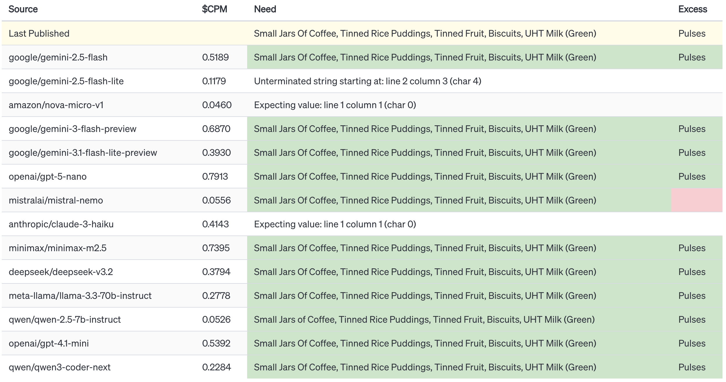
Notes:
So to test these new models we run a select part of our workload over multiple models at the same time. In the columns here you have the model name, cost of running the model 1000 times in US dollars, and the results it produced. The example workload we’re giving to each model is working out what a food bank needs to have donated and has in excess.
When a new model turns up we put it in here and test it with real-world data evaluating it’s price/performance plus taking into account the privacy/ethics of the company.

Slide 24
Rules
Model agnostic
No AI customer service
Never trust the AI 100%
Notes:
Never use AI for comms - our email address is all over food bank information and we get lots of emails from people looking to help food banks and from food banks themselves. Every email gets a human reply. It’s too important to use AI for. AI currently works
Always a human in the loop

Slide 25

PROBLEMS
Notes:
Data migration
We had a task to cleanup some data and adjust how that data is stored in the database. I set the AI off and it wrote some code that included as a small part of it a irreversible data migration. In retrospect I should have realised this. I didn’t review the code correctly and just trusted it and ran it. We had the longest downtime we’ve ever had resurrecting the entire services from backups - the whole service was down for 50 minutes, and I had a very stressful Friday morning.
Interfaces
AI produces really weird data. Like, the data is good. It’s great, and cheaply produced too. But AI is a deterministic black box, perhaps the data is good. Who knows how good it is? This demands a different type of interface, which we’ve struggled to produce.

Slide 26
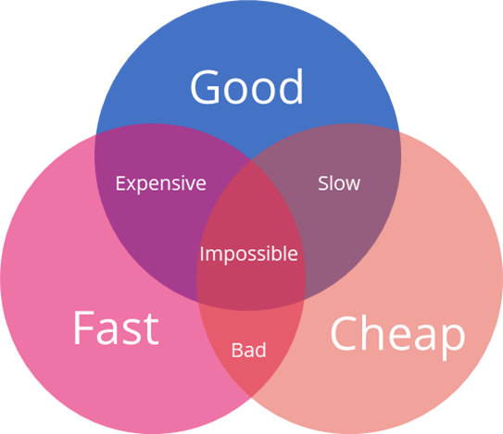
Notes:
So in software there is the idea that of Good, Cheap and Fast you can only pick two and that all three are impossible. AI changes this

Slide 27
👍
Notes:
Thank you very much! Any questions?

