Slide 1


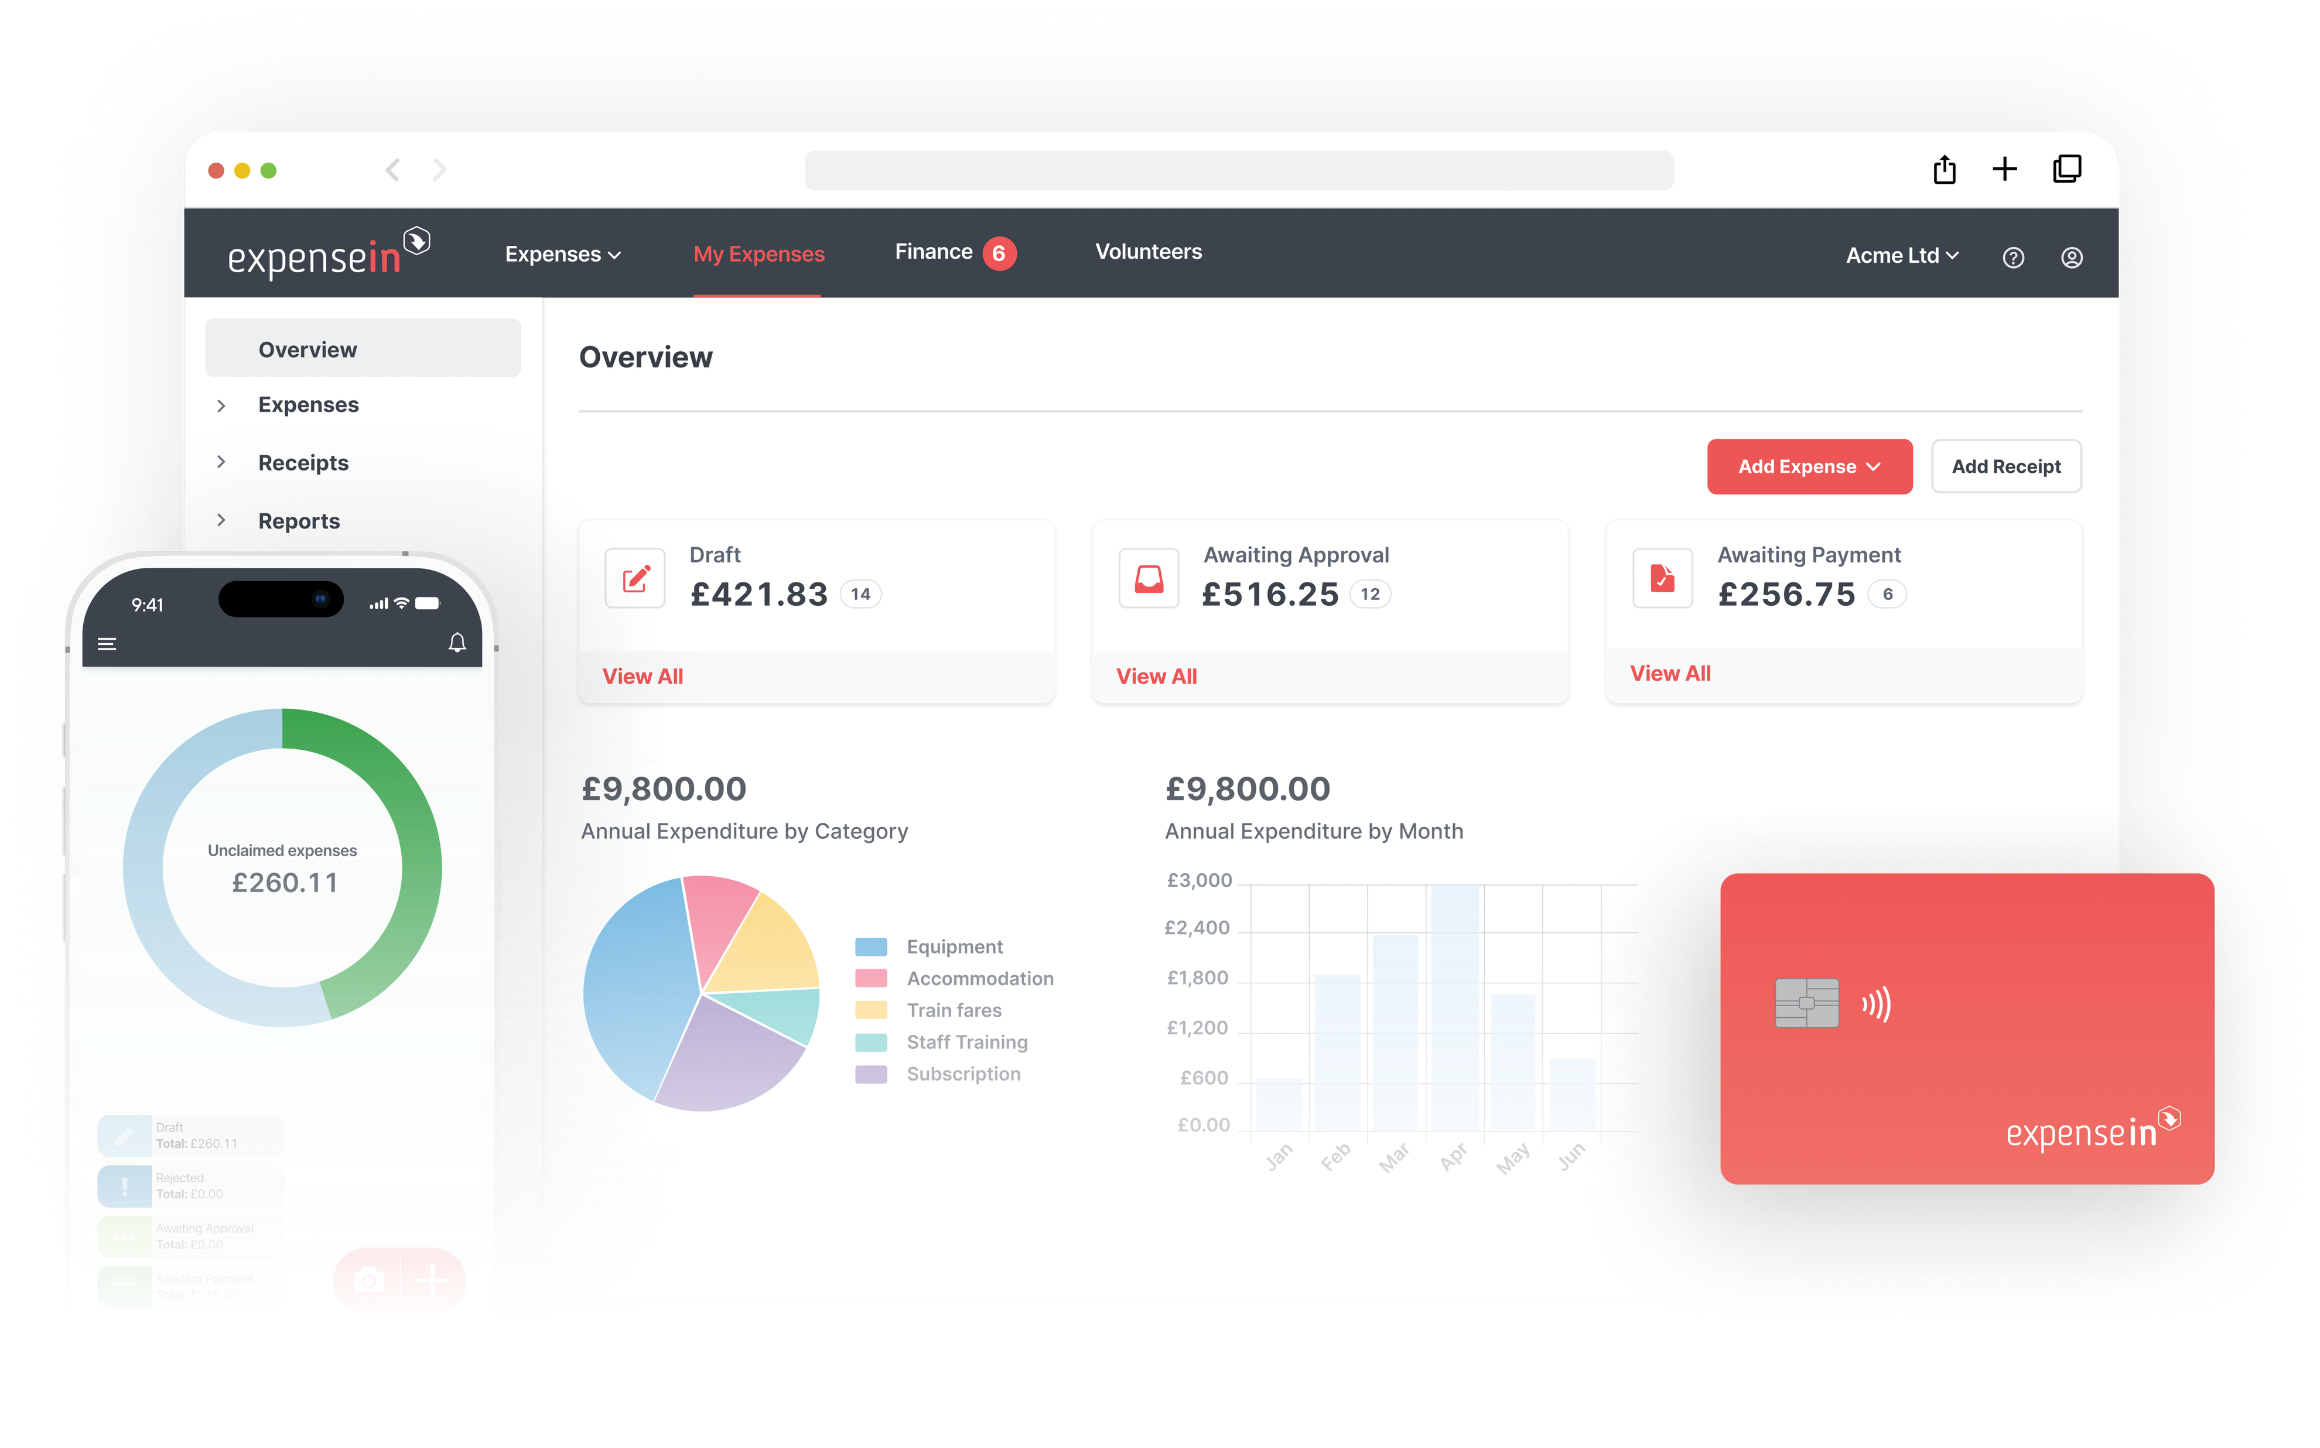
Digital Confidence for Trustees:
How to Strengthen Financial Oversight in Charities
Notes:
Trustees are expected to govern confidently in a digital environment.
One area where that confidence is often tested is finance — particularly visibility, control and oversight.
This is a look at where digital confidence breaks down in charity finance, and what ‘good’ can look like in practice with a product demo.

Slide 2


Meet Jahana
Here's a little bit about me...
I work closely with existing customers day to day
to ensure ExpenseIn not only meets their expectations but also helps streamline business processes.
I spend a lot of time understanding where expense processes create pressure — for finance teams, trustees, and volunteers — and finding the best solutions that fits their workflow. My focus is to make sure our customers feel supported, confident and they're able to get real value from ExpenseIn.
Customer Success
Team Manager

Slide 3


Agenda
Why Trustees Are Under Growing Pressure
The Real Challenges in the Charity Sector
Where Trustees Feel Less Confident Today
How Trustees Can Build More Confidence with Clarity
How to Rebuild Financial Confidence
Product Demo
Q&A

Slide 4







Why Trustees Are Under Growing Pressure
Real Time Data
Donors, regulators, and funders demand greater transparency.
Financial Planning
Trustees are expected to provide stronger financial oversight. ​
Security and Data Protection
Digital tools must meet security and compliance needs, not just operational ones.
Increased Expectation
Increased regulatory and audit expectations.
Disconnected Systems
Adopting too many digital tools can cause complexity. ​
Time VS Expectations
Governance expectations continue to rise but often lack time or resources. ​​
AI Adoption
Increasing pressure to approve or use systems with AI capabilities.
Notes:
Real Time Data
-Donors and funders increasingly expect charities to demonstrate how funds are being used.
-For trustees, this creates pressure because delayed data makes it harder to communicate and be fully transparent.
-Digital confidence comes from knowing the data exists and can be accessed when needed in real time.
Financial Planning
-Trustees are expected to look ahead, not just review what’s already happened.
-That requires confidence in budgets, forecasts, and spend controls. Delayed data can make it difficult to plan and cause reactive changes.
Increased Expectation
-Regulatory and audit expectations continue to rise across the sector.
-Charities are expected to evidence controls, policies, and processes.
Disconnected Systems
-Many charities have adopted digital tools incrementally over time.
-Disconnected systems mean more manual work, more reconciliation, and less confidence in the whole picture.
Time VS Expectations
-Increased expectations creates a tension between responsibility and capacity.
-One way to overcome this is to reduce complexity.

Slide 5
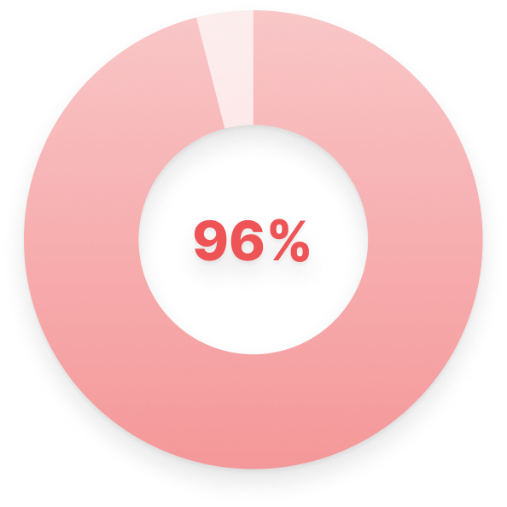
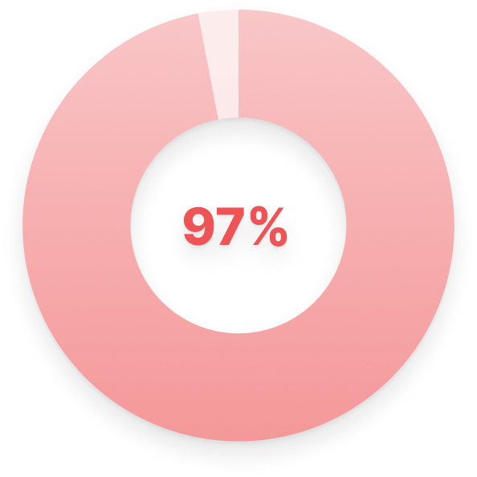


Implementing Digital Finance Tools –
What the Evidence Tells Us
96% of charities regret a finance software decision.
97% experienced hidden or unexpected costs.
Two Thirds (2/3) found implementation stressful for teams.
Over half use less than 50% of the tools.
Source: AIQ CFO Mindset Report, 2025
Notes:
Trustees face increasing pressure to lead with clarity, transparency, and confidence.

Slide 6
What Matters When Implementing Digital Tools
1.
Agree a clear purpose linked to strategy, governance and transparency
3.
Prepare data with programmes, projects, and funding in mind
5.
Configure the system to match how your charity actually works.
7.
Review early usage to ensure confidence and consistency
2.
Developing a clear implementation plan.
4.
Align policies and workflows that work for staff and volunteers
6.
Support staff and volunteers through training and clear guidance
Notes:
High level, not specific to expense management

Slide 7






How Trustees Can Build More Confidence with Digital Financial Tools
Real time data = better decisions.
Digital systems should reduce pressure, not add to it.
Consistent, understandable processes for everyone.
Replace manual processes = Time saving.
Ensure spend consistently mapped to projects, events, or programmes.
Aligning digital with strategy
Notes:
*Bridging financial tools here to expense management is important here. Please, look to link when speaking. Ideally something like, "For many charities, expense management is where this gap between finance systems and real-world spending becomes most visible.”
Trustees need consistent real time data to make better decisions
When information is delayed, decisions become reactive.
Having consistent, real-time visibility allows trustees to spot trends, apply the right controls and act earlier.
Digital systems should reduce pressure, not add to it.
When too many systems are introduced over time, complexity can increase.
Multiple systems, disconnected data and manual reconciliation all adds pressure.
Centralising can help remove this pressure.
Confidence comes from consistent, understandable processes, especially where spend touches charity staff members, volunteers, and programmes.
Confidence grows when processes are applied consistently.
If processes are hard to understand or vary too much, adoption drops.
Clear, simple processes create fairness, trust, and stronger governance.
Add the reducing risk by being dependant on one person.
Replace Manual Processes
Automation can help save time for everyone in the org.
Ensure Spend if Consistently Mapped
Clear tracking and mapping will lead to better efficiency and decision making.
Aligning digital stratergy
Do they scale as the charity grows or changes?

Slide 8


How to Rebuild Financial Confidence
Charity finance teams need expense management that is simple, affordable, and easy for staff and volunteers to use.
One simple approach for every type of charity spend
Making expenses work for all levels of tech confidence.
Spend mapped to projects, events, or programmes
Less reliance on petty cash and manual tracking
Reduces manual work without adding complexity

Slide 9
ExpenseIn for Charities
Live Demo

Slide 10
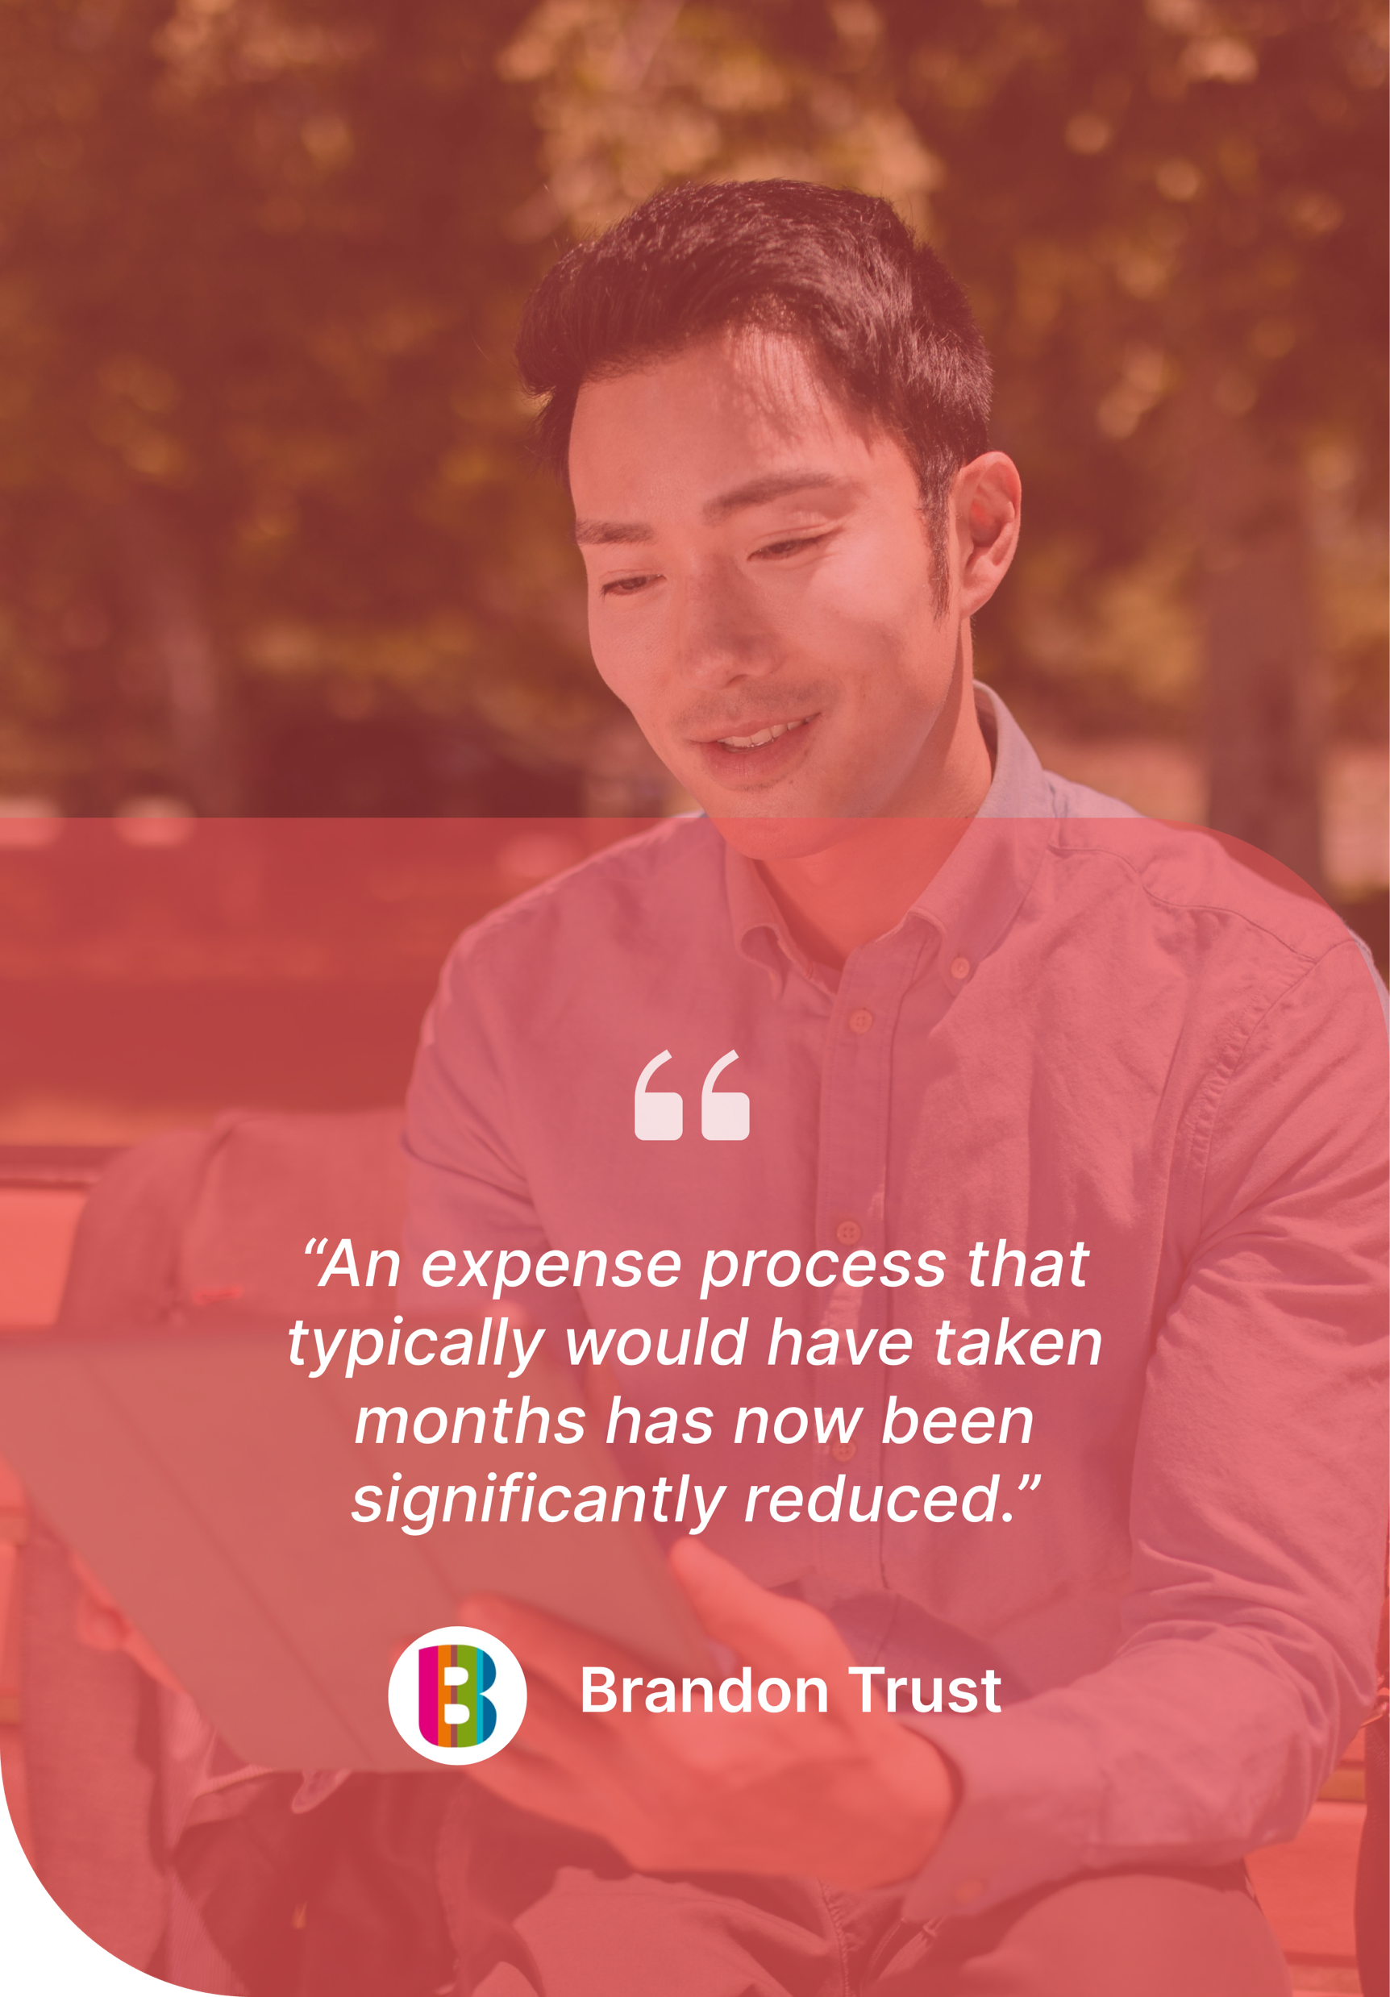



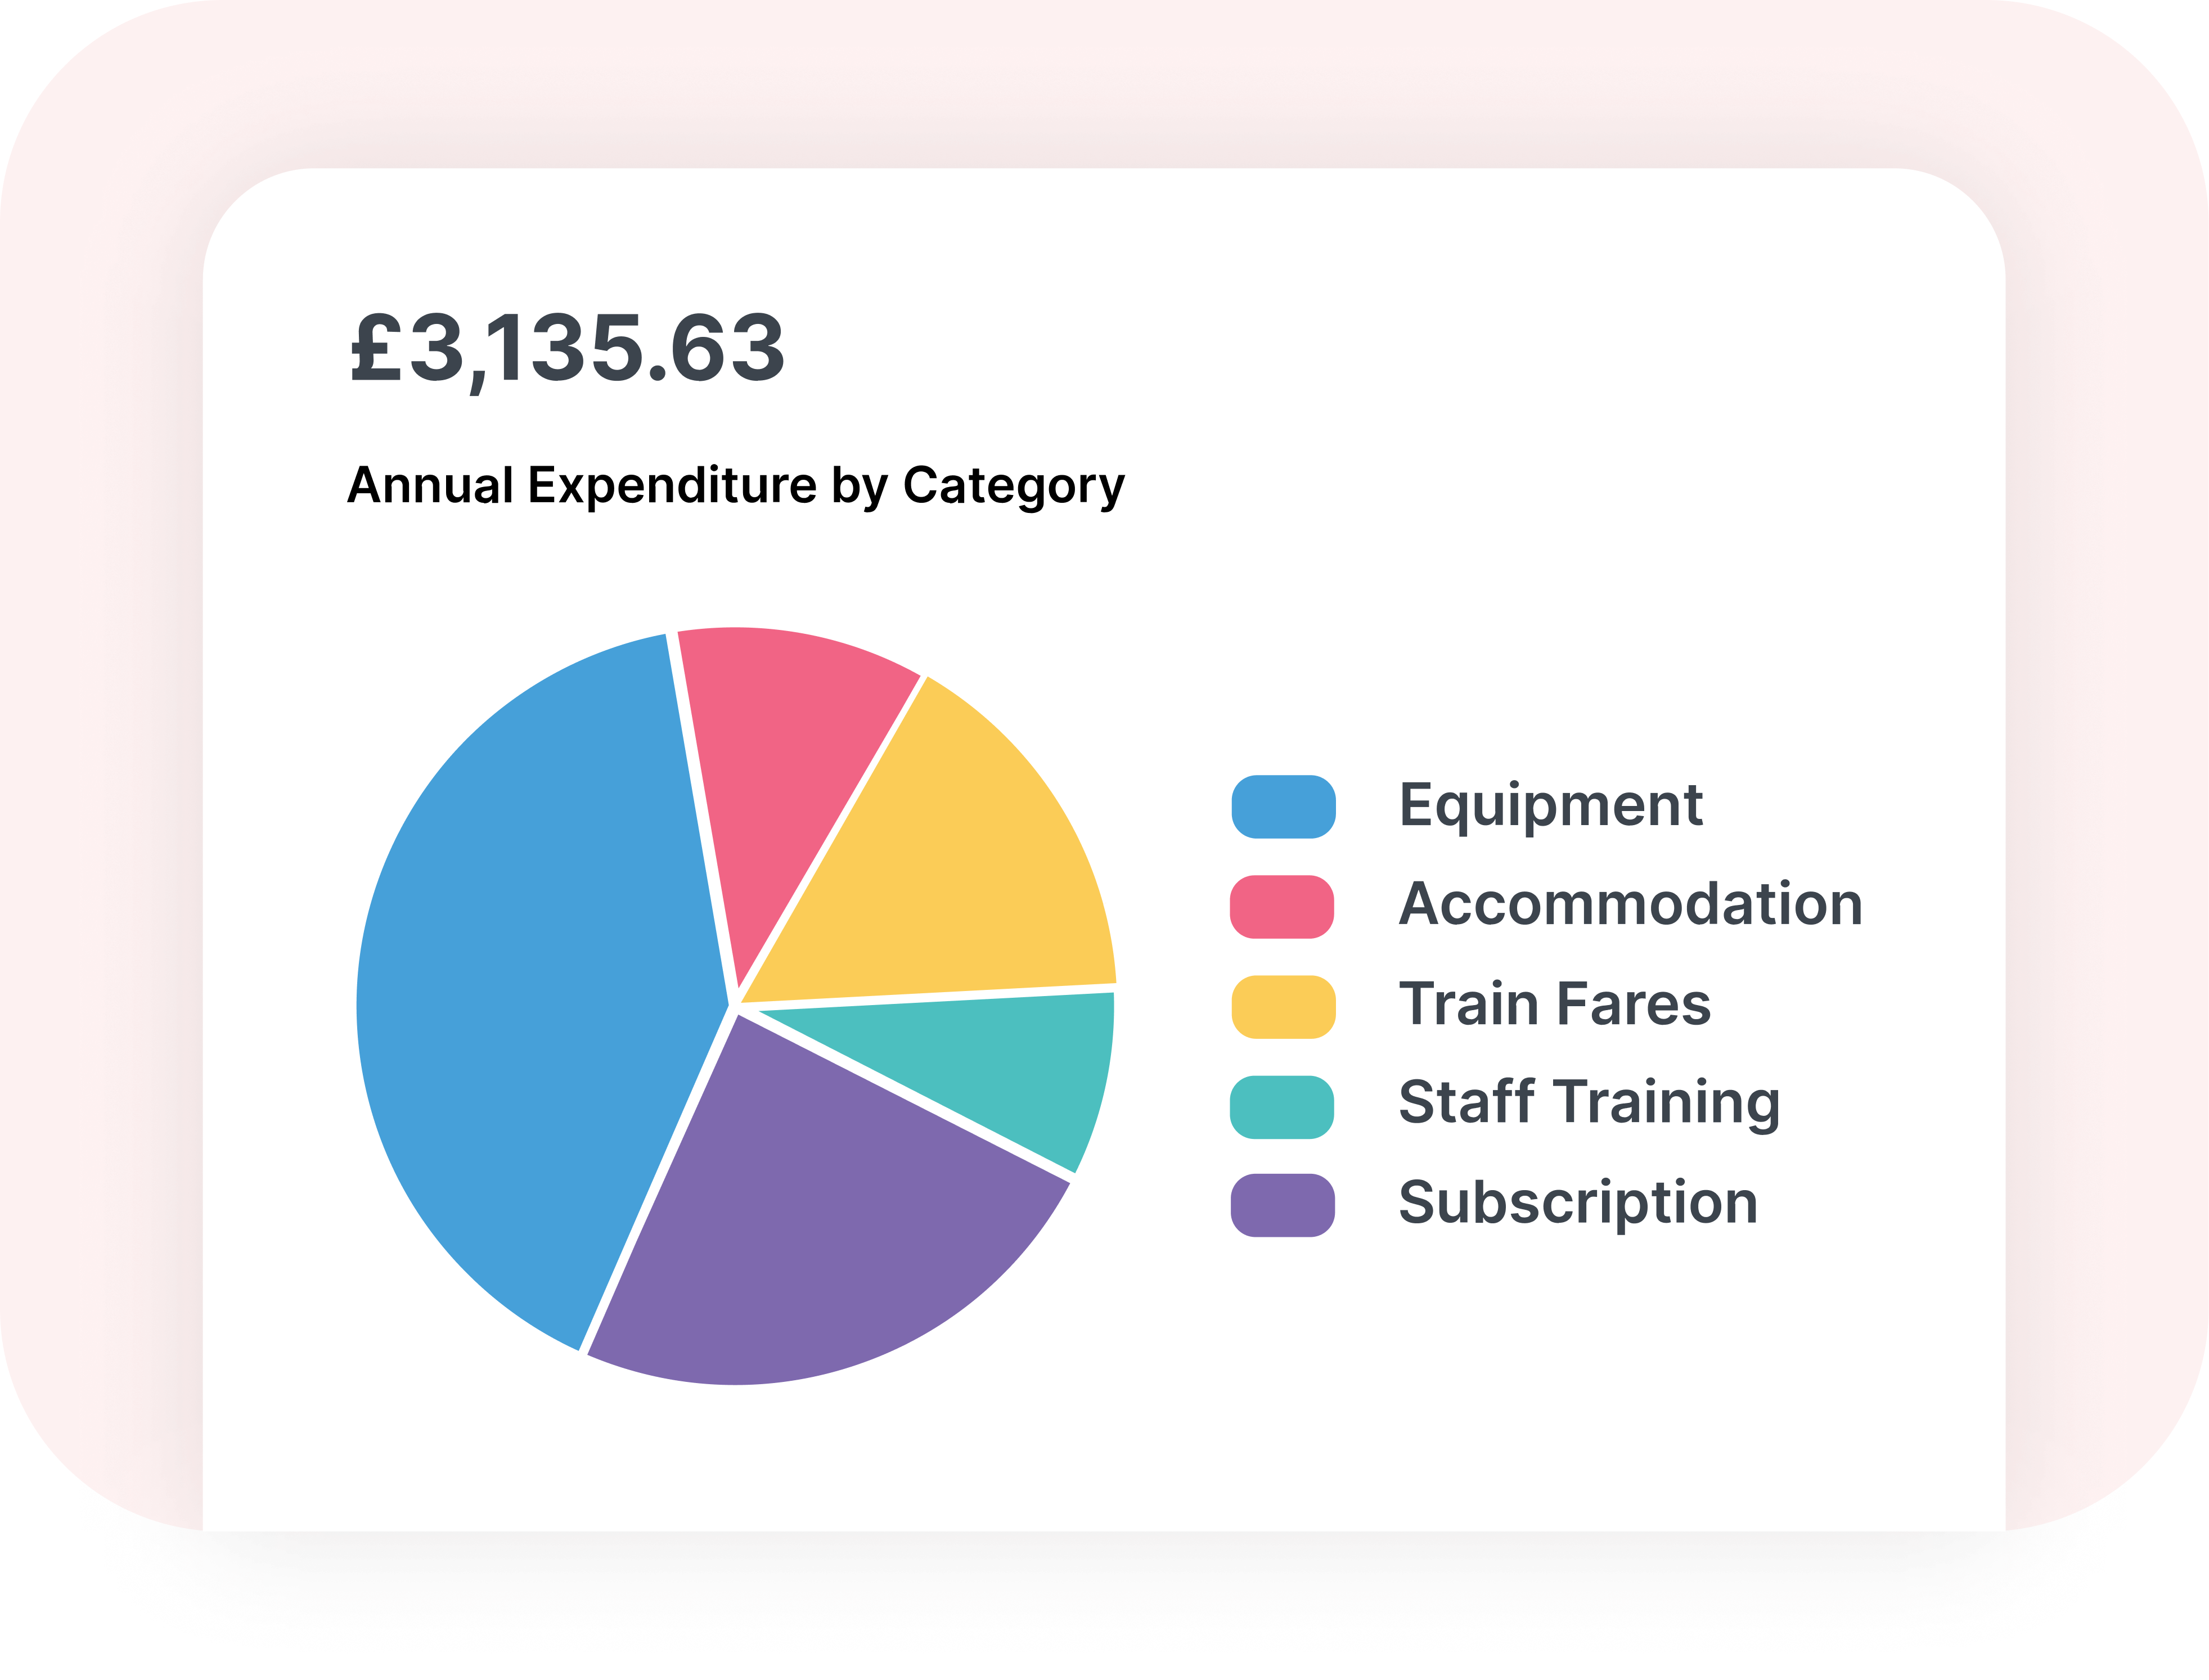

Trusted by Charities Across the UK and Ireland
With ExpenseIn, finance teams spend less time managing process, and more time staying in control.
See what’s been spent
Across cards, expenses,
mileage & invoices.
Make month-end easier
Approved data syncs directly to your accounting system.
Stop chasing information
Receipts, coding & approvals are collected upfront.
Answer questions quickly
Filter spend by fund, programme, category or date. ​
Notes:
Trustees need consistent real time data to make better decisions
-When information is delayed, decisions become reactive.
-Having consistent, real-time visibility allows trustees to spot trends, apply the right controls and act earlier.
Digital systems should reduce pressure, not add to it.
-When too many systems are introduced over time, complexity can increase.
-Multiple systems, disconnected data and manual reconciliation all adds pressure.
-Centralising can help remove this pressure.
Confidence comes from consistent, understandable processes, especially where spend touches charity staff members, volunteers, and programmes.
-Confidence grows when processes are applied consistently.
-If processes are hard to understand or vary too much, adoption drops.
-Clear, simple processes create fairness, trust, and stronger governance.

Slide 11
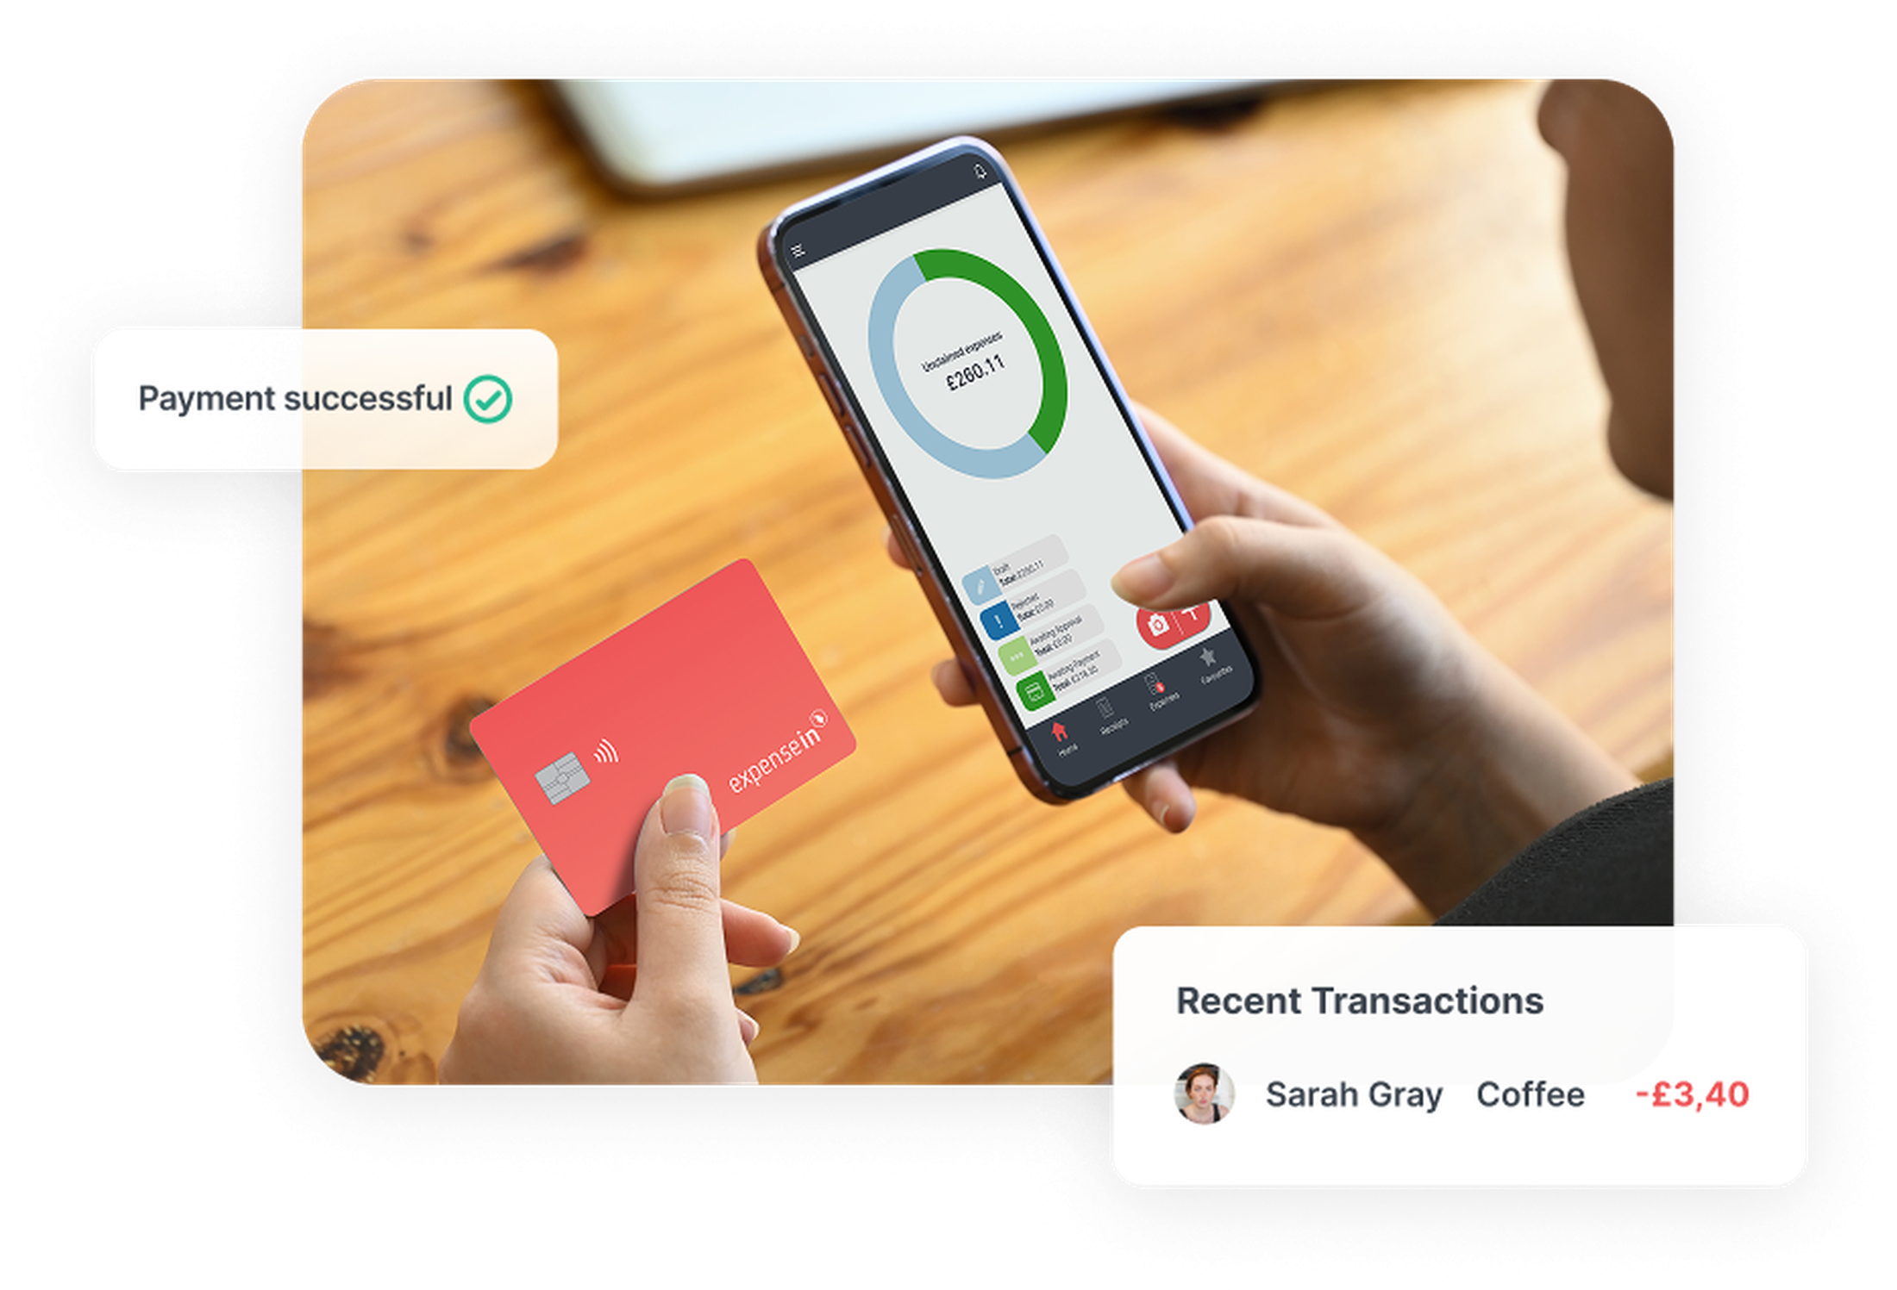
Next Steps Towards Better Expense Management
Book a chat with our team:
sales@expensein.com
If it is helpful, our team can explore:
Your challenges around expenses and visibility.
If ExpenseIn is a good fit for your team.
What setup and rollout typically looks like for charities.
Any questions specific to your team or workflow.
Notes:
Mention the 20% discount for all charities and not-for-profit organisations. Apparently, this will be changing to 15% in Feb so, please confirm with Emma before mentioning.

Slide 12

Questions?

