Slide 1


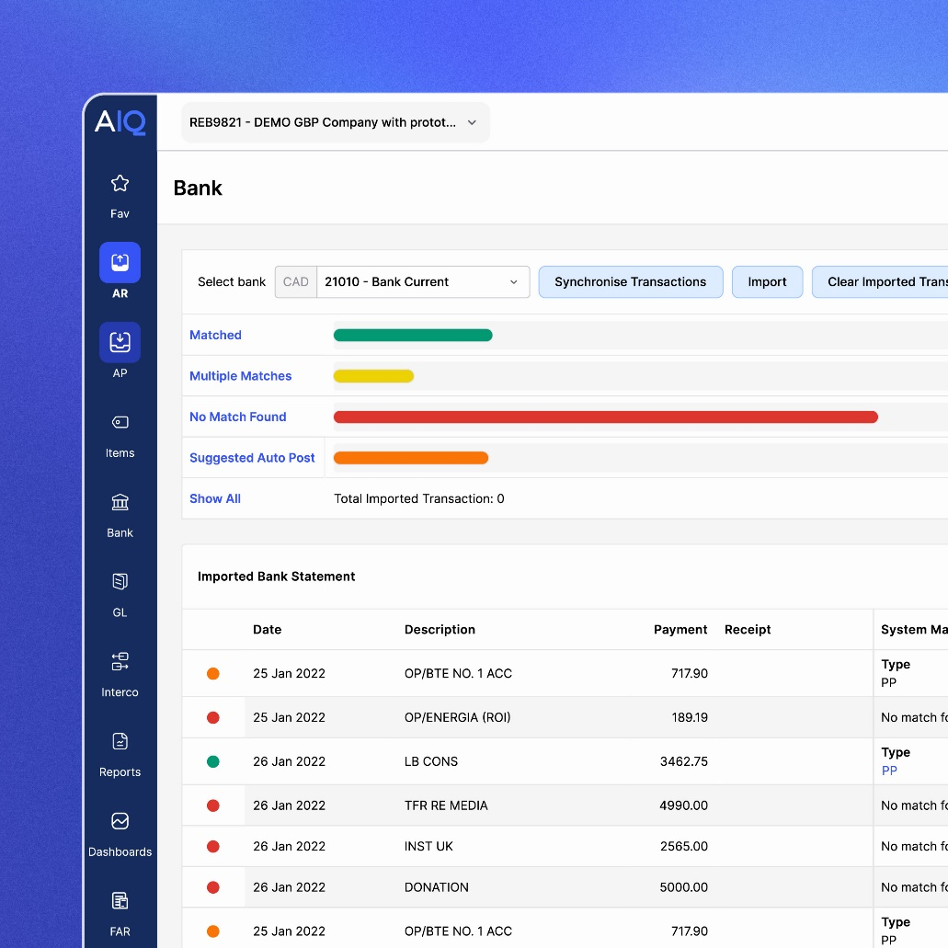
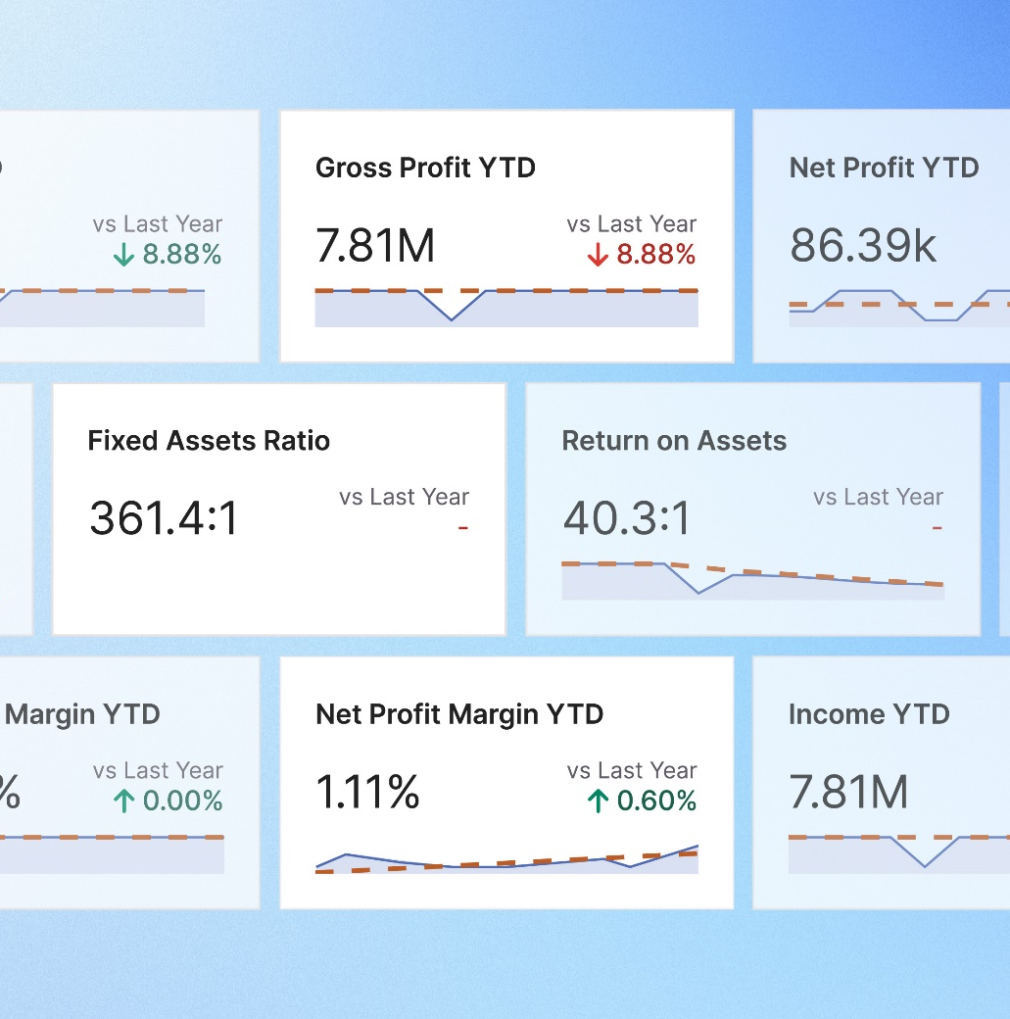
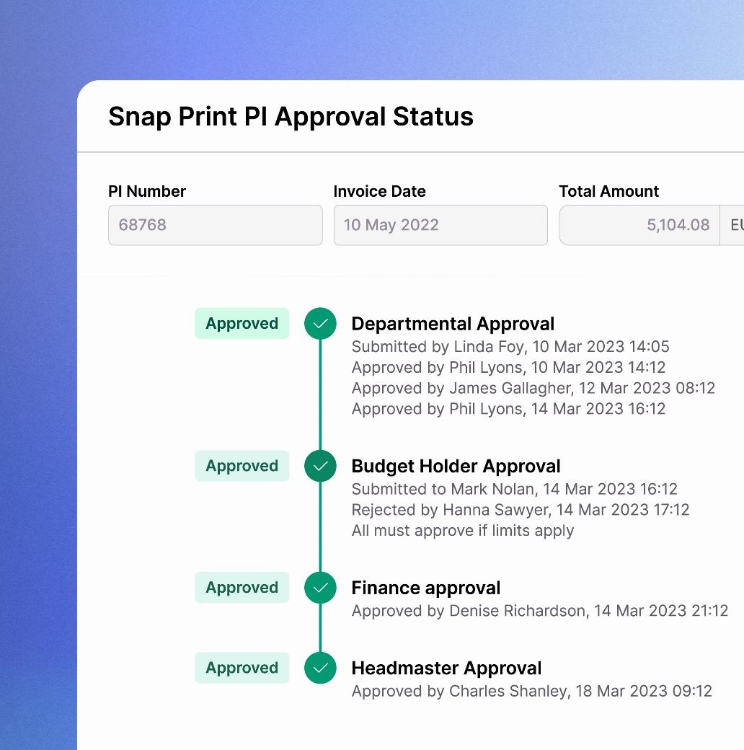
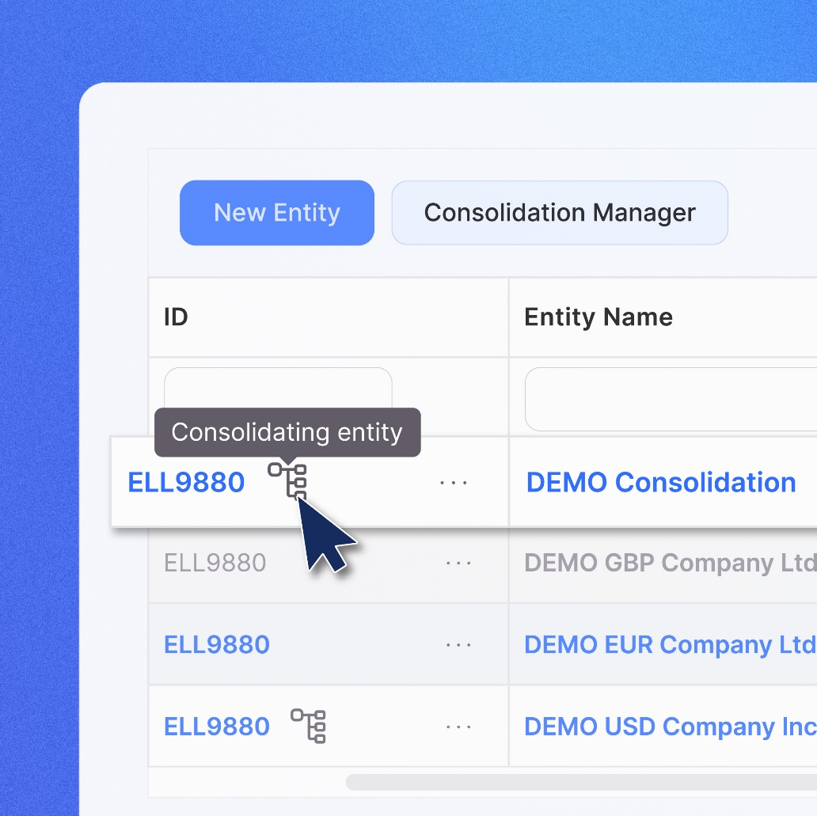
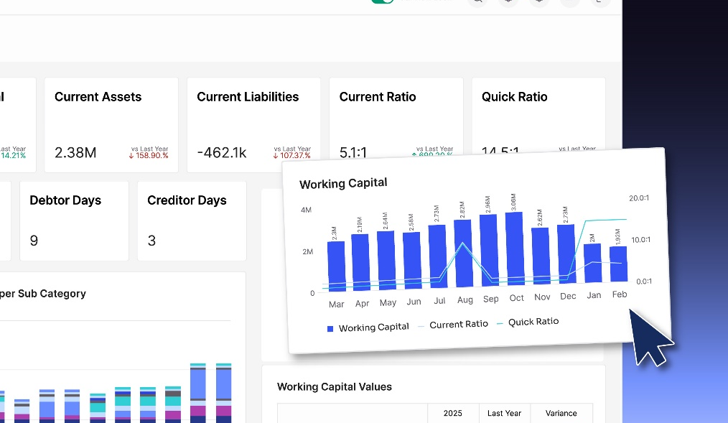
AI in charity finance: from caution to confidence
Insights from the CFO Mindset Report 2.0
Better begins now
Presented by Elaine Birch
AccountsIQ ©

Slide 2


Introduction
Elaine Birch
Content and Communications Manager
AccountsIQ
With over 20 years' experience in B2B PR and content creation, Elaine has worked with some of the biggest names in tech, finance and SaaS, including Salesforce, ServiceNow, Google, Confluent and Solarwinds. From managing and executing media relations campaigns to advising senior teams on their content strategies, Elaine knows how to tell stories that resonate with key audiences to increase brand awareness. Elaine joined AccountsIQ in May 2024 and has been responsible for overhauling the brand's core messaging, tone of voice and content strategy, leading on both external comms and marketing content creation.
www.accountsiq.com
AccountsIQ ©
Better begins now

Slide 3


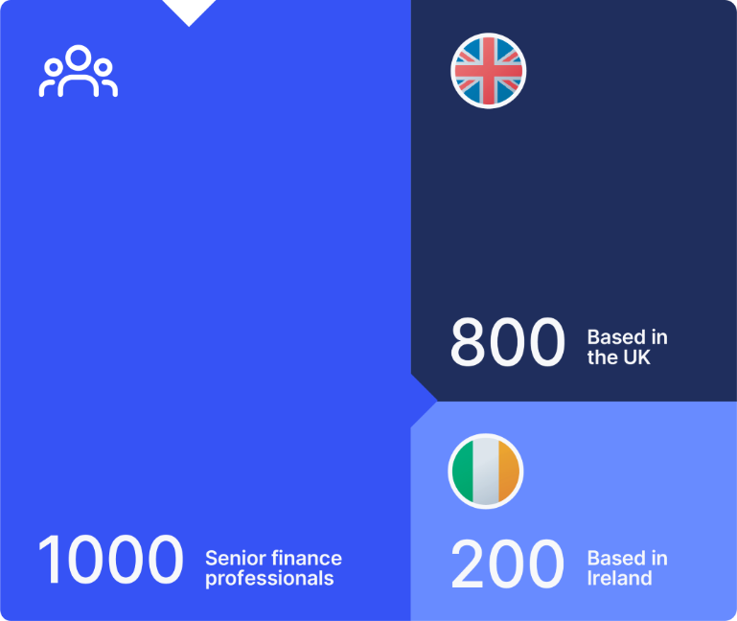
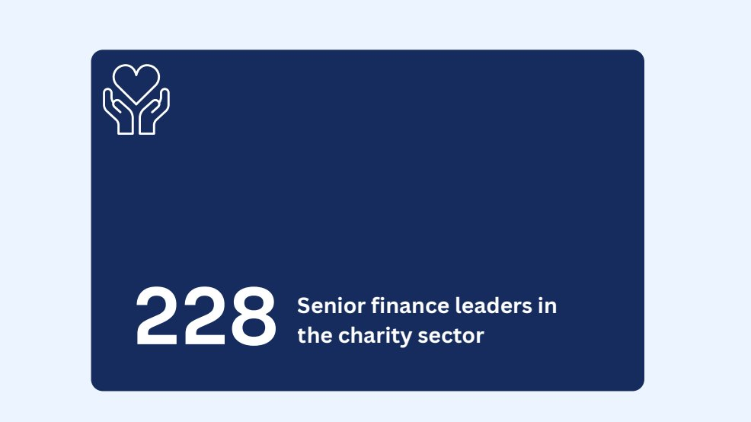
Exploring CFO attitudes in the charity sector
CFO Mindset Report 2.0:

Slide 4
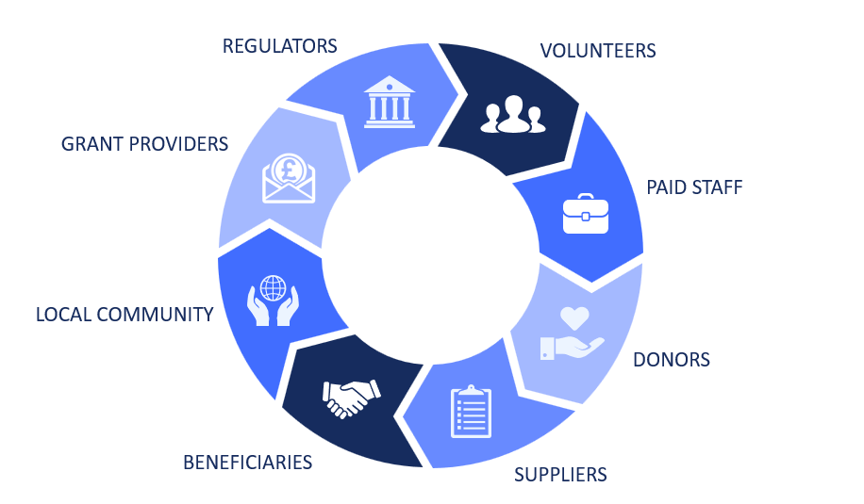
High scrutiny. Limited resources. No margin for error.

Slide 5
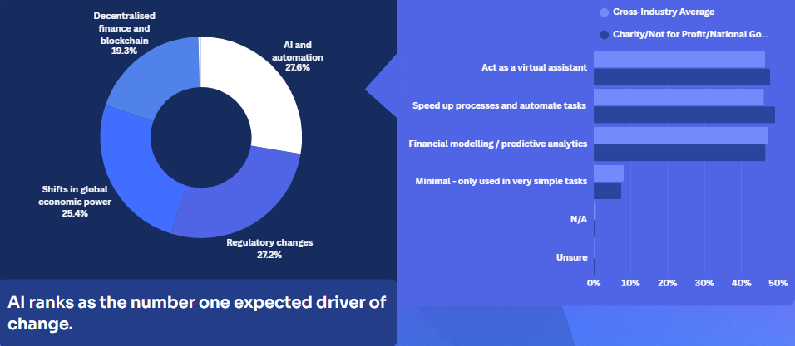
By 2030, the biggest drivers of change will be:
Notes:
What will drive change in the finance function? General stats
By 2030, finance leaders expect the biggest drivers of change to be:
26% - AI and automation
25% - regulatory changes
24% - shifts in global economic power
23% - decentralised finance
AI ranks as the number one expected driver of change. Expectation is high.

Slide 6
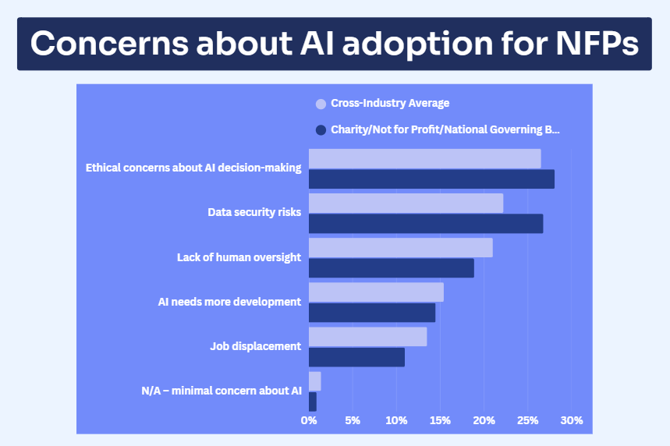
Looking ahead with caution
AI is not yet fully trusted
Top concerns in the charity sector include:
Ethical decision-making
Data security risks
Lack of human oversight
This is not resistance to innovation but reflects a different governance reality.
Notes:
Charities are cautious because:
data matters
ethics matter
human oversight matters
Which means:
rushing ahead without fixing fundamentals will increase fatigue, not reduce it
This reinforces your earlier message:
“If teams are already exhausted, adding complexity — even smart complexity — will backfire.”
“Charities absolutely see AI and automation as part of the future — but trust, ethics and data security really matter.”
Optional question to both:
“Do you think this caution is healthy?”
Andrew do you think this caution is quite specific to the nature of charities and the amount that has to be considered around security?

Slide 7

Why the charity sector is more cautious about new tech
Restricted and uncertain funding
High number of key stakeholders
Reputational sensitivity - Public trust underpins funding
Strict regulatory and reporting requirements
Notes:
Why the charity sector is naturally more cautious about new technology
Charities are not resistant to innovation. They operate within tighter constraints.
Key structural factors include:
Restricted and uncertain funding
Income is often grant-based or donor-dependent
Budgets are tightly controlled
Technology investment must be justified carefully
High number of key stakeholders
Trustees and boards
Donors and grant providers
Regulators
Beneficiaries and the public
Auditors
Decisions must stand up to scrutiny from multiple angles.
Strict regulatory and reporting requirements
Compliance obligations are non-negotiable
Financial transparency is expected
Audit trails must be clear and defensible
Reputational sensitivity
Public trust underpins funding
Errors can damage long-term credibility

Slide 8
AI adoption in charity finance depends on three pillars:
Accuracy
Explainability
Accountability
Notes:
The real barrier is not interest - it is trust
AI adoption in charity finance depends on three pillars:
- Accuracy
- Explainability
- Accountability
Without these, adoption stalls.

Slide 9

Accuracy: the non-negotiable
In charity finance:
Reporting errors affect donor confidence
Cash flow pressures are already significant
Financial oversight is constant
AI must increase financial clarity - not introduce uncertainty.
Notes:
Accuracy: the non-negotiable
In charity finance:
Reporting errors affect donor confidence
Cash flow pressures are already significant
Financial oversight is constant
AI must increase financial clarity - not introduce uncertainty.
Close enough is not good enough.

Slide 10

Managing accuracy risk
Building confidence in AI accuracy requires:
Clean and structured data foundations
Clear visibility of data sources
Human validation during early adoption
Starting with lower-risk use cases such as:
- Variance explanations
- Anomaly detection
- Trend identification

Slide 11
AI should augment judgement, not replace sign-off.

Slide 12
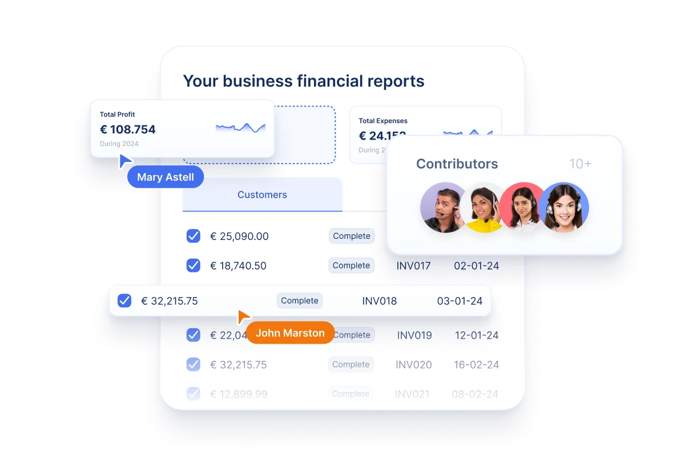
Can you defend it in a board meeting?
Ethical AI concerns are higher in the charity sector than the cross-industry average.
Black-box outputs create governance risk.
If you cannot explain:
How the conclusion was reached
What data was used
What assumptions were applied
You cannot responsibly rely on it.
Notes:
Accuracy: the non-negotiable
In charity finance:
Reporting errors affect donor confidence
Cash flow pressures are already significant
Financial oversight is constant
AI must increase financial clarity - not introduce uncertainty.
Close enough is not good enough.

Slide 13
Managing explainability
AI becomes defensible when
Outputs show reasoning, not just results
Audit trails are maintained
AI usage policies are documented
Finance teams are trained to interrogate outputs
Oversight is
preserved
Notes:
Explainability builds board confidence.

Slide 14

Who is responsible if it is wrong?
AI does not carry legal accountability.
Finance leaders do.
Charity finance is stewardship.
AI must support professional responsibility - not dilute it.

Slide 15
Managing accountability
Governed AI, not autonomous AI
Clear ownership of AI-assisted decisions
Defined escalation processes
Human approval authority retained
Governance frameworks established before scaling
Notes:
The future is supervised intelligence - not self-governing systems.

Slide 16
What this means for charity finance leaders
AI is expected to reshape the finance function
Charity-sector concern is higher than other industries - and rationally so
Adoption will depend on trust, not hype
Accuracy, explainability and accountability determine success
AI should reinforce professional judgement, not replace it

Slide 17
AI will change finance.
The question is not whether charities will adopt AI, it’s:
How do we adopt it without compromising trust and confidence?

Slide 18


Thank you
Download your copy of the CFO Mindset Report 2.0 and book time with one of our experts to learn how we use AI in a careful, practical way to support finance teams as they manage complexity, maintain accuracy and scale with confidence.
Contact us: ebirch@accountsiq.com
sales@accountsiq.com
www.accountsiq.com
AccountsIQ ©
Better begins now

