Slide 1


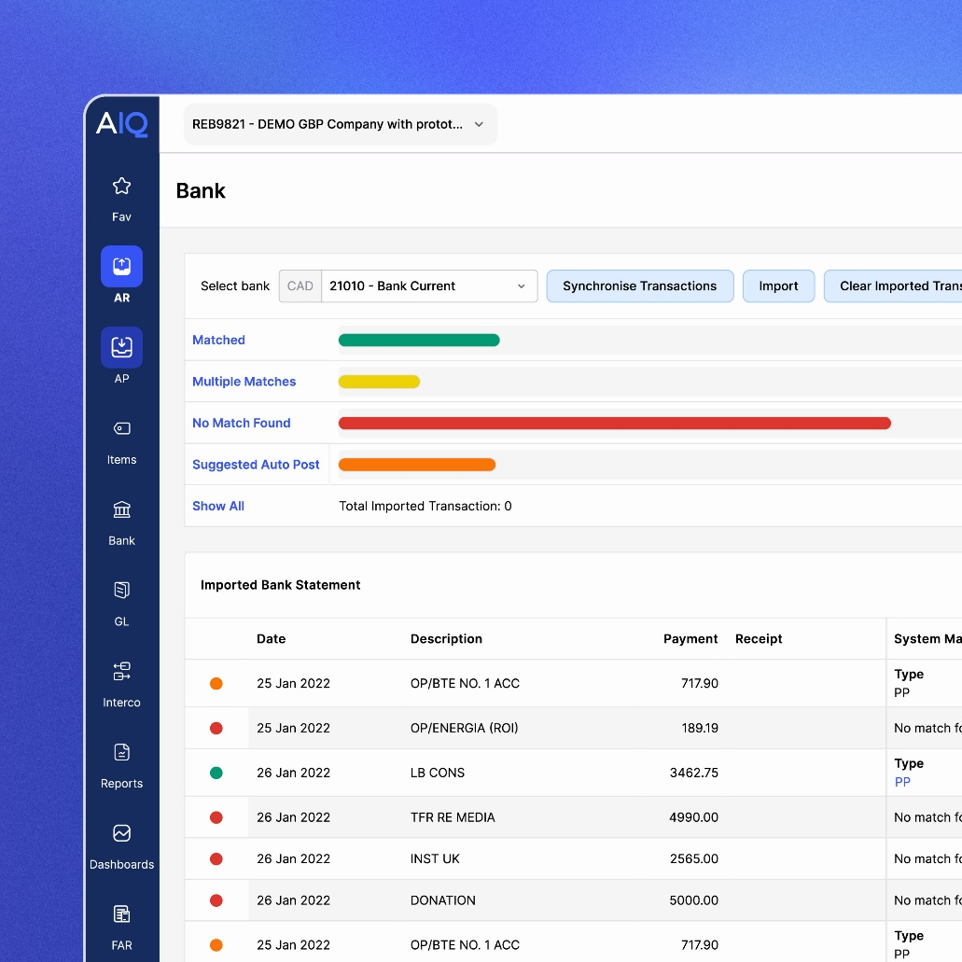
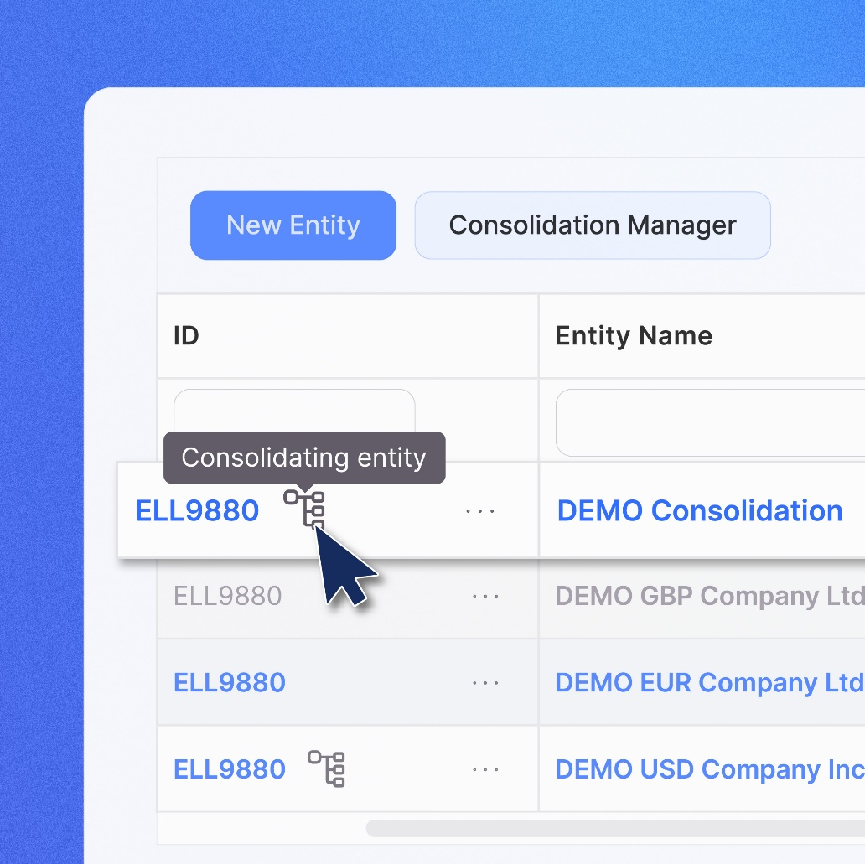
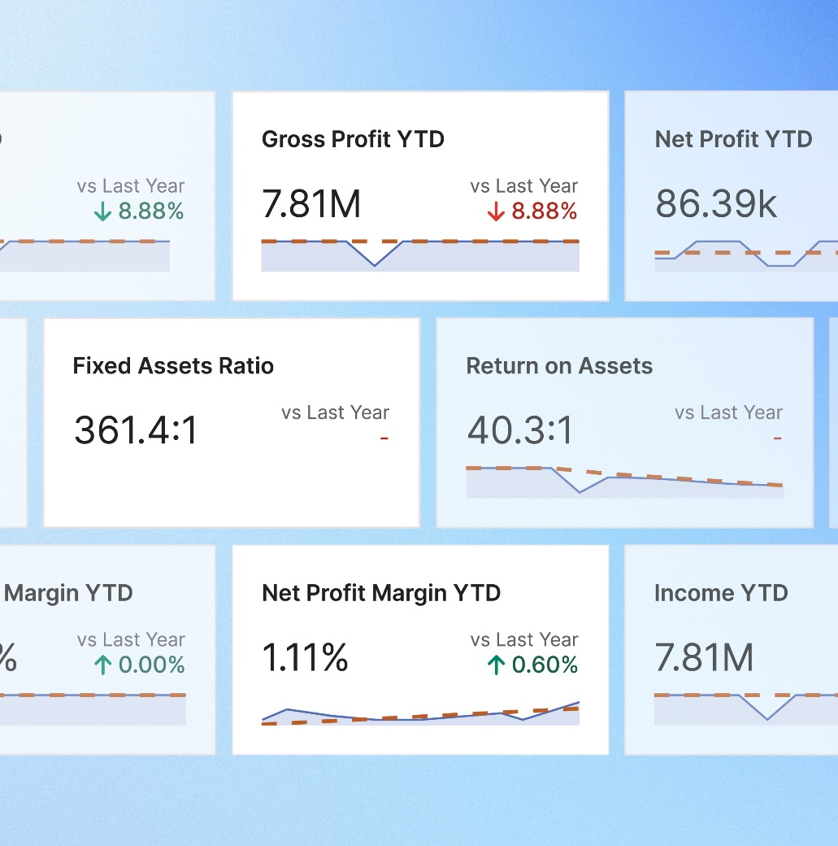
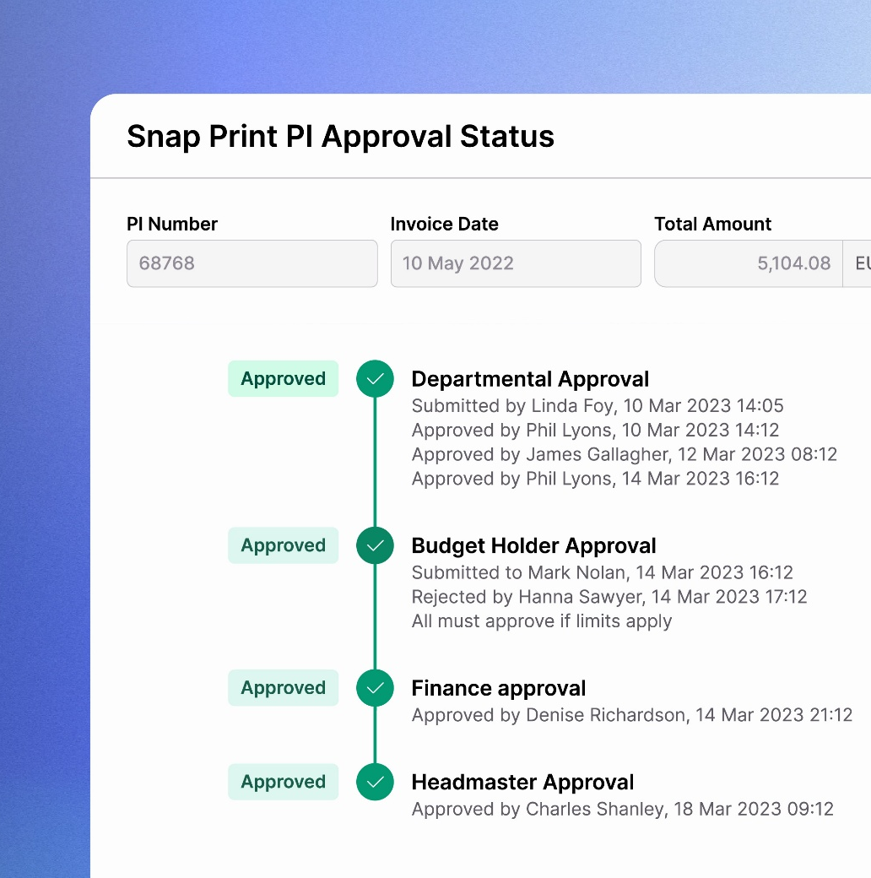
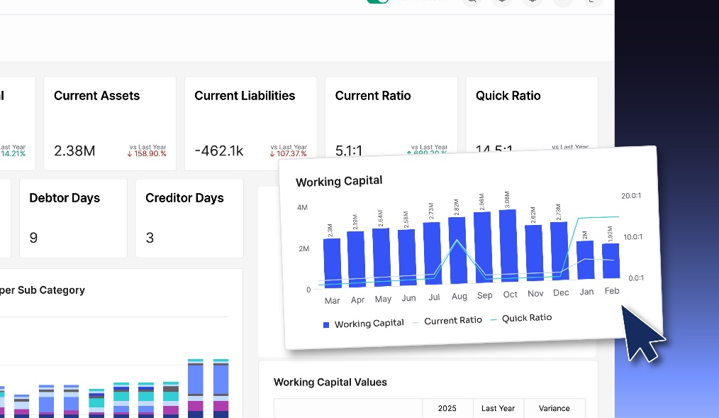
Five ways charities are automating finance to save time, stay compliant, and focus on impact
Trusted by 35,000+ users
Better begins now
Presented by Alex Oppe
AccountsIQ ©

Slide 2
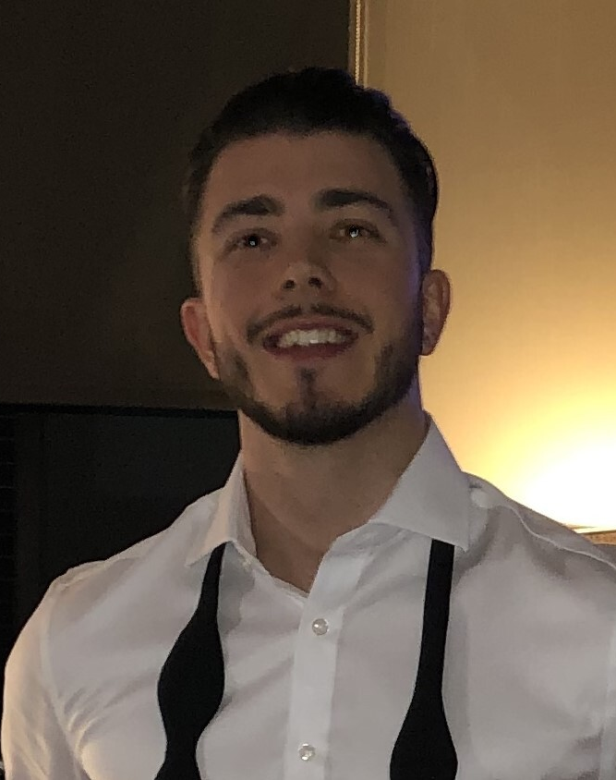
Meet the speaker
Alex Oppe Account Executive
Alex has extensive experience advising charities on how they can transform their finance function, using automation and intelligence to streamline processes, leaving more time to focus on making important business decisions.
www.accountsiq.com
AccountsIQ ©
Better begins now

Slide 3


Finance leaders today are under more pressure than ever
The need for more time in the charity sector is a constant cause for concern, particularly for charity finance teams. As a result of high-pressure funding environments and charities’ determination to do the best possible work for their service users, lack of time has undoubtedly been a key challenge for charity financial teams, especially given the gravity of their work.

Slide 4

The changing landscape of charity finance
Funding
Expectation
Regulation
www.accountsiq.com
AccountsIQ ©
Better begins now

Slide 5

Key challenges
Finding out where your team is feeling pressure
Finance teams are tasked with complex operations and heavy manual work. Ask teams to reflect on the areas that hold them back the most in terms of efficiency. Which processes can be automated?

Slide 6
Key challenges
Finding out where your team is feeling pressure
Selecting the right system
Evaluate the current systems you use and how effectively different workflows are connected. Taking a long-term view of the next five-to-ten years will help you consider whether the system remains suitable as your charity changes with time.
Finance teams are tasked with complex operations and heavy manual work. Ask teams to reflect on the areas that hold them back the most in terms of efficiency. Which processes can be automated?

Slide 7
Key challenges
Finding out where your team is feeling pressure
Selecting the right system
Evaluate the current systems you use and how effectively different workflows are connected. Taking a long-term view of the next five-to-ten years will help you consider whether the system remains suitable as your charity changes with time.
Finance teams are tasked with complex operations and heavy manual work. Ask teams to reflect on the areas that hold them back the most in terms of efficiency. Which processes can be automated?
Getting the coding structure right
Once you have made your choice, work with the vendor to personalise it to your charity. Getting the structure right will enable you to capture, process, and report every detail you need for the charity’s specific purposes.

Slide 8
Key challenges
Finding out where your team is feeling pressure
Selecting the right system
Evaluate the current systems you use and how effectively different workflows are connected. Taking a long-term view of the next five-to-ten years will help you consider whether the system remains suitable as your charity changes with time.
Finance teams are tasked with complex operations and heavy manual work. Ask teams to reflect on the areas that hold them back the most in terms of efficiency. Which processes can be automated?
Getting the coding structure right
Onboarding automation
Moving from one system to another could create a high level of risk. To avoid risks materialising, identify what these would be ahead of time, and make sure the project is delivered to ensure continuity in these areas.
Once you have made your choice, work with the vendor to personalise it to your charity. Getting the structure right will enable you to capture, process, and report every detail you need for the charity’s specific purposes.

Slide 9
Key challenges
Finding out where your team is feeling pressure
Selecting the right system
Evaluate the current systems you use and how effectively different workflows are connected. Taking a long-term view of the next five-to-ten years will help you consider whether the system remains suitable as your charity changes with time.
Finance teams are tasked with complex operations and heavy manual work. Ask teams to reflect on the areas that hold them back the most in terms of efficiency. Which processes can be automated?
Getting the coding structure right
Onboarding automation
Investing time
Moving from one system to another could create a high level of risk. To avoid risks materialising, identify what these would be ahead of time, and make sure the project is delivered to ensure continuity in these areas.
Sometimes, it is only by investing some time in the short term that organisations can gain more time in the long term. Streamlining processes can mean that staff are freed from repetitive manual tasks and have more time to help boost the charity’s impact.
Once you have made your choice, work with the vendor to personalise it to your charity. Getting the structure right will enable you to capture, process, and report every detail you need for the charity’s specific purposes.

Slide 10

From insight to action
Review your data ecosystem
Tighten controls without slowing down
Explore AI safely
Reimagine reporting as storytelling
www.accountsiq.com
AccountsIQ ©
Better begins now

Slide 11
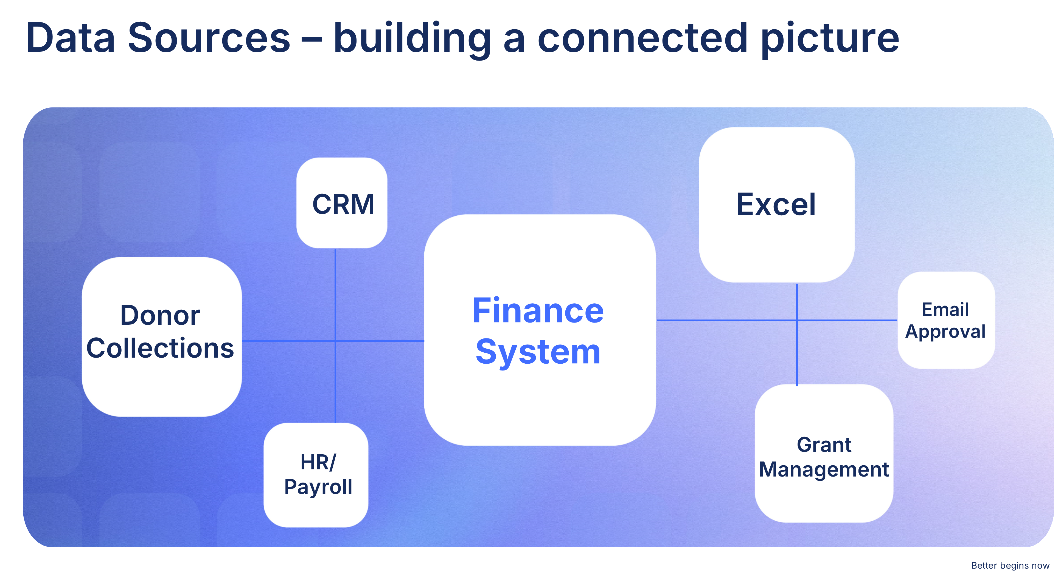
www.accountsiq.com
AccountsIQ ©

Slide 12

Financial controls that build confidence
PO & PI approvals against budget lines
Role-based approval hierarchies & automated workflows
Real-time budget checks: prevent overspend before it happens
Audit trails & restricted fund tracking
www.accountsiq.com
AccountsIQ ©
Better begins now

Slide 13
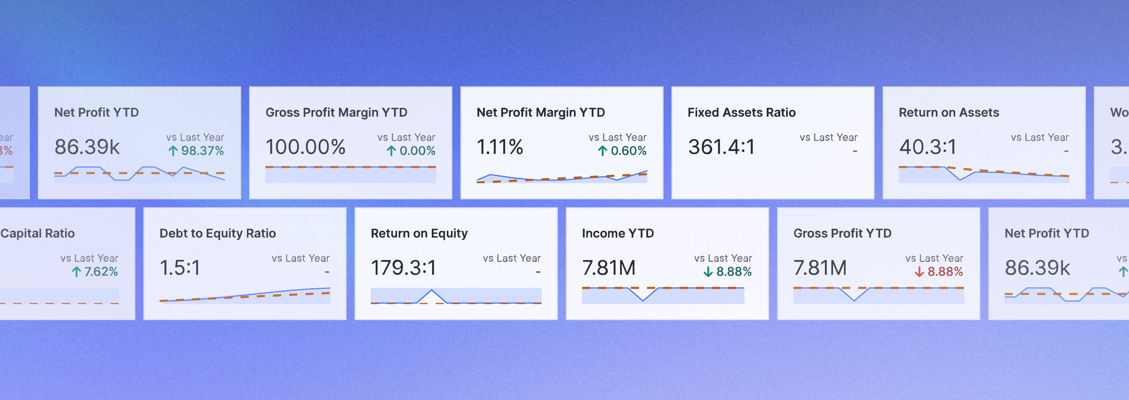

HORIZON
TECH.
INNOVATING TODAY FOR
A SMARTER TOMORROW
Product demo
www.accountsiq.com
AccountsIQ ©
Better begins now

Slide 14

Case study: Epilepsy Action
Not for profit | Moved from Sage50
"AccountsIQ delivers a combination of time saving and financial visibility that allows us to do more data analysis and really add value to our organisation."
Tony Spinks, Director of Corporate Services at Epilepsy Action
Challenge
Solution
Impact
Epilepsy Action chose AccountsIQ for its:
Integrated AP Inbox, streamlining invoices
All-in-One Financial Management for better grant tracking
User-friendly cloud-based system, reducing training time
AIQ Academy online learning platform
Complex financial management challenges
Multiple sources of income
Stringent controls over spending
Restricted fund requirements
Lack of management reporting in current system
Significant time saving, particularly around the purchasing processes which used to be very manual
Faster approvals and audit trails, enhancing efficiency
More efficient financial reporting
Scalability for future growth
case study
www.accountsiq.com
AccountsIQ ©
Better begins now

Slide 15

Case study: WCVA
Not for profit | Moved from Exchequer
"As soon as we had the demo with Ellen at AccountsIQ, I could see it was a user-friendly system with a logical, intuitive layout. It was just lovely to look at."
Tracey Marsh, Finance Director at WCVA
Challenge
Solution
Impact
Limited and inefficient reporting capabilities, being charged extra expense for reports
Existing system was server-based rather than cloud
Manual ways of working needed to be updated
High costs and inflexibility
WCVA chose AccountsIQ for its:
Cloud-based system
Flexible pricing
Automated, seamless processes
Budget holders have more autonomy
BI codes and multi-dimensional reporting
Knowledgeable support team
Significant time saving, particularly around automated bank reconciliations
Different roles have more autonomy within the system
More efficient financial and SORP reporting
Scalability for future growth
case study
www.accountsiq.com
AccountsIQ ©
Better begins now

Slide 16

Case study: Archdiocese of Dublin
Not for profit | Moved from an on-premise solution
"We realised early on that we had to offer an accounting solution to parishes that was more than a compliance exercise. With AccountsIQ we could offer them something more, an easy to use template for accounting that cut back on paperwork and saved time on manual processes. This efficiency has positively impacted uptake within parishes."
Ide Finnegan, Head of Finance at the Archdiocese of Dublin
Challenge
Solution
Impact
Existing system was server-based rather than cloud
Meeting their complex reporting needs whilst also providing a user-friendly system that parishes could easily adopt
197 parishes and funds under management that require reporting under new charity SORP regulations
The Archdiocese of Dublin chose AccountsIQ for its:
A highly secure cloud system with inclusive disaster recovery, upgrades and support
Powerful consolidation capabilities
Integration with existing systems like Salesforce
Extensive reporting capabilities
Bespoke consolidated reports meant cutting back on tedious paperwork
Automated and paperless processes makes life much more efficient for the charity’s auditors
New features and functionality make the system efficient and compliant
case study
www.accountsiq.com
AccountsIQ ©
Better begins now

Slide 17


Find out more
Book time with one of our experts to see the award winning AccountsIQ finance system in action.
Contact us: aoppe@accountsiq.com
www.accountsiq.com
AccountsIQ ©
Better begins now

