Slide 1


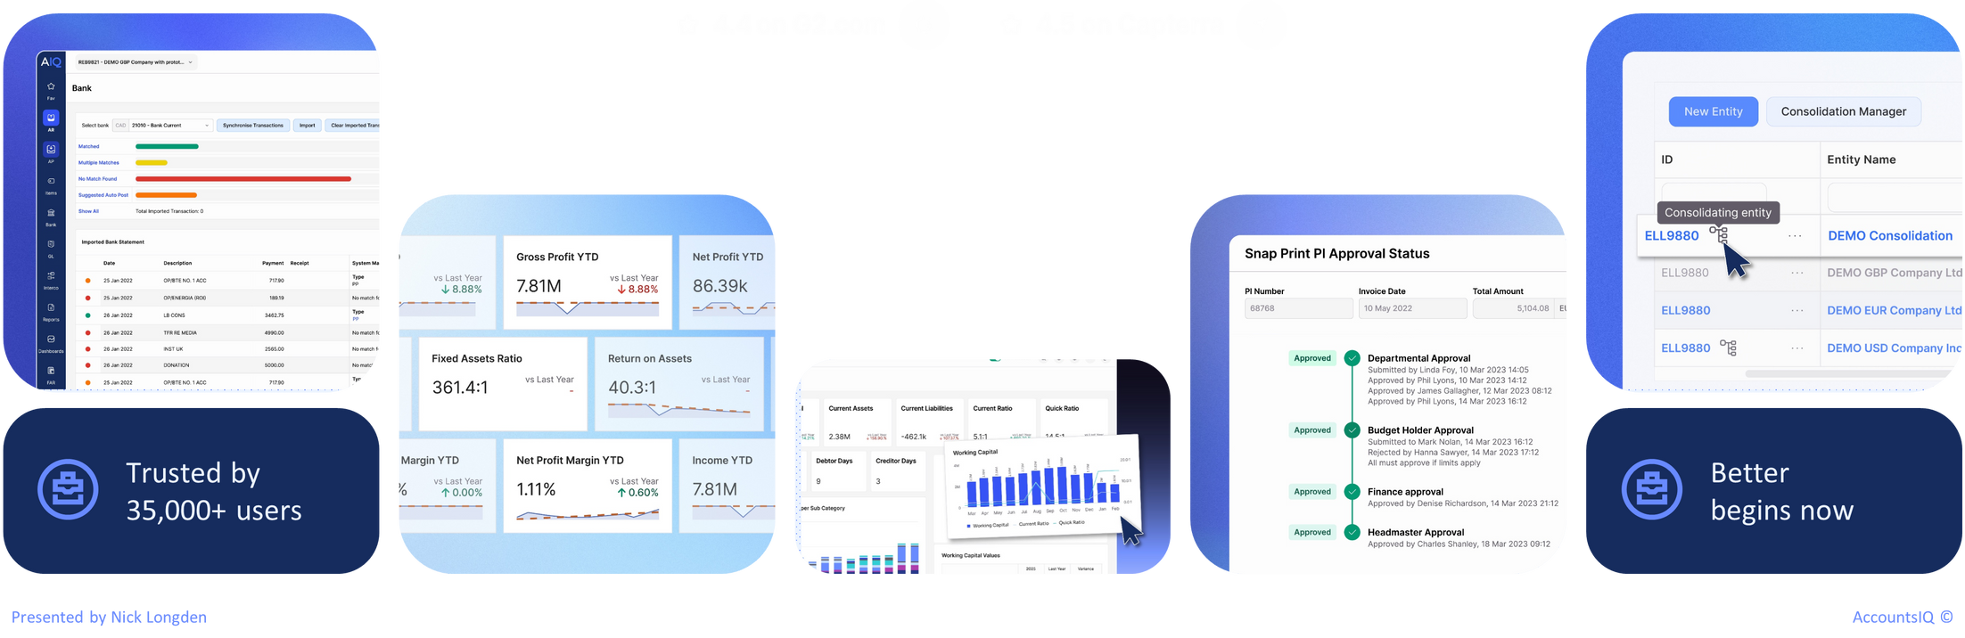
Webinar: Modern finance for charities – challenges facing CFOs and how to tackle them
Presented by Elaine Birch and Alex Oppe

Slide 2

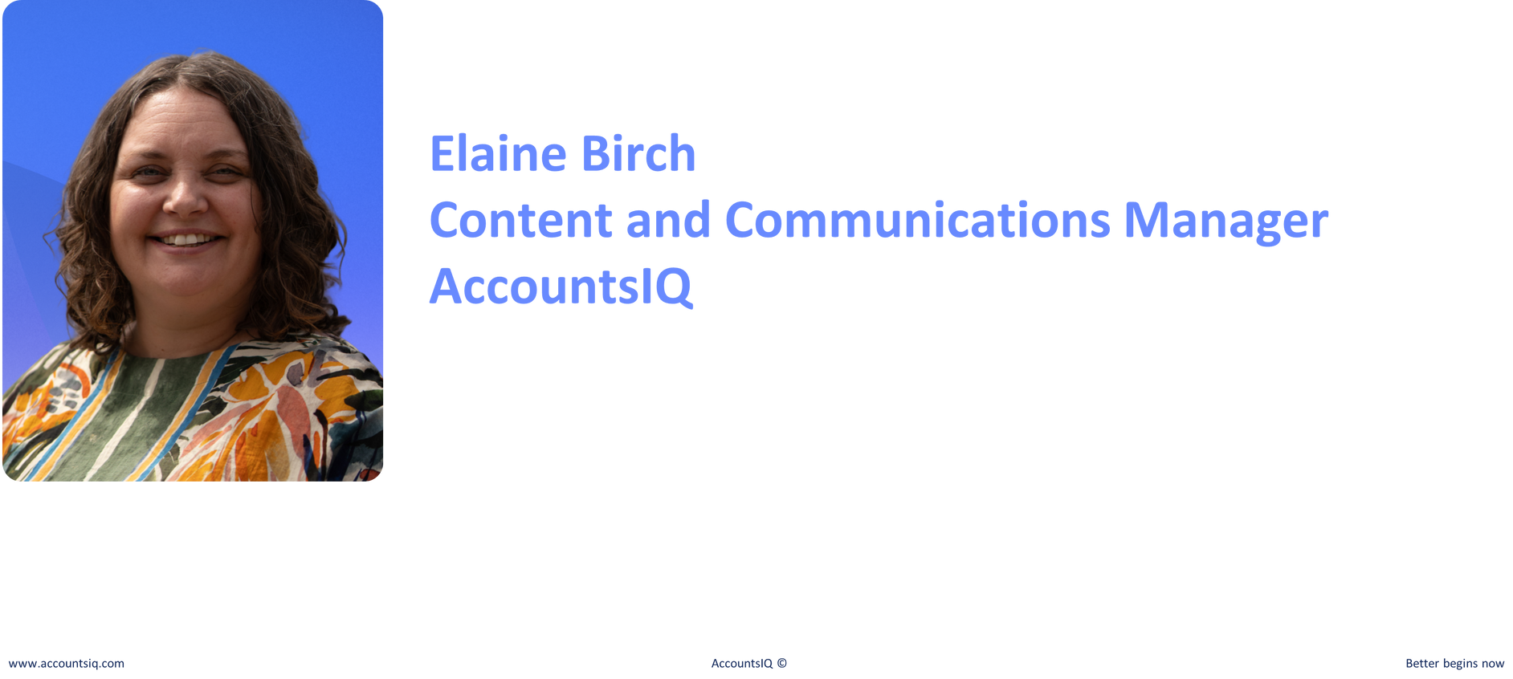

Taylor Andrew
Account Executive
AccountsIQ

Slide 3
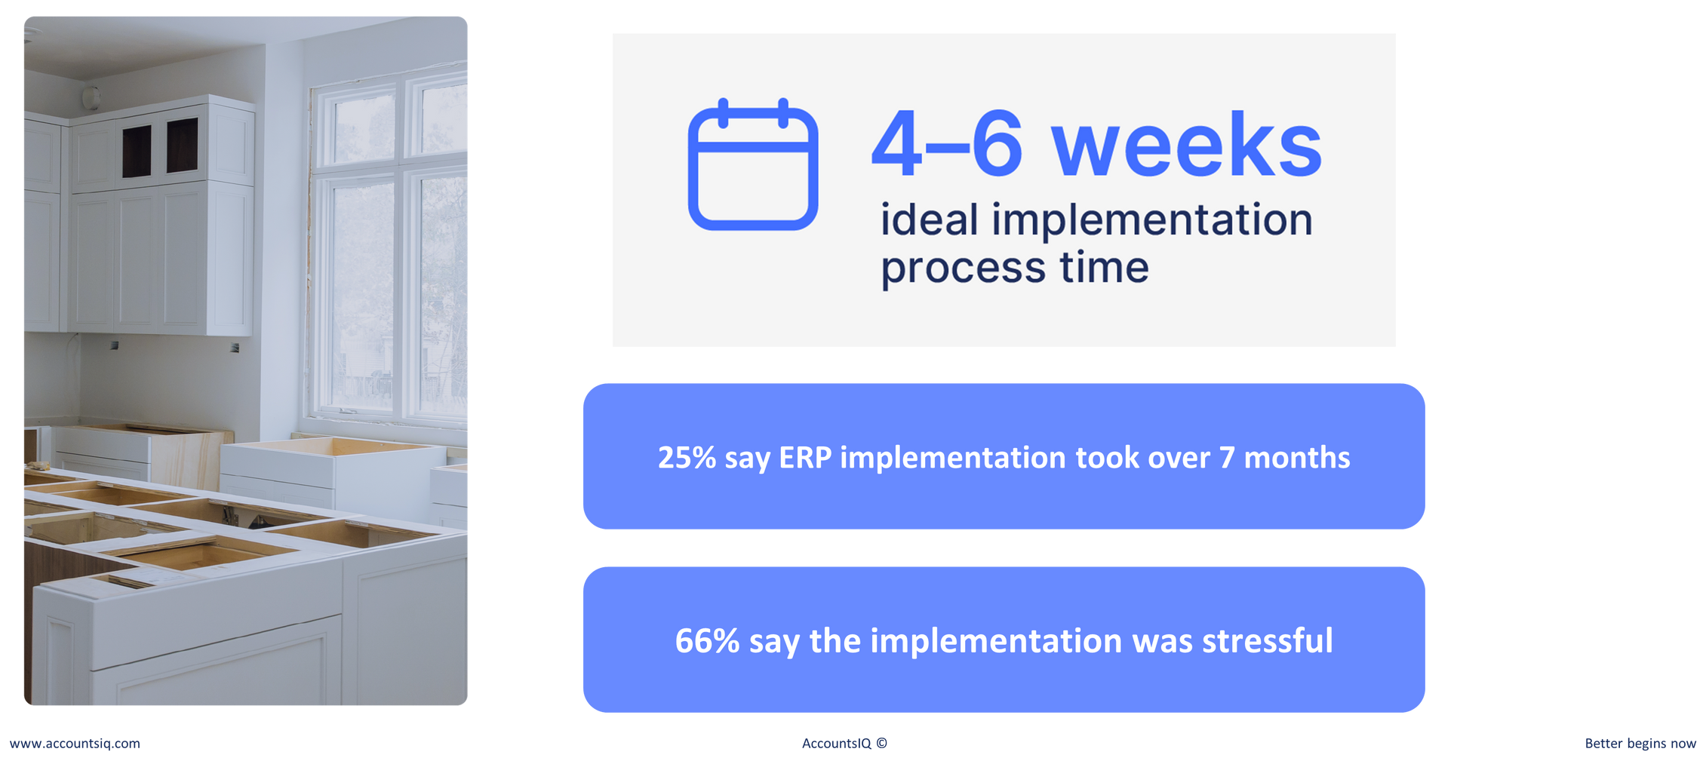
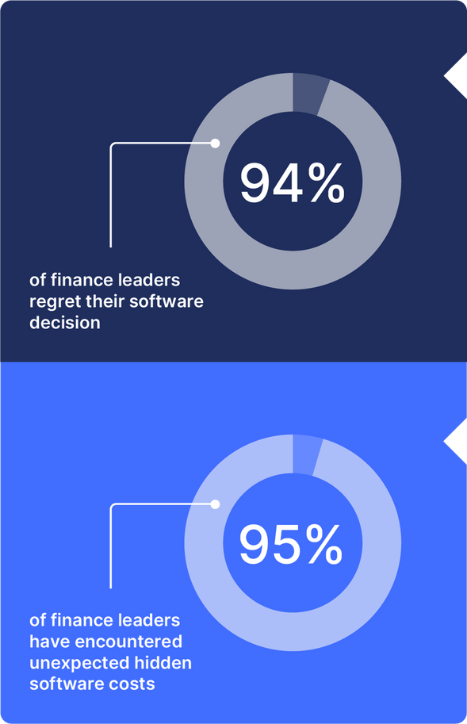
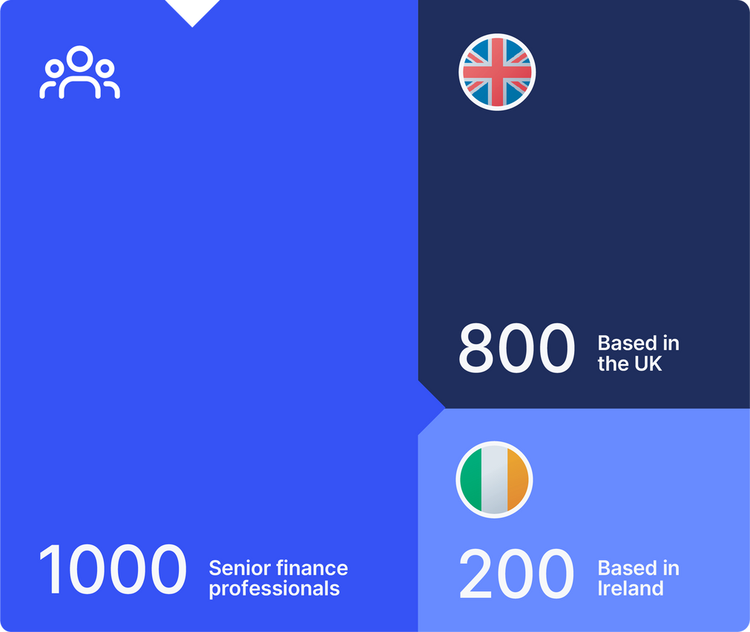

Exploring the CFO mindset and what drives their decisions
Charity focus
96%
213
Charities, Not For Profits
and National Governing Bodies
96%

Slide 4


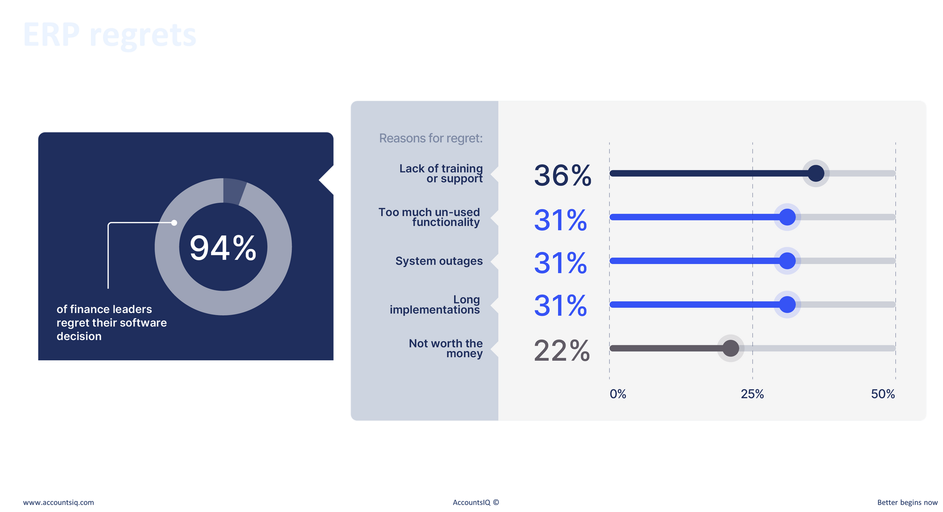
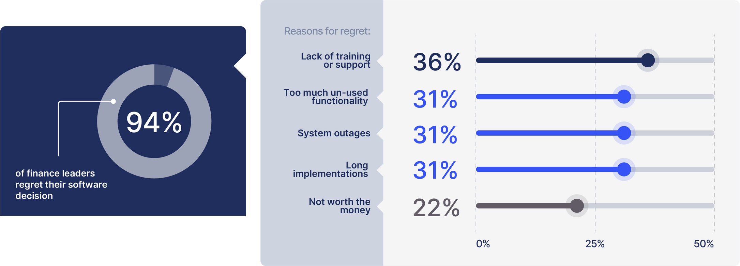
38%
37%
96%
30%
29%
27%

Slide 5
Long, painful implementations
23%

Slide 6
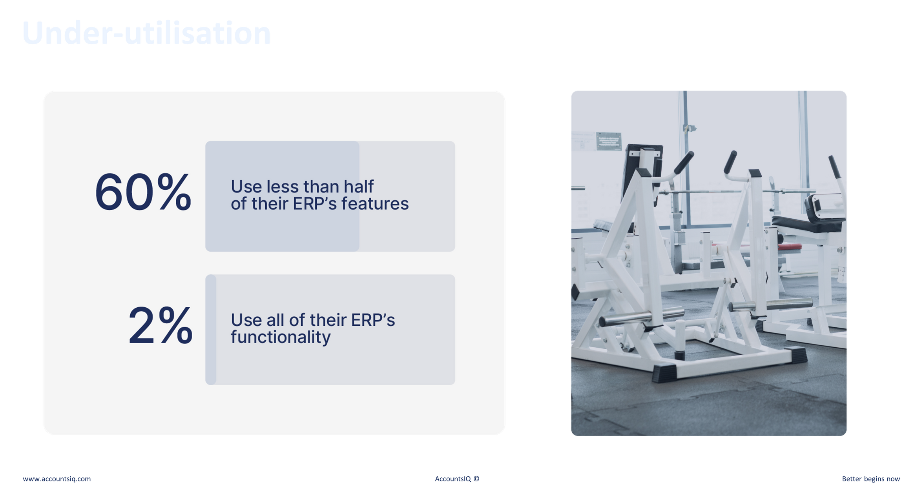
56%
Use less than half
of their ERP’s features
0.5%
Use all of their ERP’s functionality

Slide 7

Hidden costs
97%
43%
46%

Slide 8
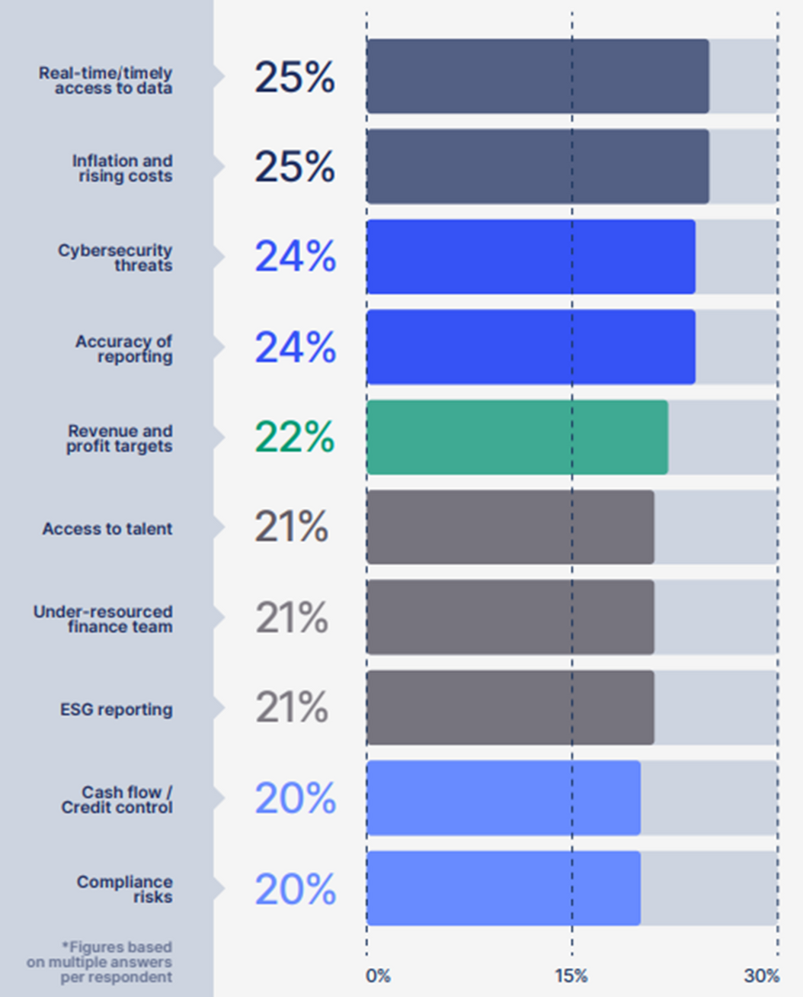
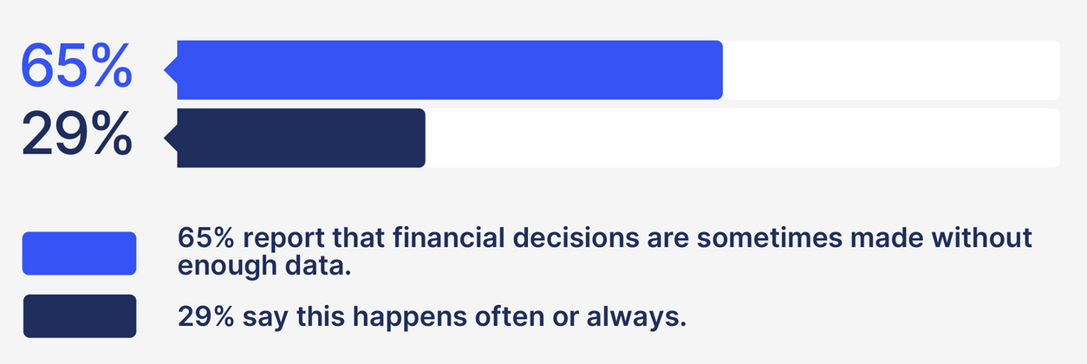

What’s keeping finance leaders up at night?
22%
29%
22%
25%
62%
24%
21%
21%
62%
24%
22%
22%
25%
18%

Slide 9
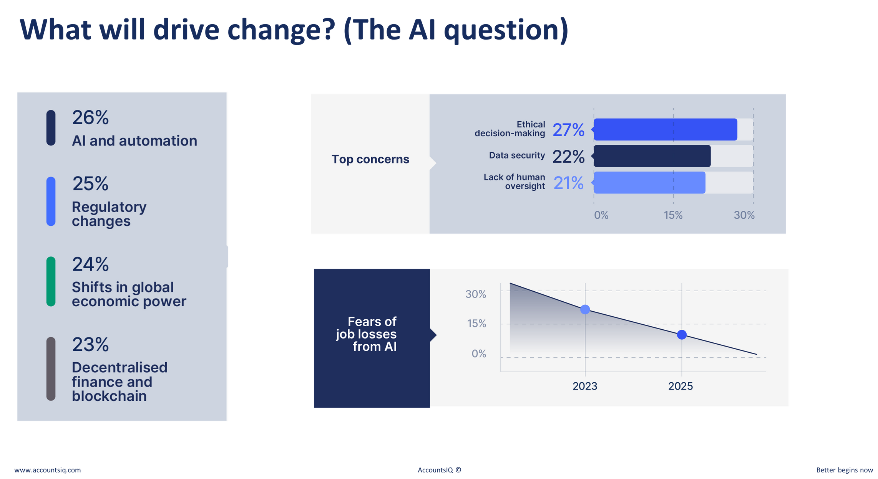
28%
28%
26%
27%
19%
25%
19%

Slide 10
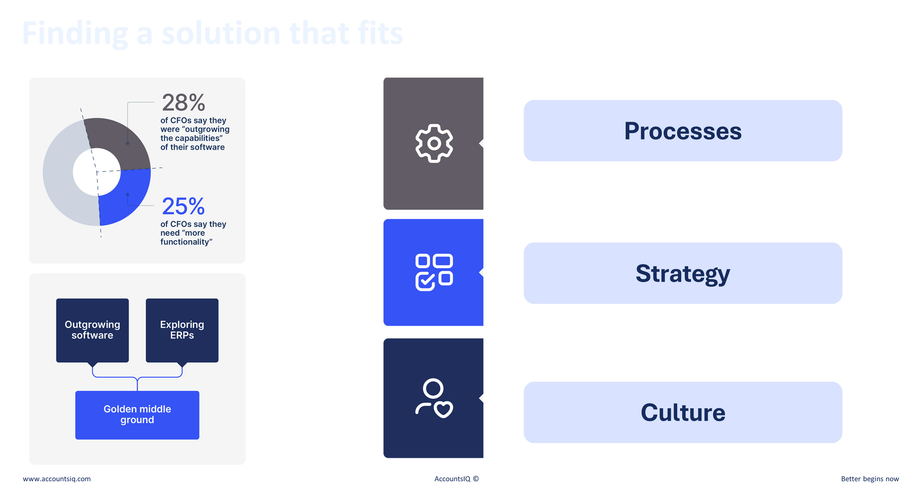
27%
28%

Slide 11
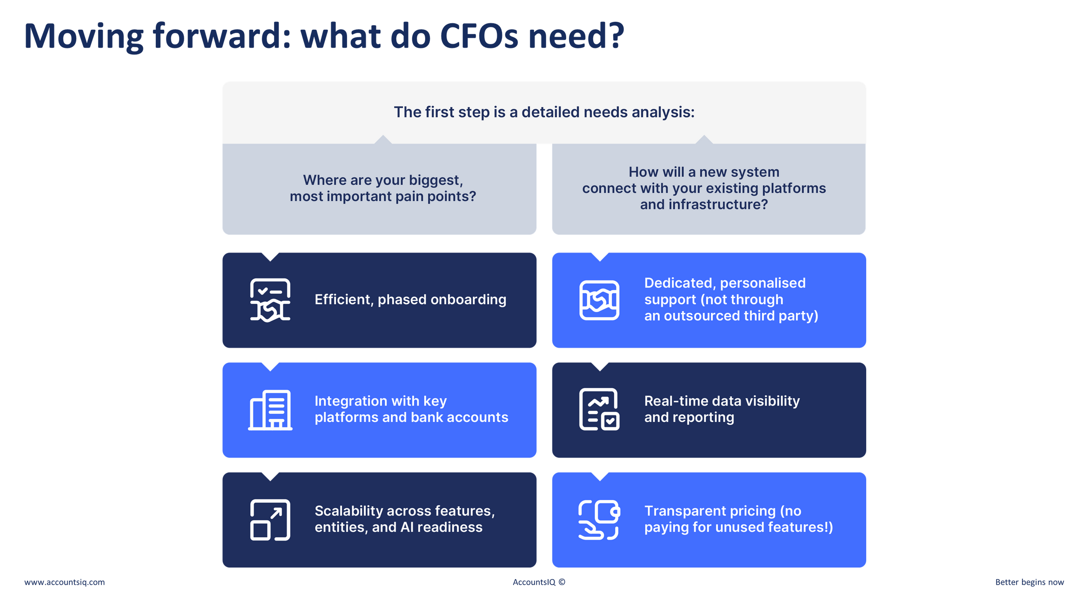

Slide 12
