Slide 1
Creating secure digital experiences for your beneficiaries
Manage all external identities with Auth0 by Okta
Brad Goettemoeller
Nonprofits Solutions Architect
Ashish Jha
Solutions Engineering Specialist, Auth0
Notes:
Brad Presents
Welcome everyone, thanks for joining. Today we’re going to talk about how to create secure digital experiences for your beneficiaries.
Entire presentation 30 min incl q&a
15 min slides
5 min demo video
5-10 min q&a

Slide 2
Secure and simplify your operations
Okta’s comprehensive solutions make it easy for nonprofits to secure and manage their many stakeholders:
Employees
Volunteers
Donors
Members
Partners
Communities
(Beneficiaries / Service Users)
Notes:
Brad Presents
These are the likely stakeholder personas that your organization interacts with. We’re going to call them identities throughout this presentation and we’re going to focus on the communities you serve specifically. You may call them Beneficiaries or Service Users. In the product demo we’re going to show, we’ll refer to this user group as Program Participants. Regardless of the name we use, we’re talking about your beneficiaries or service users.

Slide 3

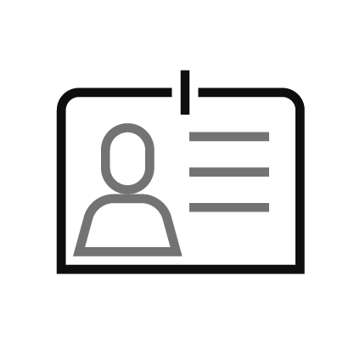

Identity is critical infrastructure
Connecting people and applications
Millions of people
Identity
Thousands of applications
Notes:
Brad Presents
The way we use the term Identity may be a new concept for you but across all sectors globally, Identity has become critical infrastructure. Identity connects people with software applications.

Slide 4



Improve access to services for beneficiaries
Security controls to secure personal data of vulnerable populations
A better UX for accessing services, information, and offerings
Flexible login options for those who don’t have smart phones or biometrics
Notes:
Brad Presents
If you address Identity as it’s own concern, you will improve access to your services because it will provide
Flexible login options for you and your external users
Security controls to protect data of your communities, many of your beneficiaries are vulnerable populations
You will delight your users with a better user experience for accessing your services and information

Slide 5

At Okta, Identity is our core mission
Modern Identity for nonprofits
Workforce Identity
Customer Identity
Every employee
Every volunteer
Every contractor
Every donor
Every member
Every community member you serve
Notes:
Brad Presents
At Okta, Identity is our core mission. We offer 2 types of platforms…one for your workforce and a couple for your external users. The product we’re going to focus on today is for what the industry calls Customer Identity….

Slide 6
Notes:
Brad Presents
and that product is Auth0.
1:30 total for first 6 slides

Slide 7
Key takeaways
1
2
3
Centrally manage and protect all Users
Quickly adapt to changing environments
Collect data points to make mission critical decisions
1
2
3
Notes:
Ashish presents slides 7-14 (12:30 total)
We'll be sharing some key product features but whether or not you choose to use Auth0 in the future, we want the takeaway from this session to be these three core tenets of a modern approach to user login security.
First, we'll talk about how you can centrally manage and protect all your users. For a charity, 'users' means everyone: your donors, your volunteers, and the people you serve. We'll show you how having one single, secure place for everyone not only simplifies your day-to-day work but also builds essential trust with your service users.
Second, the ability to quickly adapt to changing environments. The world moves fast, and your charity needs to be agile. Whether you're launching an emergency fundraising appeal or a new volunteer program, your technology should be an enabler, not a roadblock. We'll discuss how you can stay flexible and responsive.
And third, how to collect the right data to make mission-critical decisions. This is all about understanding your impact. By gathering clear insights into how people are engaging with you, you can make smarter, data-informed choices that help you grow your reach and deliver on your promises more effectively.
Ultimately, these three takeaways are all connected to helping you build a more secure, efficient, and impactful organization."
Auth0 can help you manage external identities in one location. For your staff, having all of the personas in one place can greatly improve efficiency of managing these users and can help them adapt to changes in your programs. Centralizing these users allows you to collect data points to make mission critical decisions as well.
Centrally managing users allows end users who may fit more than one persona to access your systems with just one account. For example, a user may be a beneficiary of your services but they may also be a volunteer or a donor at some point.

Slide 8
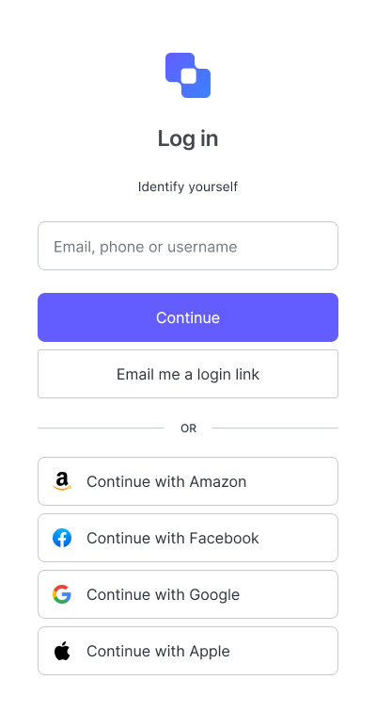
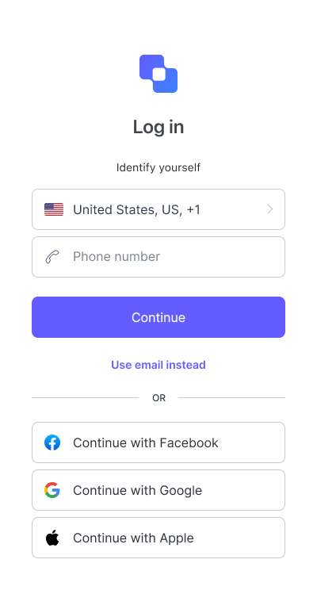
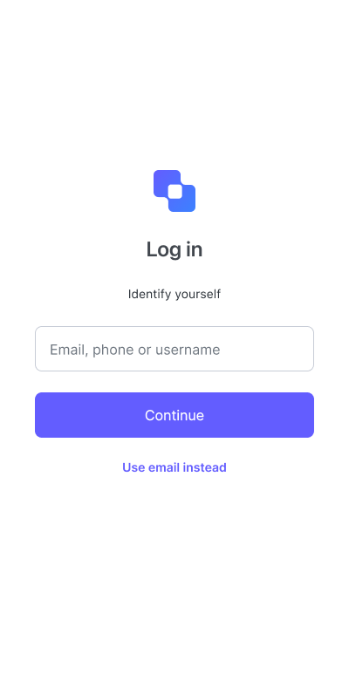
Everything begins with your login box
Tap into the power of Universal Login:
Increase your application's flexibility to adapt to changing environments and circumstances.
Offer customized experiences tailored to your different user personas.
Enhance security for all your users.
Notes:
One of the key features of any modern user identity management solution is its flexibility to adapt to changing user demands. And this starts at the Login Box itself. This means making it incredibly simple for your users - donors, volunteers, or beneficiaries - to sign in using credentials they already trust, like Google or Facebook. Or if they’re more comfortable signing in with mobile number and OTP login, you can provide them that as well.
Auth0 offers these customized experiences tailored to your different user personas out of the box without worrying about writing code for each of these login approaches.
You also enhance security for all your users as now they can just reuse their social login without the need to create another user id / password.

Slide 9
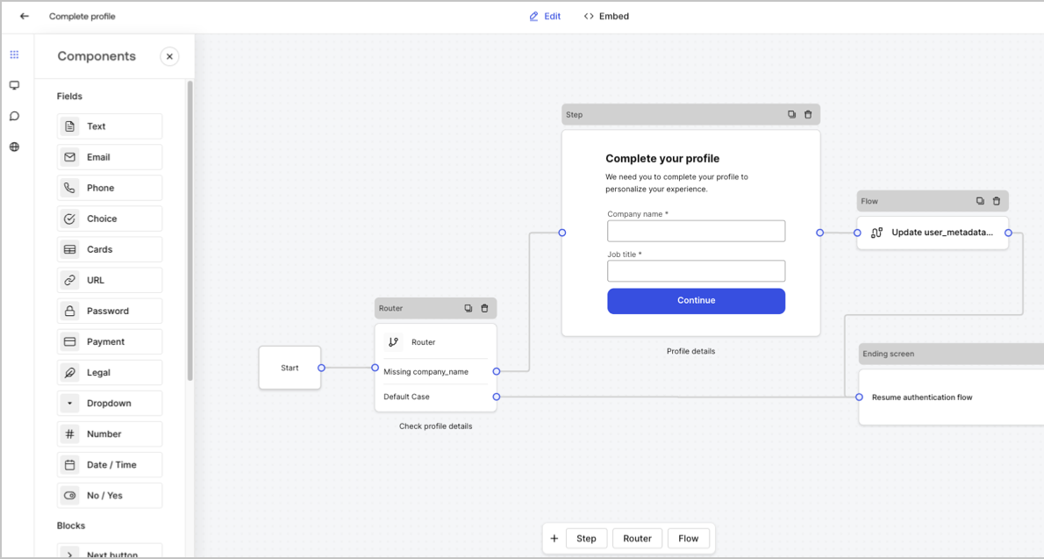
Build flexible user journeys
Dynamic no-code platform to craft unique, purposeful user signup experiences
Forms is a visual editor that allows you to create customizable signup forms that can extend your login flows with additional steps and business logic.
Notes:
Another important thing for customer retention is making the user sign up frictionless. Auth0 provides a no-code drag and drop editor that allows you to create user login experiences that are unique to your needs.
You can do things like collect more user profile details on Sign Up, ask users to accept to terms and conditions, set up payments, handle Know-Your-Customer user verification, and ask them for marketing preferences all through Auth0 itself without making any changes in your existing application.

Slide 10
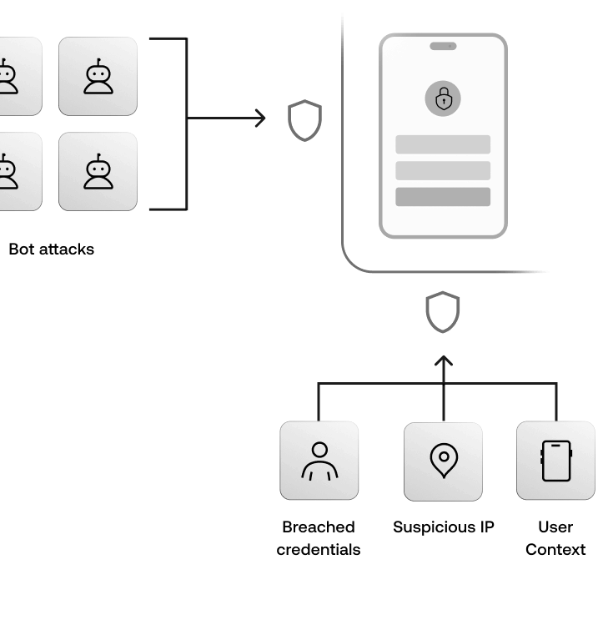

Guard applications and Users against attack
Attack protection:
Bot detection and prevention
Brute-force protection
Breached credentials detection
Suspicious IP throttling
Guard sensitive user actions like transactions with step-up MFA and biometrics
Your credentials are known to be part of a breach. Please use different credentials.
Notes:
Another important criteria for any modern user identity management tool is how they handle user security. Auth0 offers Attack Protection capabilities out of the box to guard your mobile application, web application, user portal and your users.
It can help detect attacks and stop malicious attempts to access your application such as blocking traffic from certain IPs and displaying CAPTCHA to prevent bot attacks. We also stop users from using passwords that are known to be breached in some 3P sites. And for sensitive user actions like making a donation transaction or changing profile details, Auth0 can ask the user for multi factor authentication by sending a one time passcode or asking for users’ biometrics before completing that action.

Slide 11


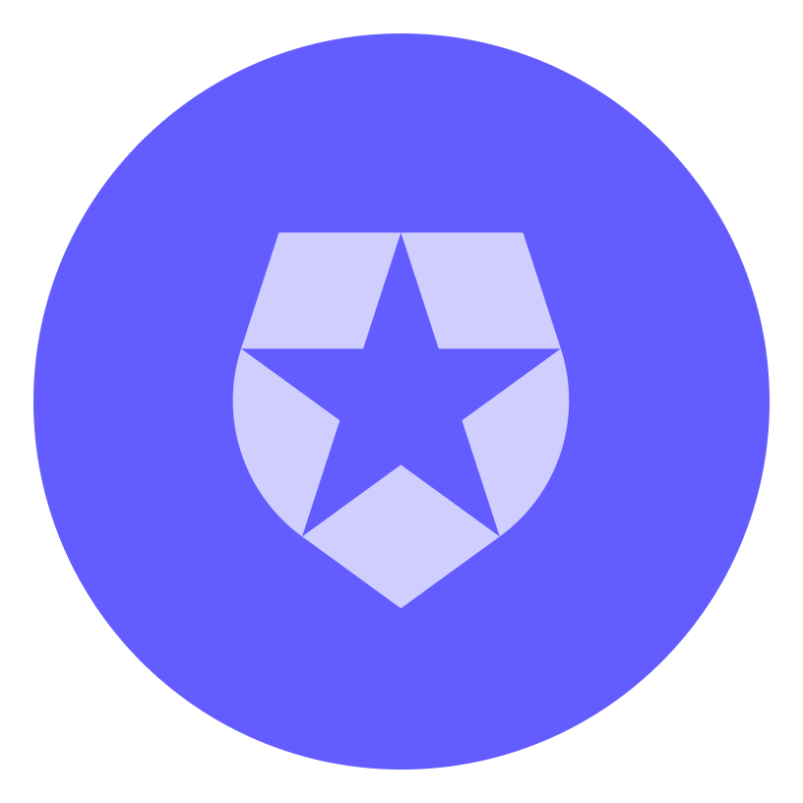

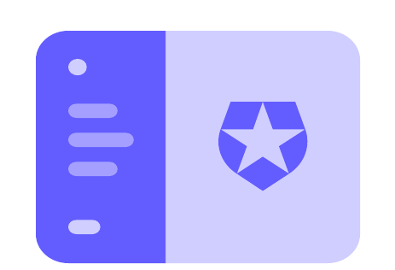
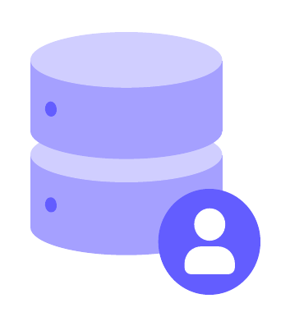
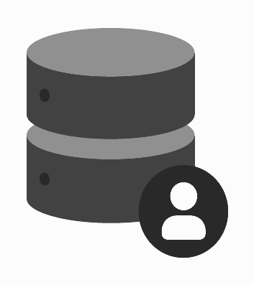
Centrally
manage all your Identities
Unify user data from different sources.
Have a single source of truth for all external users, improving user insights and operational efficiency.
Seamlessly connect with other enterprise IDPs or social identity providers.
SAML
OIDC
WS-Fed
Social
Providers

Slide 12
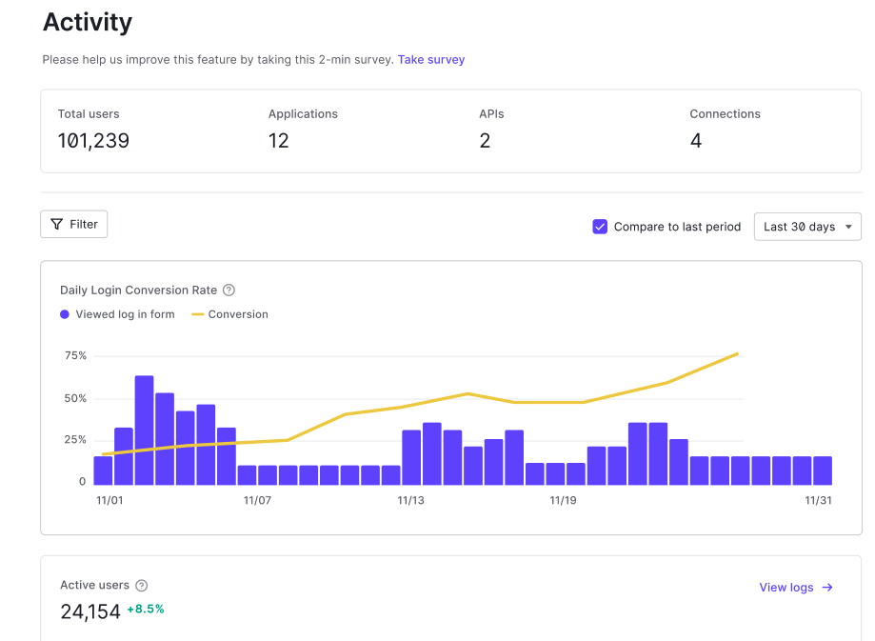
Get more actionable data
Visibility of user friction and retention with analytics dashboards
Unlock user potential and manage user experiences
Study the impact of authentication flows and policy changes on conversion funnel.

Slide 13
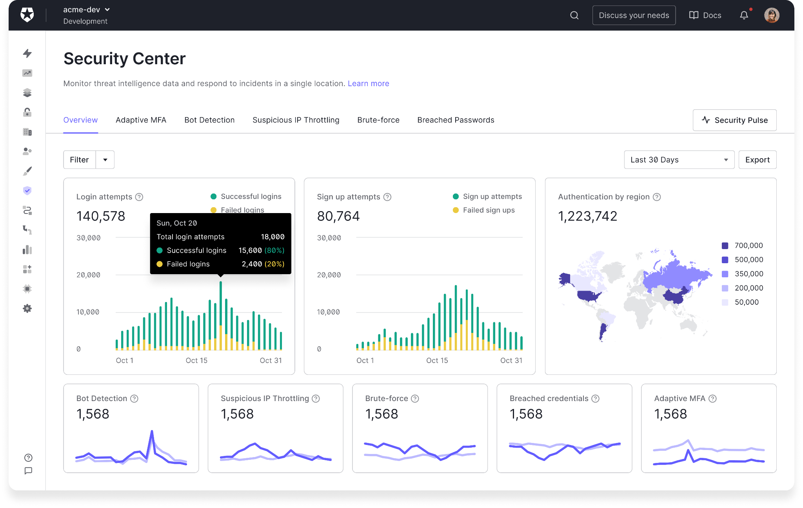
Monitor actionable data and act against threats
Real-time monitoring
Visibility of user friction and retention with analytics dashboards
Single pane of glass for the security experts
Investigate and correlate from a single event to events with similar attributes
Respond to threats with platform countermeasures
Notes:
Having real-time monitoring for your application is quite important and gives you more actionable data. With Auth0, you’ll have one central, reliable view of everyone interacting with your organization. This not only simplifies your admin work but also gives you the insights to understand what’s working or where you’re getting user friction. Any admin, no matter their technical expertise, can easily be alerted to unusual actions or patterns.
This will help you respond to any security threats or user friction challenges and make smarter decisions about your programs.

Slide 14
Putting it all together
Manage all external identities with Auth0
Greater success
Get more, so you can give more!
Login box
Flexible user journey
Analytics
Centralized identity management
Security
Capture mission critical data
Protect accounts
Adaptability
Flexibility
Multiple identifiers
Consolidate user identity sources of truth
Protect transactions
Meet your users where they are
Protect the mission
Manage all users in one place

Slide 15
Putting it all together
Manage all external identities with Auth0
Greater Impact
Get more, so you can give more!
Login box & Flexible user journey
Centralized user management & Analytics
Security & Trust
Adaptability
Multiple Login Ways
Meet your users where they are
Capture mission critical data
Manage all users in one place
Protect accounts
Protect transactions
Protect the mission
Notes:
So, to summarize how all this comes together, you can think of the journey with Auth0 in three key steps that lead to greater success for your mission.
First, we help you create a welcoming and flexible digital front door. This means making it incredibly simple for anyone - donors, volunteers, or beneficiaries - to sign in using credentials they already trust, like Google or Facebook. It’s about removing barriers and guiding every user on a journey that makes sense for them, preventing frustration and keeping them engaged.
Second, Auth0 brings all your user information together to give you clarity and efficiency. Instead of scattered lists, you get one central, reliable view of everyone interacting with your charity. This not only simplifies your admin work but also gives you the insights to understand what’s working so you can make smarter decisions about your programs.
And finally, everything is built on a foundation of security and trust. In the background, Auth0 is constantly protecting user accounts, securing transactions like donations, and safeguarding your organization’s reputation. This lets you focus on your mission, confident that the trust you've built with your community is protected.
When you combine this easy welcome, clear insights, and secure foundation, you get to the ultimate goal: Greater Impact. You improve your digital experience so you can deliver services to more beneficiaries.

Slide 16
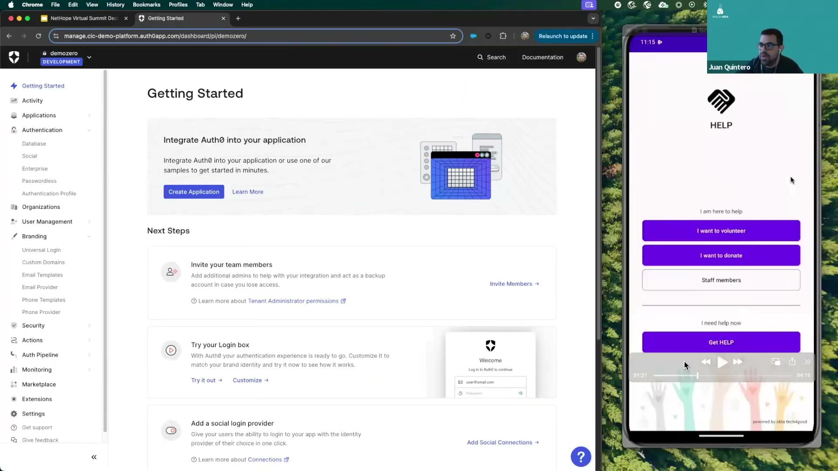

Slide 17





$24m
$23m+
in cash giving
in product & service donations
We’re on a mission to build a safely connected world where everyone can belong and thrive.
100%
88%
renewable electricity achieved
of employees actively give & volunteer
Notes:
Brad Presents
At Okta, we make a great effort to live out values, which includes our mission to build a safely connected world where everyone can belong and thrive.
This is reflected in our Okta for Good program, by mobilizing our people, products, and dollars, we enable nonprofit digital transformation, empower more equitable communities, and develop ecosystems that drive long-term change for people and the planet.
[Note: Employee participation and renewable electricity are FY23 data. All other figures are aggregate totals.]

Slide 18
Okta for Good’s
nonprofit offerings
Eligible nonprofits will get:
50 free licenses for Workforce Identity 50% discount on all additional licenses
50% off Customer Identity Does not apply to Private Cloud
50% off the Expert Learning Pass, and access to complimentary Okta Learning courses
5 complimentary passes to Okta’s annual user conference
To qualify, nonprofits must:
Hold current 501(c)(3) status in the US or your country’s equivalent
Be validated by our partner, Goodstack (formerly Percent)
Visit okta.com/nonprofits to learn more.
Notes:
Brad Presents
We offer a very robust donation and discount program for nonprofits including
Free use of the Auth0 platform up to 25,000 monthly active users and a 50% discount on Enterprise and Self-Service plans
5 complimentary passes to Okta’s annual user conference

Slide 19




Implementation support
Technical coaching
Okta implementation partners
Up to 10 hours of implementation guidance
Discounted support from service providers
Pro Bono Professional Services
Self-guided implementation
Okta Learning courses
Customer Success Hub
Okta Quick Launch Guide
Up to 19 hours of support from Okta’s Professional Services team
Visit okta.com/nonprofits to learn more.
Notes:
Brad Presents
We understand that nonprofits need more than just software licenses. You also need the expertise to implement the software in your organization. We also offer implementation support.
:45 total for last 3 slides

