Slide 1
Co-designing Wellbeing of Women’s Period Symptom Checker
Beth Granter
Freelance Digital Consultant

Slide 2



Beth Granter
Hello!
I help non-profits with digital strategy, digital transformation, and advocacy campaigns.
I’ve been doing this for 20 years.
bethgranter.com/
bsky.app/profile/megabeth.bsky.social

Slide 3

Clients

Slide 4

Wellbeing of Women
The women’s health charity.
Saving and changing the lives of women, girls and babies, since 1964.
Mission:
“Led by women’s voices, we improve health and wellbeing through research, education and advocacy.”
Notes:
Led by women’s voices – that’s key -

Slide 5
The Period Symptom Checker

Slide 6
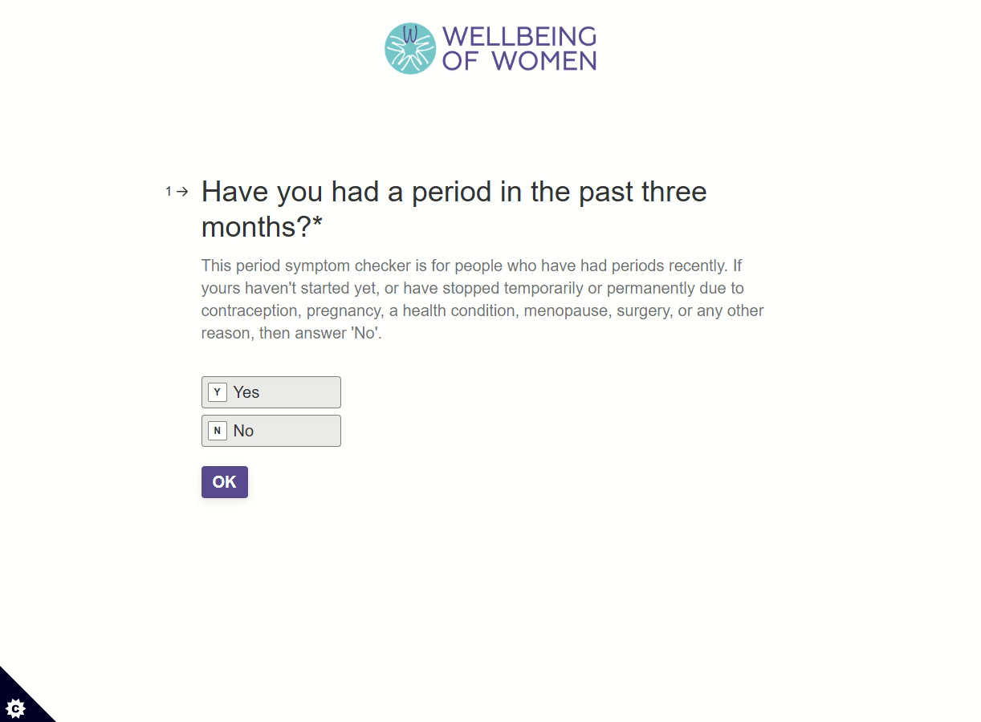

Slide 7
Human Centred Design

Slide 8
What is Human Centred Design?
Designed around the needs of ALL the different people impacted by a product.
User needs AND who else? E.g. GPs
User needs and experiences immersion and observation
Societal issues and context
Competitors / sector
Whole user journey
Prototyping
Co-design
Notes:
Societal issues example – long gynae waiting lists, short GP appointments, equalities - barriers to under-represented groups

Slide 9
Where it began

Slide 10
Government’s Women’s Health Strategy for England
August 2022
63% of survey respondents picked gynaecological conditions for inclusion in the strategy (top issue).
47% picked menstrual health (fourth top issue).
(n.b. overlap)

Slide 11
Key menstrual health issues identified by the Women’s Health Strategy
Lack of access to information
Normalisation / dismissal of pain by doctors.
Diagnosis delays due to lack of education of healthcare professionals and poor service provision.
Period poverty.
Period stigma.

Slide 12
Endometriosis facts
Affects 1 in 10 women.
Time to get a diagnosis averages 7-8 years.
Notes:
Source of 1 in 10 stat: Giudice LC, Kao LC. Endometriosis. Lancet. 2004;364(9447):1789–99. [PubMed]

Slide 13
Search trend and social listening research

Slide 14
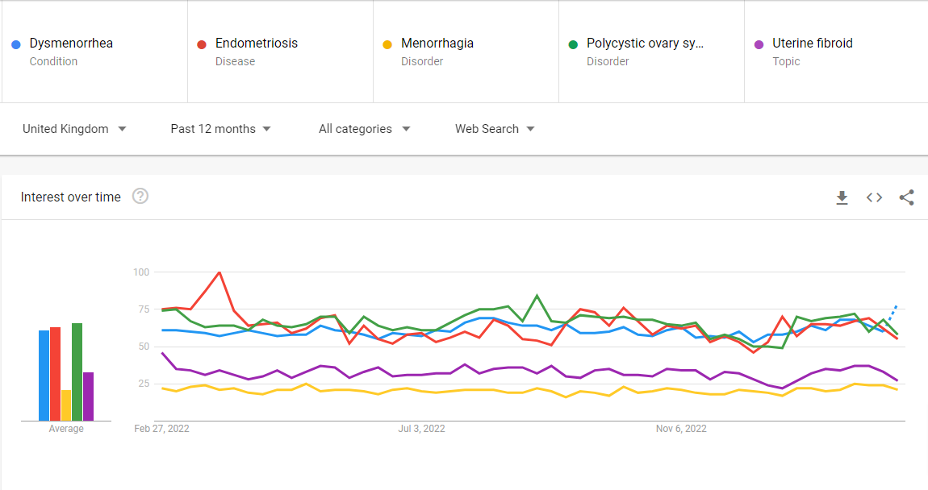
What are people searching for?
Actual used search terms grouped by medical topic
(period pain = dysmenorrhea;
heavy periods = menorrhagia)
Google Trends
Consider impact of normalisation.

Slide 15
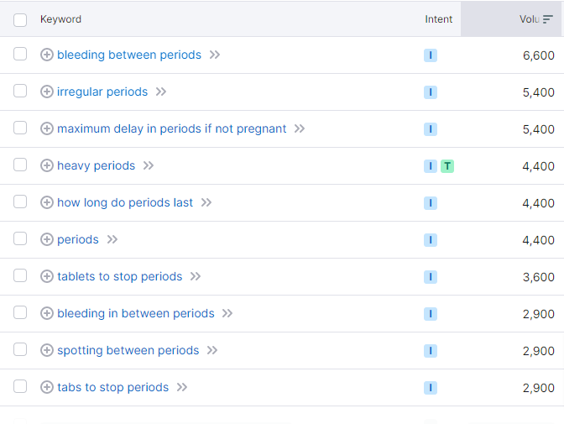
Related searches
People who searched for periods also searched for…
SEMrush.com tool
Valuable to use more than one data source.

Slide 16
Twitter conversations about periods
1 June 2022 – 31 May 2023
UK only
Individuals not organisations
Original tweets not quote tweets
Tool: Meltwater
country:GB AND ("my period" OR "period problems" OR "problem periods" OR "period pain" OR "menstrual pain" OR "heavy flow" OR "heavy period" OR adenomyosis OR endometriosis OR PCOS OR "polycystic ovary" OR fibroids OR (period near/5 cramps)) AND authorHuman:true NOT (postType:qt OR author:healing3oflife OR "AD" OR "advert")

Slide 17
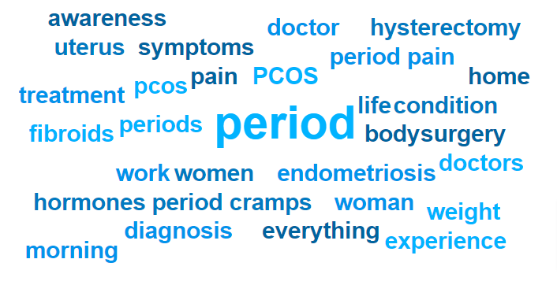
Full query word cloud (22K tweets)

Slide 18
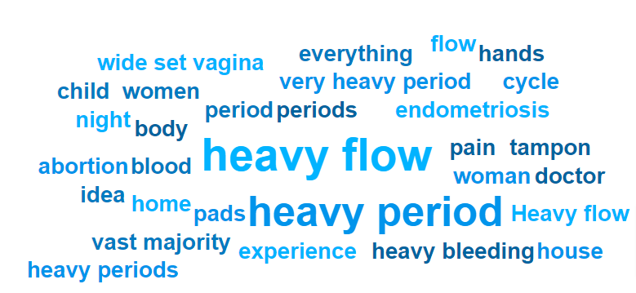
Filter: heavy bleeding (383 tweets)
Notes:
Home is about being “sent home” meaning dismissed by doctors or staying home to avoid flooding in public. House is also about not leaving the house.

Slide 19
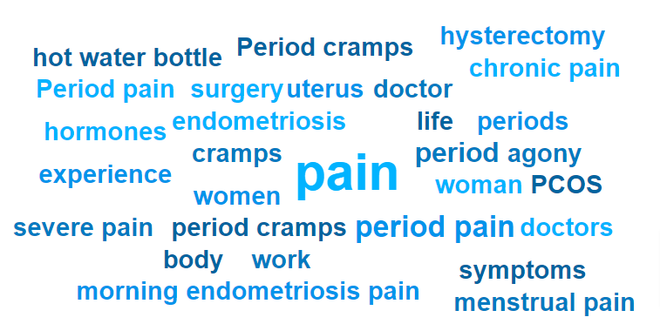
Filter: pain (4K tweets)

Slide 20
Desk research of clinical guidelines

Slide 21
Clinical guideline analysis
NICE guidelines for heavy menstrual bleeding, fibroids and endometriosis etc.
Royal College of GPs menstrual health toolkit.
NHS Scotland women’s health web pages (NHS England normalised period pain at the time).

Slide 22
Medical expert interviews

Slide 23
Researcher / expert recommendations
Wellbeing of Women spoke to menstrual health medical experts – GPs, gynaecologists and researchers: Nighat Arif, Nic Tempest, Ann Connelly, Sue Mann, Prof Hilary Critchley, Lucy Whittaker.
Info / education on pain management needed: women end up in A&E due to not taking over the counter painkillers or taking them too late.
Need to destigmatise painkillers and the ‘contraceptive’ pill, especially the latter for girls – some parents wrongly think it encourages sex.
Heavy menstrual bleeding is a key group of patients. Heavy bleeding risks anaemia.
Lack of education about what level of pain/bleeding is normal or not.

Slide 24
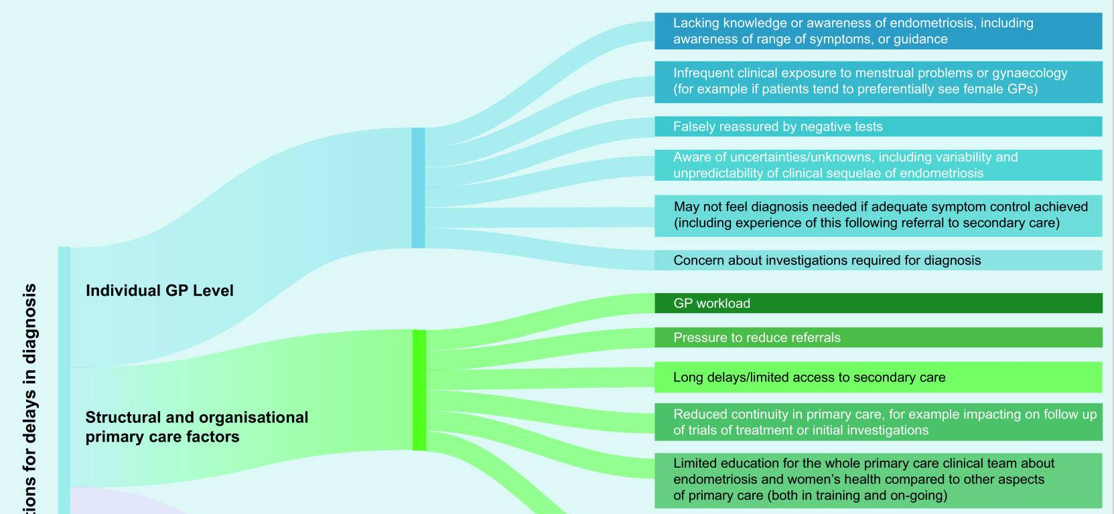
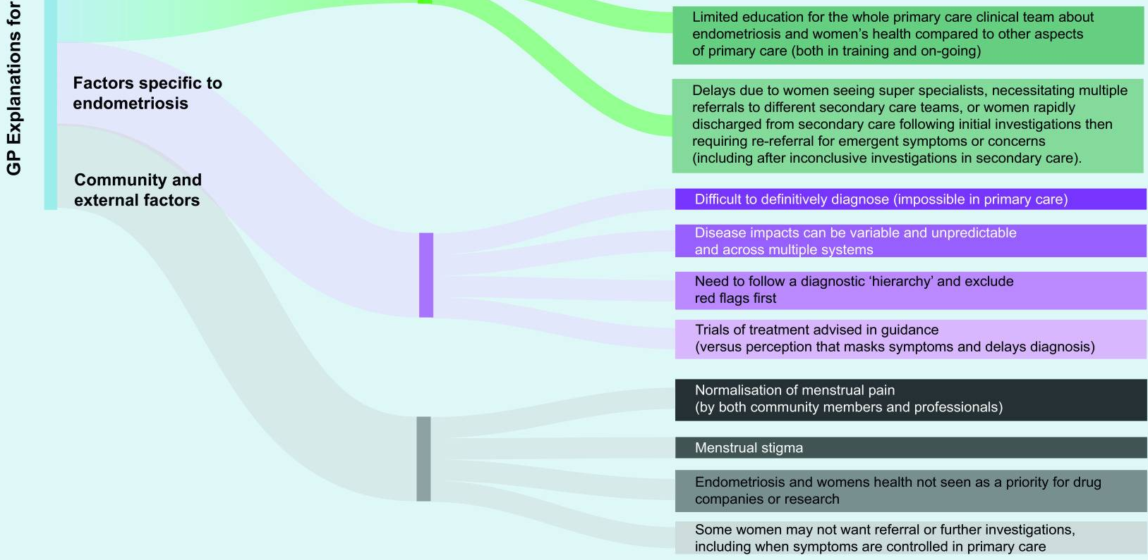
Reasons for endometriosis diagnosis delay according to GPs
Research by Sharon Dixon
Notes:
https://pmc.ncbi.nlm.nih.gov/articles/PMC8340732/figure/fig2/

Slide 25
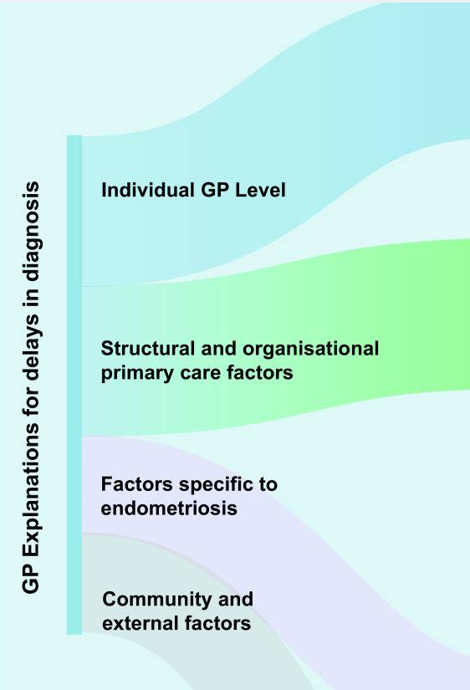
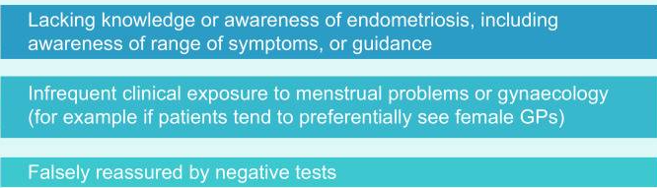
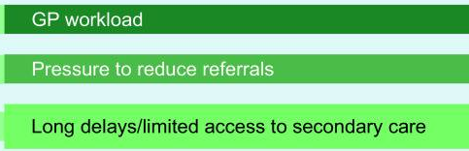
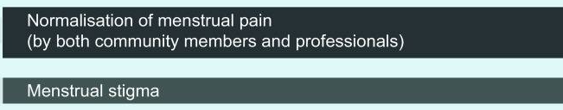
Reasons for endometriosis diagnosis delay according to GPs
Research by Sharon Dixon
Notes:
https://pmc.ncbi.nlm.nih.gov/articles/PMC8340732/figure/fig2/

Slide 26
Patient experience / journey

Slide 27
My personal experience of endometriosis and adenomyosis
20 years of agonising, debilitating pain before diagnosis.
Family and friends told me period pain was normal.
No issues shown on ultrasound, and period pain was my only symptom, so dismissed with painkillers. Years of pain followed.
Learned about endometriosis through friends
I demanded a laparoscopy after IVF failed. Endometriosis and adenomyosis diagnosed and endometriosis growths removed.

Slide 28
59%
Experience severe period pain
2023 survey of 3,000 women and girls aged between 16-40.

Slide 29
49%
Experience severe heavy bleeding
2023 survey of 3,000 women and girls aged between 16-40.

Slide 30
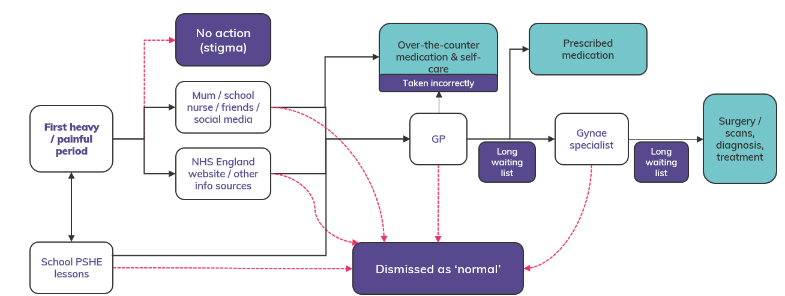
Mapping a journey of period pain to identify barriers & intervention points

Slide 31
Mapping existing campaigns/resources

Slide 32
Mapping existing campaigns against the key areas for menstrual health
Org name | Info / education | Stigma | Poverty | Pain or heavy bleeding | Diagnosis delays
Department for Education | 1
PSHE Association | 1 | 0.5
Brook | 1 | 1 | 1
Plan International |  | 0.5 | 0.5
Free Periods |  |  | 1
The Homeless Period |  |  | 1
Freedom4Girls | 0.5 | 1 | 1
HeyGirls | 0.5 | 1 | 1
Mooncup | 0.5 | 1
Bloody Good Period | 0.5 | 1 | 1
#PeriodPositive | 0.5 | 1
iRise / Empower Period | 1 | 1
Family Planning Association | 1 | 1
You Before Two | 1 | 1
WUKA | 0.5
Syrona Health | 1 |  |  | 1
Endometriosis UK | 0.5 |  |  | 1 | 1
Eve Appeal | 1 | 1 |  | 1
NICE | 1 |  |  | 1 | 1
NHS England | 1 |  |  | 0.5
NHS Scotland | 1 |  |  | 1
RCON | 1 |  |  | 1 | 1
Bodyform |  | 1 |  | 1
Nurofen |  | 1 |  | 0.5
Over 19 orgs producing UK period information/education – yet public and doctors still under-informed
Over 14 orgs working on period stigma
Period poverty (7 orgs) no longer a focus since 2020 period products in schools law change
Pain and heavy bleeding (9 orgs) often short-term corporate campaigns, or outdated/inaccurate info, or inaccessible format for those who haven’t yet sought help (e.g. assumes awareness of a particular gynae condition)

Slide 33
Number of organisations working in each area
Stigma
Information / education
Diagnosis delays
Pain / heavy bleeding
Poverty

Slide 34
Creating the campaign

Slide 35

“Just a Period” campaign
Millions of women, girls and people who menstruate suffer with severe period pain and heavy bleeding that disrupts their lives.
Instead of getting the treatment and support they desperately need, they’re often dismissed and told it’s “Just a period”.
This is unacceptable.
Nobody should suffer from period symptoms holding them back.
Creative by Lark

Slide 36
Campaign objectives
Faster access to treatment for gynae conditions that cause pain or heavy bleeding
Improved self-management of period pain and heavy bleeding
Improved menstrual health education and removal of period stigma across society

Slide 37
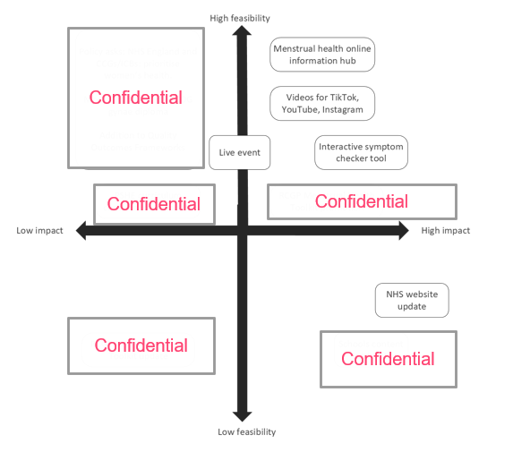
Idea prioritisation

Slide 38
The Minimum Viable Product

Slide 39
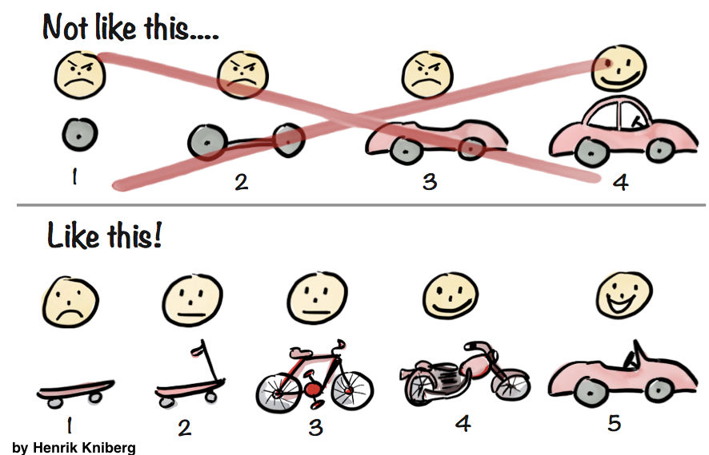
What is an MVP (Minimum Viable Product)?

Slide 40
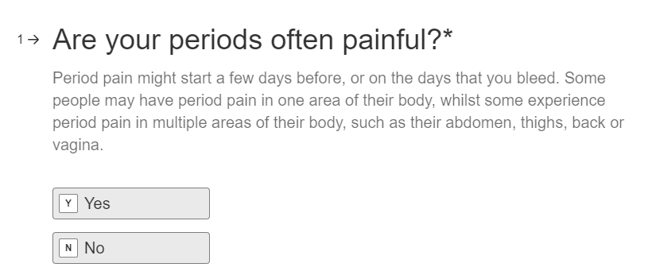
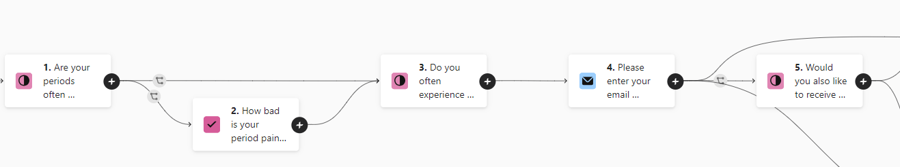
Period Symptom Checker MVP

Slide 41

The co-creation workshop
Notes:
The Wellbeing of Women team then convened a co-design workshop, inviting women with personal experience of menstrual health conditions, GPs, gynaecologists and menstrual health researchers.
In the workshop we gathered needs from all parties, deeply discussing what would be helpful, what would make women feel heard, what information was essential to GPs to streamline their subsequent conversations with patients, and what advice should be given – to inform accurately, without alarming women. This allowed us to capture a broad range of ideas. First we set the scene, sharing the insights from the campaign research, strategy and objectives – highlighting the problems surrounding menstrual health that all participants were well aware of.

Slide 42
Existing resources and other symptom checkers evaluated by workshop participants
Notes:
Then we shared…

Slide 43
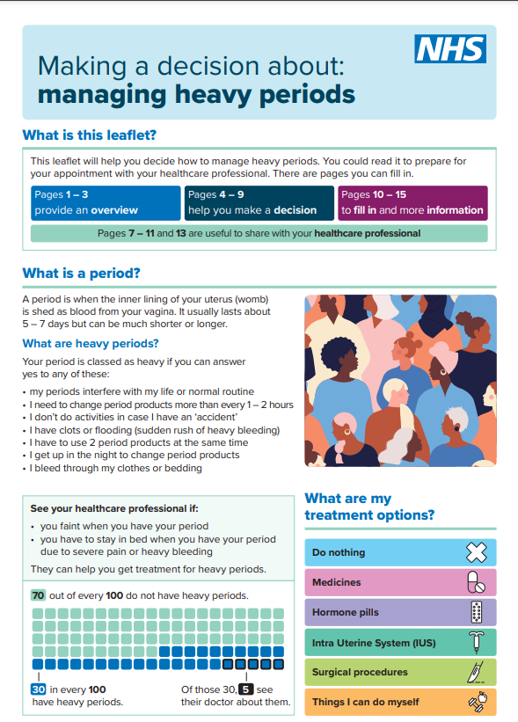
Existing resources
NHS web pages
Charity web pages
Decision maker PDFs
NHS Making a decision about: managing heavy periods (PDF)
Notes:
There was the NHS web pages, other charity web pages, and NHS ‘decision maker’ tools – which were usually PDFs like this one – Making a decision about managing heavy periods.

Slide 44
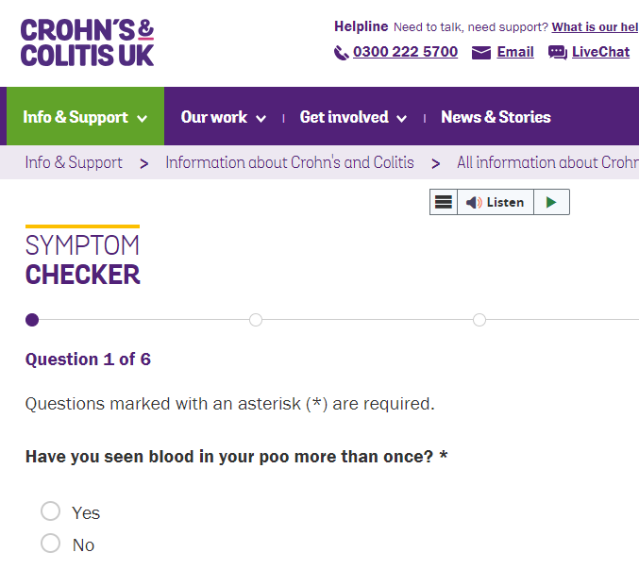
Proof of concept
Crohn’s & Colitis UK symptom checker
Notes:
Simple, short and straightforward language

Slide 45
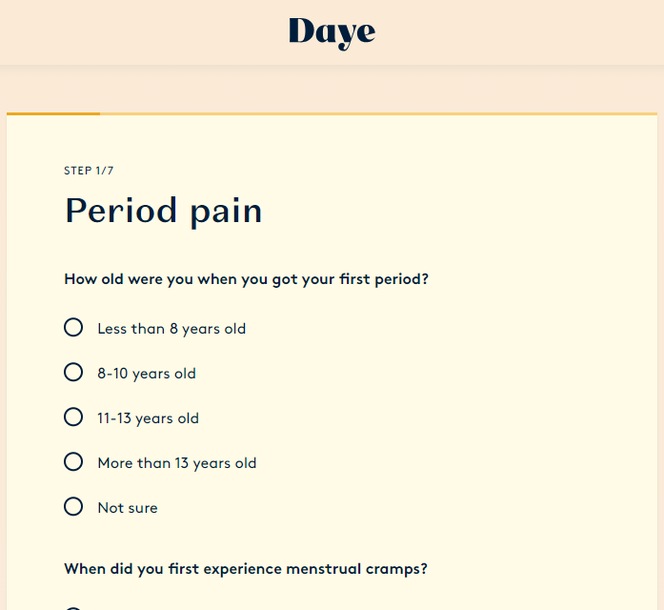
Proof of concept
Daye Period Pain Clinic tool
Notes:
Daye symptom checker – too complex, long and detailed.
For profit, private health checks advised as the next step.

Slide 46
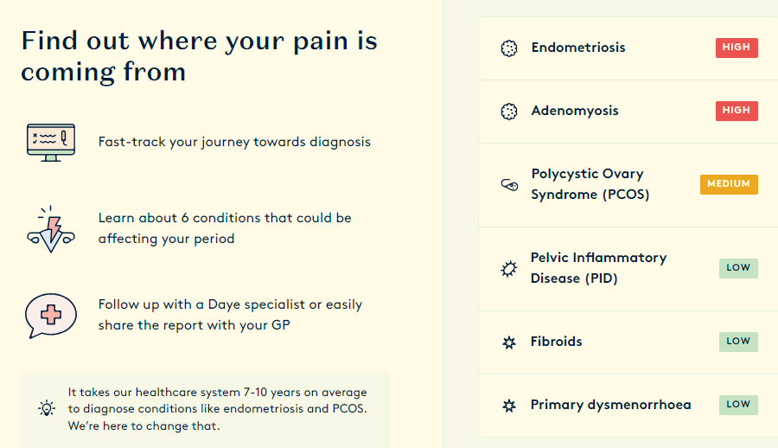
Proof of concept
Daye Period Pain Clinic tool
Notes:
Pay to view full report.

Slide 47
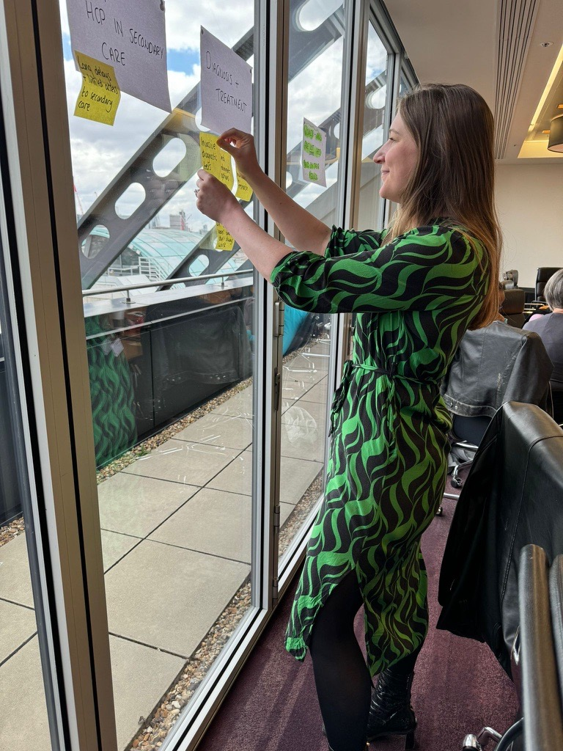
Causes and challenges
Lack of education and information about what is normal
Lack of self management of symptoms
Diagnosis/treatment delays
Due to
Lack of access to accurate information / education – for girls and women as well as boys and men
Lack of education and training of healthcare professionals.
Dismissal of pain.
Period stigma.
Long gynae waiting lists.

Slide 48

Workshop exercise: scoping and defining goals
All of the causes of the problem and challenges around menstrual health.
Which challenges could be helped by a period symptom checker, and which can’t?
Vote yes/no on each challenge.
One tool doesn’t need to solve every issue.
Examples:
YES – help to educate women & girls.
NO – difficulty getting a GP appointment.

Slide 49

Workshop exercise: scoping and defining goals
Any other challenges/barriers to progress that the tool could help to address?
How would the tool help
you / people like you
others?
Examples:
GP letter would help to avoid dismissal.
Streamline / focus GP appointments.
Photo by inforall.com

Slide 50

Vote for priority challenges to address
Of the things that the tool can help with, which are most important?
Vote!
Photo by Brett Jordan on Pexels

Slide 51
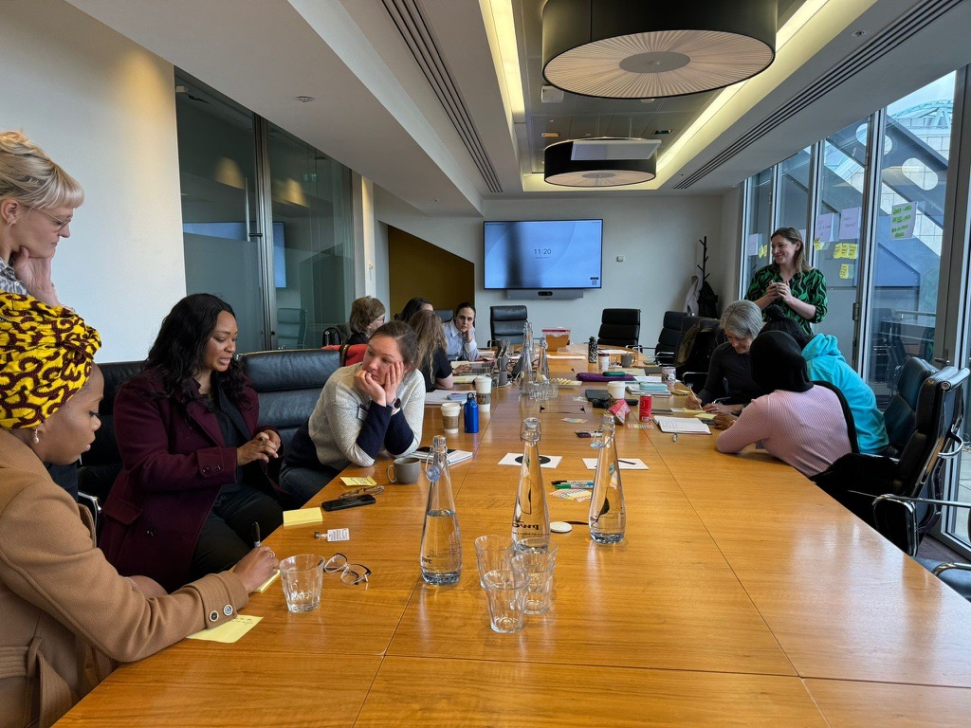
Symptom scoping
Listing all possible symptoms the tool might ask about.
Discussing challenges e.g.
irregular periods may be due to PCOS, youth, pregnancy, contraceptive medication or IUDs, menopause, other.
complexity of overlapping mental health condition symptoms and PMDD.

Slide 52
Question / journey brainstorm to generate the ‘long list’
“I want to be asked enough questions to feel I’m being given accurate advice”

Slide 53

Question for GPs
What crucial info that women could provide would help you to treat these symptoms?
How can we help avoid women being dismissed?
What information would not be needed for a GP appointment?

Slide 54
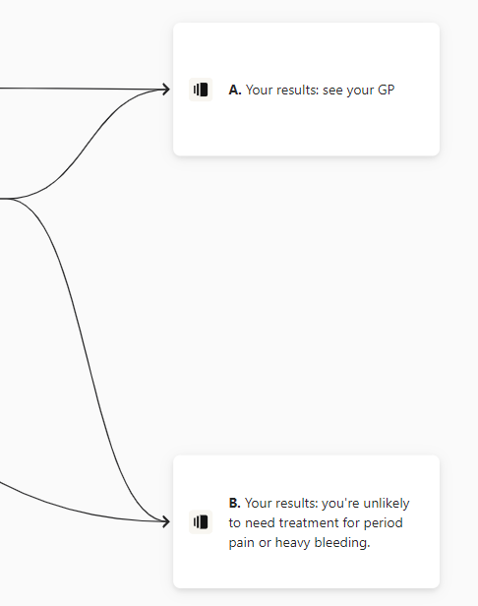
MVP outputs and end points
Recommendations for next steps – practical and further reading
Discussing how to inform e.g. cancer risks without causing alarm.
Results in web-browser (can then print)
Results via email (can then print)

Slide 55
Implementing feedback and launch

Slide 56
After the workshop
Wrote up workshop insights
Built MVP v.2.0
Shared with and added feedback from Royal College of GPs
Got feedback from workshop participants
Tested with small warm audience
Final amends
Launched (Feb 2025)
Evaluate
Adapt

Slide 57
Impact

Slide 58
16,000 users
In its first 8 weeks

Slide 59
74% completion

Slide 60
66% followed the checker’s advice to speak to their GP about their periods
(of those advised to do so, when asked two weeks later)
Of those that hadn’t done it yet, 63% planned to.
Of those who don’t plan to do so, the usual reason is they’ve tried before and felt they weren’t listened to.

Slide 61
What’s next?

Slide 62
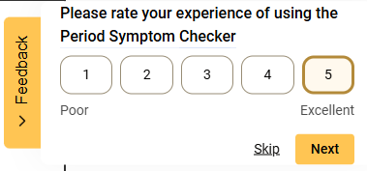
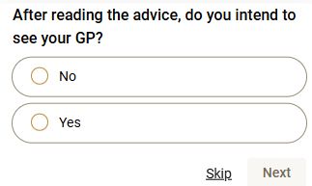
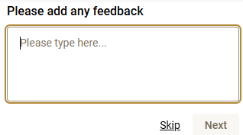
Hotjar feedback widget on end (advice) screens

Slide 63
What’s next
More feedback gathering
More analysis and evaluation
Future development TBC

Slide 64
Thank you! Bethgranter.com

