Slide 1
How to take the next best step with digital fundraising
Charity Digital Fundraising Summit 2023
01/11/23

Slide 2
We are Reason Digital
Notes:
BEN – 2 MINS TOTAL COMPNAY SPIEL + FACILITATOR INTRO

Slide 4
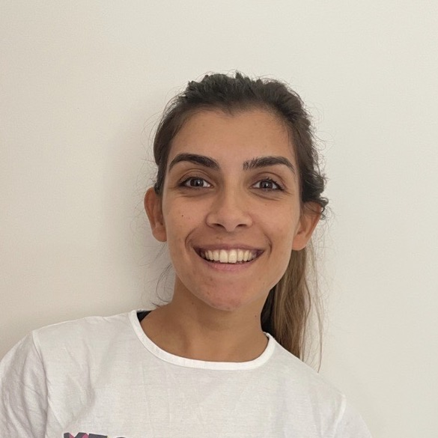
Hello! Nice to meet you
Lucy Bushby
Fanni Breczku
Sam Fox
Mo Spargo
Jasmine Vickers
Head of Strategy and Transformation
Head of Marketing
Strategist
Strategist
Strategist

Slide 6
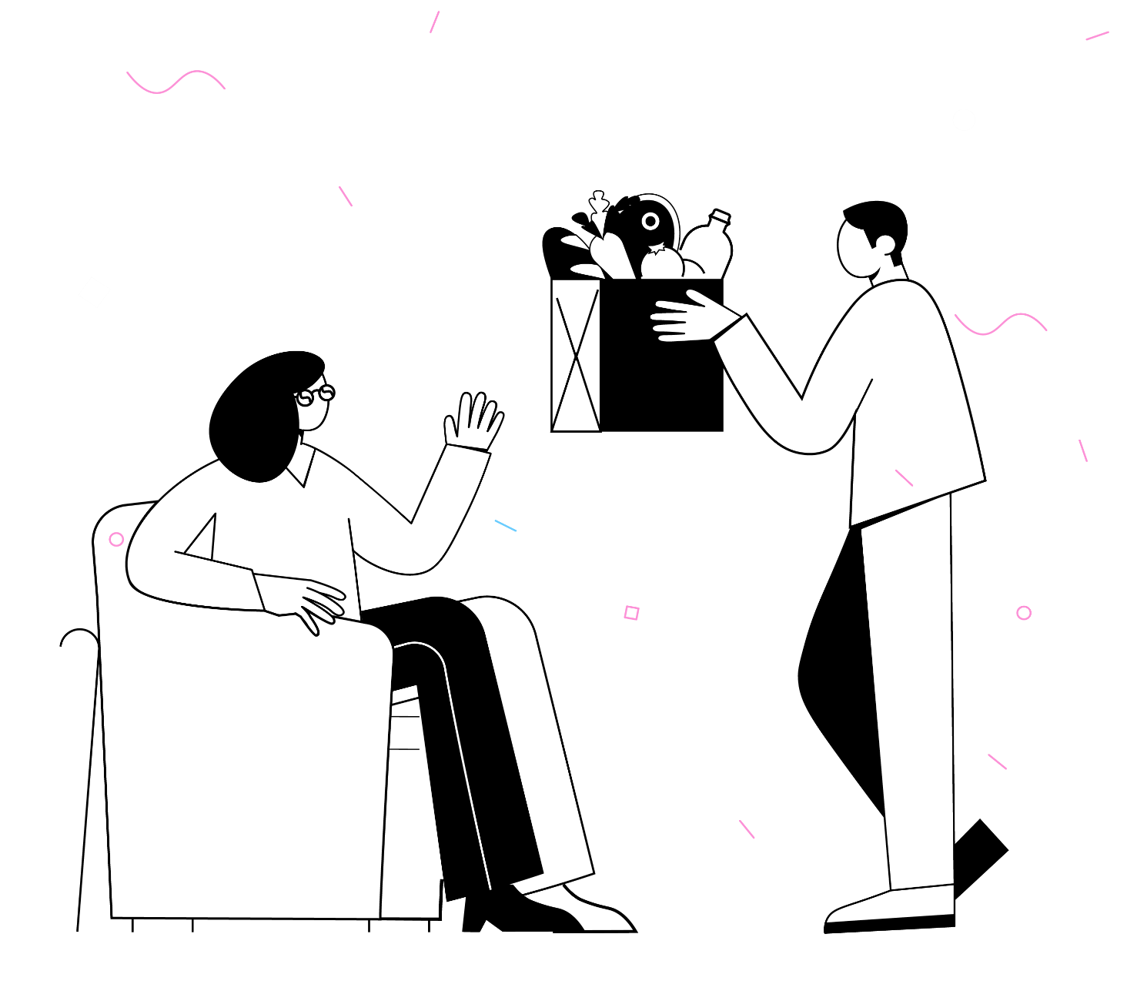
What are we doing here?
Helping you create a clear plan of action for digital fundraising
…. which will actually be used.
Notes:
LB
30 SECONDS

Slide 7
Why is this so important?
It helps you work more purposefully towards your goals
It keeps everyone aligned
It means you spend your time on the right things
It helps you to do more with digital
But, it’s really hard to get right.
We work with a lot of charities, and they all struggle with it.
Notes:
LB
30 SECONDS

Slide 8
Today we’ll cover…
Identifying challenges
Solution ideation
Prioritisation
Roadmapping
You won’t have a digital fundraising roadmap in 90 minutes, but you’ll have a start, and be able to take what you learn back to your organisation.
Notes:
KD
30 SECONDS

Slide 9
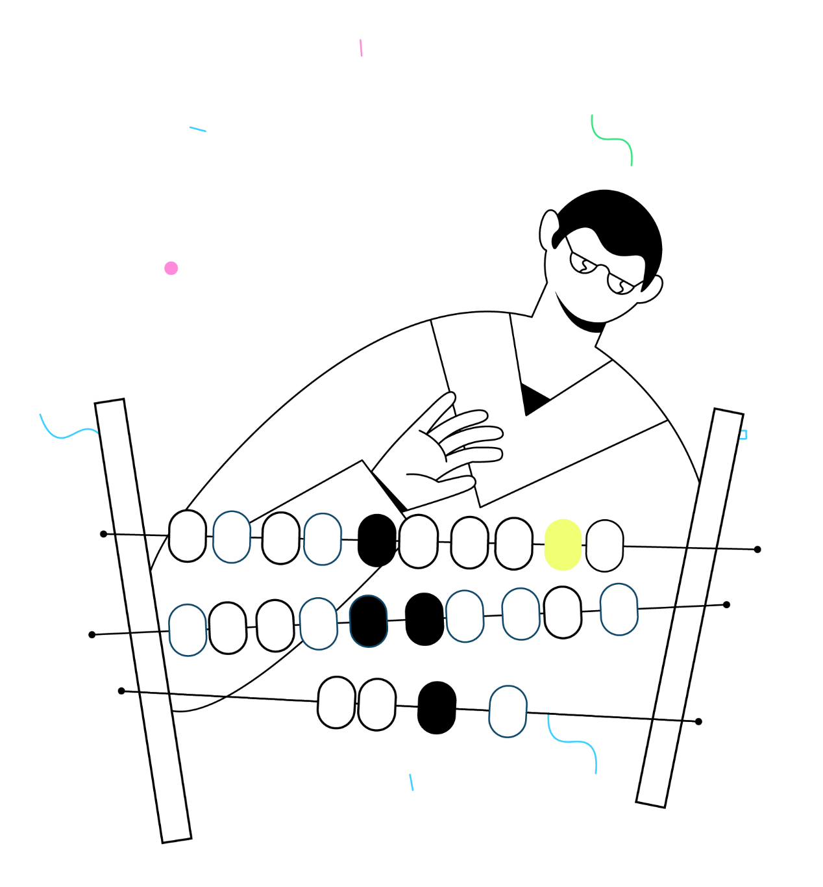
What to expect?
Lots of hands-on activities
Working as individuals and discussing with peers
Moving quite quickly
Using Miro to collaborate online in break out rooms.
RD team will be available for support
Notes:
KD
1 MINUTE

Slide 10
The plan for our session
Time | Activity
10 mins | Introductions
10 mins | Your vision, goals and constraints
10 mins | Identifying challenges
15 mins | Idea mapping
5 mins | Break
15 mins | Prioritising work
15 mins | Sequencing into a roadmap
5 mins | Wrap up
Notes:
LB
30 SECONDS

Slide 11
Before we get started…
We‘ve created this workshop for teams who are looking to plan out or troubleshoot their approach to digital.
But… the concepts work in many settings and could be applied to organising projects within any team, or just organising your own individual projects.
Everyone will have a slightly different situation, so speak to the Reason Digital team if you want help making the exercises work for you.
Notes:
LB
30 SECONDS

Slide 12
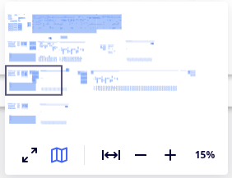
Miro tutorial
Miro is like an online whiteboard. You can use it to quickly and easily note down what you are saying, and you can use it to interact with the session more and easily contribute your thoughts and ideas.
Selecting items
Filling in a post-it
Moving around the board
Click this to be able to move stuff around
1. Fill in an existing post-it note
2. Copy and paste another post-it note
3. Create new post-it note
Move around the black rectangle to move your position on the board
These buttons zoom in and out
Click this to create a post-it
On Miro, you can double click on the post-it note and type away!
Click this to see a zoomed-out version of the Miro board

Slide 13
Top tips!
If you make a mistake or do/move something accidentally, you can press undo at the top left of the board or press Ctrl + Z
Other keyboard shortcuts work as well, like Ctrl + C to copy and Ctrl + V to paste
You can turn off seeing other people’s cursors by clicking here in the top right-hand corner

Slide 14
Your breakout room facilitator will share a link to your group’s Miro board.
Each participant has been allocated a space to work within each exercise.
Ask the Reason Digital team for help if you’re not sure about anything.
Breakout rooms
You’ll shortly be separated into breakout rooms where one of the Reason Digital team will be leading the workshop activities.
We’ll be using these throughout the session so we can have smaller group discussions about the exercises we’re doing together.
You’ll be with the same people throughout our session.
We’ll use the first breakout session for introductions, a quick Miro tutorial and very brief online ice-breaker to get to know each other a little better.
10 mins
Notes:
KD
START AT 13:43

Slide 15
Off to breakout rooms!

Slide 16
Your vision, goals and constraints
Notes:
KD
13:40

Slide 17
Take a moment to think about the bigger picture…
As leaders, it can feel like you’re being pulled in a million directions so it’s important to keep in mind what you and your team are trying to achieve.
1) Start with your overall mission, strategy and goals.
2) Then work out how your team should be supporting that.
Every charity is structured slightly differently, so we’ve kept this broad to accommodate any situation, but please try and be as specific as you can for your team.
Alongside this, it’s important to consider what constraints you’re under to make your plan realistic.
Notes:
KD
3 MINS

Slide 18
Fill out Exercise 1 on your allocated space within your breakout Miro board.
Short, bullet-pointed answers are fine.
Ask the Reason Digital team for help if you’re not sure about anything.
Your vision, goals and constraints
10 mins
Notes:
KD
START AT 13:43

Slide 19
Think about each of your digital goals in turn and give them one of the following marks:
= performing well overall
!! = not working well / at all
? = I’m not sure
Then rank them in priority order by adding ① ② ③
Evaluate your digital performance
To know where to prioritise our effort, it’s useful to reflect on how well you’re currently performing in these areas.
Top priority should be anything performing badly which is fundamental to your charity vision or strategy.
Provide information and support to our beneficiaries online
!!
Double our digital fundraising income
5 mins
!!
Digitise our volunteer journey
✰
Notes:
KD
START AT 13:43

Slide 20
Taking the first step
Notes:
LB
13:50

Slide 21
Start with the problems, not solutions
Digital isn’t something which should sit separately, on its own… it should be seen as an enabler and a useful tool for improving fundraising.
Identify a problem
Uncover the detail
Scope solutions
Test and learn

Slide 22
Example: Very low regular giving income
Identify a problem
Uncover the detail
Scope solutions
Test and learn
The vast majority of individual giving income is one-off. We struggle to convert this to regular support.
Testing on the online direct debit sign-up shows it’s clunky and confusing.
We’re not contacting donors afterwards to say thank you.
Use a different regular giving platform.
Change the front-end design and copy.
Integrate with Mailchimp to automate thank you emails
Start with changing the design and copy and integrating emails.
Review change after 3 months.

Slide 23
If in doubt, do some research
Not sure where the problems are or what your users need?
Start with some user research.
Speak to your users, front-line staff and volunteers
Look at existing user data
Try shadowing or secret shopping
It doesn’t have to be big and complicated.

Slide 24
Fill out Exercise 2 on your allocated space within your breakout Miro board.
Write down one challenge per post-it.
Ask the Reason Digital team for help if you’re not sure about anything.
Identifying challenges
Now it’s back to you. Think about where you are currently with your digital fundraising journey. Where are the problem areas that you want to address?
In this activity, use your Miro board to write down all the issues and challenges you are currently faced with.
Consider:
What is preventing you from maximising your fundraising potential?
What are your current blockers to using or optimising digital channels for raising income?
What new channels or initiatives could you try?
Are there any audiences you’re not reaching or not doing enough with?
10 mins
Notes:
KD
START AT 13:43

Slide 25
Use the post-it notes to jot down any known projects, ideas you’ve had or steps you know you need to take to make progress with digital.
Let’s get all ideas, projects and tasks down on (metaphorical) paper…
Add online donation to website
Review GA4 data
User testing on Individual Giving journey
Paid social campaign
CRM clean up
Create social media strategy
10 mins
User research with existing donors
Hire new fundraising officer

Slide 26
Off to breakout rooms!

Slide 27
Quick break!
Notes:
LB
14:20

Slide 28
Prioritising your workload
Notes:
LB
14:20

Slide 29
Prioritising work can be really hard
Since digital is so cross-cutting, there are often multiple priorities to juggle and lots to work on which all feels important – but you can’t do it all at once.
This is where having clear goals and priorities is important. It keeps you focused.
Have these handy to refer to during this next section.
Notes:
3 MINS

Slide 30
Take a look at your projects.
Do any of them absolutely HAVE TO happen by a certain date?
Maybe regulation is changing, or the project is tied to funding or a critical internal project?
Mark these with a star.
What are the non-negotiables?
There are always some things that just have to be done, so that’s a good place to start.
Notes:
START AT 14:23

Slide 31
Impact vs Effort matrix
There are many different prioritisation methods you could use but one of our favourites is the Impact vs Effort matrix (also called Ease vs Impact).
We think it’s super simple and effective and can be flexed to reflect your own interpretation.
Impact = You can consider breadth and depth of impact on your organisational or team goals.
Effort = You might want to think of this as a combination of resource, budget and complexity.
Notes:
START AT 14:25
3 MINS

Slide 32
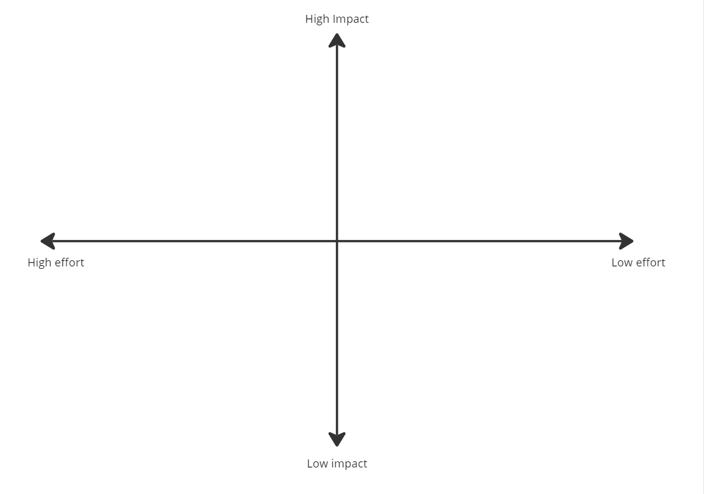
Plot all of your projects on the matrix.
Use your vision and goals to guide you.
Tip: It can be helpful to compare projects to each other to help to find the right spot.
Once you’ve plotted one you can move it if it
Impact vs Effort matrix
10 mins
Notes:
START AT 14:28

Slide 33
Off to breakout rooms!

Slide 34
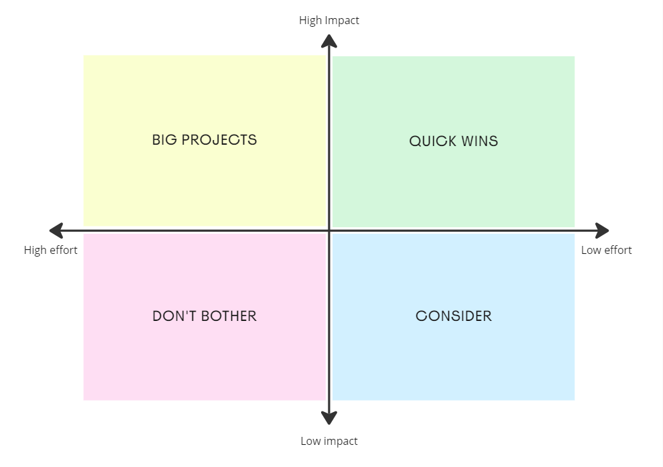
Where your projects are plotted on this matrix shows what type of project they are and whether it makes sense to deliver them.
Impact vs Effort matrix
Notes:
START AT 14:38

Slide 35
Sequencing into a roadmap
Notes:
KD
14:40

Slide 36
What is a roadmap?
A visual representation of your strategic plans, demonstrating what you will do when to meet your goals.

Slide 37
Has anyone used roadmaps before?
Open discussion

Slide 38
If you’ve done this in the past, what have you found to be the reasons?
Why do roadmaps often fail?
Common reasons in our experience:
Too detailed so it becomes onerous
Fixed to specific dates which often change
Hard to understand
Out of sight or hidden away in a document
Not kept updated
Don’t allow enough flexibility
They’re too ambitious
People don’t use them
They quickly become out of date

Slide 39
What’s the dream?
A simple and clear roadmap
Regularly updated
Accessed and viewed by everyone who needs it
Acting as a shared, single source of truth for your digital priorities

Slide 40
How do we make that a reality?
It’s not easy, but we recommend the following:
Rather than using a traditional Gantt chart which is tied to dates, use a simple “Now, next, later” Kanban style roadmap
Make it visible by embedding it into a tool which you already use so it’s where your team already work. These work in Trello, Microsoft Planner, Asana etc.

Slide 41
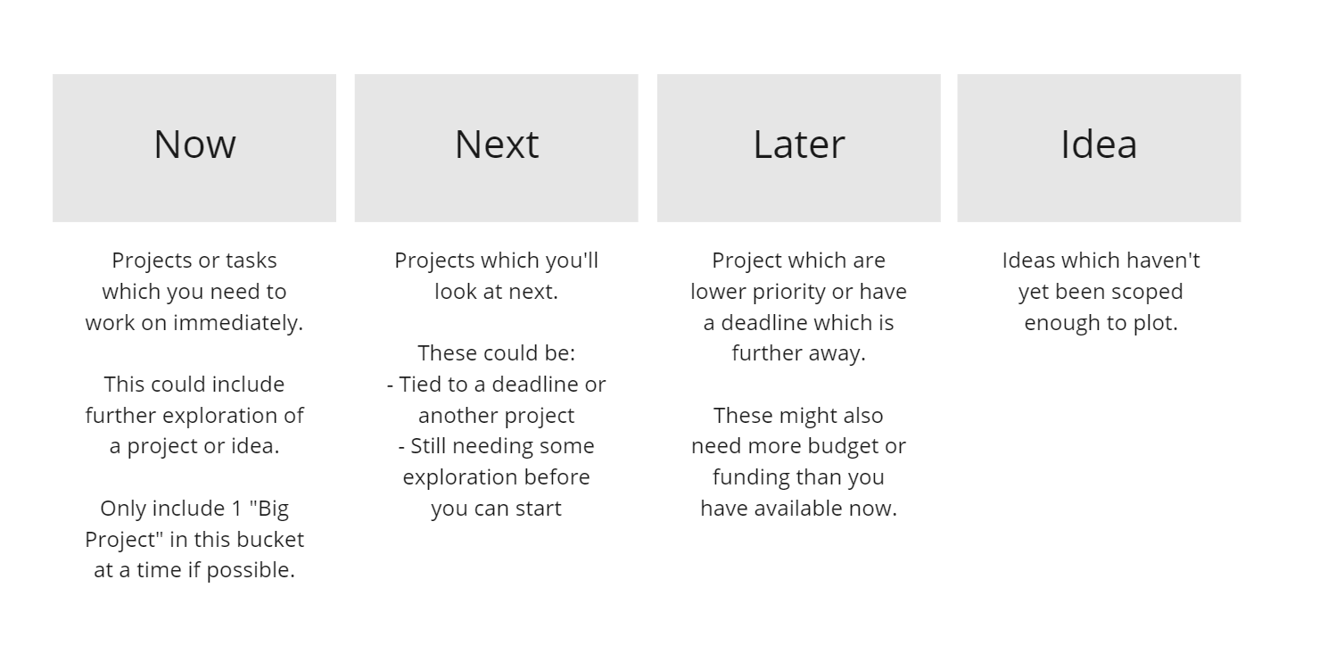
Pulling all of this together into a roadmap
Now we have all the information you need to be able to make an informed decision about the sequence of what you should do.
We’re going to plot these into a Now, Next, Later roadmap:

Slide 42
Create a roadmap by laying out the Now, Next, Later, Idea cards in front of you.
Put your project cards under the headings:
Start with your non-negotiables.
Then your Quick Wins
Then the Big Projects and Consider ones.
Check it makes sense! Some projects may need to be done in a specific order.
High level roadmap
Tip! Make sure you’re considering your constraints so you don’t put too much into your “Now” bucket.
Implement GA4
User research
New donation platform
Hire new fundraising officer
10 mins
Notes:
START AT 14:45

Slide 43
That’s a wrap!
Notes:
LB
14:55

Slide 44
Please write one key takeaway in the chat
Notes:
LB
14:55

Slide 45
Thank you for your time!
Tel: 0161 660 7949
Email: hello@reasondigital.com
Twitter: @ReasonDigital
Address: Ground Floor, 26 Lever Street Manchester, M1 1DW
Website: www.reasondigital.com

