Slide 2
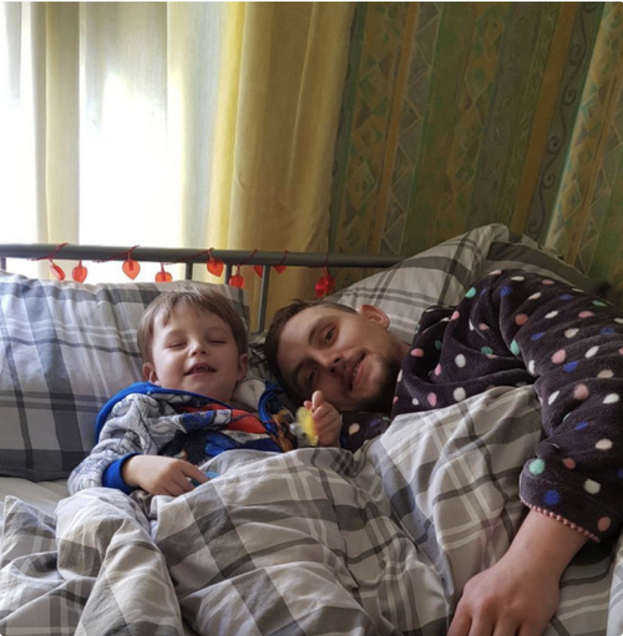
The homelessness crisis
Homelessness devastates lives.
It’s systemic, stubborn and cyclical.
By the end of 2021, 271,000 households in England had experienced the worst forms of homelessness.
It is predicted that around 1.7 million UK households will be impacted by the cost-of-living crisis and be pushed into homelessness.
This will have urgent and compounding effects on an already stretched social and health care system.
Thank you so much for giving me deposit money for my room, it’s amazing not sleeping in a tent and feeling like life is worth living now, I get to have my son over.
Dale, beneficiary

Slide 3
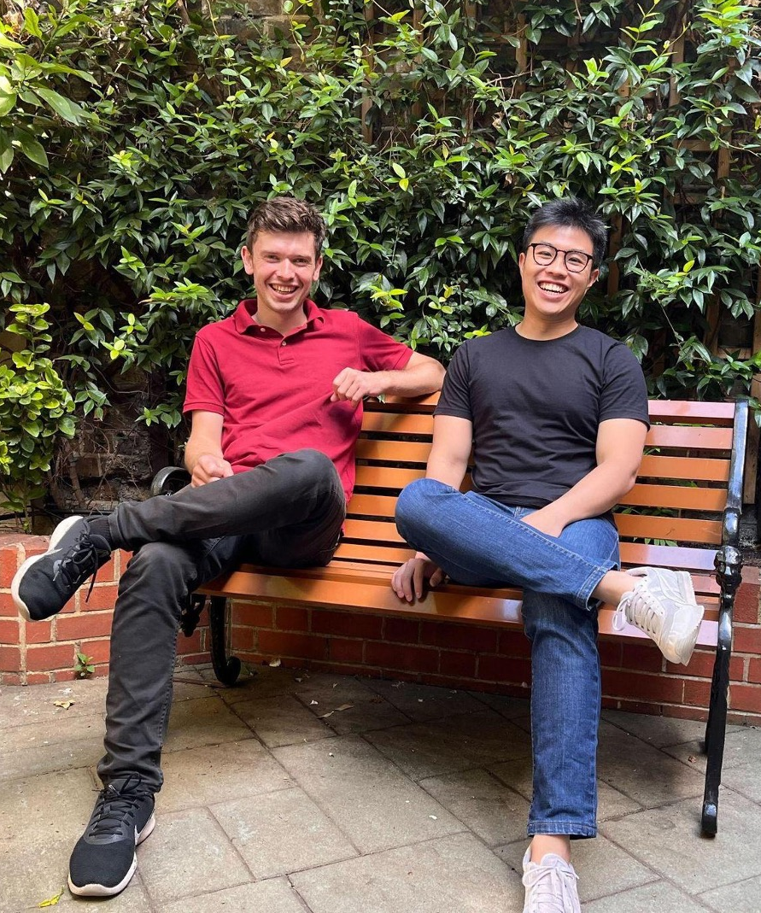
What we do
In 2019, Greater Change was created to plug the gaps in the pathway out of homelessness by providing service users with large cash grants and financial planning support to overcome financial barriers that stood in their way.
The initial goal was to help 20 clients and craft the most effective service to tackle homelessness; supported by Aspire Oxford and Oxford University Innovation.
Since then, we have supported over 700 people to take large steps out of homelessness.
Greater Change’s next immediate goal is to help 1000 more people in the next 2 years and generate the evidence and scale necessary to inform public policy.
Ultimately, we want to solve the problem of homelessness, not just manage it, and we need your help.

Slide 4
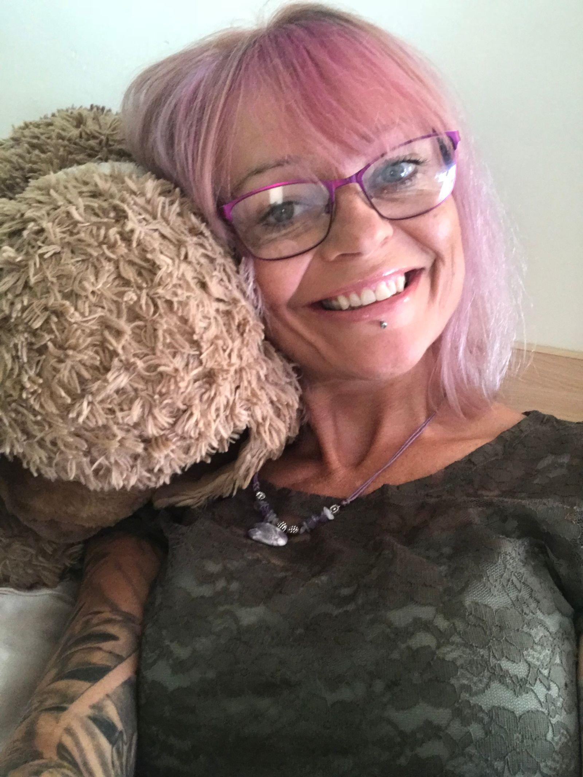
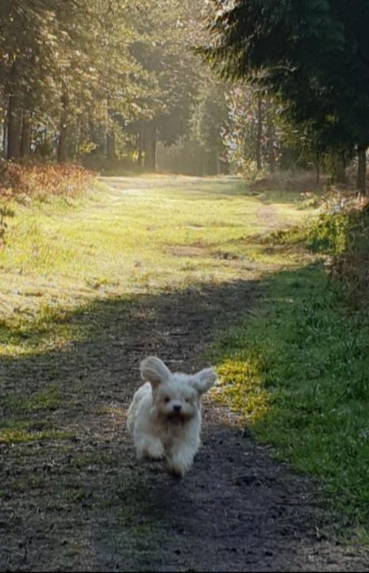
How we work
1
Many people experiencing homelessness lack financial support and resources to escape their situation.
2
We work closely with local partner charities who refer people facing these dead-ends in the statutory pathway to us.
3
We provide personalised grants and financial planning support to unlock key step changes and help people break out of the cycle of homelessness.
We supported Jane with a £1000 budget for vital furnishing and flooring when she was finally assigned a house on the housing register. This meant she could wash her own clothes, cook for herself and keep her home warm.
Jane works now as a peer mentor and adopted a dog 7 months ago. She often goes on long walks with her in scenic spots around Blackbird.
4
With this catalytic support, people are able to finally move on with their lives and take steps towards the ambitions and goals.
Social care capacity is also freed up to allow others to get the support they need.

Slide 5
What we have achieved
At Greater Change, we have always believed that we can help people achieve an effective and efficient move out of homelessness, by giving them the dignity of choice and the catalytic resources they need to take concrete action.
Over the course of the last 4 years, we have proven this to be true.
We have released £530,675.83 in personal budgets to support 762 people to take steps out of homelessness and with this initial fund, we have been able to unlock over £27.2 million in cost savings to the public purse.
All of this was achieved with a small core team of 4 full-time staff along with some very dedicated volunteers and freelancers.
We wanted to make data on our outcomes easily comparable and encourage society to hold us to account on what works, rather than what makes us feel busy or good and so, release details of how we conduct our research and analysis each year in comprehensive reports at: https://www.greaterchange.co.uk/our-impact
Key Impact Highlights from 2022/2023:
86% of people sustained their move on into stable housing
48% of people have made it into employment
75% maintained or improved their substance use recovery; compared to the 33% successful treatment completion and sustainment rate seen by Public Health England [1]
Fewer than 8% of our ex-offending cohort, re-offended in the 12 month period following our support; compared to national 12-month re-offending rates of between 23.1% to 31.8 [2]
[1] Public Health England: Drug Recovery Rates https://www.gov.uk/government/news/drug-recovery-rates-showing-signs-of-slowing#:~:text=Among%20all%20of%20the%20adults,treatment%20successfully%20and%20not%20returned
[2] Ministry of Justice: Proven Reoffending Rate https://www.gov.uk/government/statistics/proven-reoffending-statistics-april-to-june-2021/proven-reoffending-statistics-april-to-june-2021

Slide 6
Operational Challenges
Our ambitions and vision for Greater Change as an extremely efficient cash-transfer charity with a huge focus on evidence meant that we demanded a lot of our tech.
Key Needs:
We needed very good CRM software that will allow us to be quite hands on with the data
Our daily operations had to be done productively and efficiently
A lot of our work, even before covid, required remote-working
We had limited in-house resources to achieve all of the above
Key Resource:
https://charitydigital.org.uk/products/unsure-what-you-are-after-were-here-to-help
Notes:
And where one piece of software couldnt do it all on its own, we had to make sure they were able to talk to each other
Tools that directly supported us to this were important
But equally important were tools that prevented us from experiencing dramatic down-time

