Slide 1
Charities, tech and climate
Alice Kershaw, Head of Digital Transformation
Rachel Hall, Climate Change Manager
November 2023

Slide 2
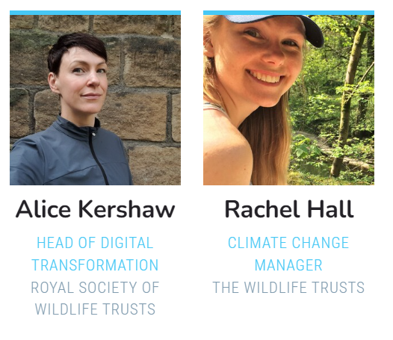
Introductions
Notes:
AK and RH

Slide 3
The Charity Sector
Overall, the report revealed three key themes:
Charities are concerned about climate change but have yet to take action
There is no universal understanding of environmental sustainability in the UK charity sector
Charities are unclear about the importance of environmental sustainability in their organisation
Notes:
AK

Slide 4
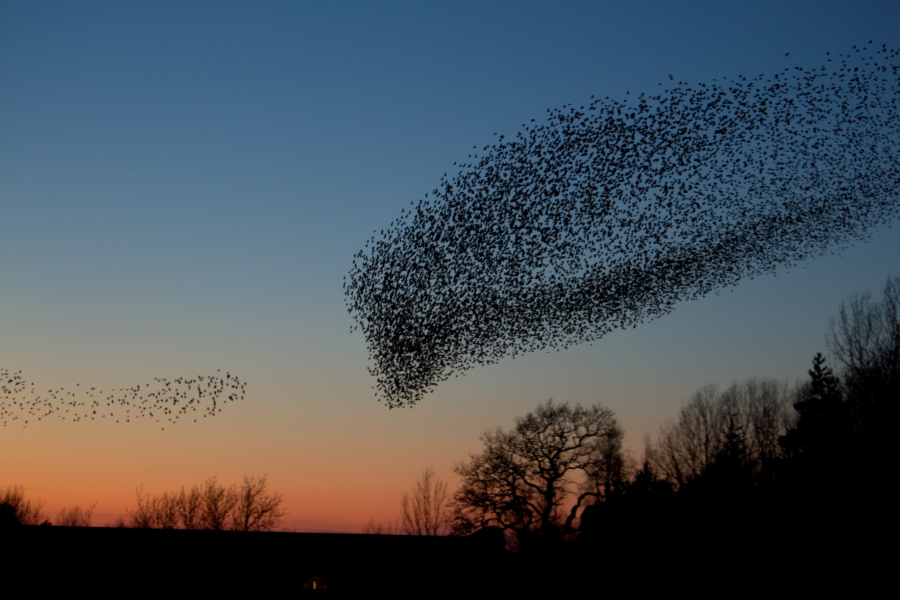
What is The Wildlife Trusts?
Notes:
AK
Federation
Land owning – one of the largest land owners

Slide 5
Notes:
AK

Slide 6
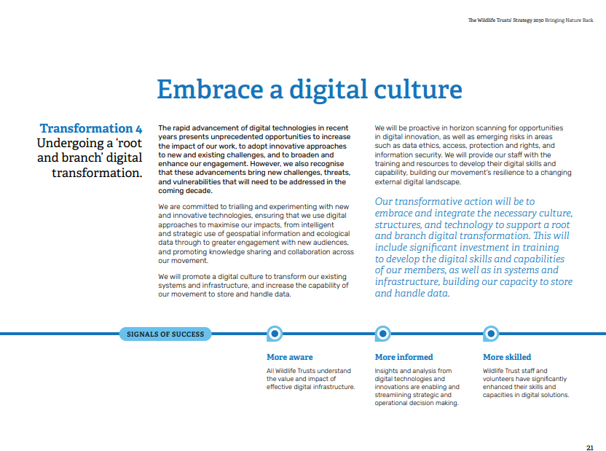
Notes:
AK

Slide 7
Notes:
RH
Charity Digital report finding – concerned but yet to take action. There is no universal understanding of environmental sustainability in the UK charity sector. Charities are unclear about the importance of environmental sustainability in their organisation
We are clear that it plays a key underpinning role across our federation and our mission.
But see it first and foremost as getting the basics right, and standing you/us in good stead as organisations
Here’s what we’re doing…. "We will work together to establish a comprehensive programme to reduce our environmental footprint and set ambitious targets in relation to key areas such as carbon emissions reduction, use of chemicals on land, and renewable energy generation“
Climate change as a culture shift, underneath everything we do as a pillar
Not just us

Slide 8
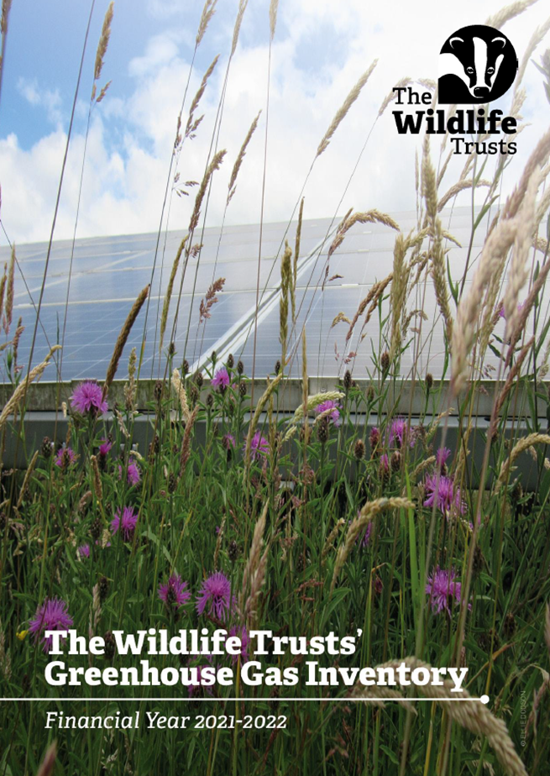
Action on climate change mitigation and adaptation
The Wildlife Trusts Position on Climate Change
The Wildlife Trusts' GHG Inventory FY2021-2022
The Wildlife Trusts’ (2022) Changing Nature
Notes:
RH
This relates to both climate change mitigation and climate change adaptation
Wouldn’t be possible without access to publicly accessible and free data – such as Climate Risk Indicators published by the Met Office, or the BEIS conversion factors
But also could be so much more efficient with access to more digital expertise and platforms. How can tech help us scale what we're doing?

Slide 9
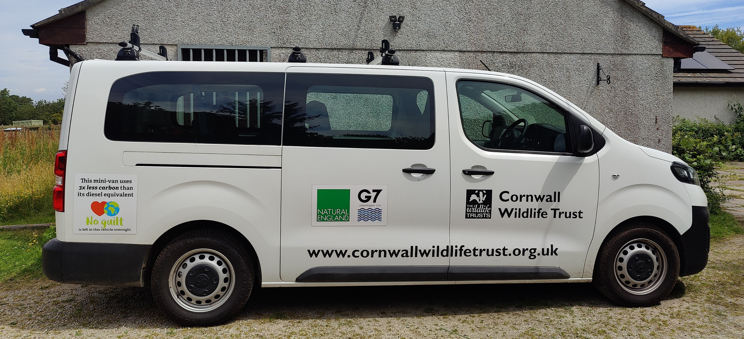
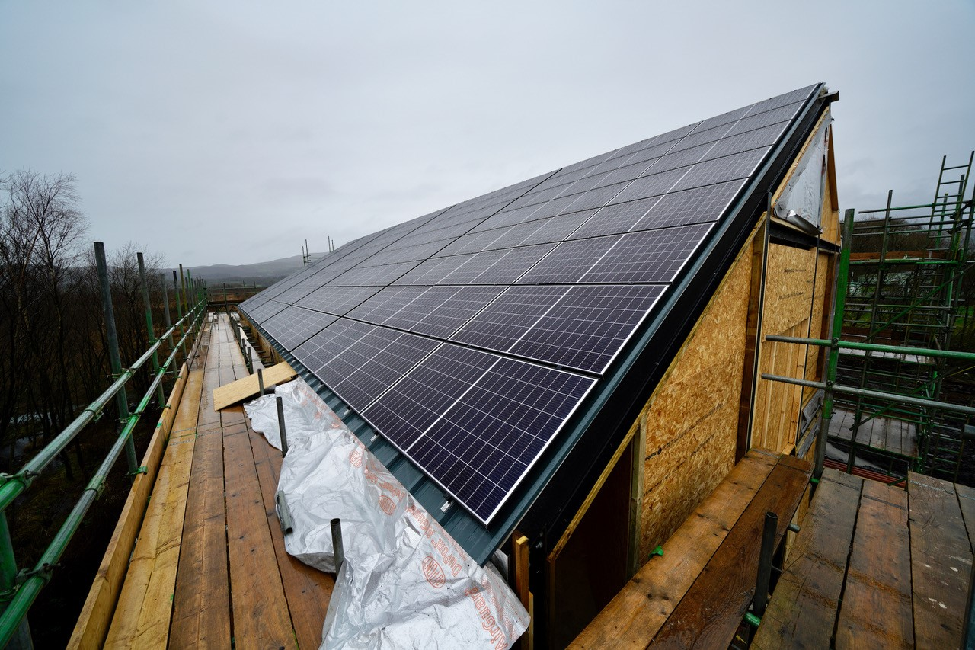
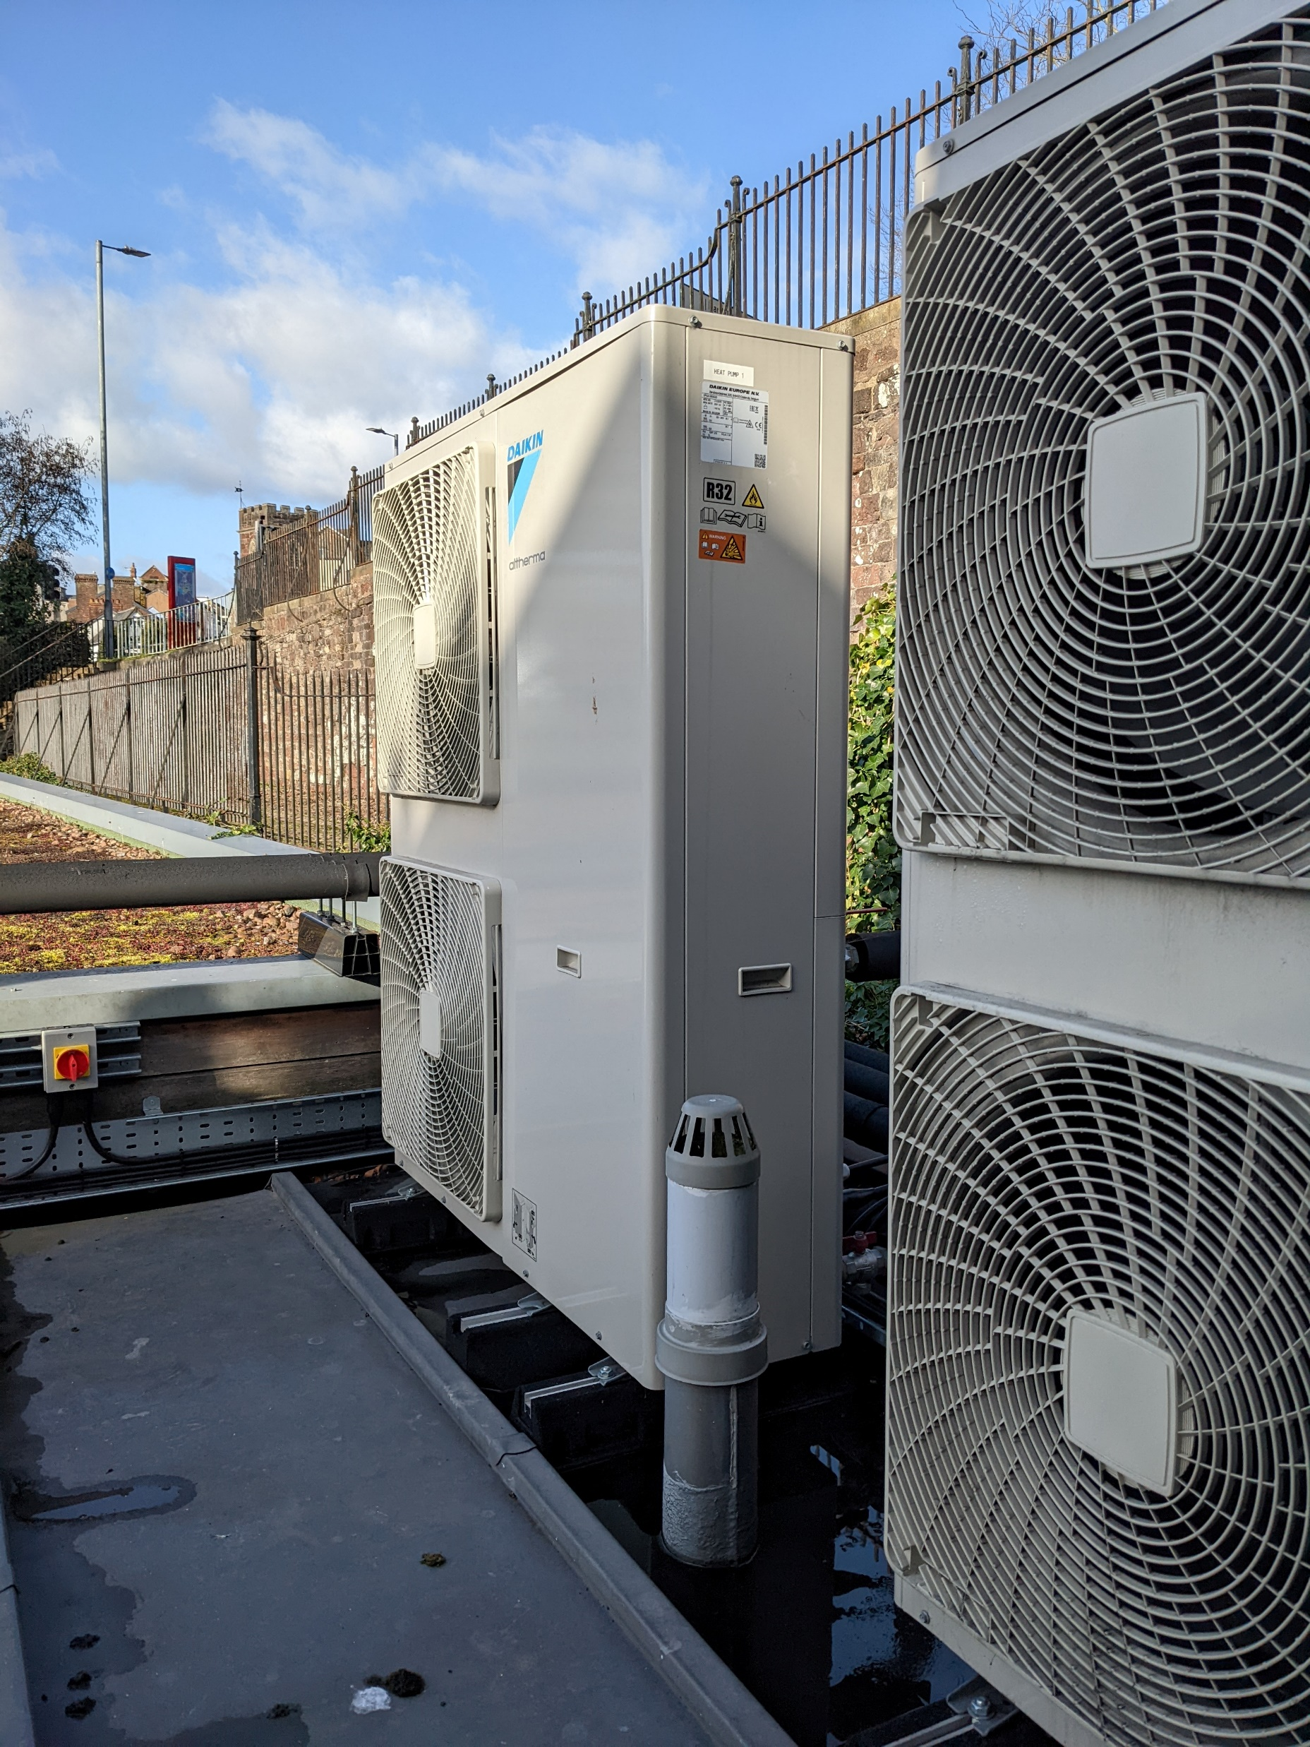
Reducing our emissions
Notes:
RH
Climate change as a culture shift too as well as direct actions, don’t underestimate the value of your people in this
And remembering it’s not just us grappling with this, networks and working together across organizational boundaries is key
Ultimately the balance is to make sure it helps us to prioritise, and make smarter decisions about the most efficient and effective pathway for us to achieve net zero alongside nature’s recovery!

Slide 10
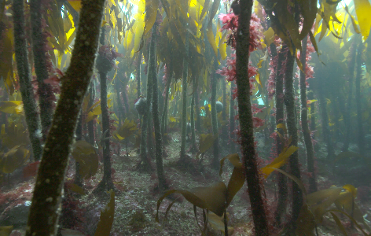
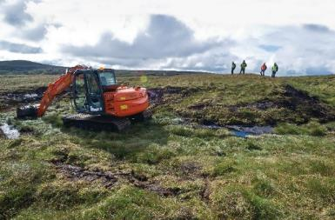
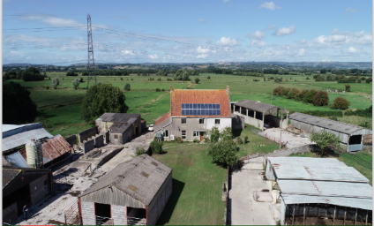
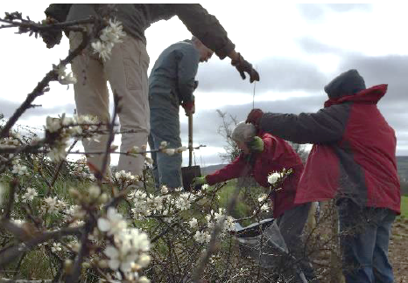
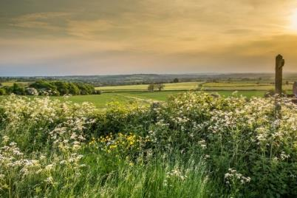
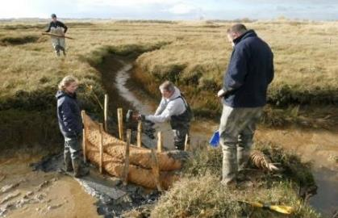
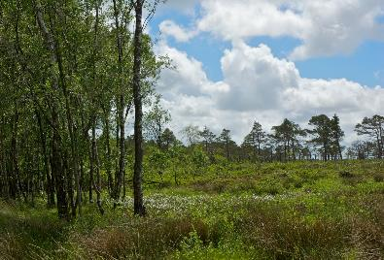
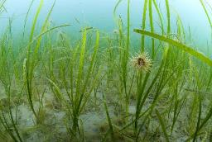
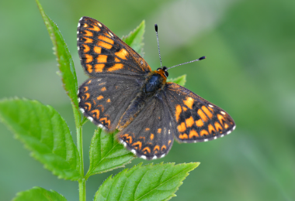
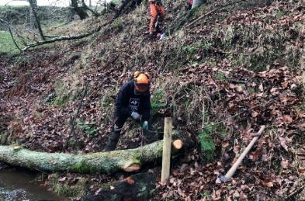
Alongside all of this
Notes:
RH - Alongside the role of nature in both helping us to capture and store carbon but also in reducing the risk we face and increasing our adaptive capacity to climate change
This is our bread and butter, but digital could help us measure and monitor a wide variety of impacts more readily

Slide 11
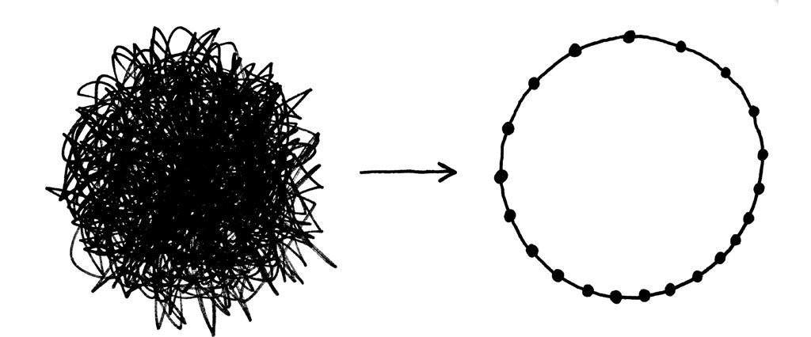
Understanding of environmental sustainability
e.g. ‘net zero’/mitigation best practice
Notes:
RH
Why is everyone not doing it?
Linking to Charity digital report finding - There is no universal understanding of environmental sustainability in the UK charity sector, So many different definitions.
This is just one example relating to climate goals/ net zero targets and accounting.
Get confused and conflated especially when some areas relate to money
Often charity sector is falling through the gaps in all of this, no off the shelf answer for us. We are all spending £ independently to figure this out
What are doing together to get a handle on that?
It’s messy and complex, lots of different definitions and initiatives, not all aligned. Need to more to more systems thinking, recognise complexity and interactions but deal with them in a coordinated and integrated way
Plus link of nature AND climate crises – need to solve both together, leads into the holistic approach slide

Slide 12
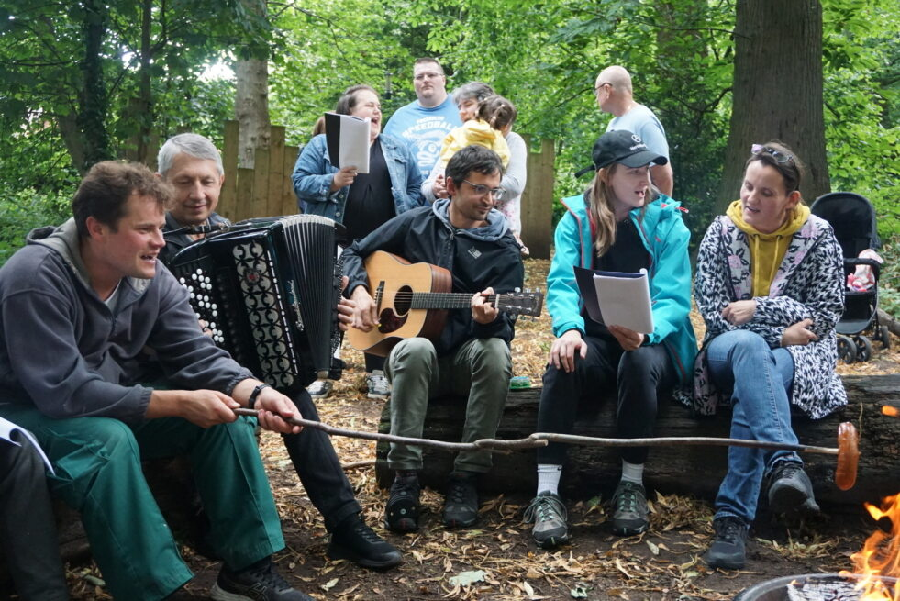
Holistic
© Rachel Sheriff
Notes:
AK
1 in 4
Nextdoor nature
Nature-based solutions
Holistic nature climate and community together, not just one element

Slide 13
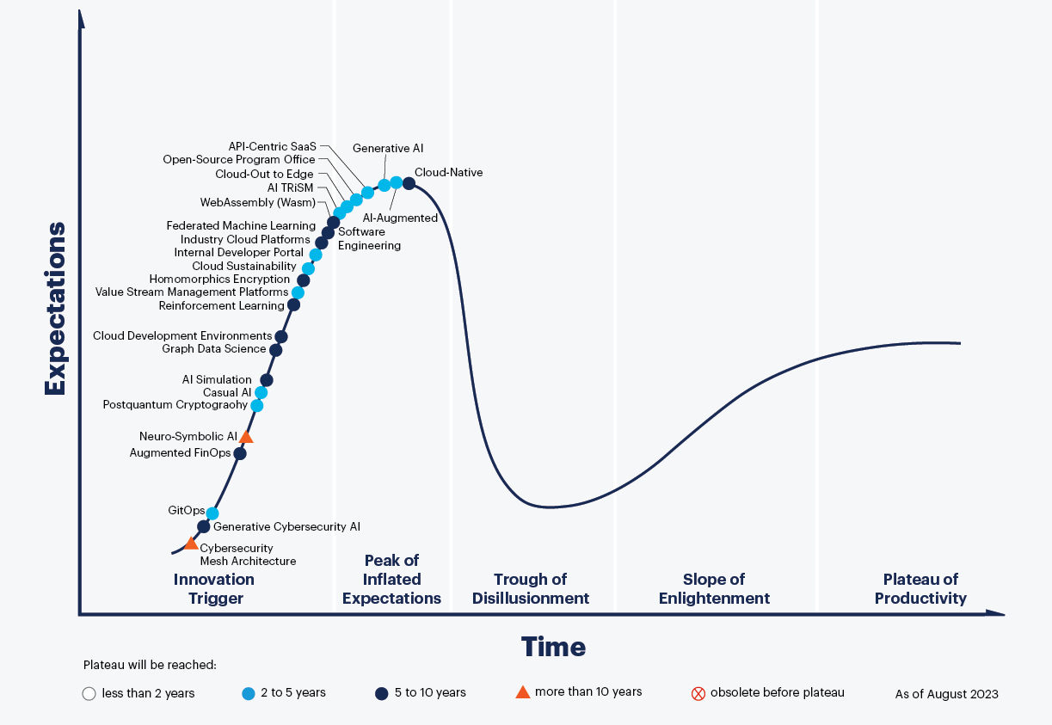
The hype cycle
https://www.gartner.com/en/information-technology/glossary/hype-cycle#:~:text=The%20five%20phases%20in%20the,Enlightenment%20and%20Plateau%20of%20Productivity.
Notes:
AK

Slide 14
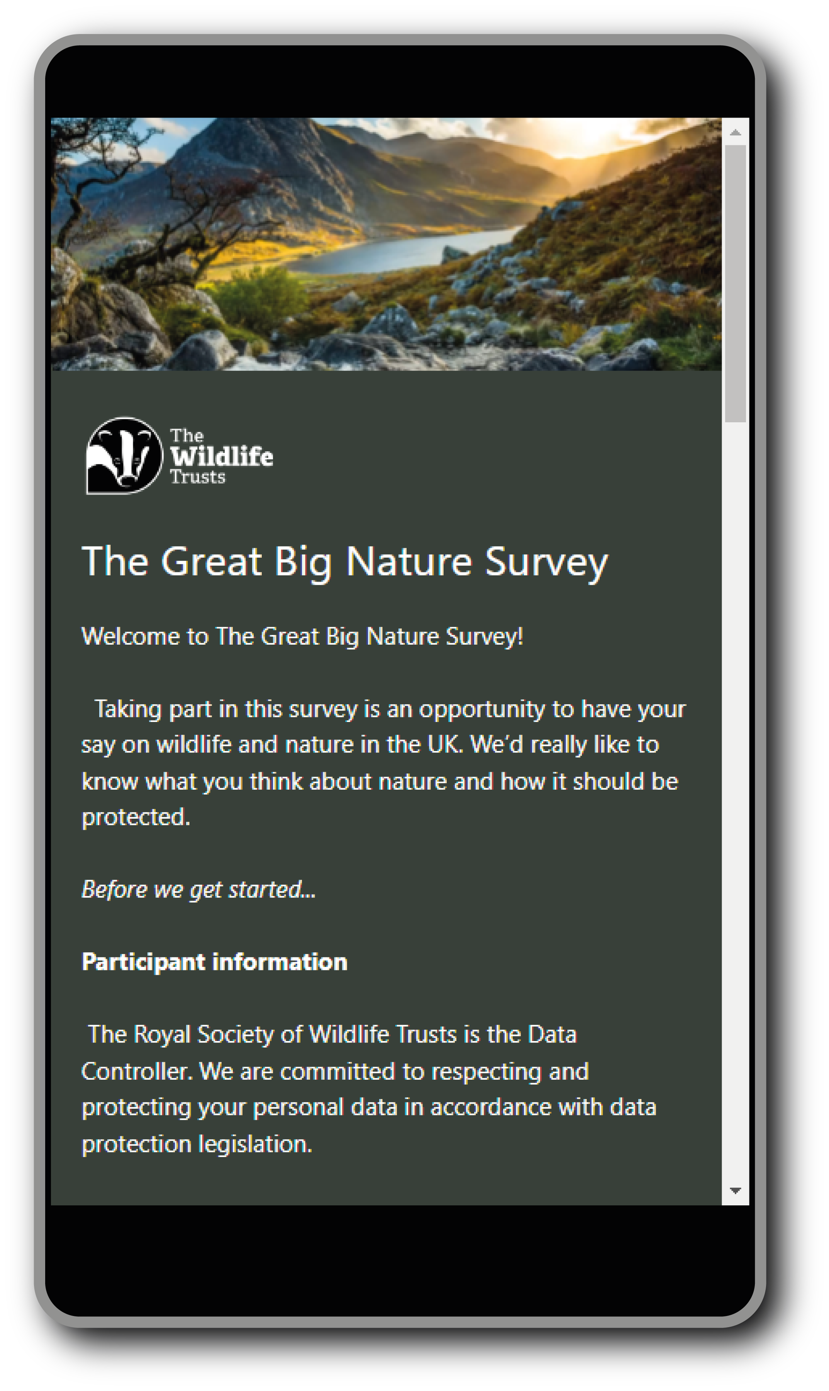
The Great Big Nature Survey in a nutshell:
It’s about the state of our relationship with nature
18,000+
responses from members,
supporters and the public
Covering:
Actions
Wellbeing
Threats
Values
Support
Demographics
46
Wildlife Trusts
4
nations
wildlifetrusts.org/great-big-nature-survey

Slide 15
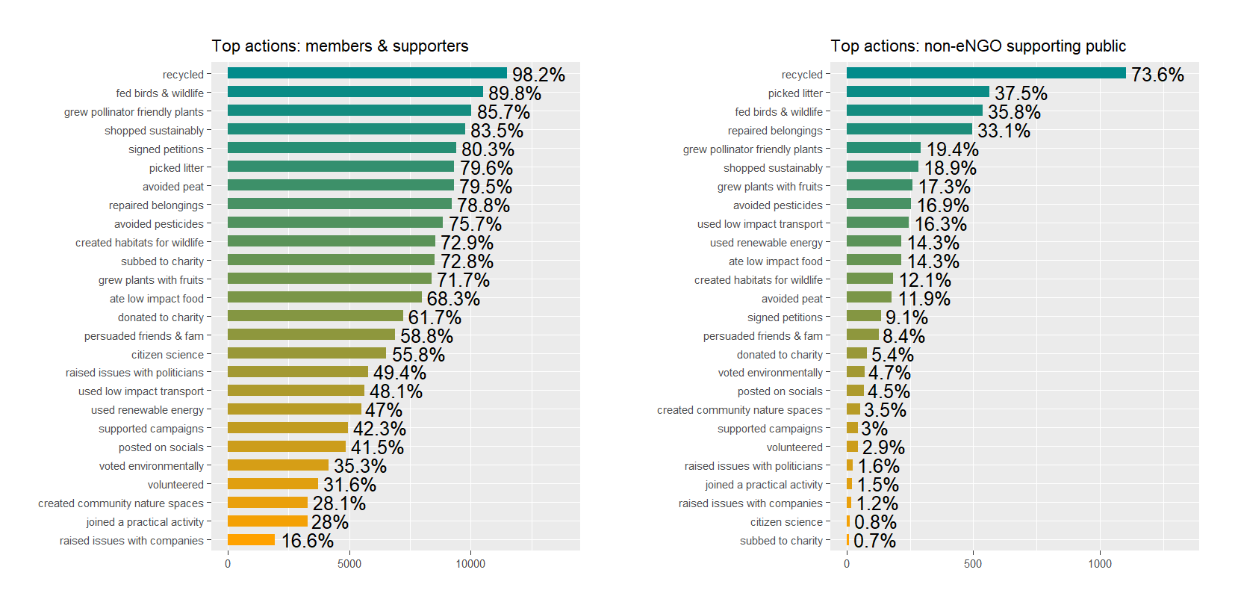
Notes:
We know people don’t know what actions are most impactful
This is from our Great Big Nature Survey,…in non-eNGO supporting public these actions are heavily skewed towards a handful. Recycling is the only majority action…most others are vanishingly rare

Slide 16
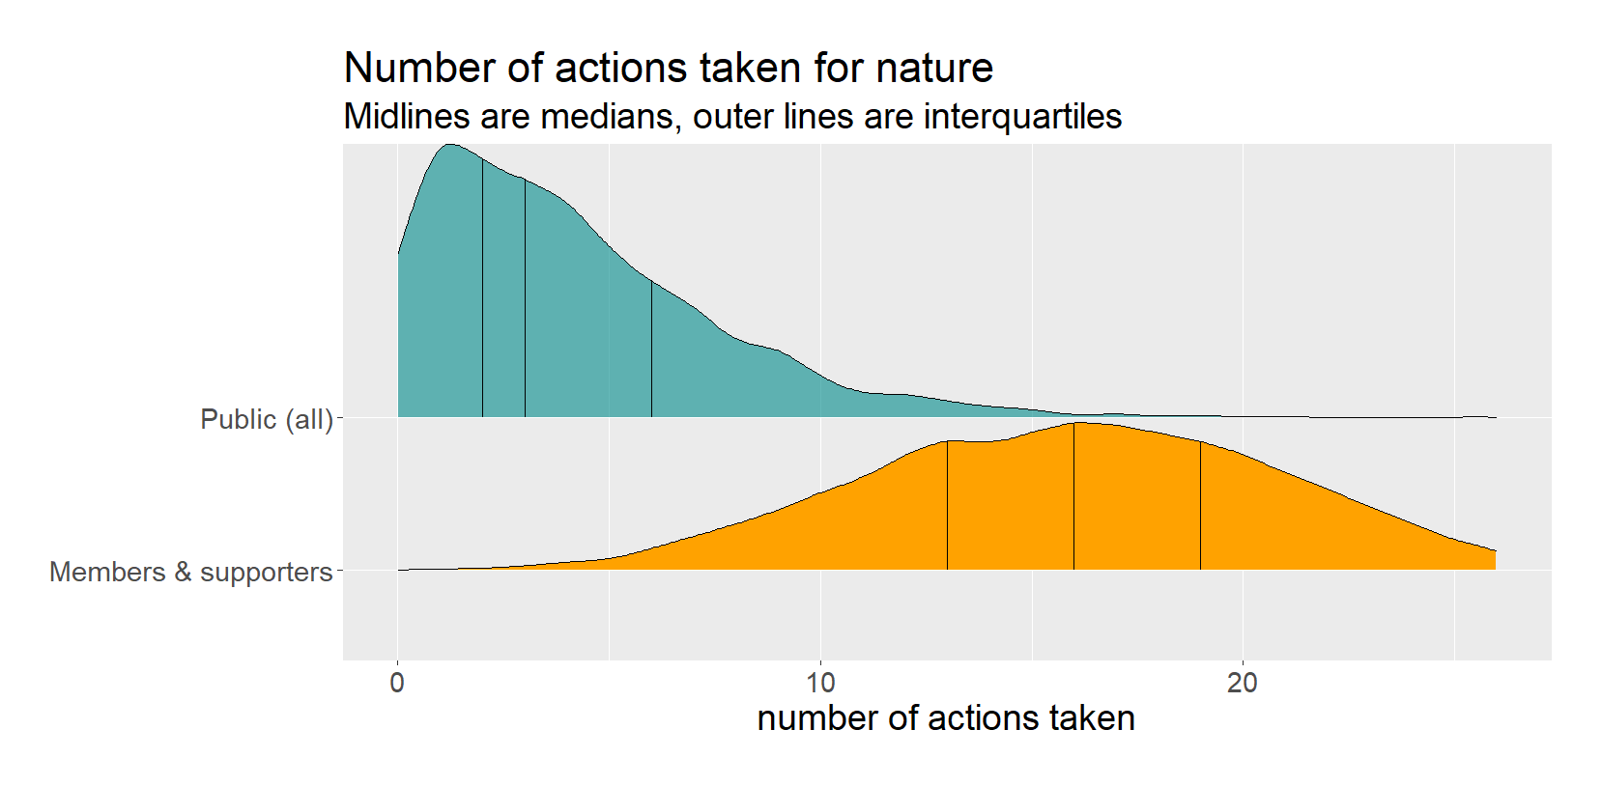
Notes:
Action counts reveal large average differences here

Slide 17
Getting the basics right
Where can technology be helpful?
Recording
Reducing
Replacing
Notes:
AK
Cant invest inappropriately

Slide 18
Also getting the basics right
https://www.wildlifetrusts.org/sites/default/files/2022-07/The%20Wildlife%20Trusts%20Greenhouse%20Gas%20Inventory%20FY%202020-21.pdf
Notes:
AK
Good to emphasise here that these relate to mitigation, we're also looking at what getting the basics means for climate risk and adaptation

Slide 19
Cloud computing, including data centres are rapidly expanding, and they will make up a much greater slice of ICT energy demand by 2030 – which is forecast to grow to 15-30% of electricity consumption in some countries by 2030.
Notes:
AK

Slide 20
Resources and waste
Manufacture of devices has significant impacts in terms of mining minerals and transportation.
Disposal of devices can result in chemicals leaking out of landfill.
Fifty million tons of electronic waste are generated every year.
Replace devices less often.
Dispose/ recycle them e.g. at Curry’s
https://www.weforum.org/agenda/2021/12/digital-carbon-footprint-how-to-lower-electronics
Notes:
AK

Slide 21
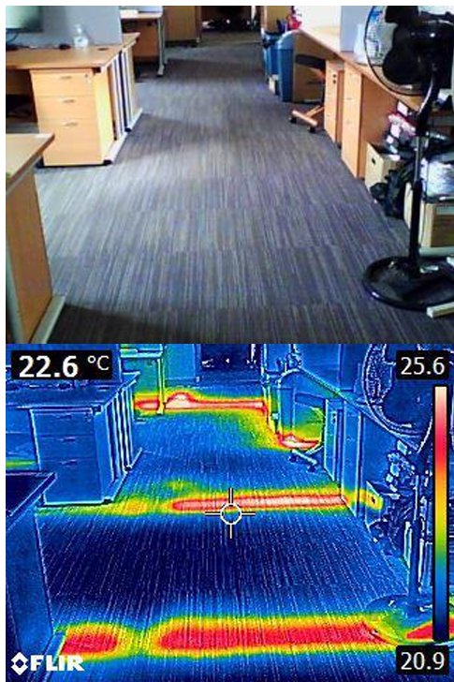
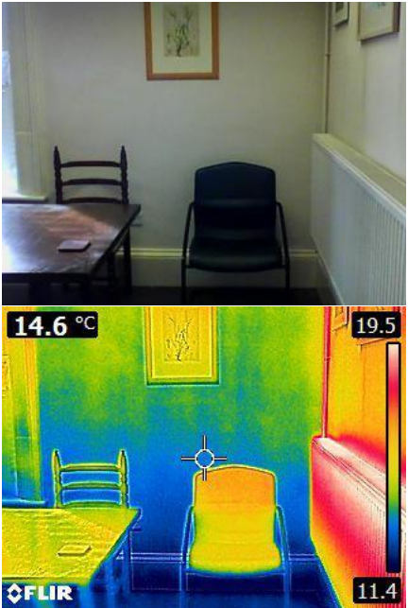
Reducing energy demand
Outside wall of older section of office
Uninsulated pipes
Notes:
AK
Pipes uninsulated and wasting a large amount of heat (image 1)
Outside walls of older office section not insulated.
Placing insulation on the inside of these walls may be most cost-effective and doable
Placing radiator reflector panels behind the radiators so the heat is more effectively distributed throughout the room rather than straight into the wall behind it.

Slide 22
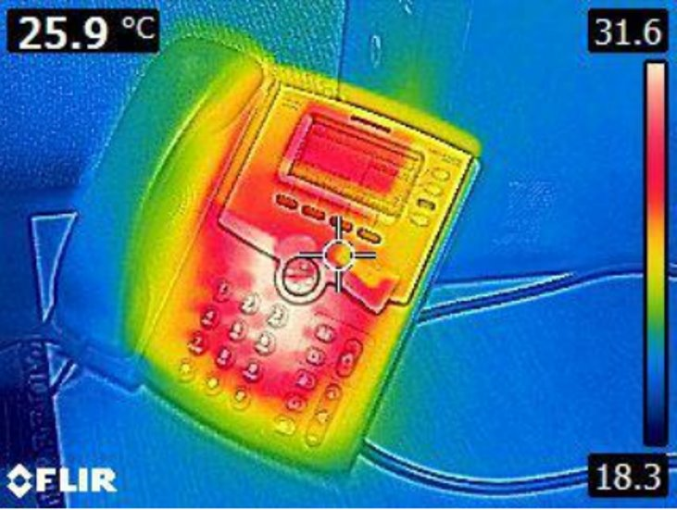
Reducing energy demand
Notes:
AK
If segwaying from last slide, might want to recognise the balance here (as saying don’t get rid of stuff, but this slide..get rid of stuff)
Landlines having significant standby consumption - estimated annual saving for us of £150 and 30kg of carbon for each phone annually. We have transitioned to mobiles but also a teams based 'landline' system. HIWWT

Slide 23
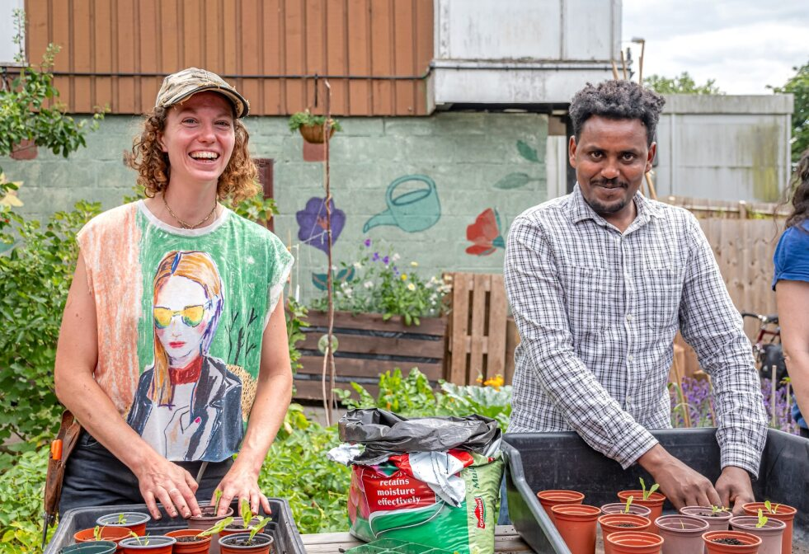
Don’t just buy an app
Tech is part of the answer but not the solution – very front of centre of our mindset
© Tay Aziz
Notes:
AK
Its about the people who need to use it,
Ensuring the actions are embedded in what you do day to day
Part of the answer but not the solution

Slide 24
Finding partners
Notes:
RH
And its about finding the right partners
Across charity
Across sectors
Partnerships – efficient use of money, multiple beneficiaries
Do you want to then speak from a tech perspective Alice?

Slide 25
Access barriers are preventing digital growth
Cost and access to digital expertise are significant barriers
Limiting development
Limiting impact
Notes:
RH and AK
Pay and skill walls
Free versions – typically overly simplistic, not detailed enough, or take longer. E.g. Carbon calculators online Or very expensive ‘business facing’ tools which are too expensive
Other digital technology we would love to access:
Satellite based
Soil based

Slide 26
Digital technologies can play a central role in helping us to reduce global greenhouse emissions globally.
They have already helped us to cut down on tonnes of physical resources.
They can require a lot of energy and the carbon emissions produced from manufacturing, powering, and cooling computers, smartphones, and data centres can add up.
Notes:
AK
Early warning systems
Met office and big data

Slide 27
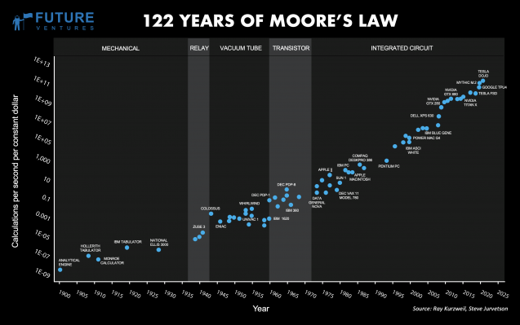
Carbon usage
https://news.climate.columbia.edu/2023/06/09/ais-growing-carbon-footprint/
Notes:
AK

Slide 28
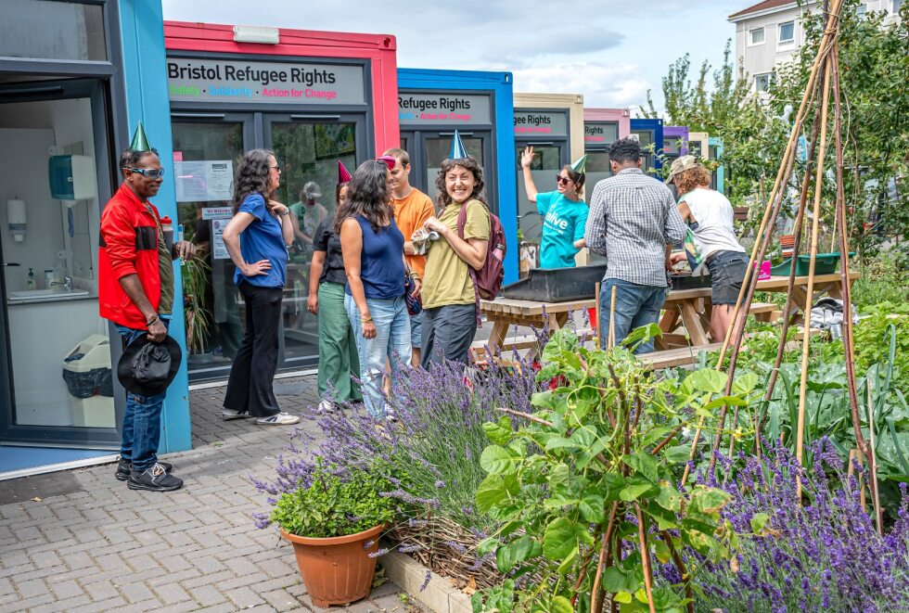
Behaviours
The way you change things – not tech but behaviours
© Tay Aziz
Notes:
AK
How we engage with the tech, behaviours to reduce energy demands, plus make the most of it where it can be useful

Slide 29
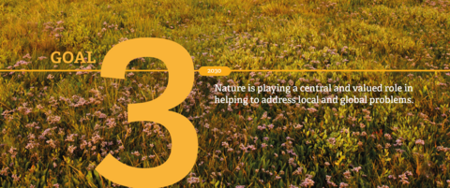
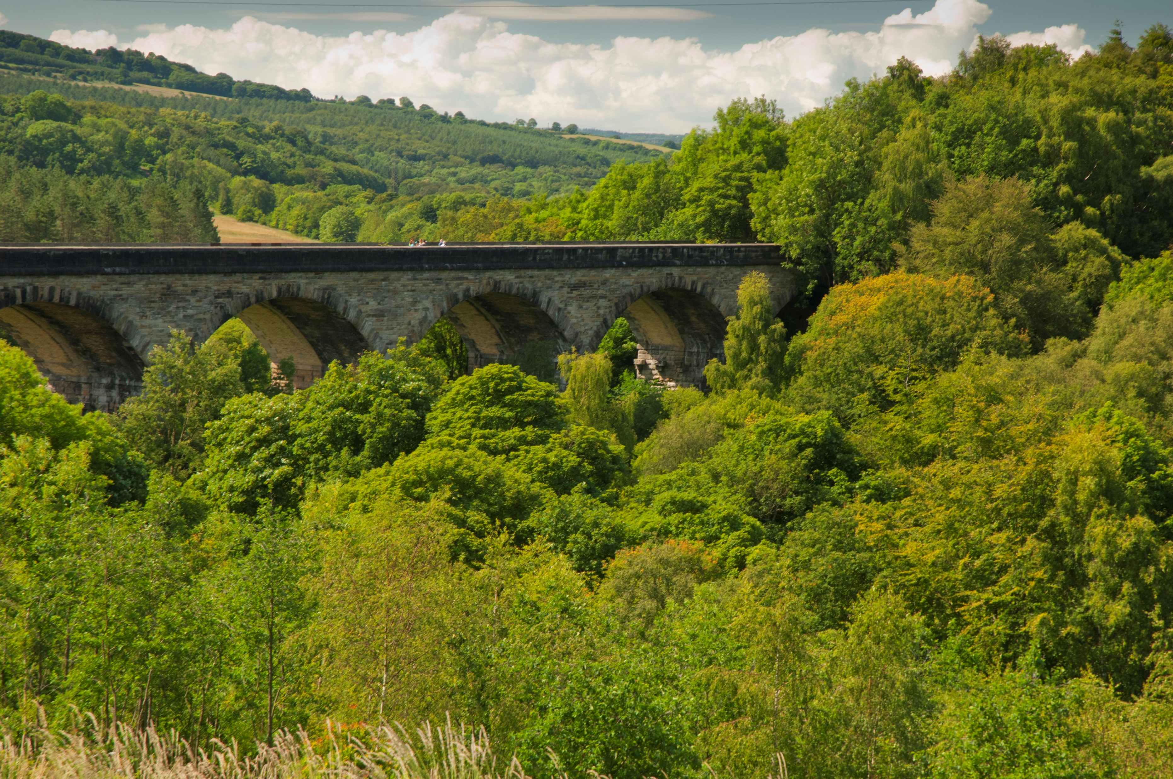
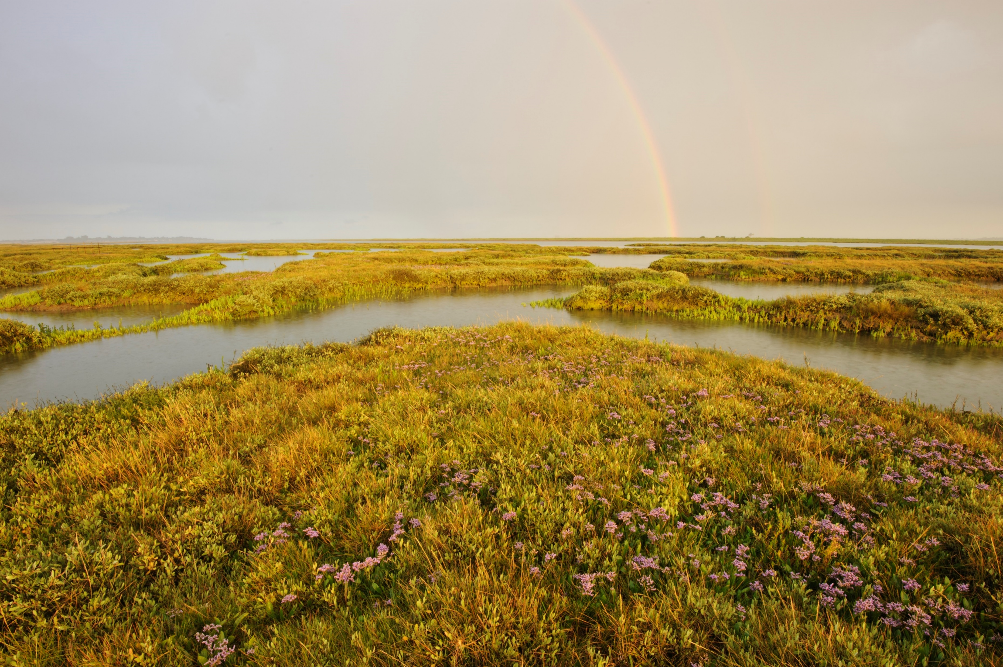
Nature and climate
Notes:
RH
Front of mind for us, link climate and nature, but really key – the role that nature can play
Link to nature-based solutions, mitigation, adaptation

Slide 30
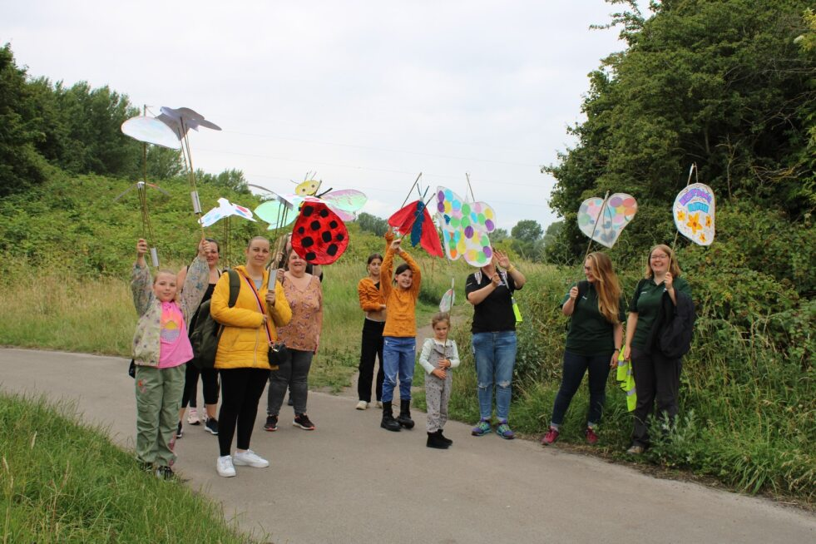
Community organising elements
Notes:
RH
One of key functions we play as charities around engagement with public
How we're using community organising
Team Wilder/ Nextdoor Nature

Slide 31
We want to ensure that our digital transformation and activities are cutting carbon emissions, not adding to them.
We also want to make sure that our digital activities consider all aspects of sustainability, in order to provide environmental, social and economic benefits and avoid unintended trade-offs.
Notes:
AK

Slide 32
Sustainability in and through design - the way we design, buy and build our software, digital tools and platforms can be part of the climate solution to a more energy efficient digital environment.
Notes:
AK

Slide 33
“Good design is as little design as possible.”
— Dieter Rams
https://sustainablewebdesign.org/category/design/
Notes:
AK

Slide 34
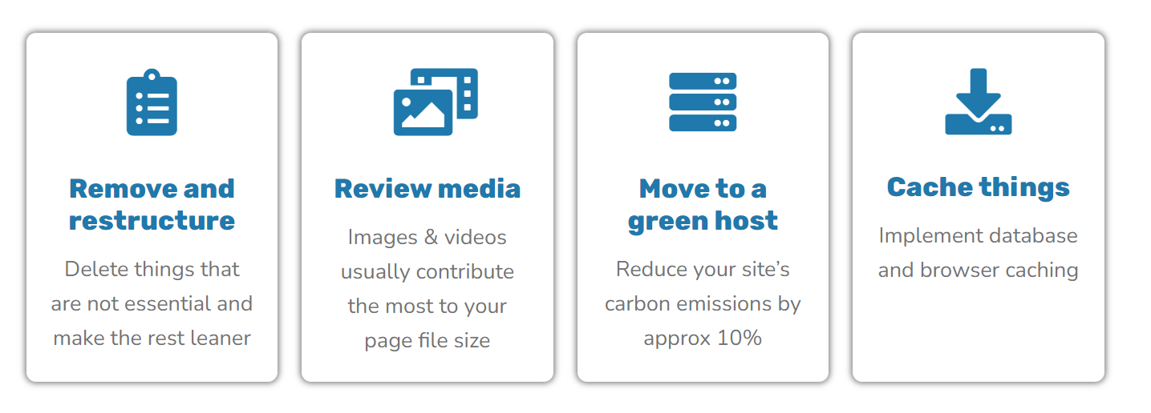
https://climateaction.tech/actions/reduce-the-carbon-emissions-of-your-website/
Notes:
AK

Slide 35
‘Both reading online or in paper format is a good thing to do if the content helps you become aware of the world, the climate crisis and what we can do about it. And reading itself is a low-carbon activity because it is hard to shop or drive while you read.’
Mike Berners-Lee, Lancaster University, UK
Notes:
AK
Don’t sweat the small stuff

Slide 36
Another people picture from the ones Autumn sent would be good here?
“Action is better than no action.
Something is better than nothing”
Notes:
RH and AK
Cohesive slide to finish on
Any key messages
Where we'd like to work with others or hear from others
Something is better that nothing

Slide 37
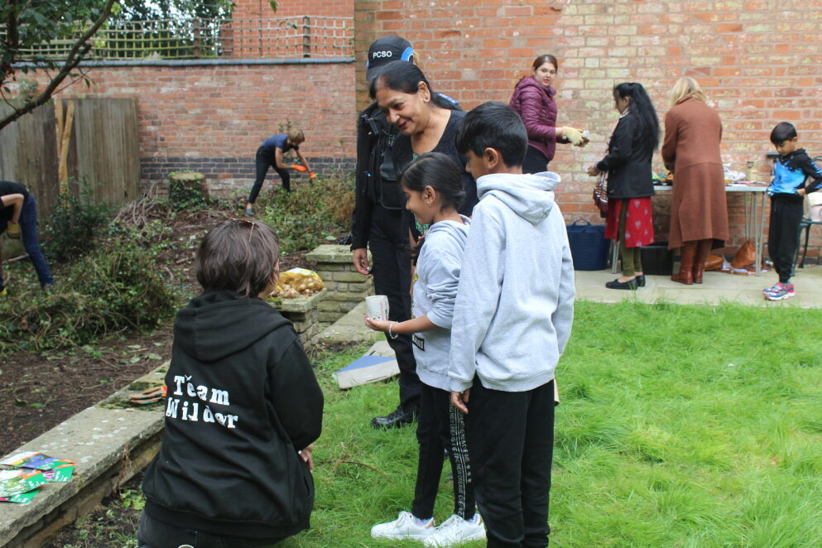
© Autumn Barlow

