Slide 1


Introduction to the National
Cyber Security Centre

Slide 2

What is cyber security?
Cyber relates to computer systems, networks (including the internet) and devices in general.
Cyber security's core function is to protect the devices we all use and the services we access - both online and at work - from being compromised.
It is also about preventing unauthorised access to the vast amounts of personal information we store on these devices, and online.
Cyber security is important because smartphones, computers and the internet are a part of modern life. From online banking and shopping, to email and social media.

Slide 3
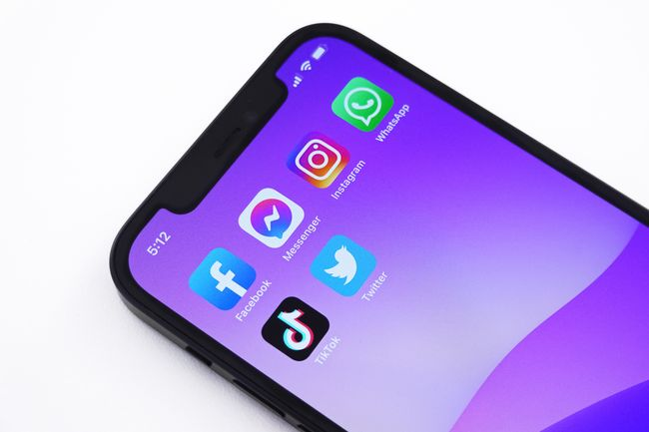
Why is my organisation at risk?
Regardless of the size or nature of your business, the information you hold is valuable to a criminal.
Phishing emails
Ransomware
Social Media Hacking
Email Hacking
Even if you don’t lose money directly, a data breach (which is when information is stolen or accessed without authorisation) could cause the temporary shutdown of your business whilst the breach is investigated and damage your reputation with customers and partners.
Notes:
You may not think it, but regardless of the size or nature of your business, the information you hold is valuable to a criminal. Although they may not target you specifically, it’s all too easy to be damaged by scam emails (also known as ‘phishing’) that cyber criminals send out, indiscriminately, to millions of businesses. Even if you don’t lose money directly, a data breach (which is when information is stolen or accessed without authorisation) could cause the temporary shutdown of your business whilst the breach is investigated and damage your reputation with customers and partners.

Slide 4
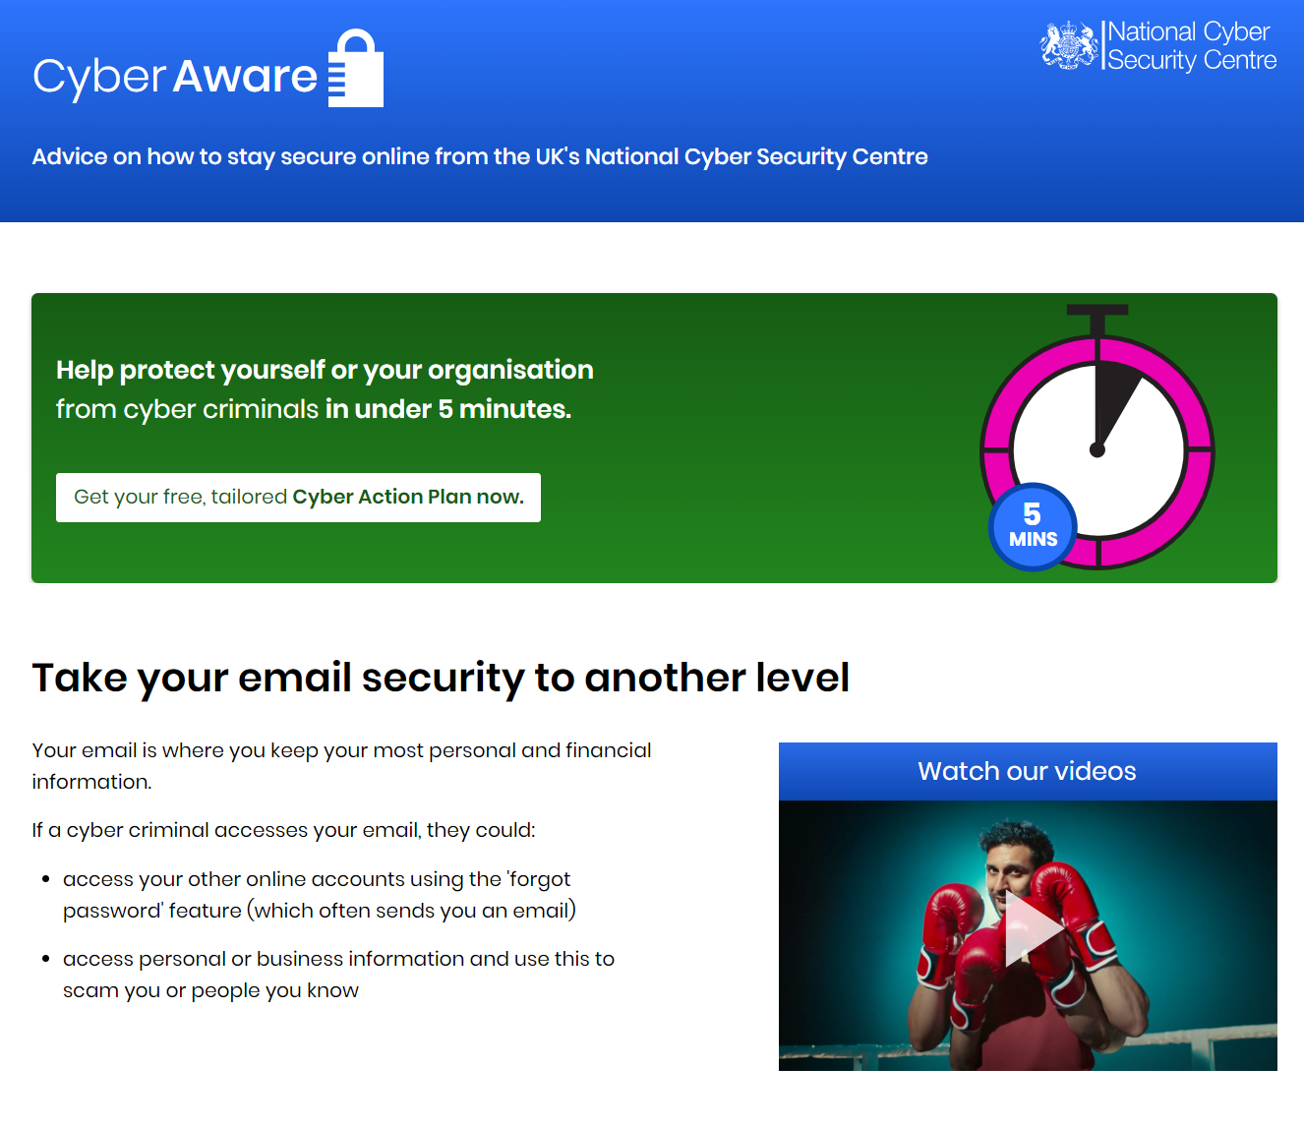
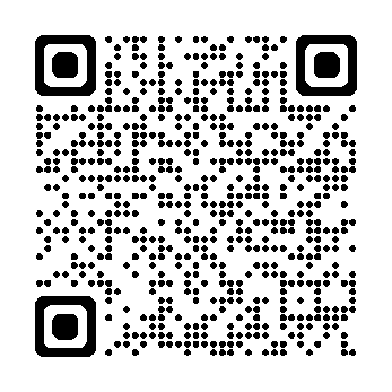

Slide 5
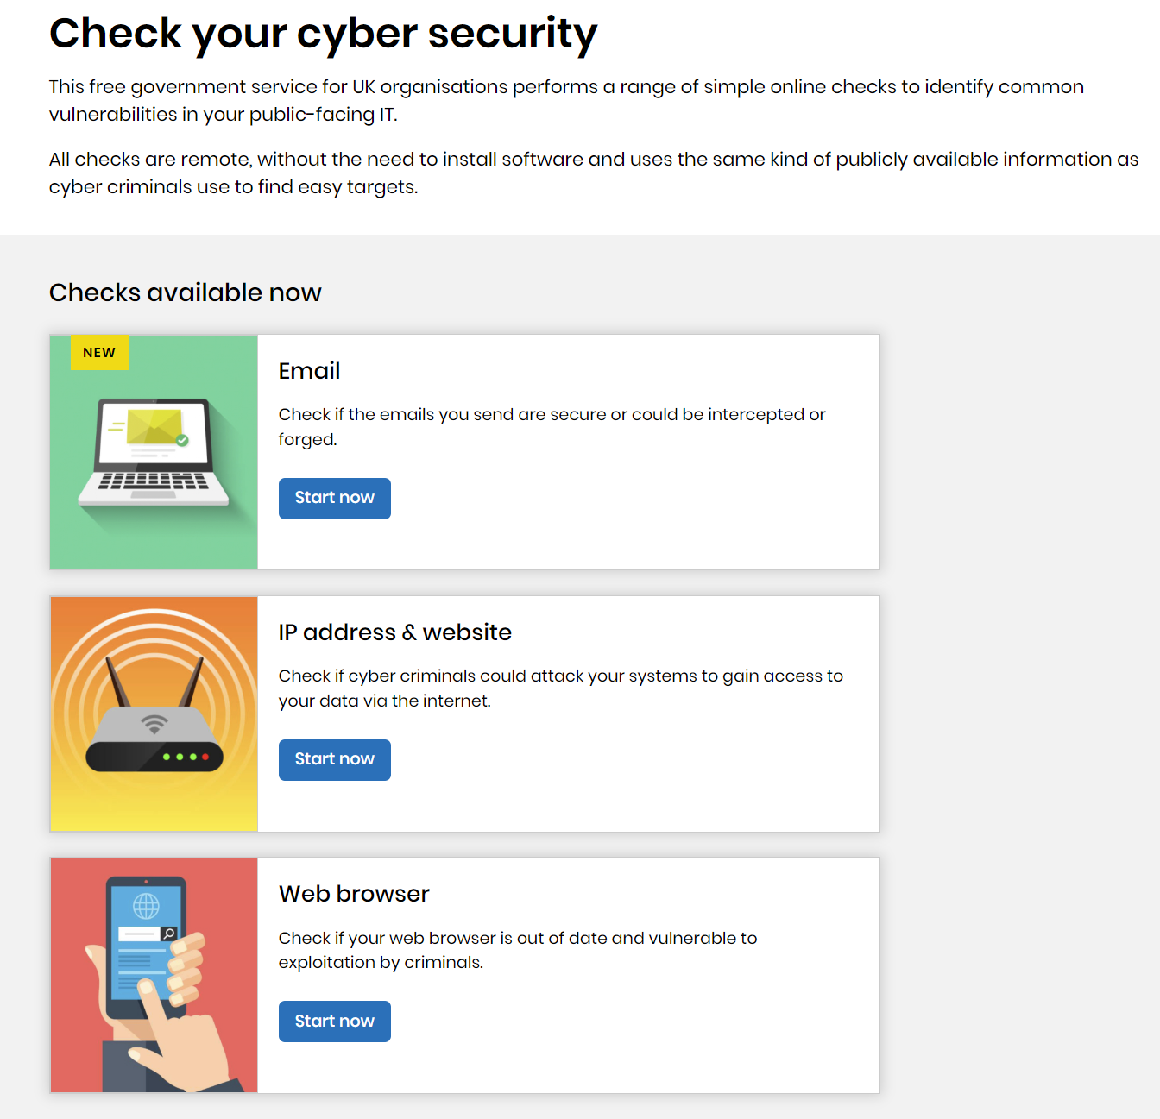

checkcybersecurity.service.ncsc.gov.uk

Slide 6
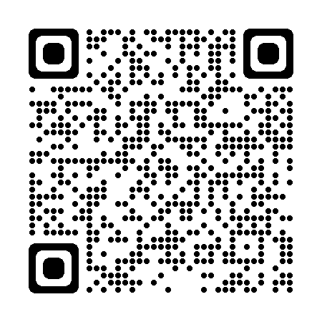
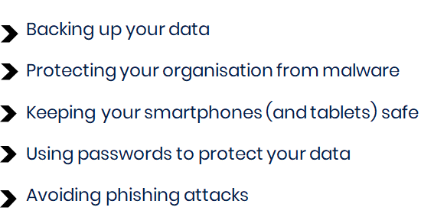
NCSC Subscription Centre
NCSC Small Organisations Newsletter
Weekly Threat Reports
NCSC Advisories
Information about CyberUK
NCSC Digital Lofts
Notes:
Can sign up to receive the services via the NCSC website to receive updates straight to your inbox
Newsletter – is suitable for all organisations, The Small Organisation Newsletter aims to break down cyber related issues into bitesize pieces which can be read in your coffee break.
We want to arm you and your business with the advice and tools to minimise the risk of a cyber-attack.
If you feel not relevant to you, unsubscribe at anytime.

Slide 7

If I have a cyber incident or suffer from fraud how do I report it?
Report fraud and cybercrime to Action Fraud:
Online at www.actionfraud.police.uk or by phone on 0300 123 2040
24/7 live cyber reporting for businesses currently suffering a live cyber attack (in progress) call 0300 123 2040
Report a scam email:
Forward emails to report@phishing.gov.uk
Report a scam text:
Forward texts to 7726

Slide 8
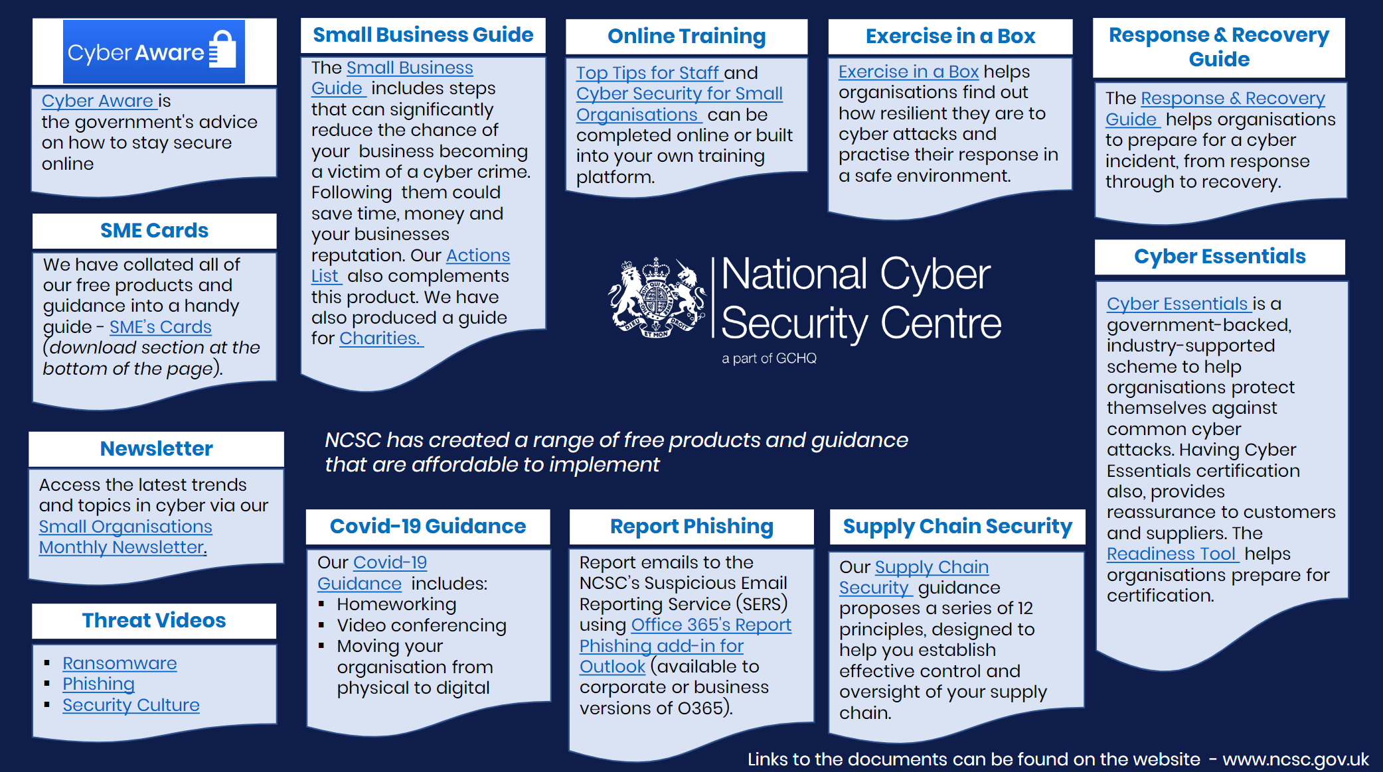
Notes:
Visit ncsc.gov.uk and search for any of the headings in the white boxes.

