Slide 1
Ettie Bailey-King (She/her)
Inclusive and accessible communication consultant
Fighting Talk

Slide 2
Today
What inclusive language is
Why inclusive language matters
10 practical tips

Slide 3
What inclusive language is

Slide 4
People often say
Inclusive language does not:
discriminate.
cause harm.
perpetuate stereotypes.
Notes:
And that’s all true. But… still doesn’t tell us what it DOES do.

Slide 5
What does inclusive language do?
Accurately describe reality.
Points to structural causes.
Empowers people to describe themselves.

Slide 6
Why language matters

Slide 7
Language affects:
Memory
Perception
Belief
Action

Slide 8
Many experiences of discrimination and oppression happen through language.

Slide 9
“The bad news is that your language probably reflects the transphobic values of the culture you live in. But the good news is that changing your language can also help to change those cultural values.”
Lal Zimman

Slide 10
The bad news is that your language probably reflects systems of oppression.
The good news is that changing your language can also help to challenge those systems.

Slide 11
❌
✅

Slide 12
❌ Questioned
✅ Encouraged

Slide 13
Avoid euphemism

Slide 16
Be specific

Slide 18
Be factual

Slide 22
LGBTQIA+ inclusive language

Slide 23
Not everyone is a man or a woman.
❌ Ladies and gentlemen.
✅ Colleagues, team, folks, you, all, good morning everyone.

Slide 24
Not everyone is a heterosexual man or a woman.
❌ Husbands and wives.
✅ Partners, spouses, plus ones, people you’re dating.

Slide 25
LGBTQIA+ is an umbrella term.
Be as specific as possible.

Slide 26
Having to “come out” can be scary and exhausting.
❌ What does your wife do for a living?
✅ Do you have a partner? What do they do?

Slide 27
Use singular they. You already know how!
✅ Someone called for you. They didn’t leave their name.
✅ My bike got stolen. I hope they get a flat tire.
✅ Staff should fill out their appraisals by Friday.

Slide 28
Sexual orientation is an enduring part of our identities.
❌ Sexual preferences.
✅ Sexual orientation, sexuality.

Slide 29
Try not to guess gender.
✅ I’ll take a question from the person in the red shirt.

Slide 30
Need to know how to describe someone? Ask.
✅ “So that I can introduce you before you speak on the panel, can I check how you’d like me to refer to you?”

Slide 31
Pronouns ≠ gender.

Slide 32
Sharing your pronouns helps to:
make it easier for other people to come out,
decentre the assumption that everyone is CisHet.
⚠️ Being “out” is a choice. It’s not safe for everyone.

Slide 33
They’re not “preferred” or “chosen” pronouns.
If someone uses the pronouns “she/her”, then her pronouns are “she/her.”

Slide 34
Think of pronouns as being like names:
You can’t guess them from looking.
There are lots of them, not just two.
It’s not up to others to decide yours.
Getting it wrong isn’t the worst thing, so long as it’s handled well.

Slide 35
✅ Mirror people’s words.
If they say husband, girlfriend, boyfriend etc, say what they say.

Slide 36
⚠️ Watch out for reclaimed slur words.
Not everyone agrees on whether it’s okay to say queer, for example.

Slide 37
Ask people

Slide 39
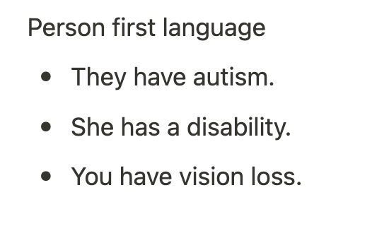

Slide 40
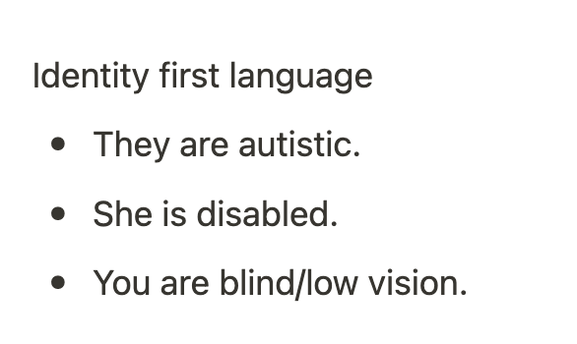

Slide 41
Not everybody agrees.
That’s okay!

Slide 42
Ask people
Most of the time, we don’t need to talk about people.
There’s no need to comment on your new colleague:
Having a stutter,
Using a wheelchair,
Having vitiligo.

Slide 43
Ask people
But if you do need to talk about somebody, ask them what language they prefer.

Slide 44
It’s better to ask, than to guess and get it wrong.
We often worry it’s rude to ask people about their identity.
It’s not, so long as:
There’s a clear reason for asking,
We’re polite and professional,
We listen and respect what they tell us.

Slide 45
Explain why you’re asking. Don’t put them on the spot.

Slide 46
Impact matters more
than intent

Slide 48
How to apologise

Slide 49
How to correct a mistake
Everyone says things they don’t mean. That’s okay!
You can:
Acknowledge.
Apologise (only you can keep the apology brief and sincere).
Avoid repeating the mistake.

Slide 50
Take action

Slide 51
Share what you learn
You could say:
“I used to say _ too. I recently learned _, and now I say _ instead.”
“I noticed you said _. Just so you know _.”

Slide 52
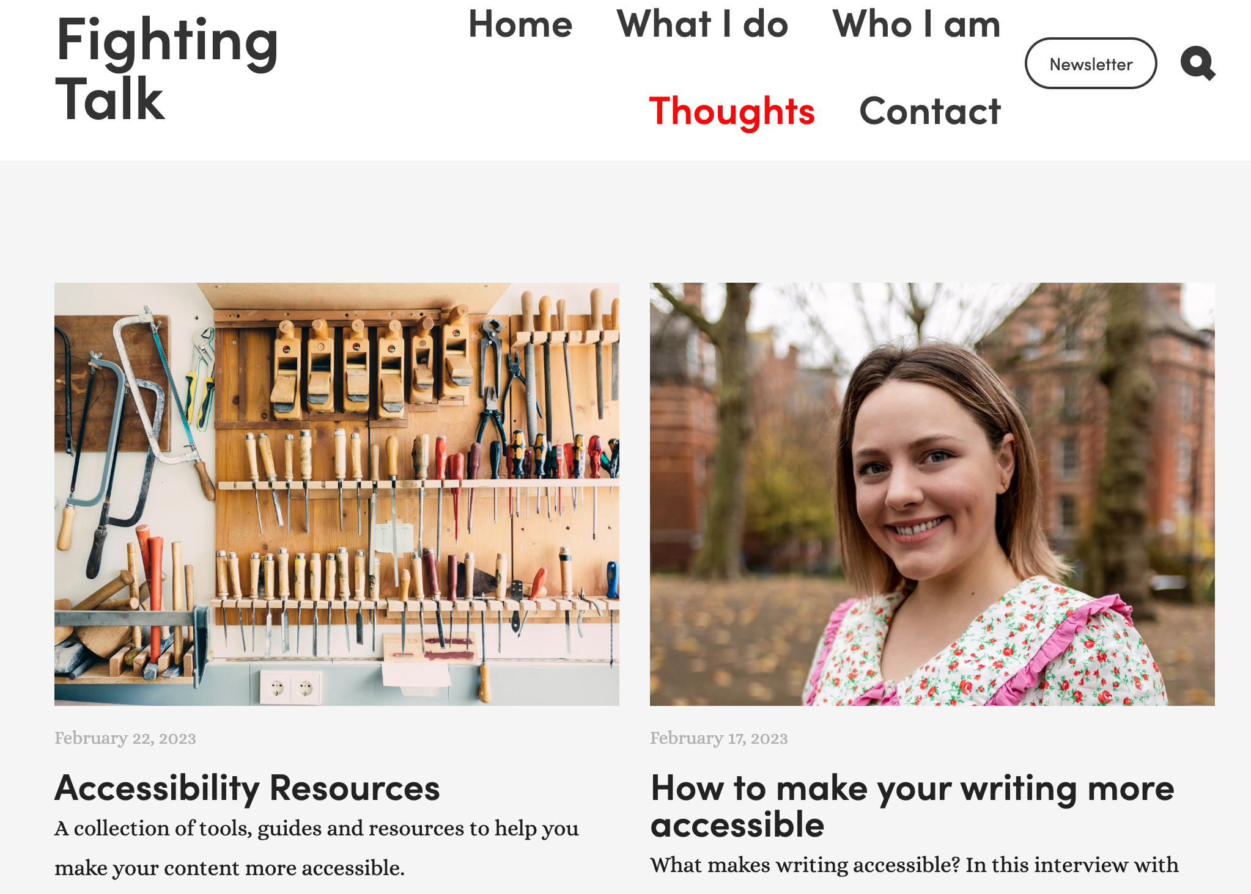
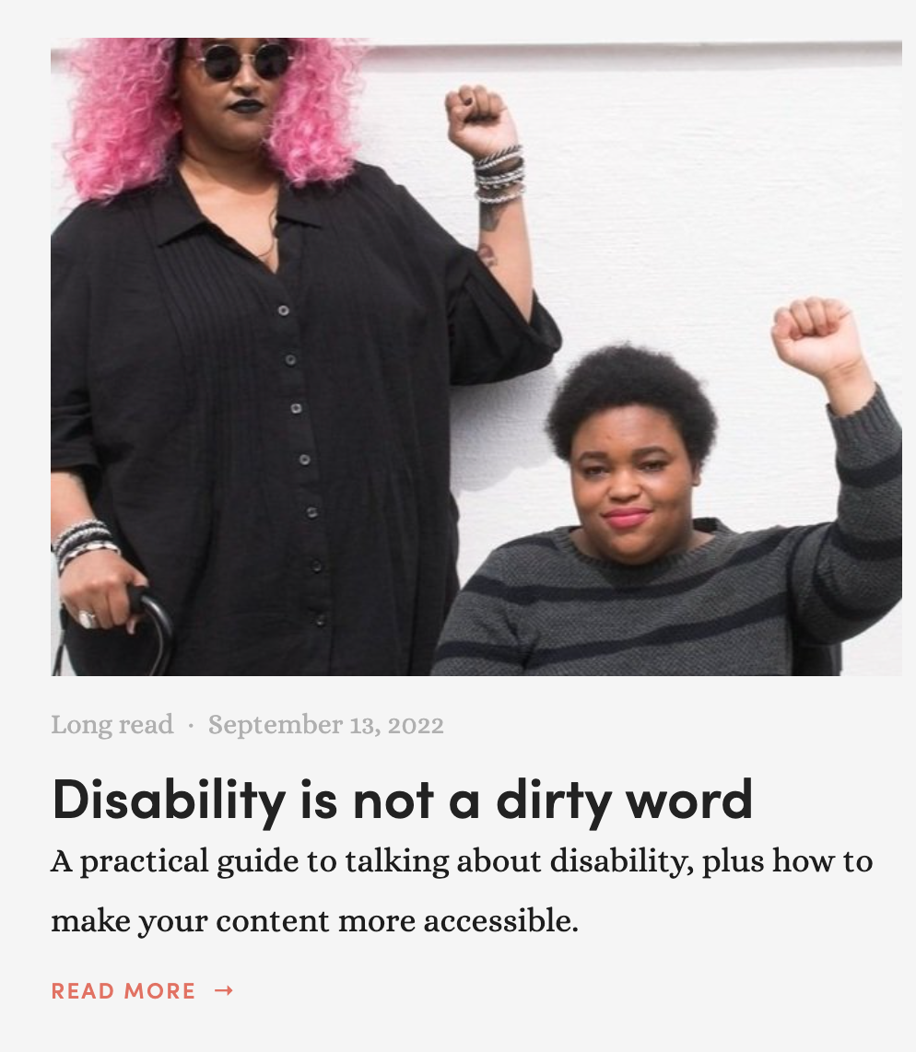
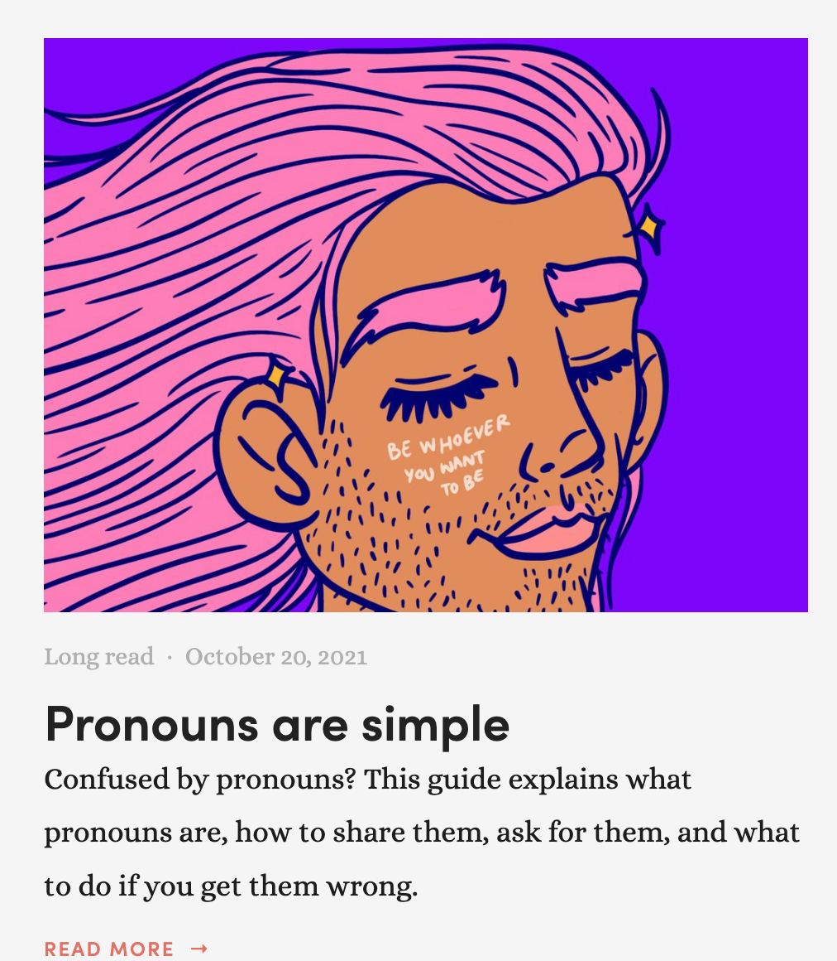
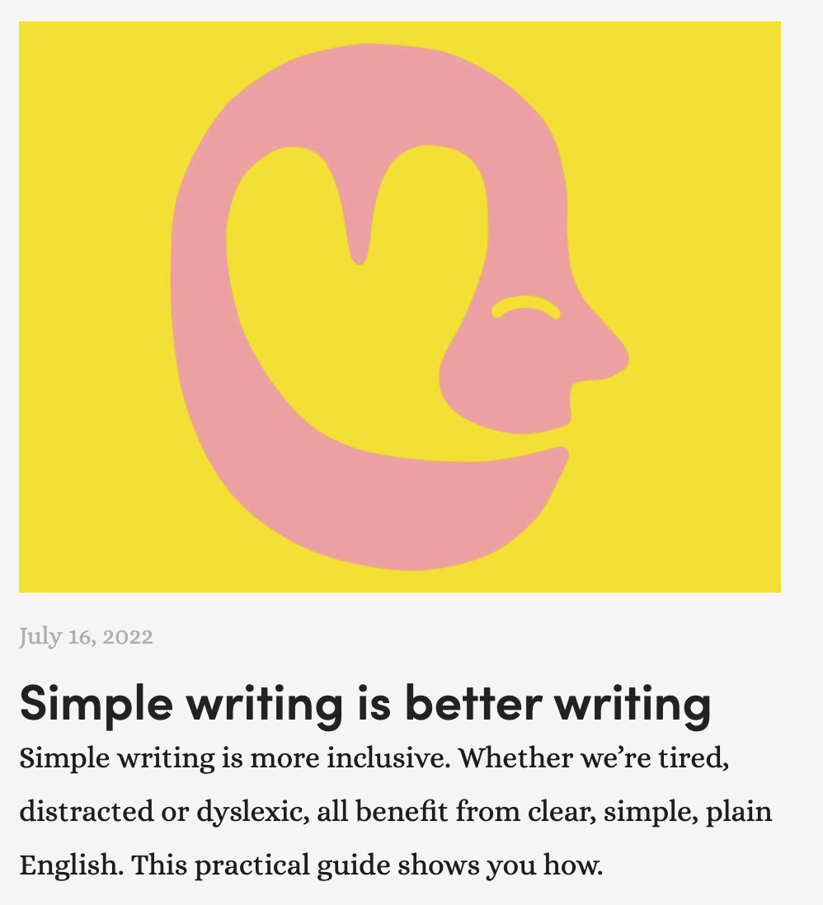

Slide 53
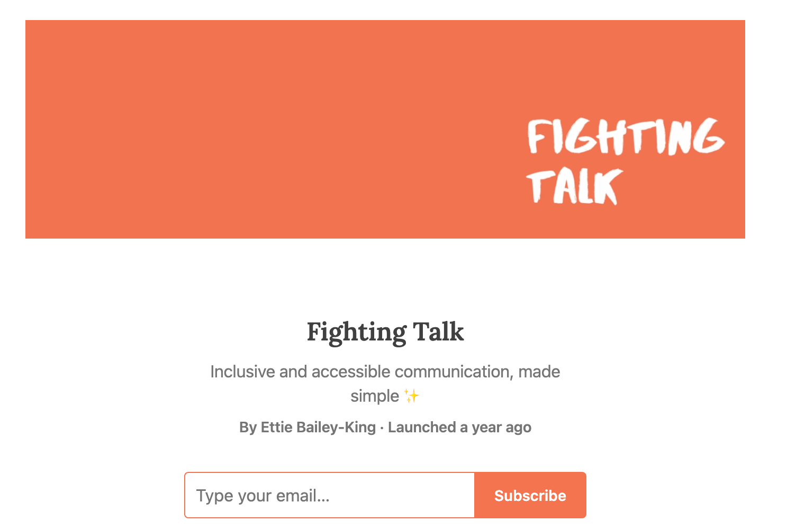

Slide 54
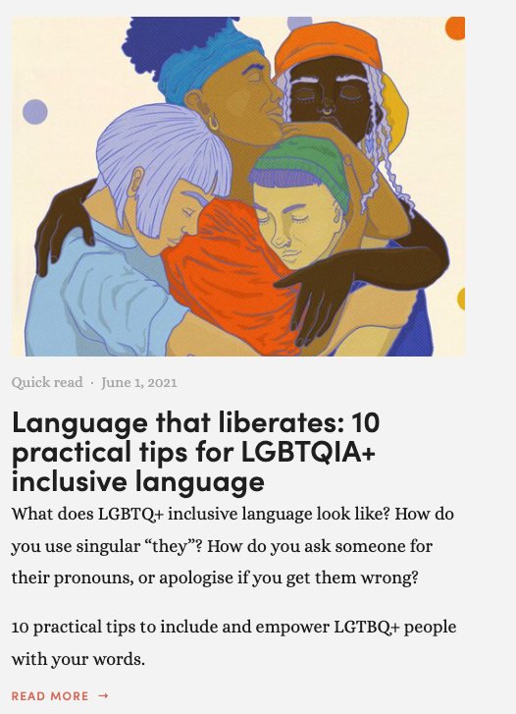
Visit my website for free resources.
www.FightingTalk.uk

