Slide 1
Agile Organisations
Why your charity should embrace agile working
Jen Lowthrop - Feel Good Do Good

Slide 2
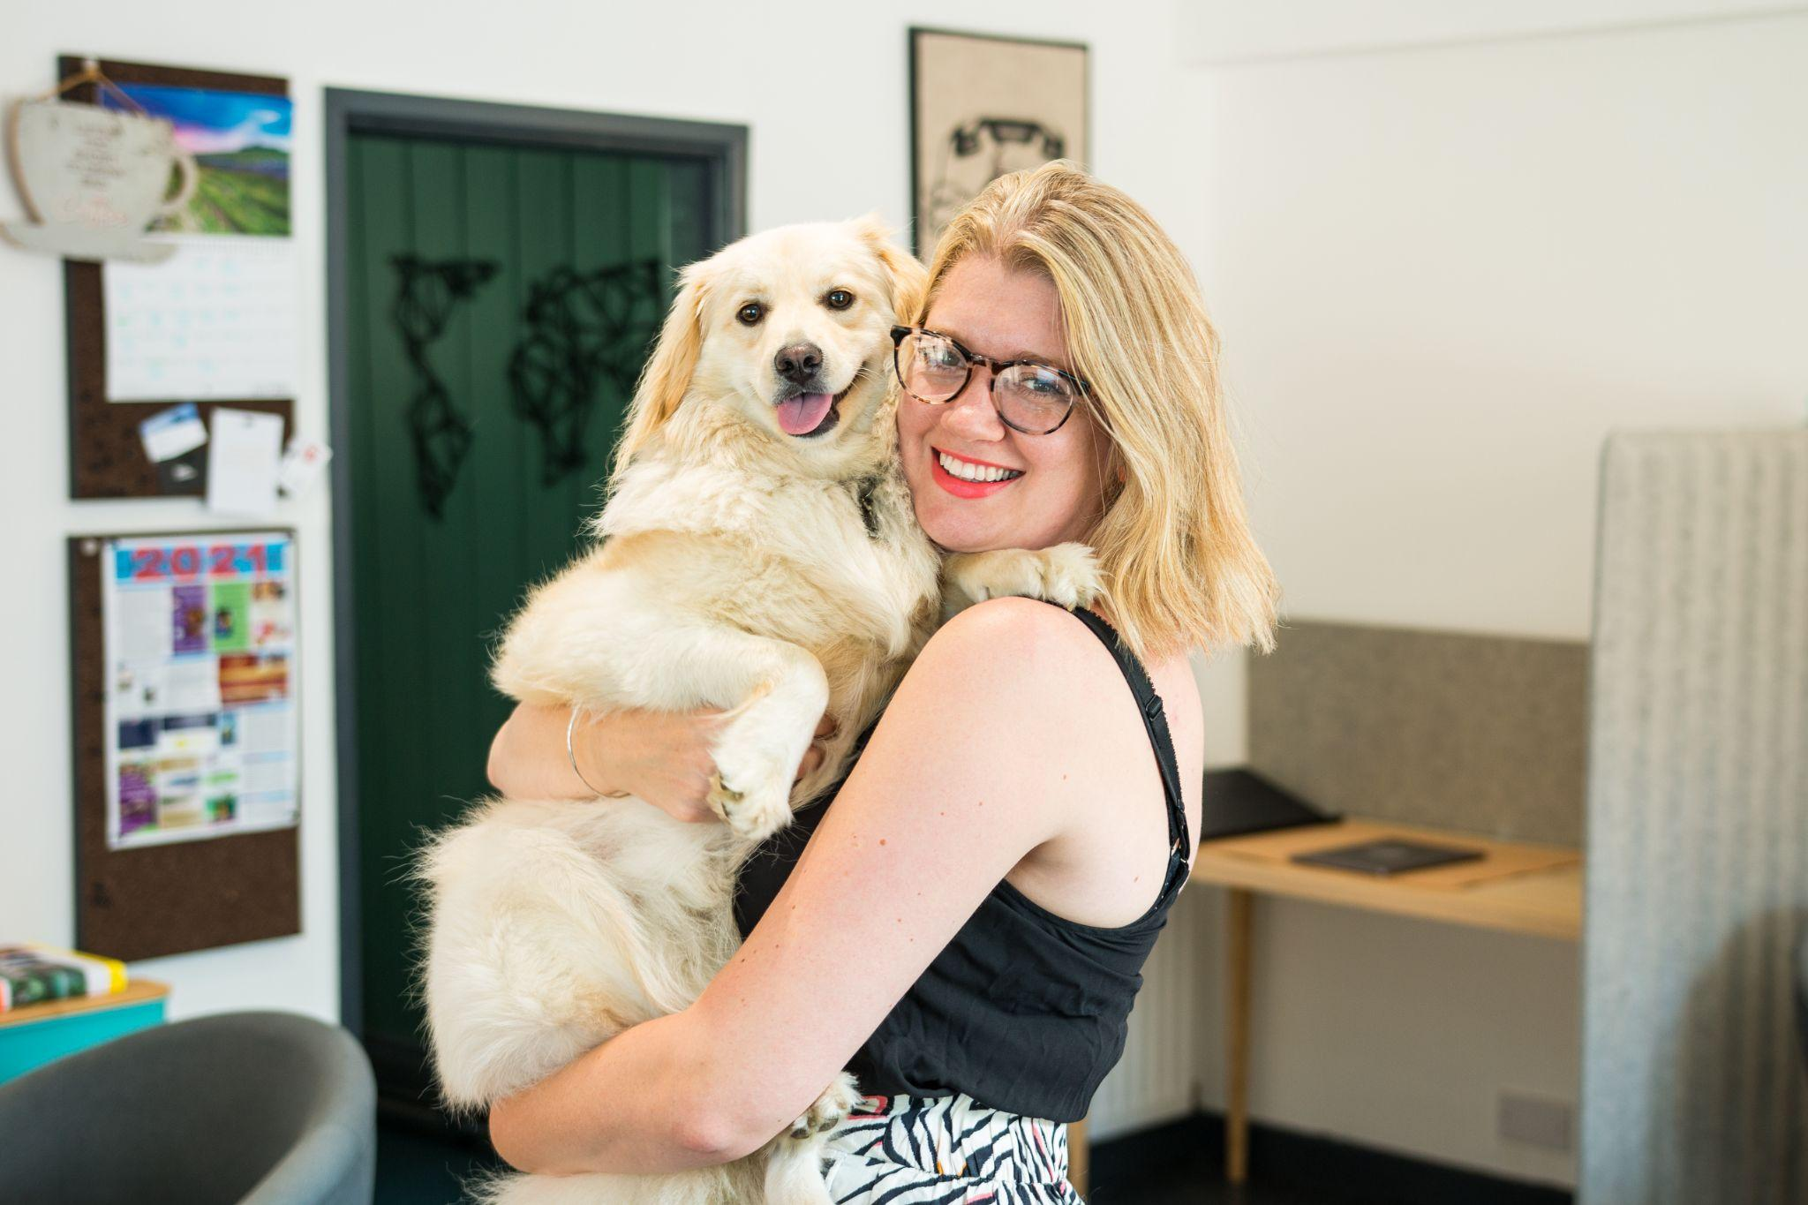
About Me
Certified Happiness Trainer, Certified Scrum Master and Certified Agile Leadership (O&E)
Chair of Trustees for Peak District National Park Foundation
Over 15 years’ experience working with SMEs, charities and public sector organisation on a variety of training and consultancy projects.
Self-confessed productivity and happiness geek
Blogger and Coworking Space owner (Coworking Corner)

Slide 3
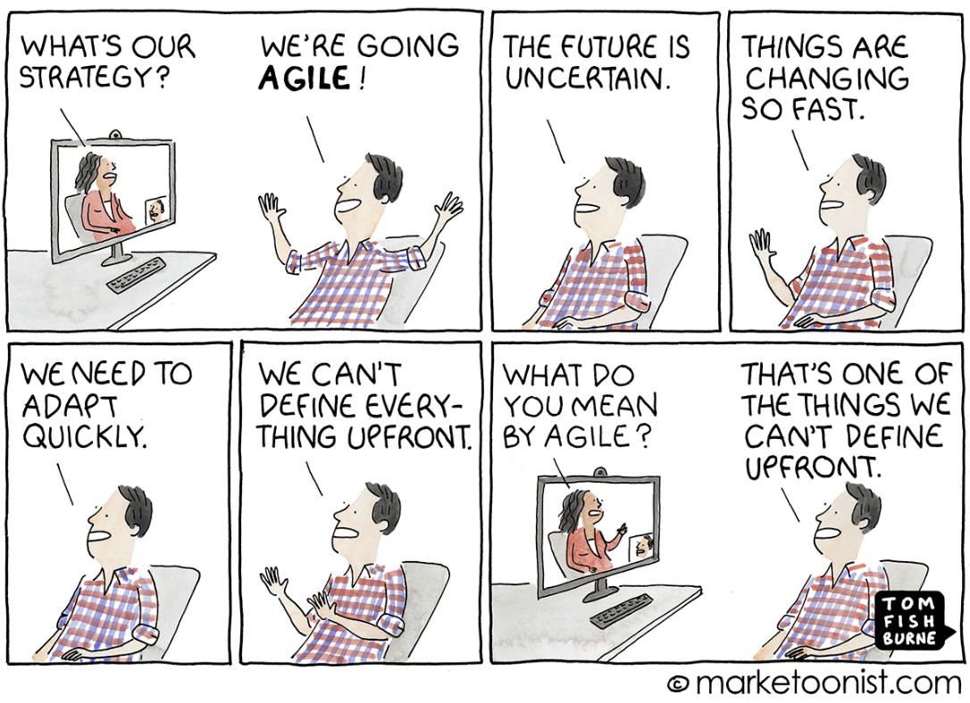
What is Agile?

Slide 4
Agile (with a capital A) vs agile (small a)
An iterative process to project management
A series of values, methods, roles and practices e.g Scrum, Kanban
What we do
A Mindset
Durability
Flexibility
Part of the DNA of an organisation
Who we are

Slide 5
The Agile manifesto
Individuals and Principles over processes and tools
Working software over comprehensive documentation
Customer collaboration over contract negotiation
Responding to change over following a plan
While
there is value in the items on
the right, we value the items on the left more.

Slide 6
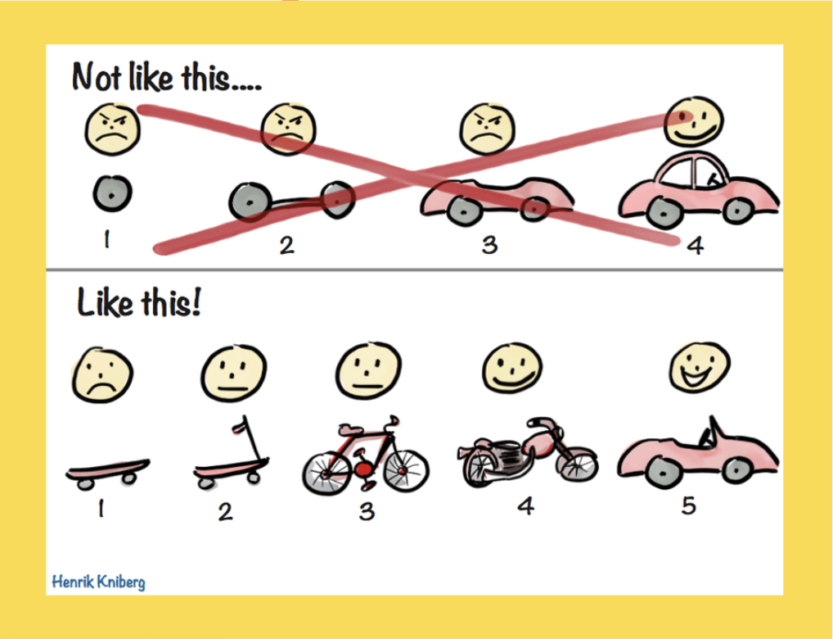
The most recognised image in Agile
An agile organisation often starts with an Agile team or project.
Notes:
Share about Northern council

Slide 7
An agile mindset is about creating and responding to change in uncertain and turbulent environments. It’s about thinking through how you can understand what’s going on in the environment, identify what uncertainty you’re facing and figure out how to adapt as you go along.
The agile mindset

Slide 8
Growth Mindset | Fixed Mindset
Embraces challenges | Avoids challenges
Continues in spite of failure | Gives in when they come up against hardship
Believes that people can increase their intelligence or skills | Believes that intelligence and skills are something you’re born with and can’t develop
Is inspired and motivated by the success of others | Is threatened by the success of others
Wants to learn | Believes they know everything already
Accepts and embraces criticism | Ignores or dismisses criticism
Developing a growth mindset
How can you create a growth mindset in your organisation?

Slide 9
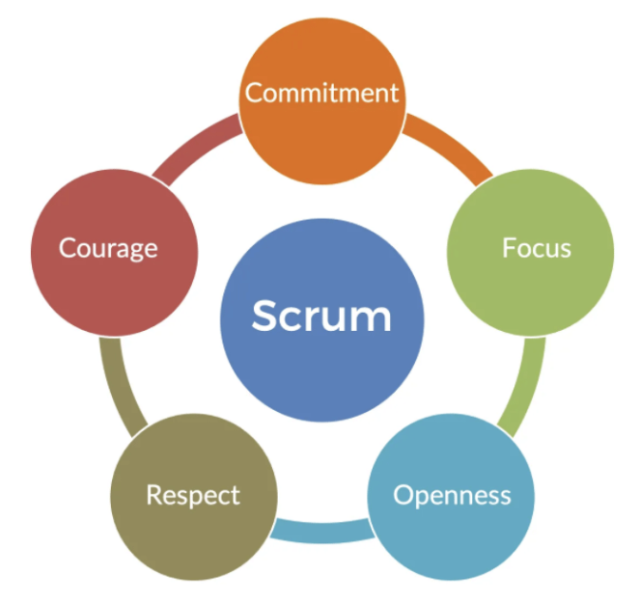
But, how do we plan?
The key is to have REALLY CLEAR GOALS!
GOALS

Slide 10
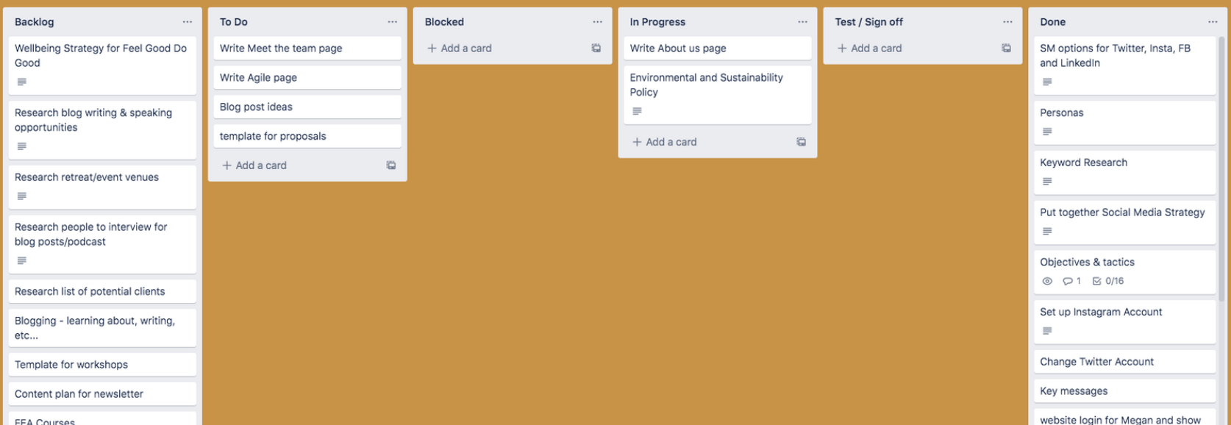
The Can do Kanban Board

Slide 11
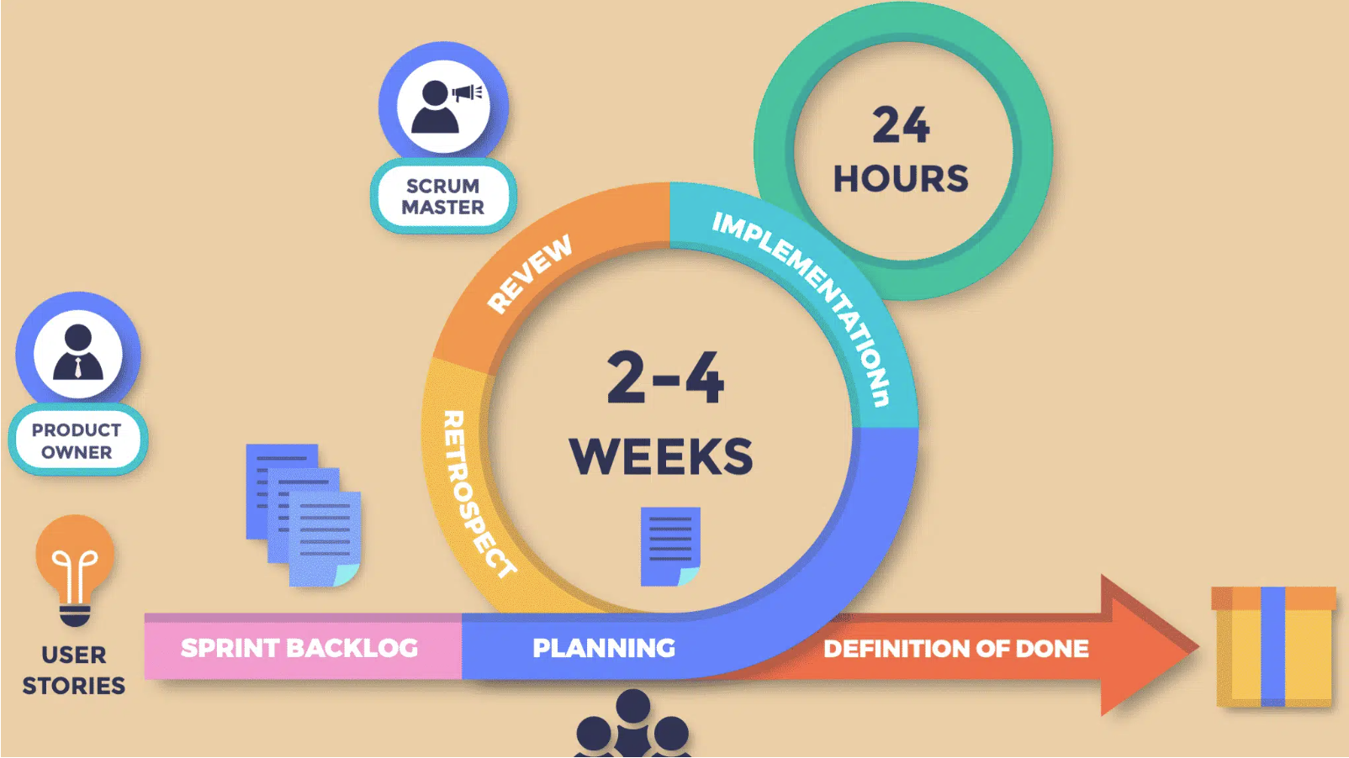
Scrum isn’t set in stone
Backlog maintenance
Sprint planning
Daily Scrum
Retrospective
Review
Scrum diagram from MarTech

Slide 12
What you might find in an agile organisation
Regular Customer / Beneficiary feedback
Open Meetings
Cross functional teams
Fast decision making
Non hierarchical
Goals and values everyone is signed up to
Retrospective
Cross organisational collaboration
Anticipate and ready for change

Slide 13
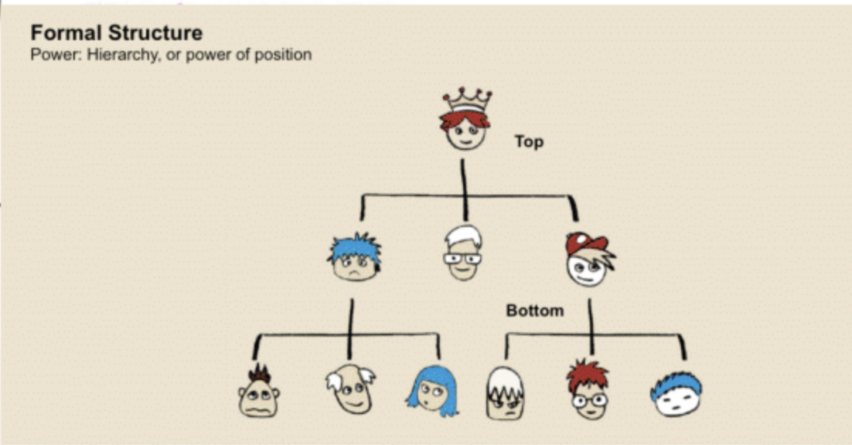
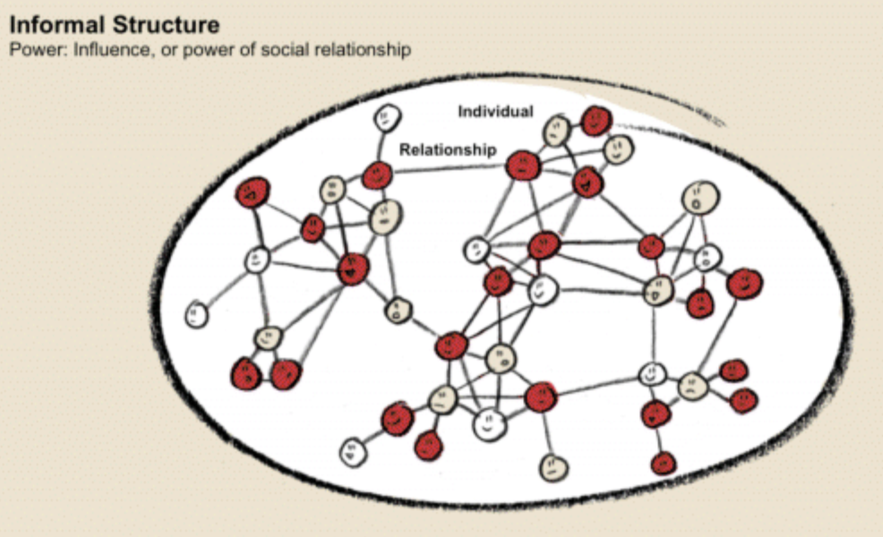
Organisational Structures
Formal
Informal

Slide 14
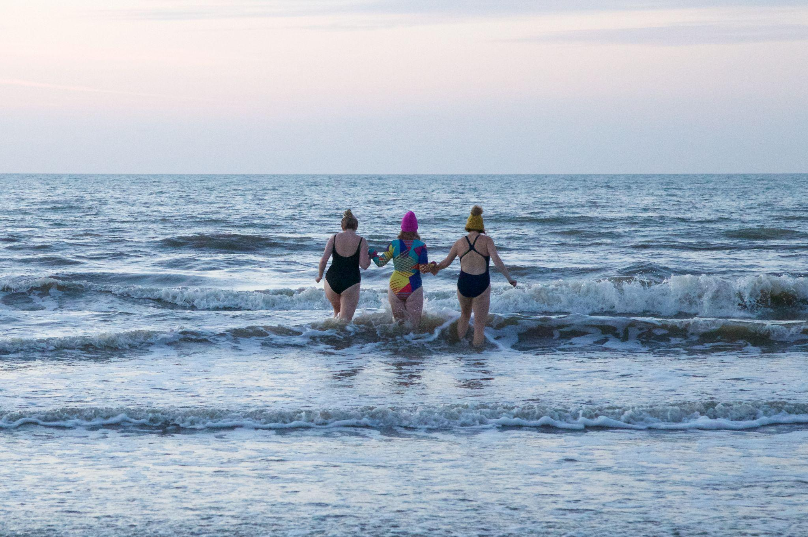
And what about wellbeing…

Slide 15
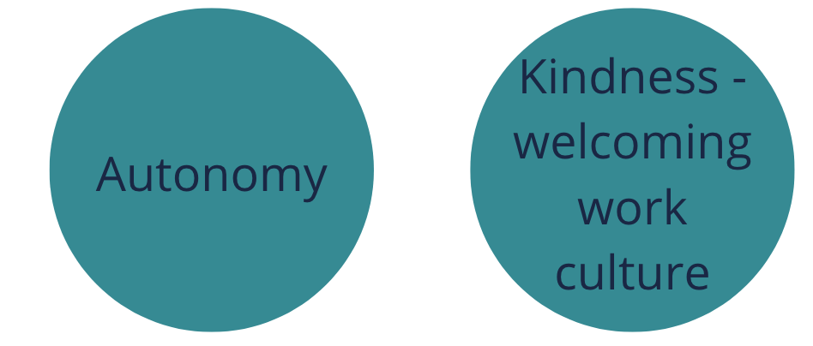
What really makes us happy at work?

Slide 16
The happy chemicals
Breaking things down into manageable chunks
The hug hormone
Lots of feedback and support
Regular check ins
Appreciating others openly
Belonging and togetherness
Colour!
Eustress
Giving
Laughter

Slide 17
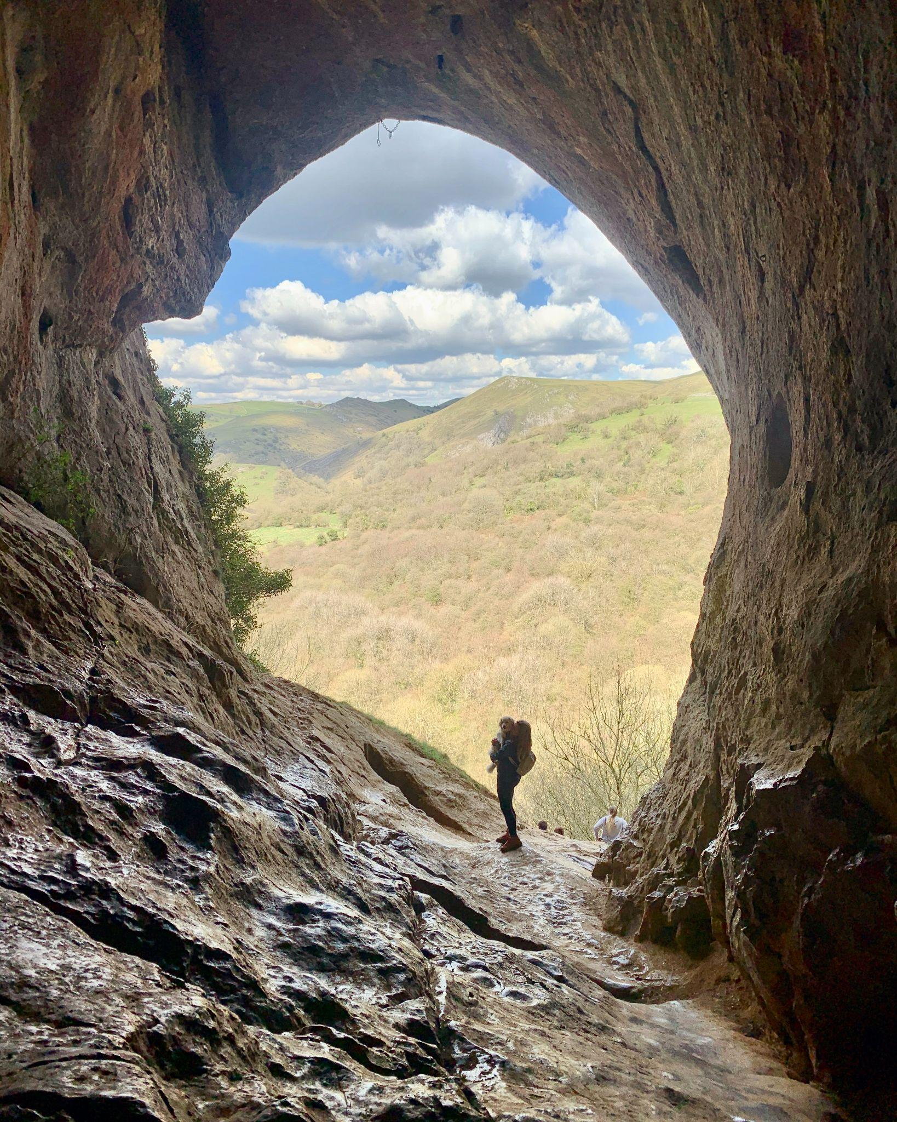
What you measure is what’s paid attention to…
Customer satisfaction
Productivity
Velocity / Effort
Delivery
Time to market
Employee Engagement

Slide 18
What you measure is what’s paid attention to…
Customer satisfaction
Productivity
Velocity / Effort
Delivery
Time to market
Employee Engagement
How can you measure employee engagement?

Slide 19
Why ‘go agile’?
Increased employee engagement
Continuous learning and feedback
Increased customer satisfaction
Improved innovation and creativity
Better cross team collaboration

Slide 20
So, how can you get started?
Start small and build incrementally
Share ideas on agile working with the wider organisation - get feedback and ideas for how it might work for you
Add in regular reflections and learning opportunities
Set really clear goals
Look at opportunities for cross team working - they might not be the obvious
Have goals and actions where people can see them - in the office/a shared trello board
Run open reviews for different areas of work
Have regular ‘customer’ and ‘staff’ feedback mechanisms and change according to feedback

Slide 21
Any questions?
Thank you
Jenny Lowthrop
@jlowthrop

